Slide 1
General Chemistry
11. Chemical bonds
Dr. István Szilágyi
Department of Physical Chemistry and Materials Science
2024.

Slide 2
The types of chemical bonds
During the development of chemistry, many theories were born about how and why elements are able to connect with each other and create new substances.
Establishing the periodic table and learning the structure of atoms gave the key to understand the forces between atoms and the nature of chemical bonds.
As a result of the interaction between atoms, there are three types of primary chemical bonds, and several secondary bonds were identified.

Slide 3
The ionic bond
The first type of bond, the nature of which was recognized, is the so-called ionic bond.
Materials built-up with ionic bonds dissociate in a polar solvent, e.g., when dissolved in water, to oppositely charged ions, without the presence of neutral molecule consisting of these ions upon dissolution – strong electrolytes.
During its formation, electron(s) from the force field of one atom pass into the force field of another atom. Their energy state is determined by the force field of the new nucleus.
Only electrostatic attraction occurs between the ions, which results in an undirected and close-fitting, infinite crystalline system.

Slide 4
The covalent bond
Covalent bonding creates substances with properties different from ionic compounds.
The easiest way to define its nature is that a bond that holds two or more atoms in a definite geometry results in a closed molecule.
During the formation of the bond, the electrons of the individual atoms enter the force field of the nuclei of the other atoms, but do not leave them completely, their state is determined by the force field of several nuclei together. It is a directed connection. In solid phase, the so-called secondary bond(s) act between the molecules formed by covalent bond(s).

Slide 5
Metallic bond
Metallic bond creates new materials that are different from the previous types of bonding, but still exhibit certain properties of them.
A common property between compounds built-up either by metallic or ionic bonds is that it does not create a closed molecule, but since it is not a bond with a straight direction, it creates infinite, tightly fitting systems.
It is similar to the covalent bond in that, the electrons of the individual atoms enter the force field of the nucleus of the other atoms, and do not completely leave the force field of their original nucleus, and all atoms in the metallic lattice jointly determine their state. They are delocalized electrons.

Slide 6
Estimation of the nature of primary bonds
It would be good to know in advance what kind of bond is expected to form between the two atoms in question.
The generic concept of electronegativity (EN) was already mentioned during the course. Knowing these data is a tool for bond type estimation.
The difference and the sum of EN values of the two atoms involved must be examined.
ΔEN - large
ionic bond
covalent bond
metallic bond
ΔEN - small
ΣEN - small
ΣEN - large

Slide 7
Secondary interactions
Molecules interact not only with an external electric field, but also with each other's electric fields.
  between two polar molecules, dipole-dipole interaction,
  between two apolar molecules, induced dipole-induced dipole,
  between a polar and an apolar molecule, dipole-induced dipole.
What is the range of secondary interactions?

Slide 8
Attractive interactions
+
r
V ~ 1/r
+ −
q₁
q₂
r
V ~ 1/r³
r
− +
+ −
V ~ 1/r²
q₁
Between 1-1 n-pole and m-pole:
V ~ 1/r^{(n+m-1)}

Slide 9
Secondary interactions
To calculate the final formula, it is necessary to apply the statistical distribution resulting from the rotation of the molecule, which results in a distance dependence of 1/r⁶ for the secondary interactions/bonds.
However, in addition to the attractive potentials, repulsive interactions also occur when the molecules approach each other, but these decrease by a higher power as the distance increases.
One of the relations used to describe secondary interactions is the Lennard-Jones potential, as follows.

Slide 10
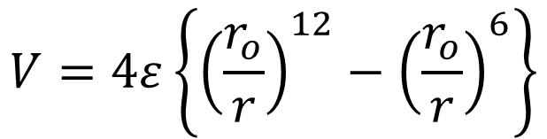
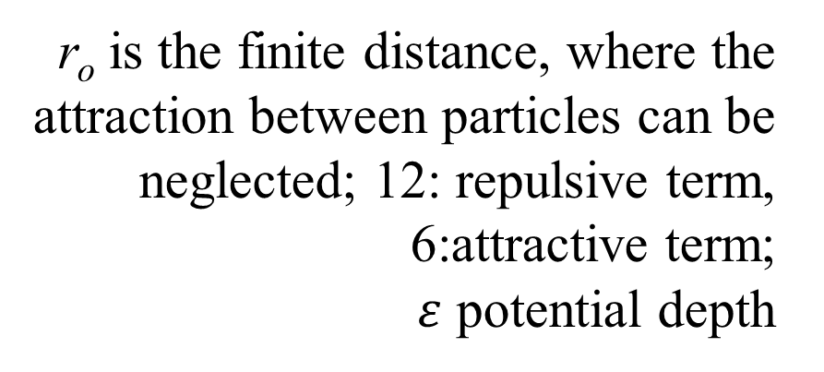

Secondary interactions
The shape of the Lennard-Jones (12,6)-potential describing the total potential:
$$V=4ε\left\{{\left(\frac{r_{o}}{r}\right)}^{12}−{\left(\frac{r_{o}}{r}\right)}^{6}\right\}$$
V/J
r_{o} is the finite distance, where the attraction between particles can be neglected; 12: repulsive term, 6:attractive term;
$ε$ potential depth
~ ΔH_{evaporation}
$$ε$$
r/pm
The average molecular distance in liquids: a condensed phase!
Smaller distance: higher density, larger distance: smaller density

Slide 11
The hydrogen bond
The hydrogen bond is an interaction between stable molecules, which is important from the point of view of the origin and evolution of life.
Energy- and feature-wise, it is between primary and secondary chemical bonds:
  its energy is around 10 kJ/mol, while primary bonds are over 100 kJ/mol and secondary bonds are around 1 kJ/mol,
  partially directed, less than covalent bonds, but more than secondary bonds,
  it commonly forms between the hydrogen atom and the non-metallic elements of the second row of the periodic table (N, O, F).

Slide 12
The hydrogen bond
Due to formation of hydrogen bonds:
  most properties of water affected, such as high freezing and boiling point, the fact that ice floats on water, changes in density with temperature, etc.
  the secondary structure of the catalysts of the living world, the enzymes (proteins), which ensures their effectiveness,
  the double helix of DNA and RNA, which carries and transmits genetic information.

