Slide 1
General Chemistry
10. Build-up of atoms
Dr. István Szilágyi
Department of Physical Chemistry and Materials Science
2024.

Slide 2
The electron structure of the atom
The name ”atom” comes from the Greek word "indivisible" and, as stated at the beginning of the course, it is the smallest unit that carries chemical properties and cannot be further broken down by chemical methods.
Earlier, however, the fact that the atom is made up of three subatomic constituents was discussed. The proton and the neutron make up the nucleus, while the same number of electrons as the number of protons is found in the electron cloud surrounding the nucleus.
This presentation is about the structure of this electron cloud and its connection to chemical properties.

Slide 3
Classification of the elements
The concept of an element is closely related to the concept of an atom, since one call a set of substances consisting of atoms with the same atomic number an element.
From this definition, it can be concluded that the chemical properties must be determined by the number of protons in the nucleus.
From a very early age, those working in chemistry wanted to understand why the chemical properties of individual elements are so similar in one case, and why they are so different in the other case. This resulted in the development of the periodic table.

Slide 4
Classification of the elements
Like all scientific achievements, the periodic table was not born in a certain time, although most of the time they are associated with the name of a person. As the discoverer of the system of elements, the periodic table, D.I. Mendeleyev (Дмит-рий Иванович Менделеев) is usually mentioned.
He deserved this by the fact that the system he created went beyond other attempts of his time, by not limiting the system to the already known elements, but by taking into account the chemical properties, he predicted the existence of new, yet-to-be-discovered elements!

Slide 5
Classification of the elements
However, the development of the theory of atoms was a prerequisite for some kind of systematization of the elements to develop.
At the beginning of the XXth century, quantum mechanics was the theory that simultaneously explained the structure of the electron system of atoms and the structure of the periodic table.
Simple motions, linear, uniform circular motion in a plane, spatial, i.e., spherical rotating motion, vibrating motion, were described with the help of quantum mechanics, which prepared the creation of the quantum mechanical model of atoms.

Slide 6
Description of the electron structure of atoms
The examination of all movements led to the conclusion that any kind of constraint, restriction of movement, eliminates the continuity of the particle's energy state (so-called quantized states). This was completely in line with the experimental results obtained at that time.
The first success was a description of the structure of hydrogen-like atoms, which consisted of a nucleus with a Z charge and a single electron around it. In reality, apart from hydrogen, only a few low atomic number elements and their ions - e.g., He⁺; Li²⁺, Be³⁺ - correspond to this model, i.e., it cannot be applied for more complicated multi-electron atoms.

Slide 7
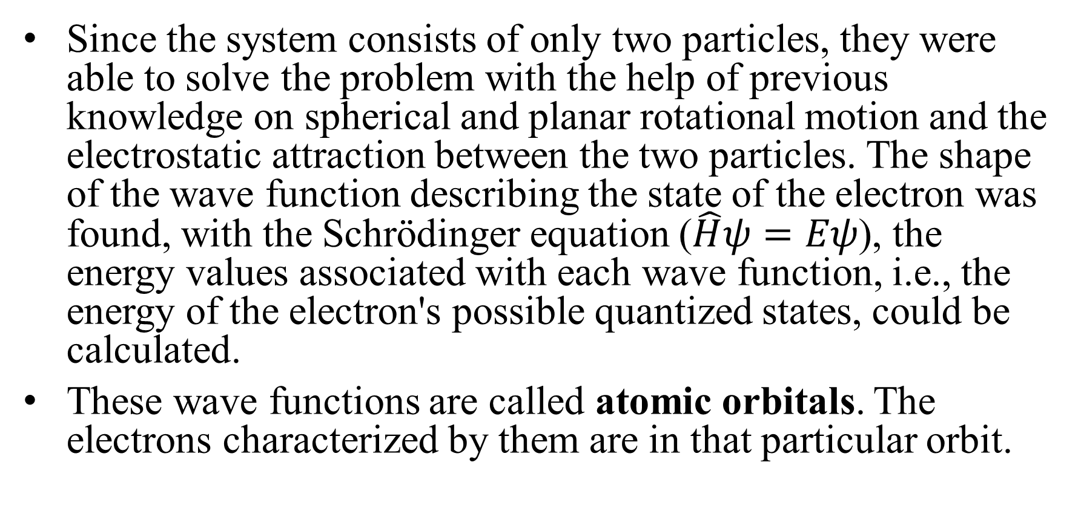
Description of the electron structure of atoms
Since the system consists of only two particles, they were able to solve the problem with the help of previous knowledge on spherical and planar rotational motion and the electrostatic attraction between the two particles. The shape of the wave function describing the state of the electron was found, with the Schrödinger equation ($\hat{H}ψ=Eψ$), the energy values associated with each wave function, i.e., the energy of the electron's possible quantized states, could be calculated.
These wave functions are called atomic orbitals. The electrons characterized by them are in that particular orbit.

Slide 8

Description of the electron structure of atoms
The general form of wave functions in the spherical polar coordinate system:
where r is the nucleus-electron distance,
while Θ and φ are two other coordinates
of the polar coordinate system, the polar
and the azimuthal angle.
$R_{n,ℓ}\left(r\right)$ depends on the nucleus-electron
distance, while $Y_{ℓ, m_{ℓ}}\left(Θ,φ\right) describes the$
$electron spherical rotation$.
z
$ψ_{n,ℓ,m_{ℓ}}\left(r,Θ,φ\right)=R_{n,ℓ}\left(r\right)∙Y_{ℓ, m_{ℓ}}\left(Θ,φ\right)$
x
y

Slide 9

Description of the electron structure of atoms
The latter radial part (because it only depends on the radius of the sphere) describes the movement of the electron in the force field of the nucleus’ charge.
The shape of this function depends on the angular momentum (or secondary) quantum number (ℓ) and on the principal quantum number (n).
Each function contains a term that decreases exponentially with increasing electron-nucleus core distance (r) and a polynomial term containing powers of r.
Principal quantum number (n) can be 1 (K), 2 (L), 3 (M), 4 (N)...
$$R_{n,ℓ}\left(r\right)$$

Slide 10
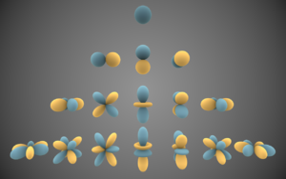
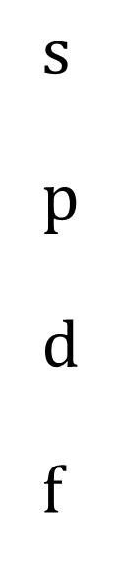

Description of the electron structure of atoms
The shape of the functions describing spherical rotation may be familiar, these are the so-called spherical functions.
where ℓ and m_{ℓ}, are the
angular momentum
quantum number and the
magnetic quantum
number, respectively.
$$Y_{ℓ, m_{ℓ}}\left(Θ,φ\right)$$
$$s$$
p
d
f

Slide 11
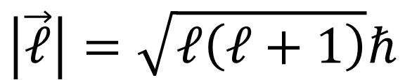
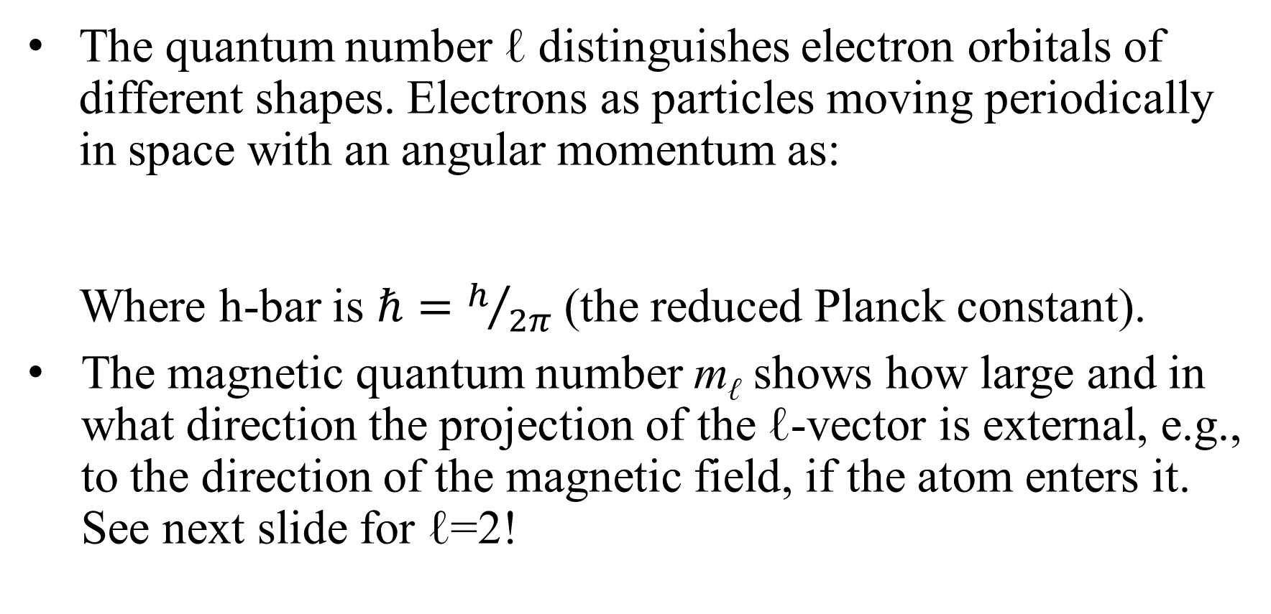
Description of the electron structure of atoms
The quantum number ℓ distinguishes electron orbitals of different shapes. Electrons as particles moving periodically in space with an angular momentum as:
Where h-bar is $ℏ=h/{2π}$ (the reduced Planck constant).
The magnetic quantum number m_{ℓ} shows how large and in what direction the projection of the ℓ-vector is external, e.g., to the direction of the magnetic field, if the atom enters it. See next slide for ℓ=2!
$$\left|\vec{ℓ}\right|=\sqrt{ℓ\left(ℓ+1\right)}ℏ$$

Slide 12
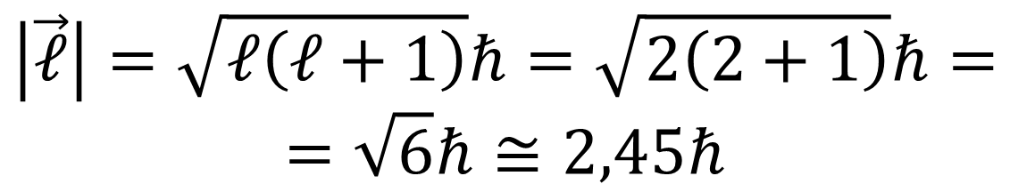
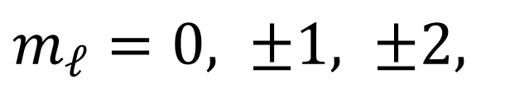

Description of the electron structure of atoms
If ℓ=2, then:
The spin can therefore never be parallel to
the direction of space, and the number of
its projections 2ℓ+1!
z
$$\left|\vec{ℓ}\right|=\sqrt{ℓ\left(ℓ+1\right)}ℏ=\sqrt{2\left(2+1\right)}ℏ= \\ =\sqrt{6}ℏ≅2,45ℏ$$
$${\vec{l}}_{z}=m_{ℓ}ℏ$$
$$m_{ℓ}=0, ±1, ±2,$$

Slide 13
Description of the electron structure of atoms
Based on Born's interpretation of the wave functions, by calculating the square of the spherical functions, one gets the probability that the electron is found in certain parts of a sphere's surface.
If ℓ=0, then it is likely to be in the small neighborhood of every point on the spherical surface, so the length of the resulting spin will be zero.
If ℓ is higher, the electron can be more likely found on the spherical surface in the small neighborhood of the points of certain areas.

Slide 14
R(r)
R(r)
R(r)
0.40
0.70
2.00
n=3
l=0
3s
n=2
l=0
2s
n=1
l=0
1s
0.35
0.50
1.00
0.30
0.25
0.00
0.30
0.00
4.00
8.00
r/a_{o}
0.20
0.15
0.10
0.10
-0.10
0.05
0.00
5.00
10.00
15.00
20.00
r/a_{o}
0.00
-
0.05
-
0.10
0.00
5.00
10.00
15.00
20.00
25.00
30.00
r/a_{o}
since l=0, the second part is zero

Slide 15
R(r)
R(r)
0.160
n=3
l=1
3p
n=2
l=1
2p
0.070
0.120
0.080
0.050
0.040
0.030
0.000
0.0
5.0
10.0
15.0
20.0
r/a_{o}
0.010
-
0.010
-
0.030
0.0
5.0
10.0
15.0
20.0
25.0
30.0
35.0
40.0
r/a_{o}
since l=1, the second part has a value

Slide 16
R(r)
R(r)
0.035
0.040
n=4
l=2
4d
n=3
l=2
3d
0.030
0.030
0.025
0.020
0.020
0.015
0.010
0.010
0.000
0.005
0.0
10.0
20.0
30.0
40.0
r/a_{o}
0.000
-
0.005
-
0.010
-
0.015
0.0
10.0
20.0
30.0
40.0
50.0
60.0
r/a_{o}
since l=2, the second part is not zero

Slide 17

Description of the electron structure of atoms
Based on Born's interpretation, the square of the wave function, due to the change of the coordinate system, is
changed to dτ = dxdydz = r² sin Θ dr dΘ dφ.
Thus, the distance from the electron to the nucleus:
It shows the probability that the
electron resides in a spherical
shell of radius r and thickness
dr around the nucleus.
Let us see some examples!
$$P\left(r\right)=R^{2}\left(r\right)∙r^{2}dr$$
r
dr

Slide 18
R²(r) r²
States with different n and the same l.
Maxima indicate the radius of shell!
R²(r) r²
r
States with the same n, but different l.
r

Slide 19
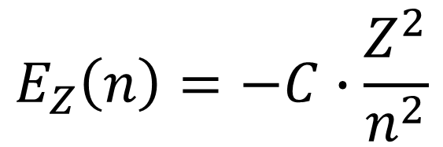
Description of the electron structure of atoms
Using the Schrödinger equation, the possible values of the energy states of hydrogen-like atoms are determined by the principal quantum number, and the charge of nucleus (atomic number Z).
The C constant involves data about the electron, mass, charge, and other universal constants.
The energy is equal to the work done by the nucleus charge on the electron upon its arrival at the radius of the atomic orbital from infinite distance.
The correctness of the result is confirmed by the emission spectrum of the hydrogen atom!
$$E_{Z}\left(n\right)=−C∙\frac{Z^{2}}{n^{2}}$$

Slide 20
Spectral lines of hydrogen atom
R_{H}/cm⁻¹
0
n=∞
n=6
-0.63
n=5
-0.11
n=3
n=4
-0.25
n=2
Paschen
Balmer
Lyman
0
-1
n=1

Slide 21
The structure of multi-electron atoms
However, the description of the electronic structure of multi-electron atoms is a more difficult story. The Hamiltonian operator would be so complicated that finding suitable eigenfunctions describing the state of the electrons has so far been unsuccessful.
The so-called atomic orbital approximation was used to describe the structure of multiple electron atoms, whose energy is the sum of the energies of the individual electrons. Based on the recipes of the "quantum cookbook", this means that the entire wave function can be given as the product of the wave functions of the individual electrons.
What about the wave functions for the state of each electron?

Slide 22
The structure of multi-electron atoms
An obvious solution was the use of wave functions obtained for hydrogen-like atoms.
However, their exact use led to incorrect orbital energies, because when examining a given electron, it is affected not only by the electrostatic force field of the nucleus, but also by the other electrons.
Since the atomic spectrum of every atom consists of lines, i.e., each electron is in a definite energy state, to which a definite electrostatic force field can be assigned. Therefore, instead including the nucleus charge in the functions, one gets correct results by using a smaller charge.

Slide 23
The structure of multi-electron atoms
This charge is the effective nucleus charge. Its value is smaller than the real charge of the nucleus, but greater than the charge obtained by subtracting the charge of the electrons of lower energy than the selected one, i.e., closer to the nucleus, from the nucleus charge:
where k is the number of lower energy electrons.
The previously presented radial distribution functions can be used to explain the phenomena of penetration and shading.
$$Z_{nucleus}>Z_{effective}>Z_{nucleus}−k∙e$$

Slide 24


The structure of multi-electron atoms
Penetration means that electrons with a higher principal quantum number are able to get closer to the nucleus than electrons with a lower one. Because, according to the maxima on their radial distribution functions, they are able to stay within their orbital radius with a certain probability, so the attraction acting on them is greater than
Z_{nucleus}-k∙e
It also explains why even the lowest energy 1s electron is not attracted by the full charge of the nucleus, only by the effective one.
R²(r) r²
$$Z_{effective}> \\ Z_{nucleus}−k∙e$$
$$Z_{nucleus}>Z_{effective}$$
r

Slide 25

The structure of multi-electron atoms
Additional consequences:
The energies of electrons in shells with the same principal quantum number, but different secondary quantum numbers are no longer equal, but follow the order of s < p < d < f.
Their shading ability increases in the opposite direction.
R²(r) r²
$$E_{s}<E_{p}<E_{d}<E_{f}$$
r

Slide 26
The structure of multi-electron atoms
The model thus perfectly describes the structure of multi-electron atoms and is also suitable for explaining their chemical properties and the built-up logic of the periodic table.
What is the electronic structure of multi-electron atoms in the stationary ground state (state of lowest energy)?
This can be specified with the so-called electron configuration.
The electron configuration lists the atomic orbitals with increasing energy level and indicates the number of electrons in the orbital in the superscripts.

Slide 27

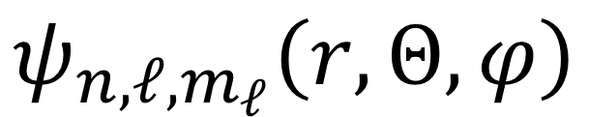


The structure of multi-electron atoms
It was earlier stated that the maximum value of the angular momentum quantum number determines the possible values of the magnetic quantum number as:
The calculations for hydrogen-like atoms, however, also stated that the possible values of the angular momentum quantum number are determined by the value of the principal quantum number as:
In addition, the possible values of the principal quantum number are the natural numbers:
$$ψ_{n,ℓ,m_{ℓ}}\left(r,Θ,φ\right)$$
$$m_{ℓ }=±ℓ;±\left(ℓ−1\right);⋯0$$
$$ℓ=0;1;⋯\left(n−1\right)$$
$$n=1;2;3;etc.$$

Slide 28
The structure of multi-electron atoms
Quantum numbers therefore form a hierarchical system:
  The principal quantum number n basically determines the energy of the electron, the average value of the electron's distance from the nucleus. Orbits with the same principal quantum number form the electron shells. Accordingly, n=1: K-shell, n=2: L-shell, etc.
  The angular momentum quantum number ℓ also affects the energy of the electron and gives the length of the momentum vector of the spherical rotation. Orbitals with the same n and ℓ form the subshells. Orbitals belonging to the same subshell have the same energy, also known as degenerated orbitals.

Slide 29
The structure of multi-electron atoms
Then, the possible trajectories by shells and subshells are:
Their energy level is determined by the nucleus charge.

Slide 30
The structure of multi-electron atoms
notation
The order of filling the shells is by n and ℓ using their sum: n+ℓ. If this sum is equal, then the principal quantum number n always decides, i.e., the shell with the smaller principal quantum number is filled first.

Slide 31
The structure of multi-electron atoms
So, with the help of 56 orbitals organized into 7 shells and 17 subshells, the electronic structure of all atoms found in the periodic table can be described! ...but they are more than 100...
So, not only one electron can be located in an atomic orbital?
The Stern-Gerlach experiment: Ag atoms were deflected in a magnetic
field in such a way that as if the quantum number describing their spin is ½. This cannot come from the spherical rotation of the electron, so the electron has its own momentum, which is the spin!

Slide 32
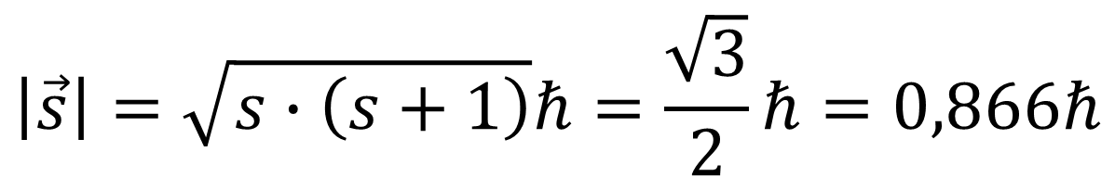
The structure of multi-electron atoms
The quantum number describing the electron's own spin is called the spin quantum number (m_{s}).
The length of the momentum vector can be calculated similarly to the spherical rotation :
It also behaves in a magnetic field similarly to the orbital spin, its spatial projection can be ±½ℏ, and the value ±½ can be taken by the magnetic spin quantum number, which explains the results of the Stern-Gerlach experiment.
So far, we have not taken this property into account in the description of the state of the electron.
$$\left|\vec{s}\right|=\sqrt{s∙\left(s+1\right)}ℏ=\frac{\sqrt{3}}{2}ℏ=0,866ℏ$$

Slide 33
The structure of multi-electron atoms
Taking into account the state of the electron's spin, one can summarize the four quantum numbers that determine the state of an electron in atoms:
  three quantum numbers characterizing wave functions: n, ℓ, és m_{ℓ}
  the quantum number m_{s} describing the state of its spin, which means two states, indicated by α and β for each orbit.
Thereafter, let us start to determine the basic state configuration of an atom, to fill the atomic orbitals with electrons.

Slide 34
Br - 35 e⁻
E(n,l)/eV
4p
-20
4s
3d
-87,6
Principles:
-200
3p
3s
Hund's rule of maximum multiplicity: electrons must be placed in atomic shell of the same energy with the greatest value of spin multiplicity.
2p
-1600
2s
Pauli's exclusion principle: there can be only two electrons in an atomic orbital with opposite spins.
-13335
1s
Aufbau principle: the next electron must be placed in the lowest energy orbital that is not yet filled.

Slide 35
Br - 35 e⁻
E(n,l)/eV
4p
-20
4s
3d
-87,6
-200
3p
This representation is equally good.
3s
2p
-1600
In both mode, the electron configuration of bromine atom:
2s
-13335
1s
$\text{B}\text{r}\text{:} \text{1}{\text{s}}^{2}\text{2}{\text{s}}^{2}\text{2}{\text{p}}^{6}\text{3}{\text{s}}^{2}\text{3}{\text{p}}^{6}\text{3}{\text{d}}^{10}\text{4}{\text{s}}^{2}$ $\text{4}{\text{p}}^{5}$

Slide 36
The periodic table
The so-called long periodic table (used nowadays) is arranged on the basis of the atomic orbital approximation, comparing the electron configurations obtained for individual atoms.
The grouping is based on the occupancy of the outer shell with the highest principal quantum number:
  the elements with the same principal quantum number of electrons in their outer shell are placed in the same row according to their atomic number.
  the elements with the same number of electrons in the outer shell are placed in the same column.
This also explains why this shell is called a valence (outer) shell. The state of these electrons determines their chemical properties.

Slide 37
attraction by the nucleus increases
non-metals
metals

Slide 38
Characteristics of atoms
So the attraction by the atomic nucleus to the electrons in the valence shell basically determines the chemical nature of the element.
  the stronger the attraction, the less metallic the element's property, it rather forms anions.
  if the nucleus attracts the electrons of the valence shell less, the atoms form cations of metallic properties.
Since the attraction changes significantly within a raw, all resulting properties, e.g., the atomic size is also changes, that’s why properties change periodically with the atomic number. The change in the columns is much smaller.

Slide 39
Characteristics of atoms
The electron-attracting ability of the nucleus is very well characterized by the energy difference that can be measured, when an anion is formed by adding an electron to a neutral atom. This is called electron affinity.
The other characteristic feature is when, oppositely to the previous one, an electron is removed from the neutral atom and a cation is formed. The energy required for this is the so-called first ionization energy. This also changes periodically.

Slide 40
Characteristics of atoms
In almost every published version of the periodic table, in addition to the elements and several other data, there is a property, which tries to combine the features manifested in electron affinity and ionization energy. This property is called as electronegativity.
There are several types of scales for this, but the Pauling scale is the most widely used to predict the nature of the chemical bond between two elements.

