Slide 1
General Chemistry 9. Structure and description of the matter
Dr. István Szilágyi
Department of Physical Chemistry and Materials Science
2024.

Slide 2
The worldview
In the XVII-XVIIIth century, the knowledge known today as classical physics developed and taught in public education based on the axioms of Isaac Newton.
Light, like pure energy, is considered as electromagnetic radiation with wave properties.
At the beginning of the XIXth century, description of atom by Dalton and Avogardro.
At the end of the XIXth century, the world of subatomic constituents began, the electron is discovered by J.J. Thomson.
The breakthrough was achieved by Rutherford and his colleagues in the XXth century with the discovery of the nucleus, the proton and the neutron.

Slide 3
Structure of atoms
Rutherford and his colleagues did some pioneering works regarding the subatomic constituents:
The atom consists of a nucleus and a cloud of electrons.
The nucleus contains two particles, protons and neutrons.
The ratio of protons and neutrons can vary within certain limits.
The chemical quality of the atom is determined by the proton number, because it determines the number of electrons.
Isotope (same atomic number, different mass and neutron number) Isobar (same mass number, different atomic and neutron number) Isotone (same neutron number, different atomic and mass number)

Slide 4
Structure of atoms
The fact that these nuclei can transform into each other was discovered and explored by Bequerel and the Curie family.
The phenomenon that nuclei can transform followed by different radiations has already been named radioactivity by Marie Curie.
His daughter and her husband, the Joliot-Curie couple, discovered that this can also be induced artificially.
Today extensive knowledge of the transformations of atomic nuclei is available.

Slide 5
Natural radioactivity
The majority of unstable nuclei found in nature came to Earth when it was formed (Big Bang…), and since they decompose slowly, they have not yet disappeared, but their quantity is constantly decreasing - primordial radionuclides (isotopes)
The radiations accompanying the decomposition:
the so-called α-radiation, when the outgoing α-particle is the nucleus of a helium atom, which carries a well-defined part of the energy released during the transformation - 14-20 000 km/s:
where X is the parent nucleus and Y is the daughter nucleus. Such a decomposition, with few exceptions, is characteristic of heavy atoms.
${}_{z}^{A}X⟹{}_{Z−2}^{A−4}Y+{{}_{2}^{4}{He}}^{2+}$

Slide 6
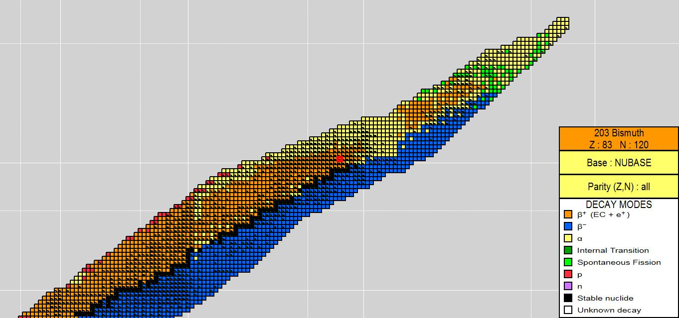
Nuclide map of the elements
N=84
Number of protons (Z)
Number of neutrons (N)

Slide 7
Natural radioactivity
Several types of so-called β-transformation is known, including the subsequent radiation.
During β⁻ radiation, much smaller particles, an electron and an anti-neutrino leave the nucleus. The energy released during the decomposition is distributed among the particles, so their energy is not clearly defined. Their speed approaches the speed of light!
This decomposition is characteristic of almost all neutron-rich nuclei below the stability line. One can detect electrons, but hardly anti-neutrinos!
$${}_{Z}^{A}X⟹{}_{Z+1}^{A}Y+e^{−}+{\tilde{ν}}_{e}$$

Slide 8
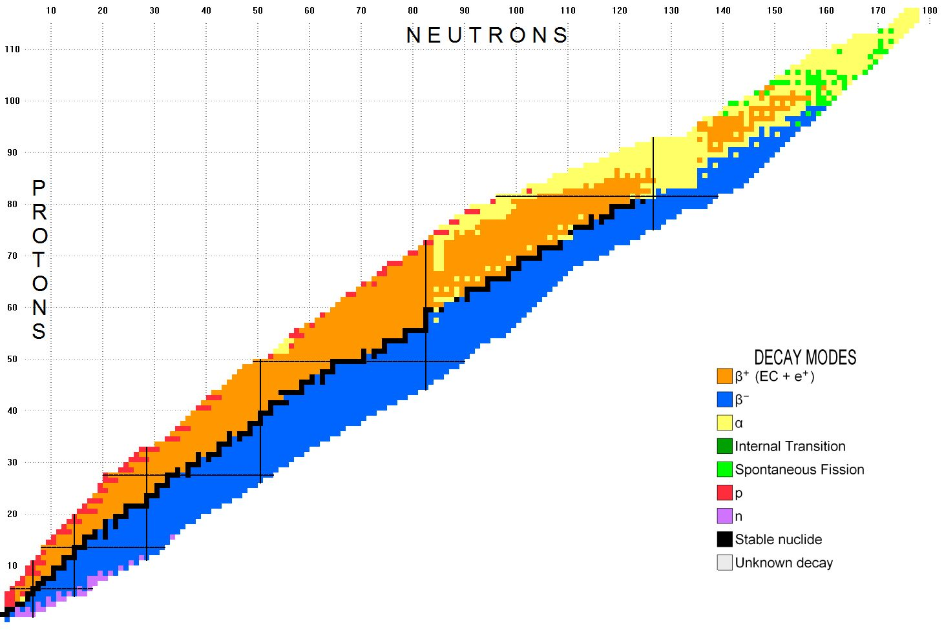

Slide 9
Natural radioactivity
The other two types of β-decays are not usually separated from each other because, with few exceptions, in the case of the same nucleus, they occur in parallel and result in the same daughter nucleus.
During the β⁺ radiation, the leaving particles are the anti-particles of β⁻ radiation, i.e., one anti-electron/positron, and one neutrino exit the nucleus. The energy released during the decay is also distributed among the particles, so their energy is not clearly defined. Their speed approaches the speed of light.
The decay is characteristic of almost all proton-rich nuclei above the stability line. Positrons can be detected well, neutrinos hardly.
$${}_{Z}^{A}X⟹{}_{Z−1}^{A}Y+ e^{+}+ν_{e}$$

Slide 10
Natural radioactivity
During the electron capture (EC), which results in the same daughter nucleus, the nucleus captures one of the 1s electrons and one of its protons is converted into a neutron. The only particle emitted from the nucleus is a neutrino. It carries the energy released during decomposition.
This decay is characteristic of almost all proton-rich nuclei above the stability line. One can hardly measure neutrinos, therefore one cannot measure particle radiation in the case of nuclei that transform purely by electron capture.
$${}_{Z}^{A}X+e^{−}⟹{}_{Z−1}^{A}Y+ν_{e}$$

Slide 12
Natural radioactivity
The third, so-called γ-radiation is not independent of the previous ones, because it only appears if the nucleus has previously undergone α- or β-decay, but as a result of the radiation, a nucleus of higher energy is created. The generated excited nucleus eliminates its excess energy by emitting a γ-photon. Similar to the excited electrons in an electron orbitals (see later). Since the composition of the nucleus does not change, this is a so-called isomeric transformation (IT):
The resulting photon with a definite energy is characteristic for such a transformation of the nucleus.
$${}_{Z}^{A}{X^{m}}⟹{}_{Z}^{A}X+{hν}_{γ}$$

Slide 13
Natural radioactivity
Beside these primordial radioisotopes, which have remained in nature since the creation of the Earth, there are also unstable isotopes in our environment that are still continuously produced today. These are called cosmogenic radionuclides (isotopes), because they are formed from stable isotopes on Earth as a result of cosmic radiation. The most known is:
Isotope of carbon of mass number 14, which is formed from nitrogen in the atmosphere as a result of neutrons arriving at the boundary between the atmosphere and the space:
$${}_{7}^{14}N+n^{o}⟹{}_{6}^{14}C+p^{+}$$

Slide 14
The basis of the radiocarbon dating
The C-14 isotope reacts with oxygen and forms carbon dioxide, which enters into the air, into plans and finally into animals, i.e., it is distributed in living organisms. In the meantime, it decomposes and transforms as:
But as a result of metabolism, its quantity is constant, i.e., a stable concentration of ${}_{6}^{14}C$ is maintained in living organisms. However, this stops when the organism dies and ${}_{6}^{14}C$ level decreases. This can be followed by measuring the intensity of the radiation, and from the rate of decrease, it can be calculated when the metabolism stopped, i.e., when the organism died.
$${}_{6}^{14}C⟹{}_{7}^{14}N+e^{−}+ {\tilde{ν}}_{e}$$

Slide 15
Natural radioactivity
There are also many other cosmogenic isotopes, all of which can be used as "radioactive clock".
Tritium (H-3 isotope) is also formed at the boundary of the atmosphere/space from nitrogen and neutrons:
Turning into water, it enters the surface waters, and as long as it remains on the surface, its concentration is constant. However, it starts to decrease, when it gets underground (i.e., no contact with the atmosphere). By measuring the radiation in drilled wells, it is possible to calculate the time, when the water got under the surface:
$${}_{7}^{14}N+n^{o}⟹{}_{6}^{12}C+{}_{1}^{3}H$$
$${}_{1}^{3}H⟹{}_{2}^{3}{He}+e^{−}+ {\tilde{ν}}_{e}$$

Slide 16
Natural radioactivity
Other cosmogenic isotopes are used on a daily basis, e.g., to determine the age of the rocks, how long they are under the surface.
Some of the isotopes found in nature today do not belong to the previous two groups, because their presence is a consequence of the fact that we, humans, created them, e.g., during nuclear experiments. These are anthropogenic radionuclides (isotopes).
Their appearance is the result of nuclear technology, energy production, medicine, material testing and analytical procedures and weapon development.

Slide 17
Application of radioisotopes
Medical diagnostics: radioisotope-labelled biomolecules are introduced into the body and, with the help of radiation, they follow their path, the speed of processing, and assume the disease.
Medical therapy: the radioisotope is deliberately introduced into the organ, where they want to influence the functioning of cells with the radiation.
Analytical applications: purity level control or material quantity determination, e.g., with isotope dilution.
Material tests: identification of material defects based on the absorption of radiation.

Slide 18
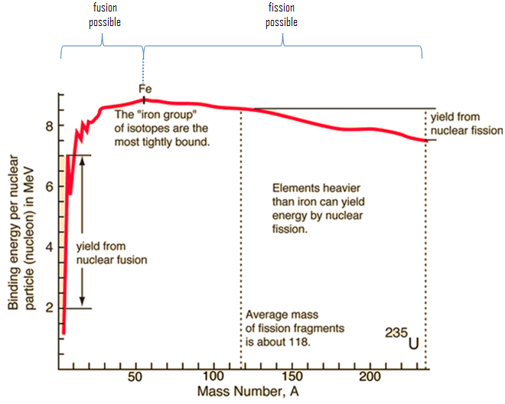
Application of radioisotopes
Energy production: the change in the binding energy per nucleon shows a maximum in the case of isotopes found in nature.
i.e., nuclear fission (splitting) of large mass number nucleus, or
or fusion of low mass number nucleus.
https://www.nuclear-power.com/nuclear-power/fission/nuclear-fission-vs-fusion/

Slide 19
Application of radioisotopes
Nuclear fission: In nuclear power plants, U-235 is mainly split using slow neutrons. For instance,
in which more than one neutron is produced and is suitable for maintaining the reaction, for continuous operation. Of course, the products can be different isotopes and the number of neutrons can also change.
$$n^{o}+{}_{92}^{235}{U⟹}{}_{36}^{89}{Kr}+{}_{56}^{144}{Ba}{+3n}^{o}$$

Slide 20
Mechanism of nuclear fission
$$⟹{}_{56}^{144}{Ba}$$
$${+3n}^{o}$$
$$n^{o}+{}_{92}^{235}{U⟹}$$
$${}_{36}^{89}{Kr}$$

Slide 21
Application of radioisotopes
Nuclear fission: The latest reactor designs include equipment based on fast neutron fission of U-238 and Th-232.
Nuclear fusion: To create the fusion, the atoms must be brought to a plasma state, i.e., they must be freed from most of their electron cloud. The regulated maintenance of this state is still an unsolved problem. Developments are going in international cooperation. Both have been in a promising phase for decades! ☺

Slide 22
Natural background radiation
Primordial and cosmogenic radioisotopes of natural origin are always present, because they are everywhere. However, this means that our body is constantly exposed to radiation. This is called natural background radiation, to which living organisms have become resistant during their evolution.
It consists of the radiation of 34 radioisotopes of about 28 elements, but two isotopes are responsible for the majority.
the isotope Rn-222 is produced by the decomposition of U-238, which is present everywhere in rocks. It is a noble gas, it is not chemically bound, it is released from the rocks and concentration increases in the air of the room - it gives 60% of the background radiation.

Slide 23
Natural background radiation
the K-40 isotope is also present everywhere, its salts dissolve in water, and this ion is necessary for living bodies, e.g., for the functioning of muscles. Once inside our body, it radiates, giving 6% of the background radiation.
the other isotopes contribute as well, together with the radiation from the cosmos, which is not neutralized/reflected by the atmosphere and the Earth's magnetic field.
Of course, this this radiation is healthy, because it also causes diseases.
At the same time, it is also responsible for the fact that mutations occur and living organisms can adapt to the changing environment.
However, the increase in background radiation is harmful. Action must be taken against irresponsible human activity that causes this.

Slide 24
Understanding the „Micro World”
optional
The discovery of the structure of atoms and elementary particles gave a huge boost to the development of physics in the beginning of the 20th century.
This development was initiated by experimental results that could not be explained by the previously known physics.
The first step was the development of quantum theory, which doubts on the fact that microparticles can store energy in arbitrary energy states by performing various movements.

Slide 25
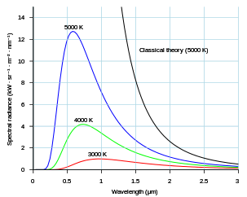
Development of quantum theory
optional
The phenomenon of the so-called black-body radiation.
When solids are heated, they emit electromagnetic radiation (light), which shows a maximum when the intensity is plotted as a function of wavelength.
The model of classical physics could only explain the low-energy rising side, it predicted that the intensity of high-energy UV radiation increases beyond all limits as the temperature rises. Cooking a soup would be deadly ☺
limiting the possible energies of the oscillators to specific values, nhν, the result is a maximum curve, as discovered by Max Planck.

Slide 26
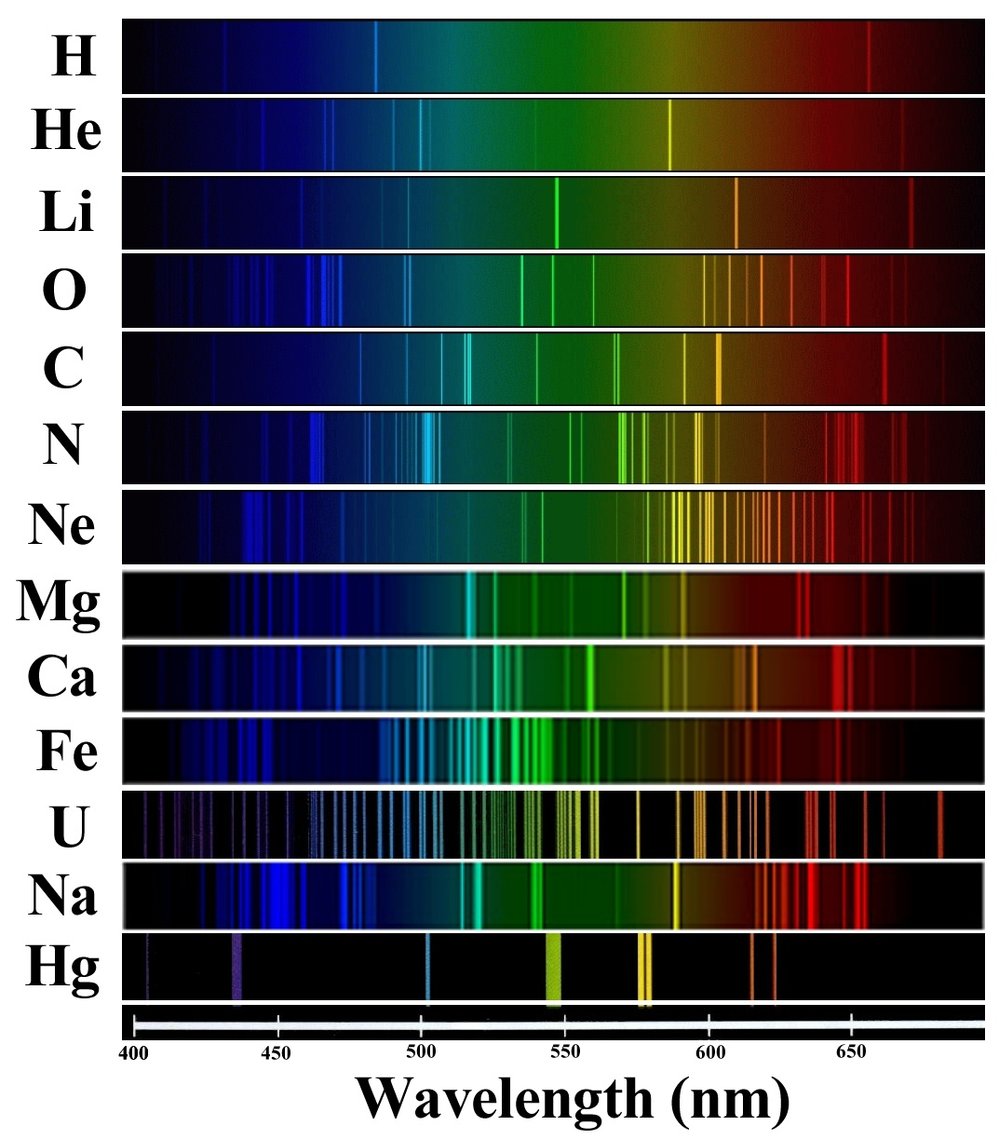
Development of quantum theory
optional
Line spectra of atoms by experiments.
By introducing different metal salts into a gas flame, they color the flame.
Examining the flame with the method used for examining the radiation of solids, however, a completely different result is obtained. Instead of the maximum curve, „lines” appeared, which are characteristic not only of metals, but of all atoms.
Atoms can only exist in a specific energy state, their states are „quantized”.
https://www.youtube.com/watch?v=9oYF-HxtoYg

Slide 27
Development of quantum theory
optional
The phenomenon of the photoelectric effect:
everyone has seen a photocell door that opens when a beam of light is interrupted;
the basis of its operation is that the light beam shines on a metal, from which electrons are continuously released, and they provide an electric current. If the light is interrupted, the current is interrupted, to which the equipment responds by opening the door;
a detailed examination of the phenomenon led to a result that was completely opposed to what was expected based on the previous physical picture/knowledge.

Slide 28
Photoelectric effect
optional
Consequences: outgoing electrons’ kinetic energy is independent
Classical physical model:
E/J
E_{incident} = constant
0
T/J
Independent!
V_{binding}
ν/Hz
x/nm
ν_{incident} = constant
The energy of the electron is increased by light absorption.
Any wavelength of light is good if it has the right intensity.
T/J
e^{x} - Lambert-Beer law
I_{limit}
I_{o}/lux
Notes:
A másik, a klasszikus fizika alapján nem értelmezhető jelenség, a fotoelektromos effektus volt. Az, hogy fény hatására elektronok lépnek ki egyes fémekből, önmagában még nem gond. A klasszikus fizika alapján, ha az elektron folyamatosan elnyeli a fényt (az amplitúdója csökken), akkor állandó bruttó besugárzási energiát alkalmazva, bármely hullámhosszú/frekvenciájú fény esetén ugyanolyan kinetikus energiájú elektronok kilépését eredményezne. Ugyanakkor egy adott hullámhosszú/frekvenciájú fény alkalmazása mellett, a besugárzó intenzitásának függvényében vizsgálva a kilépő elektronok kinetikus energiáját, a fényelnyelés törvénye (Lambert-Beer-törvény) alapján, egy minimális intenzitású fény szükséges a kilépéshez, és a kilépő elektronok kinetikus energiájának exponenciálisan nőnie kellene az alkalmazott fényintenzitás növekedésével.

Slide 29
Photoelectric effect
optional
Experimental results:
Explanation:
Einstein (1905) – Nobel Prize in Physics in 1921
E_{initial} = constant
The ejection of an electron is the result of a single event.
The photon's existence and energy are fixed: E=hv
Quantization of states and there is no intermediate state!
T/J
Linear
ν_{limit}
ν/Hz
E/J
T₁
<
T₂
ν_{initial} = constant
0
T/J
Φ
Independent
V_{binding}
I_{o}/lux
x/nm
Notes:
A kísérleti tapasztalatok azonban gyökeresen eltértek a klasszikus fizika alapján vártaktól! Eltérő hullámhosszú/frekvenciájú fényt, de állandó bruttó besugárzási energiát alkalmazva, azt tapasztalták, hogy egy határfrekvencia alatt (határ-hullámszám felett) az alkalmazott bruttó energiától függetlenül nem lépnek ki elektronok, ugyanakkor a határfrekvencia felett akármilyen kis intenzitású fény kiváltja az elektronokat. Az alkalmazott fény intenzitástól a fotoelektronok száma függ, de a kinetikus energiájuk a frekvenciának a lineáris függvénye.
A jelenség helyes magyarázatát Einstein az egyik híres 1905-ös cikkében adta meg, amiért 1921-ben Nobel-díjat kapott. Eszerint a fotoelektron kilépése egyetlen esemény, egyetlen kölcsönhatás eredménye, mégpedig a fény részecskéje a foton és az elektron között. A foton energiája E=hν, amely csak akkor váltja ki elektron kilépését, ha meghaladja az elektron kötési energiáját. Az elektron kinetikus energiája pedig attól függ, hogy mennyivel haladja ez az „energiaadag” – energiakvantum a kötési energiát. Ugyanakkor azt a következtetést is le lehetett vonni, hogy az elektronok csak jól meghatározott energiaállapotban ún. kvantált állapotban létezhetnek a fémekben.

Slide 30
Light as particle
optional
The elementary particles leave a track in Wilson's cloud chamber.
When illuminated with high-energy electromagnetic radiation, some of its tracks show a sharp break, but other particles have no track.
The inertia (Newton’s 1st) law is not true?
Notes:
Amikor a mikrorészecskék világának tanulmányozása került előtérbe, azonban egyre több olyan kísérleti tapasztalat halmozódott fel, amely ellentmondani látszott a klasszikus fizika törvényeinek. Az egyik ilyen tapasztalat az volt, hogy a Wilson-féle ködkamrában, ahol a részecskék pályája a kondenzáció miatt jól látható volt, de az elekromágneses sugárzás nem hagyott nyomot, a részecskék pályája látszólag minden ok nélkül megváltozott. Ez felvetette, hogy baj van a tehetetlenség törvényével.

Slide 31
Compton effect
optional
In 1923, Compton examined the collision of weakly bound electrons and X-rays. He found the solution!.
The particle is deflected by the light - light has momentum?
The wavelength of light changes, not its intensity - that is not the characteristic of energy?
Notes:
Compton részletesen, mennyiségileg is vizsgálta a jelenséget, és arra a következtetésre
jutott, hogy a jelenség oka, hogy az elektronok fény hatására változtatják meg a pályájukat,
és a fény hullámhossza is megváltozik a kölcsönhatás következtében. A fénynek eszerint
van lendülete, ami a részecskékre jellemző mv szorzatként definiáltunk. A másik furcsaság
az volt, hogy a hullámtól átvett, neki átadott energia nem az amplitudót, hanem a
hullámhosszot változtatta meg!

Slide 32
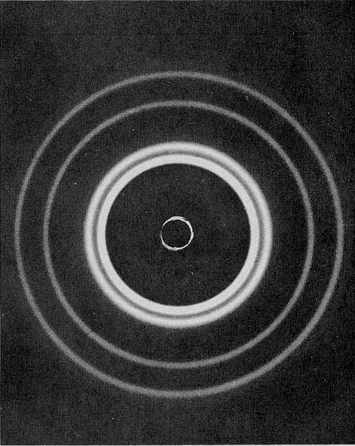
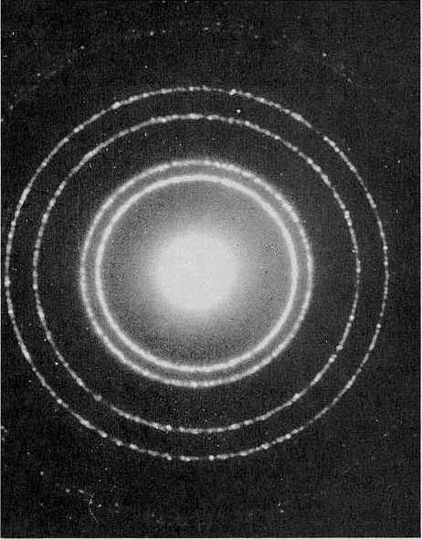
Particles as waves
optional
Davisson-Germer experiment: scattering of electrons on nickel crystal (1927)
joint Nobel Prize
1937
GP Thomson: scattering of electrons and X-rays on metal foil (1927)
Al-foil
electron - Röntgen
scattering
duality -
de Broglie
Notes:
A foton feltételezése a hullámok oldaláról vezetett az anyag duális, részecske és hullámtermészetének a felfedezéséhez. A másik irányból a Davisson-Germer kísérlet bizonyította, hogy a korábban részecskeként kezelt elektron is képes hullámtulajdonságokat mutatni, rácson hullámként szóródni, és interferencia képet produkálni.
A mennyiségi leírást de Broglie adta meg, mely szerint a részecske hullámhossza, és a lendülete összefügg, szorzatuk éppen a Planck állandót adja meg. λ·p = h

Slide 33
A new kind of uncertainty!
optional
The accuracy of the measurement can be improved by changing the tools and methods, and the repetition and averaging of the measurement leads to an improvement of the accuracy beyond all limits - classical physics.
In 1927, Heisenberg came to the conclusion that the deviation of the averages obtained as a result of multiple measurements of position and momentum (impulse) cannot be improved indefinitely, only at the expense of each other.
NEW PHYSICS NEEDED TO BE DEVELOPED!
Notes:
A bizonytalanság egy új típusának a megjelenése végleg lerombolta a klasszikus fizikát. Újra volt szükség! Ennek az alapfeltevéseivel foglalkozunk a következőkben.

Slide 34
Basic assumptions of quantum mechanics
optional
Nr.1. The state of the particle is represented by the position, and instead of the momentum vector, it is described by a wave function.
Nr.2. The physical quantities are represented by operators.
Nr.3. The measurable value of physical quantities is given by a constant that can be calculated from an eigenvalue equation.
Nr.4. The limit value of the average of a large number of measurements is given by the expected value integral.
Nr.5. Uncertainties of physical quantities with non-interchangeable operators obtained by a large number of measurements can only be corrected to a limited extent at the same time
$$Ψ(\text{x}\text{,}\text{y}\text{,}\text{z}\text{,}\text{t})$$
$$\hat{Ω}$$
$$\hat{Ω}Ψ=\text{ωΨ}$$
$$\left\langle ω\right\rangle =\int_{−∞}^{∞}{Ψ^{∗}\hat{Ω}Ψ}\text{dτ}$$
$$\text{Δ}{\text{ω}}_{1}\text{Δ}{\text{ω}}_{2}≥\text{konst}\text{.}$$
Notes:
Az új fizika, a kvantummechanika öt alapelve tehát összefoglalva:
A részecske állapotát az. Ún. hullámfüggvény írja le.
A fizikai mennyiségeket ún. operátorok reprezentálják.
A fizikai mennyiségeket az ún. sajátérték egyenletek segítségével kaphatjuk meg.
Nagyszámú mérés átlagát a várható érték integrál adja meg.
Az egymással nem felcserélhető operátorú fizikai mennyiségek bizonytalanságai, nagyszámú mérések átlagában, egymás rovására, csak korlátozottan javíthatók.

Slide 35
Quantum mechanics and classical physics
optional
Classical physics was the physics of certainties. It claimed that if we know exactly the parameters of a system's initial state, we can calculate its future state with certain precision.
Quantum mechanics, on the other hand, is the physics of probabilities, which can answer to a specific question such as „whether a particle is here or not” with one probability. According to Born's interpretation of the wave function, the probability of the particle is in small dτ environment of spatial coordinates τ = (x,y,z):
$$P\left(τ\right)=ψ^{∗}\left(τ\right)∙ψ\left(τ\right)∙dτ={\left|ψ\left(τ\right)\right|}^{2}∙dτ$$

Slide 36
The successes of quantum mechanics
optional
If one had to throw away everything that is due to quantum mechanics in our lives, then our existence would become very boring and joyless!
electronic devices - TV, radio, computer, mobile phone, etc.
lasers - CD/DVD players, security equipment, etc.
molecular biology, gene technology, medical diagnostics, therapy, etc.
According to John Gribbin, you don't need to understand why quantum mechanics works, you just have to follow the recipes in the "quantum cookbook" and "quantum chefs" cook good food.

