Slide 1
General Chemistry
8. Reaction kinetics
Dr. István Szilágyi
Department of Physical Chemistry and Materials Science
2024.

Slide 2
Time evolution of chemical reactions
Everyone has some idea about speed :
  "Take your feet faster! - Don't rush so much!”
  "Deliver the books faster! - Don't be so fast, I have to line up!"
  "Eat slowly, it's still hot! - Eat faster, everyone is waiting for you and the second course!"
In each case, some extensive quantity, e.g., the distance traveled, the number of books and the volume of soup, per unit time is discussed.

Slide 3

Time evolution of chemical reactions
What can characterize the speed of chemical processes?
  It is definitely related to the change in the amount of reactants/products per unit time!
Let's follow the following reaction in time:
  solutions containing 4 moles of A and 3 moles of B are measured into a container, and the volume of the product is 5 dm³.
  the amount of C produced is measured at every 90 seconds and the amounts of remaining A and B are calculated for each point.
  plot the molar amount versus time curves and examine their changes over time!
$$2A+3B=5C$$

Slide 4

Time evolution of chemical reactions
Time evolution of the molar amount
$$2A+3B=5C$$
n_{C}
The change in the molar amount per unit time for the individual components matches neither in the values nor in their sign.
n_{A}
n_{B}
Let us divide the solution into two!

Slide 5

Time evolution of chemical reactions
Time evolution of the molar amount -
for half of the reaction volume
By halving the volume of the solution, the quantities of substances are also halved, so their change per unit time is also halved.
$$2A+3B=5C$$
n_{C}
n_{A}
n_{B}
This can be eliminated by normalizing to the volume of the solution!

Slide 6

Time evolution of chemical reactions
Time evolution of the molar amount
c_{C}
$$2A+3B=5C$$
The resulting plots are now independent of the volume of the solution, but still different values are obtained.
c_{A}
c_{B}
Let us use the constancy of n_{i}/|ν_{i}| like during solving stochiometry calculations.

Slide 7
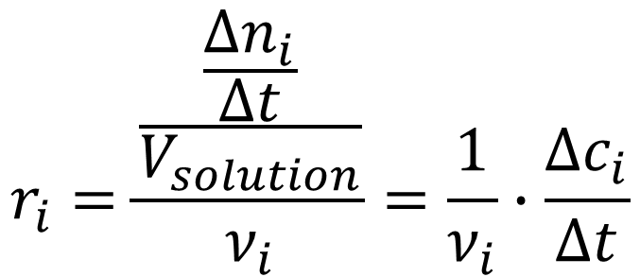

Time evolution of chemical reactions
Quotient of the normalized concentration change and the reaction time
$$r_{i}=\frac{\frac{\frac{Δn_{i}}{Δt}}{V_{solution}}}{ν_{i}}=\frac{1}{ν_{i}}∙\frac{Δc_{i}}{Δt}$$
$$2A+3B=5C$$
If one divides by the stoichiometric number itself, and not by its absolute value, then the signs are also fixed!
r_{C}= r_{A}= r_{B}

Slide 8
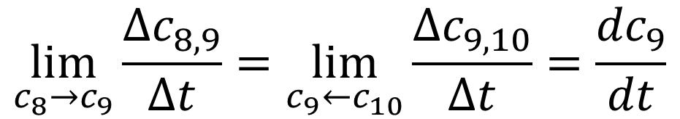

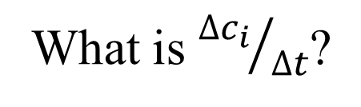

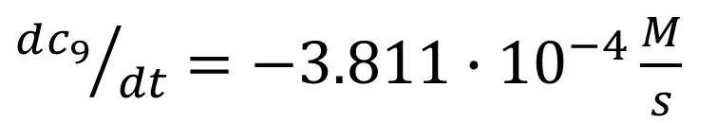

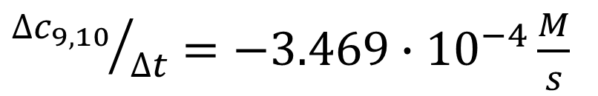

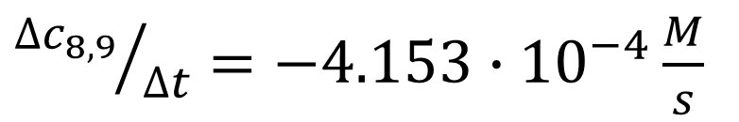

Difference or differential quotient (derivative)
What is ${∆c_{i}}/{∆t}$?
1.03
8
${∆c_{8,9}}/{∆t}=−4.153∙{10}^{−4}\frac{M}{s}$
1.02
1.01
$$∆c_{8,9}$$
${∆c_{9,10}}/{∆t}=−3.469∙{10}^{−4}\frac{M}{s}$
1.00
9
c_{A}/M
0.99
$$∆t→0$$
$$∆t$$
0.98
$$\lim_{c_{8}→c_{9}}{\frac{{∆c}_{8,9}}{∆t}}=\lim_{c_{9}←c_{10}}{\frac{{∆c}_{9,10}}{∆t}}=\frac{{dc}_{9}}{dt}$$
$$∆c_{9,10}$$
0.97
10
0.96
$$∆t$$
0.95
${dc_{9}}/{dt}=−3.811∙{10}^{−4}\frac{M}{s}$
625
645
665
685
705
725
745
765
785
805
t/s

Slide 9

Reaction rate divided by volume
The rate of chemical reactions is therefore
where r is the rate of reaction divided by the volume,
c_{i} is the concentration of component i,
ν_{i} is the stochiometric number of component i,
Dimension/unit: [r]= 1 mol∙dm⁻³∙s⁻¹
What does the rate of reactions depend on?
$$r=\frac{1}{ν_{i}}∙\frac{dc_{i}}{dt}$$

Slide 10
The empirical rate equation
All those scientists who investigated the rate of reactions found that it always depends on the concentration of the reacting materials, but they did not necessarily find a direct proportionality between rate and concentration.
Unlike equilibrium reactions, however, the rate was found to be independent of the concentration of the products.
Relationships between the stoichiometric coefficient and the power exponent of the concentration of each component were searched.
A match was rarely found!

Slide 11
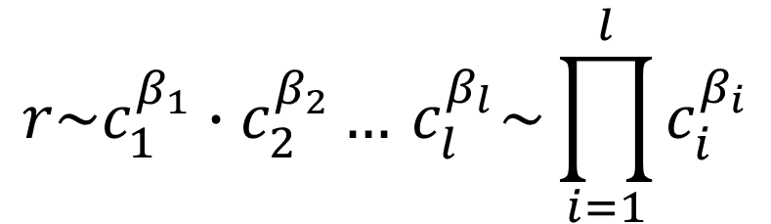
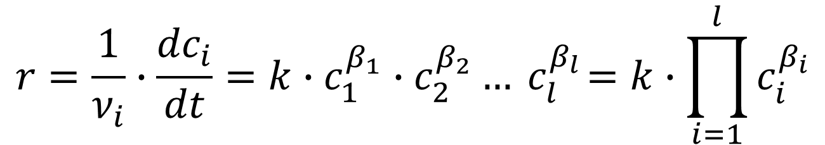
The empirical rate equation
These experiences led to the conclusion that the rate of a chemical reaction is
proportional to the product of the reactants (i=1, 2, ... l) concentrations (c_{i}) on a certain power (β_{i}).
Proportionality is equated with a constant (k) characteristic of a given reaction:
$$r\sim c_{1}^{β_{1}}∙c_{2}^{β_{2}}…{ c}_{l}^{β_{l}}\sim \prod_{i=1}^{l}{c_{i}^{β_{i}}}$$
$$r=\frac{1}{ν_{i}}∙\frac{{dc}_{i}}{dt}=k∙c_{1}^{β_{1}}∙c_{2}^{β_{2}}…{ c}_{l}^{β_{l}}=k∙\prod_{i=1}^{l}{c_{i}^{β_{i}}}$$

Slide 12
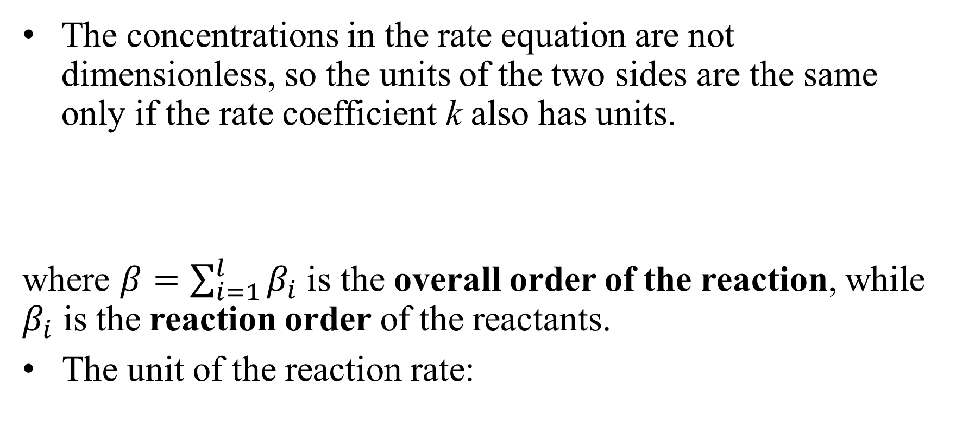
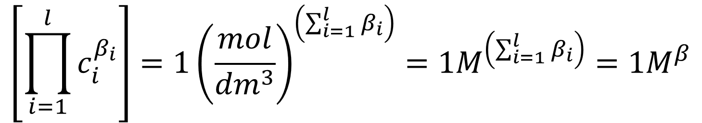
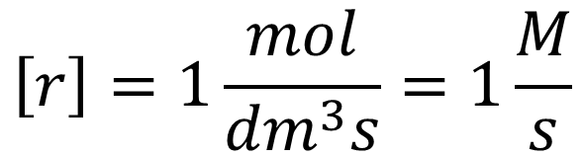
The empirical rate equation
The concentrations in the rate equation are not dimensionless, so the units of the two sides are the same only if the rate coefficient k also has units.
where $β=\sum_{i=1}^{l}{β_{i}}$ is the overall order of the reaction, while $β_{i}$ is the reaction order of the reactants.
The unit of the reaction rate:
$$\left[\prod_{i=1}^{l}{c_{i}^{β_{i}}}\right]=1{\left(\frac{mol}{{dm}^{3}}\right)}^{\left(\sum_{i=1}^{l}{β_{i}}\right)}=1M^{\left(\sum_{i=1}^{l}{β_{i}}\right)}=1M^{β}$$
$$\left[r\right]=1\frac{mol}{{dm}^{3}s}=1\frac{M}{s}$$

Slide 13
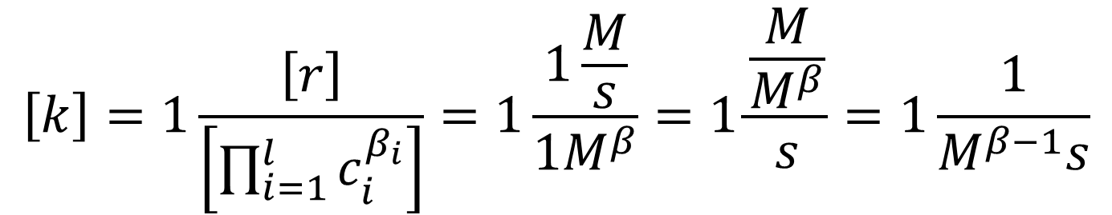
The empirical rate equation
The dimension of the rate coefficient is therefore:
Accordingly, it depends on the reaction orders, i.e., the overall rate depends on the power of the reactant concentrations in the rate equation.
The reaction orders are not necessarily integers, they can be any positive value or even zero.
$$\left[k\right]=1\frac{\left[r\right]}{\left[\prod_{i=1}^{l}{c_{i}^{β_{i}}}\right]}=1\frac{1\frac{M}{s}}{1M^{β}}=1\frac{\frac{M}{M^{β}}}{s}=1\frac{1}{M^{β−1}s}$$

Slide 14
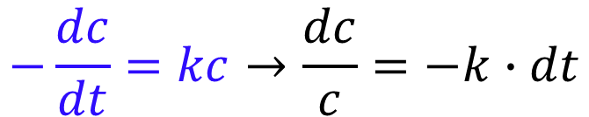
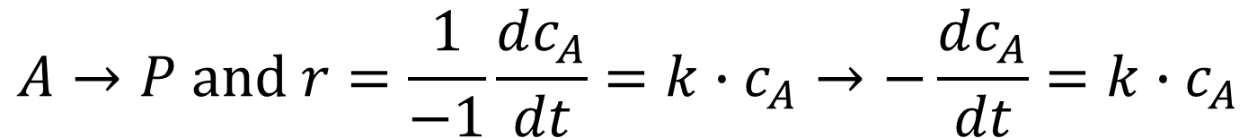
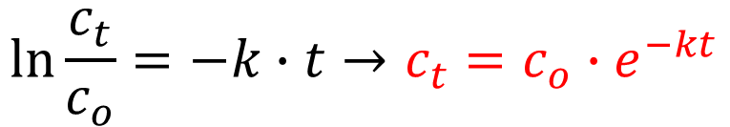
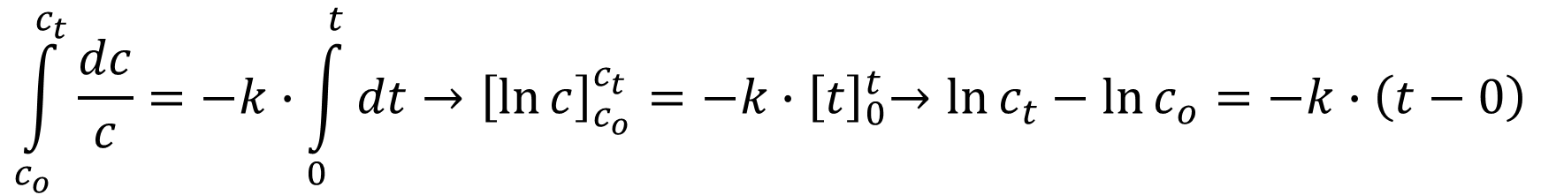
Special cases - first-order reactions
Reactions, in which the starting material is transformed into products in a single step have a reaction order of one - unimolecular reaction!
The so-called separable differential equations, after rearrangement, can be solved by integration:
From differential to integral form!
$$A→P and r=\frac{1}{−1}\frac{dc_{A}}{dt}=k∙c_{A}→−\frac{dc_{A}}{dt}=k∙c_{A}$$
$$−\frac{dc}{dt}=kc→\frac{dc}{c}=−k∙dt$$
$$\int_{c_{o}}^{c_{t}}{\frac{dc}{c}}=−k∙\int_{0}^{t}{dt}→{\left[\ln{c}\right]}_{c_{o}}^{c_{t}}={−k∙\left[t\right]}_{0}^{t}→\ln{c_{t}}−\ln{c_{o}}=−k∙\left(t−0\right)$$
$$\ln{\frac{c_{t}}{c_{o}}}=−k∙t→c_{t}=c_{o}∙e^{−kt}$$

Slide 15
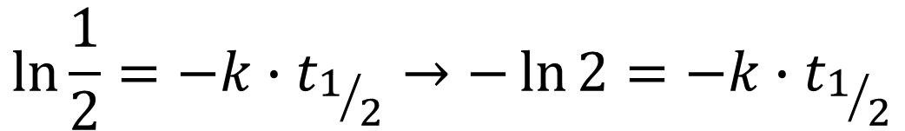
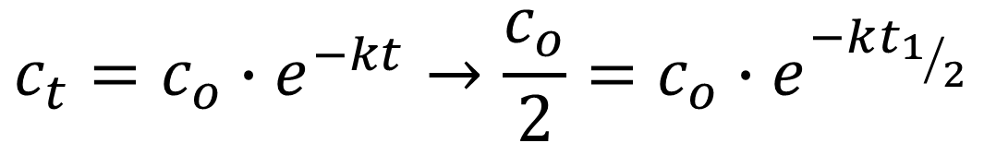
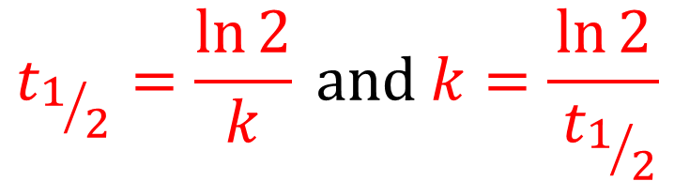
Special cases - first-order reactions
Half-life of a reaction (t_{½}): is the time, during which the initial concentration is reduced by half, i.e., time frame necessary for c_{t}= c_{o}/2!
For a first-order reaction, from the integrated rate equation:
$$c_{t}=c_{o}∙e^{−kt}→\frac{c_{o}}{2}=c_{o}∙e^{−kt_{1/2}}$$
$$\ln{\frac{1}{2}}=−k∙t_{1/2}→−\ln{2}=−k∙t_{1/2}$$
$$t_{1/2}=\frac{\ln{2}}{k} and k=\frac{\ln{2}}{{ t}_{1/2}}$$

Slide 16

Special cases - first-order reactions
How to measure the rate coefficient of a first-order reaction?
The half-life is independent of the starting concentration.
Any pair of points is suitable to calculate the rate coefficient, between which the concentration is reduced by factor of 2.
first-order reaction
$$k=\frac{\ln{2}}{{ t}_{1/2}}$$
t_{½}
t_{½}
t_{½}
t_{½}
t_{½}
t_{½}

Slide 17
Special cases - first-order reactions
How can the rates of reactions be compared? Which one is faster?
The answer must be found in the value of the rate coefficient!
Let's examine three first-order reactions, which take place at different rates, and one measured the concentration of the reactant at different initial concentrations.
Of course, comparing the concentration-time curves gives information for an expert, but there is a better way!

Slide 18
Special cases - first-order reactions
At first glance, all three curves have clearly different sections:
where the concentration of the reactant is the smallest,
where it is the largest, etc.
How could they be compared?
Let's examine the integral rate equation!
first-order reaction

Slide 19
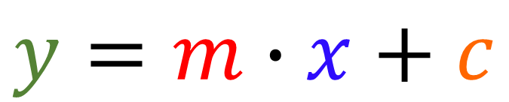
Special cases - first-order reactions
Convert the integrated rate equation to its logarithmic form:
Linear relation with slope of -k!
Plot data like that!
It is OK, but could be better!
$$c_{t}=c_{o}∙e^{−kt}→\ln{c_{t}}=\ln{c_{o}}−k∙t$$
first-order reaction
$$y=m∙x+c$$

Slide 20
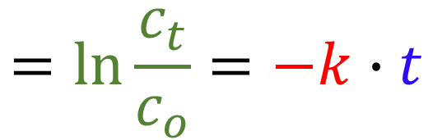
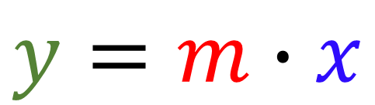
Special cases - first-order reactions
To eliminate the disturbing effect of the different intercepts:
This is a linear fit with slope -k and 0 intercept.
Plot data like that!
$$\ln{c_{t}}=\ln{c_{o}}−k∙t→\ln{c_{t}}−\ln{c_{o}}=−k∙t=$$
first-order reactions
$$=\ln{\frac{c_{t}}{c_{o}}}=−k∙t$$
m = -k₁
$$y=m∙x$$
k₁ < k₂ < k₃
m = -k₂
m = -k₃

Slide 21
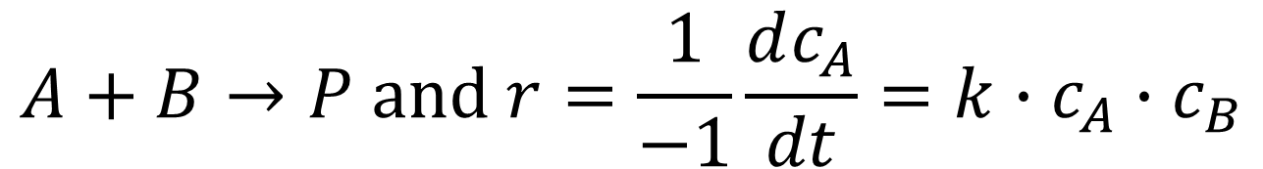
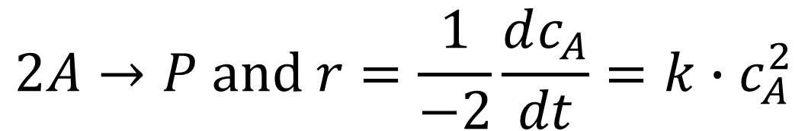
Special cases – second-order reaction
Second-ordered is a reaction if two particles are converted into products as a result of an inelastic collision - bimolecular reaction!
Two possibilities exist:
The integrated rate equations are much more complicated than for the first-order one. For example, the half-life also depends on the starting concentration(s)!
$$2A→P and r=\frac{1}{−2}\frac{dc_{A}}{dt}=k∙c_{A}^{2}$$
$$A+B→P and r=\frac{1}{−1}\frac{dc_{A}}{dt}=k∙c_{A}∙c_{B}$$

Slide 22
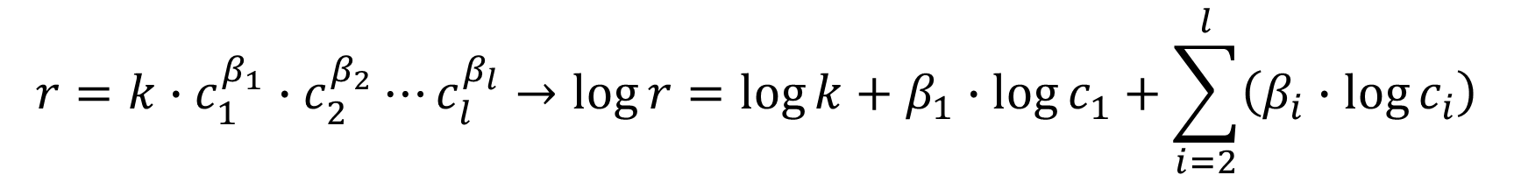
Determination of reaction order
To know how a reaction takes place, the first step is to determine the reaction order of the reactants!
Let's logarithmize the rate equation!
The obtained expression shows that any order can be determined, if the concentration of reactants is significantly higher than the component to be studied, i.e., the changes in their concentrations in the initial stage of the reaction is negligible.
$$r=k∙c_{1}^{β_{1}}∙c_{2}^{β_{2}}⋯c_{l}^{β_{l}}→\log{r}=\log{k}+β_{1}∙\log{c_{1}}+\sum_{i=2}^{l}{\left(β_{i}∙\log{c_{i}}\right)}$$

Slide 23
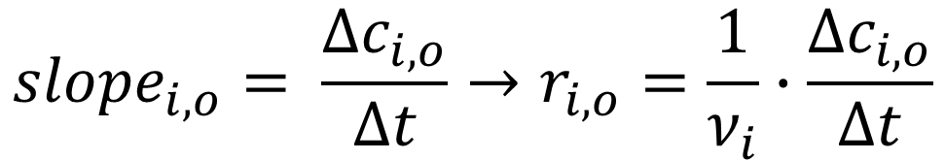
Determination of reaction order
One runs the reaction for short time at several occasions with different starting concentrations of the reactant chosen.
The initial rate of the reaction is calculated from the first part of the exponential curve approximated by a straight line.
The slope of the line fitted to the initial stage is the rate of decrease in concentration of a given reactant, which is the difference quotient in the rate equation:
$${slope}_{i,o}= \frac{∆c_{i,o}}{∆t}→r_{i,o}=\frac{1}{ν_{i}}∙\frac{∆c_{i,o}}{∆t}$$

Slide 24
Method of the initial rates
method of the initial rates
Kezdeti sebességek módszere
c_{t}/M
3.300
2.800
2.300
The rate of the reaction is obtained by dividing the slopes with the stoichiometric number.
1.800
1.300
0.800
0
20
40
60
80
100
t/s

Slide 25
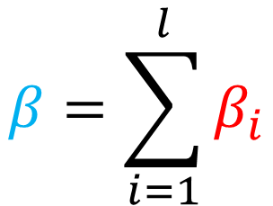


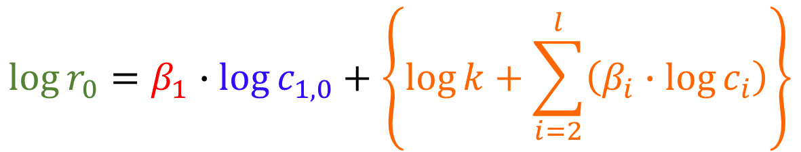
Method of the initial rates
$$\log{r_{0}}=β_{1}∙\log{c_{1,0}}+\left\{\log{k}+\sum_{i=2}^{l}{\left(β_{i}∙\log{c_{i}}\right)}\right\}$$
determination of reaction order
$$m=\frac{∆y}{∆x}=β_{i}$$
$$y=m∙x+c$$
Δy
The slope gives the reaction order for the reactant.
Δx
$$β=\sum_{i=1}^{l}{β_{i}}$$
With such measurements for each reactant, the overall order of the reaction can be obtained!

Slide 26
Temperature dependence of reaction rate
Kitchen experiences in reaction kinetics: "Turn up the gas, it will be ready faster!" or "Turn down the heat, slow cooking will be better!"
It is also not a coincidence that the foods are stored refrigerators.
By changing the temperature, the rate of the chemical/biological processes is different.
Accordingly, the rate of the reactions depends on the temperature!
Why and how?

Slide 27
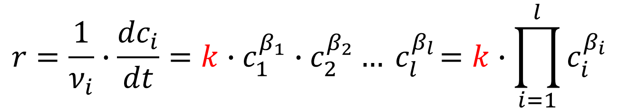
Temperature dependence of reaction rates
What can depend on temperature in the rate equation?
Molar concentrations change slightly due to density, but do not account for the significant rate increase experienced.
The rate coefficient can be the reason for the temperature dependence!
Arrhenius, mentioned earlier in connection with his acid-base theory, measured the rate of various reactions at different temperatures. For comparison, he calculated the rate coefficients.
$$r=\frac{1}{ν_{i}}∙\frac{{dc}_{i}}{dt}=k∙c_{1}^{β_{1}}∙c_{2}^{β_{2}}…{ c}_{l}^{β_{l}}=k∙\prod_{i=1}^{l}{c_{i}^{β_{i}}}$$

Slide 28
Temperature dependence of reaction rates
Based on the obtained curves, it was difficult to compare the different reactions because the values of k differ greatly.
However, similar to Arrhenius, if one plots the logarithm of the rate coefficient (ln k/Ms⁻¹) against the reciprocal of the temperature (1/T), a surprising result is obtained.

Slide 29
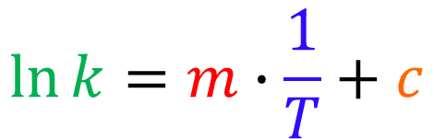
Temperature dependence of reaction rates
The calculated data points fall on a straight line of negative slope.
The slopes and intercepts are different.
These data are called Arrhenius parameters and characterize the temperature dependence of the reaction rate.
$$\ln{k}=m∙\frac{1}{T}+c$$

Slide 30
Temperature dependence of reaction rates
Arrhenius parameters of the reactions given in the previous figure:
The slope is apparently related to how fast the reactions proceed: k₁ > k₂ > k₃ and m₁ > m₂ > m₃
The intercepts, on the other hand, change in the opposite direction:
k₁ > k₂ > k₃ and c₁ < c₂ < c₃

Slide 31
Temperature dependence of reaction rates
Today the physical meaning of these parameters is known and how the temperature dependence of the rate of reactions can be explained.
Take a look at A+B = P bimolecular reaction.
A
B
P₂
P₁
P₃

Slide 32
Temperature dependence of reaction rates
Let's examine the energetic effect that particles A and B have on each other when they collide.
When they are still far away, there is no significant interaction between them, they only have kinetic energy.
When they get closer, first their electron shells and then, when they get even closer, their nuclei repel each other. The potential energy of the system of two particles begins to increase and their kinetic energy decreases since their total energy is constant.
If their total initial energy is high enough, the repulsions are not able to separated them, the electron shells of the two particles merge, their bonds are rearranged, and the products are created, which represent a more favorable energy state and move away from each other.

Slide 33
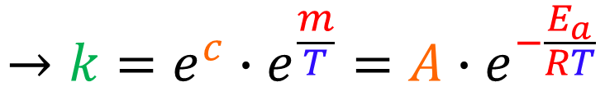
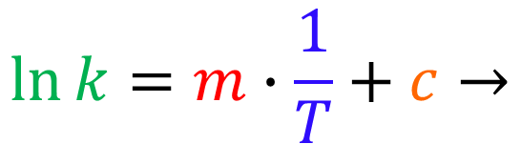
Temperature dependence of reaction rates
The curve of the potential energy of the system passes through a maximum as the reaction progresses.
E/kJ
$$\ln{k}=m∙\frac{1}{T}+c→$$
A
B
P
P
P
₁
₂
₃
A
B
E_{a}
$$→k=e^{c}∙e^{\frac{m}{T}}=A∙e^{−\frac{E_{a}}{RT}}$$
A
B
A – pre-exponential factor
E_{a} – activation energy
ΔH_{r}
ΔH_{r} – reaction heat
P
₁
P
P
₂
P
P
P
₃
₂
₁
₃
ξ – reaction coordinate

Slide 34


Temperature dependence of reaction rates
Why do the rates of reactions depend exponentially on temperature?
The explanation is concerned with the Maxwell-Boltzmann distribution curves, which have already been used when discussing the volatility of liquids.
The number of particles with a kinetic energy greater than E_{a} increases exponentially.
$$\frac{dn}{N}/\%$$
1.40E+01
1.20E+01
T₁
T₁< T₂< T₃
1.00E+01
T₂
r₁< r₂< r₃
8.00E+00
6.00E+00
T₃
4.00E+00
2.00E+00
0.00E+00
0
10
20
30
40
50
60
70
80
E_{a}
$$v/\left(\frac{m}{s}\right)$$

Slide 35
Temperature dependence of reaction rates
The existence of the pre-exponential factor (A) requires a more complicated explanation. For a variety of reasons, not all collisions of the same energy lead to the formation of products. One of the easiest reasons is, for example, that the important molecular parts and atoms do not come close to each other.
It can therefore be concluded that the rate of all elemental, i.e., unimolecular and bimolecular, reactions accelerates with temperature.
At the same time, all more complicated reactions can be derived into elementary reaction steps, which also assign to this law.

Slide 36



Catalysis
Everyone has heard of catalysts. How do they work?
E/kJ
A
B
E_{a,c} < E_{a} - at the same temperature, the reaction rate increases in the presence of the catalyst.
$$A+K⇌\left[KA\right]$$
P
P
P
₂
₃
₁
K
C
A
C
B
E_{a,c}
E_{a}
$$\left[KA\right]+B⟶\left[KAB\right]$$
$$⟶K+P$$
C
P
P
P
₁
₂
₃
ξ – reaction coordinate

Slide 37


Catalysts - Enzymes
Catalysts are present in many industrial manufacturing processes.
  ammonia synthesis - Haber-Bosch process (Fe catalyst)
  sulfuric acid synthesiss - 2SO₂ + O₂ → SO₃ (V₂O₅ catalyst)
  production of gasoline by catalytic cracking process (zeolite catalyst)
The most effective catalysts are found in living organisms – the enzymes.
The typical route of enzyme reactions can be described by the Michaelis-Menten mechanism. The enzyme (E)-substrate (S) balance is shifted towards the formation of the ES complex!
$$⇀$$
$$E+S⇌\left[ES\right]⟶E+P$$

Slide 38
Inhibitors
The phenomenon of inhibition can be observed when the inhibitor binds to the enzyme and prevents the enzyme from functioning.
There are several ways to do this:
  the inhibitor takes the place of the substrate and binds stronger there.
  the inhibitor binds to another part of the enzyme, and its 3D structure is modified in such a way that the substrate cannot bind, or the groups assisting the enzymatic catalysis are out of optimal position, and the transformation cannot take place.
Poisons and numerous medicines also work in this way!

