Slide 1
General Chemistry
7. Electrochemistry
Dr. István Szilágyi
Department of Physical Chemistry and Materials Science
2024.

Slide 2
Electrochemistry
Ionic conductor
Chemical reaction by electric current
Electric current by chemical reaction
- conduction of melts
- conduction of solutions
- Electrolysis cells
galvanic (voltaic) cells
- batteries
- fuel cells

Slide 3
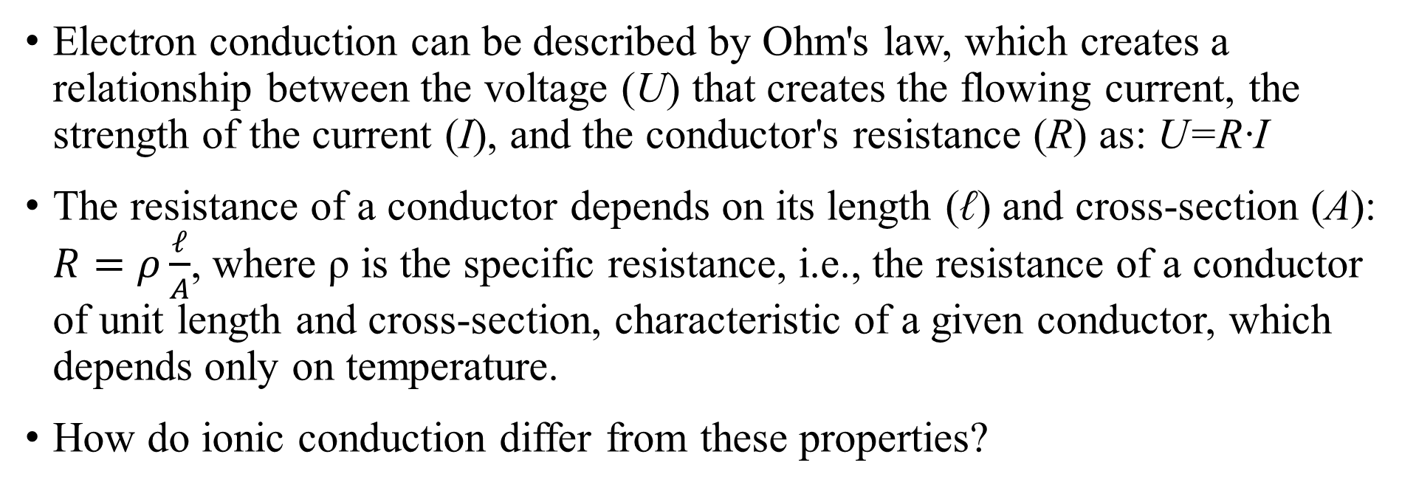
Electron conductors
Electron conduction can be described by Ohm's law, which creates a relationship between the voltage (U) that creates the flowing current, the strength of the current (I), and the conductor's resistance (R) as: U=R·I
The resistance of a conductor depends on its length (ℓ) and cross-section (A): $R=ρ\frac{ℓ}{A}$, where ρ is the specific resistance, i.e., the resistance of a conductor of unit length and cross-section, characteristic of a given conductor, which depends only on temperature.
How do ionic conduction differ from these properties?

Slide 4
Conductance of melts
At an appropriately high temperature, the lattice of solid materials containing oppositely charged ions in the lattice points collapses, because the transmitted heat, exciting the vibrations of the ions, increases their amplitude so much that the attractive force is no longer able to return them to their original position, i.e., the solid melts.
Under the influence of an electric field, the ions in the melts move relative to each other, i.e., the melts conduct the electric current.
The movement of oppositely charged ions in opposite directions is, however, much more strongly inhibited than for electrons in a metal lattice, so their conductivity is orders of magnitude lower than that of electron conductors.
https://www.youtube.com/watch?v=NfNIn4R8tg4

Slide 5
Conductance of melts
At the same time, substances consisting of ions in a polar solvent, such as water, dissociate into their ions. Even though the ions are surrounded by solvent molecules, forming a solvate – hydrate in water – shell, they are able to move under the influence of an electric field, i.e., electrolyte solutions also conduct electricity.
Conduction in electrolyte solutions is more complicated than that in metallic conductors, since in addition to the type of the ions and the temperature, conduction also depends on the number of charged particles in the solution, i.e., on the concentration of the electrolyte.
Melts of electrolytes and their solutions are the so-called ionic conductors, whose electrical conduction laws are important.

Slide 6
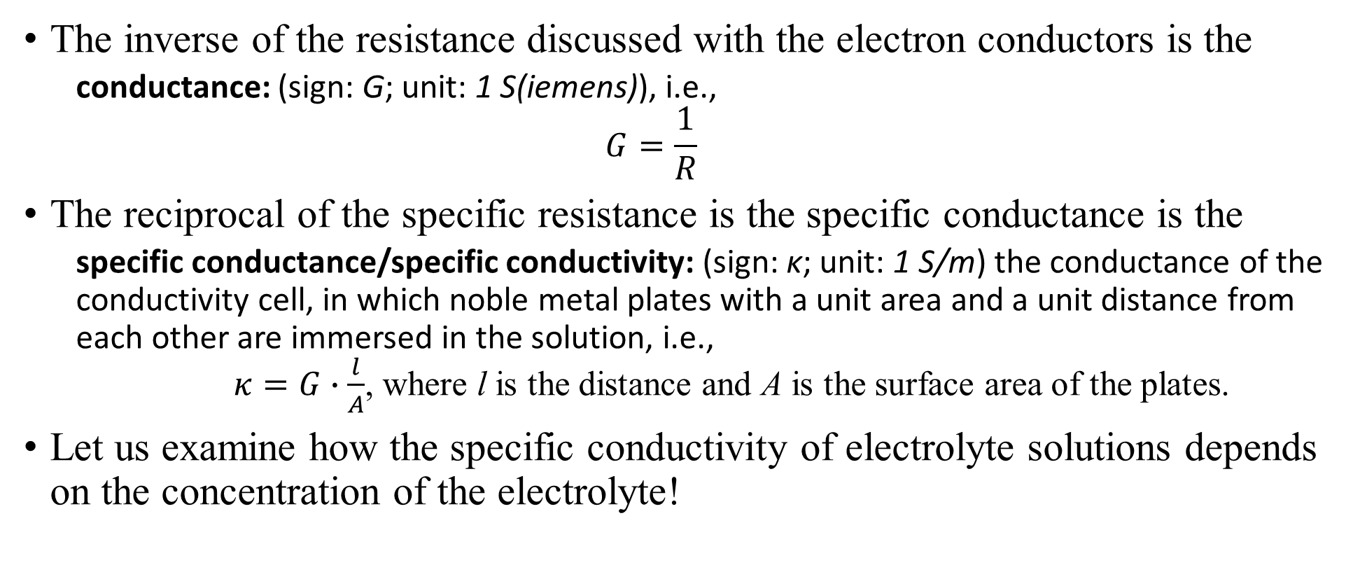
Conductance and specific conductance
The inverse of the resistance discussed with the electron conductors is the
  conductance: (sign: G; unit: 1 S(iemens)), i.e.,
  $$G=\frac{1}{R}$$
The reciprocal of the specific resistance is the specific conductance is the
  specific conductance/specific conductivity: (sign: κ; unit: 1 S/m) the conductance of the conductivity cell, in which noble metal plates with a unit area and a unit distance from each other are immersed in the solution, i.e.,
  $κ=G∙\frac{l}{A}$, where l is the distance and A is the surface area of the plates.
Let us examine how the specific conductivity of electrolyte solutions depends on the concentration of the electrolyte!

Slide 7

Concentration dependence of specific conductance
G
κ/S·m⁻¹
H₂SO₄
70
60
-
+
-
+
KOH
-
+
50
-
+
+
-
40
+
-
LiCl
+
30
+
+
$$κ=G\frac{ℓ}{A}$$
-
-
20
MgSO₄
-
+
+
-
10
+
-
HAc
0
+
-
0
5
10
15
A
ℓ
-
-
+
c/mol·dm⁻³

Slide 8
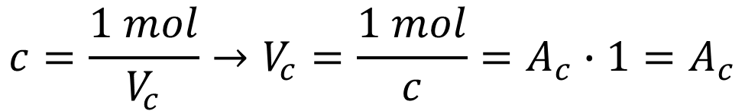
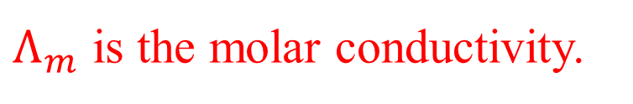
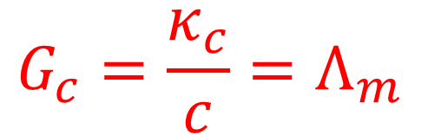
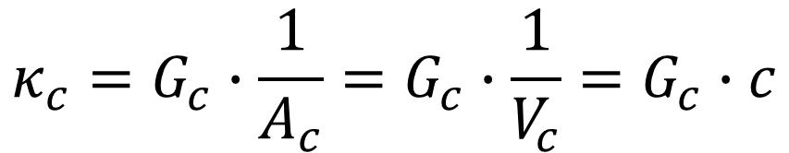
Molar conductivity
The specific conductance is not suitable for comparing electrolytes. Another indicator must be introduced, for which the number of conducting particles does not change.
Apply n=1 mole of electrolyte between the two plates, and then dilute it with solvent. The measured conductivity can be calculated from the specific conductivity and the concentration of the solution.
G
+
-
$$c=\frac{1 mol}{V_{c}}→V_{c}=\frac{1 mol}{c}=A_{c}∙1=A_{c}$$
$$κ_{c}=G_{c}∙\frac{1}{A_{c}}=G_{c}∙\frac{1}{V_{c}}=G_{c}∙c$$
$$G_{c}=\frac{κ_{c}}{c}=Λ_{m}$$
1
$Λ_{m}$ is the molar conductivity.
1
1

Slide 9
Molar conductivity
Plot molar conductance versus the volume of the solution under investigation!
NaOH
G
248
Λ_{m}/10⁻⁴ S m²mol⁻¹
MgSO₄
+
-
133
HAc
0
0.0
2.5
5.0
V_{c}/10⁻⁴ m³
For very diluted solutions that κ – c plot is linear, Λ_{m} is constant and equal to the molar conductivity at infinite dilution - Λ∞
1
1
1

Slide 10

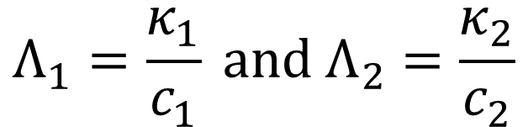
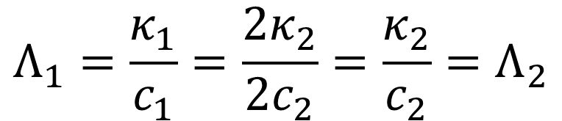
Molar conductivity
Let us prove the previous statement!
G
Dilute the solution by a factor of 2! Concentration and specific conductance then:
+
-
$$c_{1}=2∙c_{2} and{ κ}_{1}=2∙κ_{2}$$
V₁
$$Λ_{1}=\frac{κ_{1}}{c_{1}} and{ Λ}_{2}=\frac{κ_{2}}{c_{2}}$$
In addition:
V₁
$$Λ_{1}=\frac{κ_{1}}{c_{1}}=\frac{{2κ}_{2}}{{2c}_{2}}=\frac{κ_{2}}{c_{2}}{=Λ}_{2}$$
...and thus...
1
1
1
It is obvious that molar conductance does not change!

Slide 11
Molar conductivity
In infinitely diluted solution, oppositely charged ions move independently of each other, i.e., the conductance is the sum of the conductances of the anions and cations!
Accordingly, from the molar conductivities of infinite dilute solutions of salts with different compositions, the corresponding values for each ion can be calculated. They can be found in tables and handbooks!
$Λ_{∞}= ∑_{i=1}^{n}ν_{i}λ_{i}, where λ_{i} is the molar conductance of ion "i„$ and $ν_{i} is its stochiometric number in the electrolyte.$

Slide 12
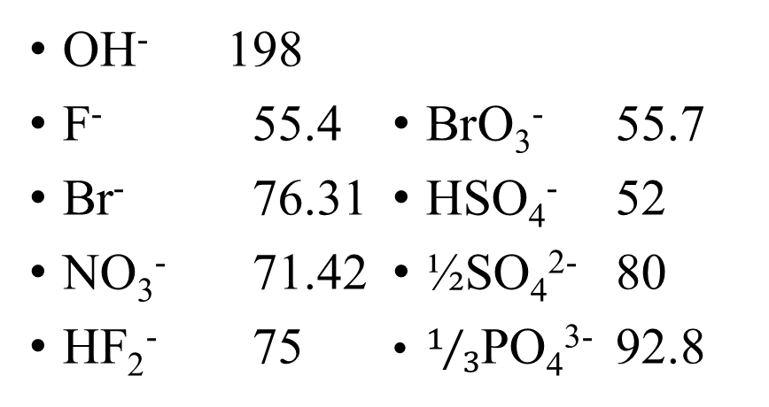
Molar conductivity
λ_{i}/(10⁻⁴ S m²/mol) - cations
λ_{i}/(10⁻⁴ S m²/mol) - anions
H⁺ 349.65
Li⁺ 38.66
K⁺ 73.47
½Cu²⁺ 53.60
½Pb²⁺ 71
½Mg²⁺ 53.0
½Zn²⁺ 52.8
½Ba²⁺ 63.60
NH₄⁺ 73,5
OH⁻ 198
F⁻ 55.4
Br⁻ 76.31
NO₃⁻ 71.42
HF₂⁻ 75
BrO₃⁻ 55.7
HSO₄⁻ 52
½SO₄²⁻ 80
$1/3$PO₄³⁻ 92.8
-
+
+
+
+
2-
2-
2-
+
2-
+
2-
2-
+
+
+
+
+
+
+

Slide 13
Electric current by chemical reaction
Many portable power sources in our daily life. The devices ranges from an alarm clock to a car. How do they operate? What is the electrochemical background?
Let's do an experiment in mind. Dip a metal in water. What happens on the surface?
The metal can only dissolve in the form of a cation.
-
+
The electrons left behind induce negative charge on the surface of the metal, while the cations accumulate a positive charge in the solution. A double layer is formed, it is a capacitor. A potential difference develops.
-
+
+
-
+
-
-
+

Slide 14
Electrode, electrode potential, cell potential
electrode/half-cell: an electron conductor and an ionic conductor, in which the electron conductor is immersed, i.e., an electrode and an electrolyte solution/melt together.
electrode potential: (sign: ε; unit: 1 V) the potential difference between the electron conductor and the ion conductor, i.e., the metal and the solution. It cannot be measured directly, it has no natural zero point. It corresponds numerically to the cell potential of the electrochemical cell whose anode is the standard hydrogen electrode in equilibrium, and whose cathode is the electrode with the potential in question – we will study this later.
electrochemical cell: a system, in which two electron conductors are immersed in one or one-one ionic conductor (electrolyte).
galvanic/voltaic cell: an electrochemical cell consisting of two electrically connected electrodes/half-cells, in which electricity is generated as a result of a spontaneously occurring chemical reaction.
cell potential: (sign: E, unit: 1 V) the difference between the electrode potentials of two half-cells.

Slide 15
Electric current by chemical reaction
The charge and thickness of the double layer formed due to the surface equilibrium depends on the chemical composition of the material, and (if the salt of the metal is present in dissolved form in ions) also on the electrolyte concentration. Surface potential cannot be measured!
However, the difference between the potential of the system formed from two different metals and their salt solutions can be measured! – Daniell cell
One plate is zinc, the other is copper. The zinc plate is immersed in zinc(II) sulfate solution, and the copper is immersed in copper(II) sulfate solution.
The two solutions are connected with a tube containing an ion conductor, so that the voltage between the metal plates can be measured.
V

Slide 16
Concentration dependence of cell potential
By changing the concentration of the electrolytes in the Daniell cell, a remarkable relationship is obtained when the potential measured with a high internal resistance voltmeter is plotted against the concentration! E= (ε_{Cu} – ε_{Zn}) (T=298,15K)
The measured potential is a two-term expression and ln(c/(1mol/dm³)) = 0 if c=1mol/dm³.
E/V
E/V
ln ([Cu²⁺]/1M)
ln ([Zn²⁺]/1M)

Slide 17
The cell reaction – anode and cathode
One can observe that ε_{Cu} > ε_{Zn,} since positive potential difference is measured!
If metallic zinc is dipped in copper(II) sulfate solution, the color of the solution becomes pale and copper precipitates on the zinc plate. In the opposite case, nothing happens!
The current producing reaction in the cell is then: Zn + Cu²⁺ = Zn²⁺ + Cu – a zinc is oxidized, copper is reduced.
anode: in the electrochemical cell, the electrode, where the oxidation occurs.
cathode: the electrode in the cell, at which the reduction occurs.
Obviously, E= (ε_{Cu} – ε_{Zn}) = (ε_{cathode} – ε_{anode}) is the cell potential measured.
https://www.youtube.com/watch?v=6CKdw66inFQ

Slide 18
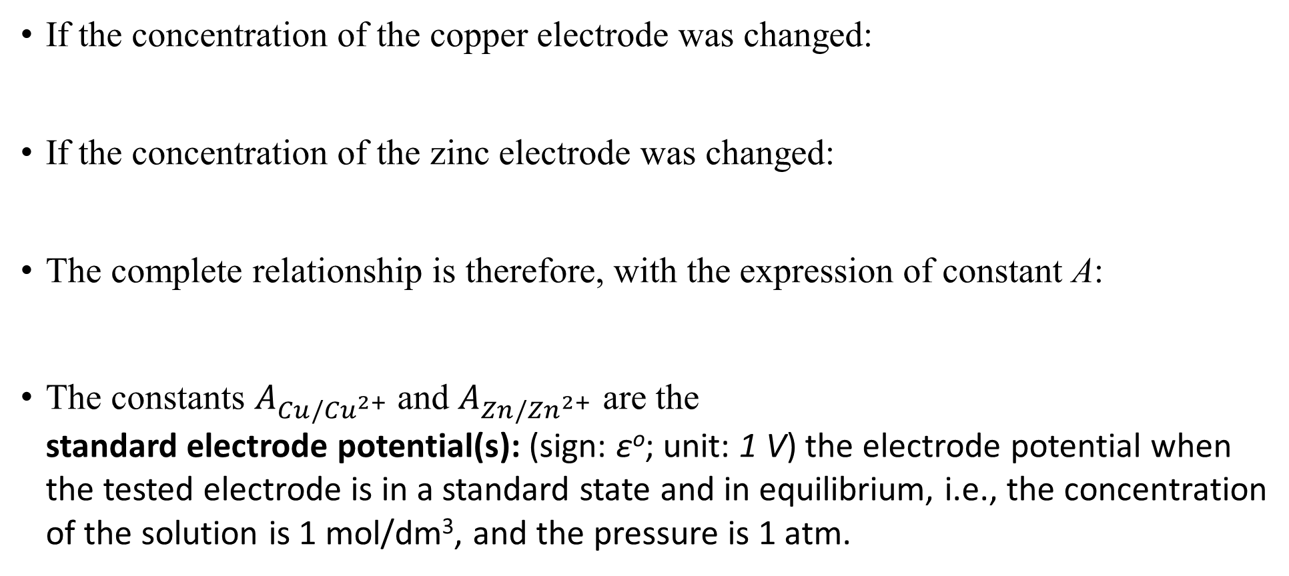
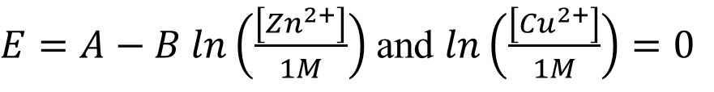
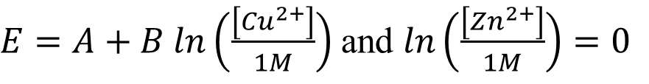
Nernst equation
If the concentration of the copper electrode was changed:
If the concentration of the zinc electrode was changed:
The complete relationship is therefore, with the expression of constant A:
The constants $A_{Cu/{Cu}^{2+}}$and $A_{Zn/{Zn}^{2+}}$ are the
standard electrode potential(s): (sign: εº; unit: 1 V) the electrode potential when the tested electrode is in a standard state and in equilibrium, i.e., the concentration of the solution is 1 mol/dm³, and the pressure is 1 atm.
$E=A+B ln\left(\frac{\left[{Cu}^{2+}\right]}{1M}\right)$ and $ln\left(\frac{\left[{Zn}^{2+}\right]}{1M}\right)=0$
$E=A−B ln\left(\frac{\left[{Zn}^{2+}\right]}{1M}\right)$ and $ln\left(\frac{\left[{Cu}^{2+}\right]}{1M}\right)=0$
$E=A_{Cu/{Cu}^{2+}}+B ln\left(\frac{\left[{Cu}^{2+}\right]}{1M}\right)−A_{Zn/{Zn}^{2+}}−B ln\left(\frac{\left[{Zn}^{2+}\right]}{1M}\right)=ε_{cathode}−ε_{anode}$

Slide 19
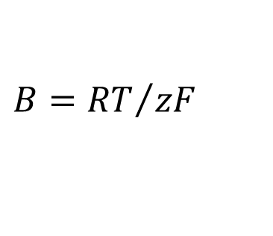
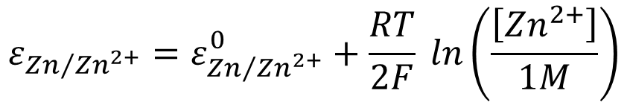
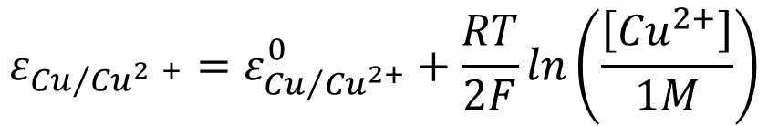
Nernst equation for electron conductors
Using the standard potentials:
Performing the experiment at a higher temperature, B is constant, and the slope of the curves decreases.
Note that , where z is the number of electrons participating in the half-reaction taking place in the cell, while F=96485 C/mol, the Faraday constant, the charge of 1 mol electron.
The potentials of the metal electrodes are therefore the following:
$$E=ε_{{Cu}/{{Cu}^{2+}}}^{0}+B ln\left(\frac{\left[{Cu}^{2+}\right]}{1M}\right)−\left[ε_{{Zn}/{{Zn}^{2+}}}^{0}+B ln\left(\frac{\left[{Zn}^{2+}\right]}{1M}\right)\right]=ε_{{Cu}/{{Cu}^{2+}}}−ε_{{Cu}/{{Cu}^{2+}}}$$
$$B={RT}/{zF}$$
$$ε_{{Zn}/{{Zn}^{2+}}}=ε_{{Zn}/{{Zn}^{2+}}}^{0}+\frac{RT}{2F} ln\left(\frac{\left[{Zn}^{2+}\right]}{1M}\right)$$
$$ε_{{Cu}/{{Cu}^{2 +}}}=ε_{{Cu}/{{Cu}^{2+}}}^{0}+\frac{RT}{2F}ln\left(\frac{\left[{Cu}^{2+}\right]}{1M}\right)$$

Slide 20

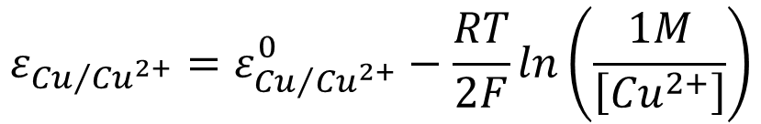



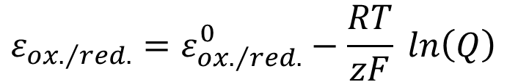
General form of the Nernst equation
The form of the Nernst equation valid for all types of electrodes:
The half-cell reaction is always in the direction of reduction, e.g.:
The reaction quotient:
For the copper electrode, according to the rules of the solid-liquid equilibria:
$$ε_{{ox.}/{red.}}=ε_{{ox.}/{red.}}^{0}−\frac{RT}{zF} ln\left(Q\right)$$
$$Q=\frac{\left[red.\right]}{\left[{ox.}^{z+}\right]}$$
$${ox.}^{z+}+ze^{−}=red.$$
$${Cu}_{(aq.)}^{2+}+2e^{−}={Cu}_{(s)}$$
$$ε_{{Cu}/{{Cu}^{2+}}}=ε_{{Cu}/{{Cu}^{2+}}}^{0}−\frac{RT}{2F}ln\left(\frac{1M}{\left[{Cu}^{2+}\right]}\right)$$
$$Q=\frac{1M}{\left[{Cu}^{2+}\right]}$$

Slide 21


Nernst equation for redox electrodes
In case of the so-called redox electrodes, the metal (a noble metal like platinum) is immersed in a solution, in which both the reduced and oxidized forms of the half reaction ions are present in a dissolved state. E.g., a solution containing both iron(II) and iron(III) ions.
$$Q=\frac{\left[{Fe}^{2+}\right]}{\left[{Fe}^{3+}\right]}$$
$${Fe}_{(aq.)}^{3+}+e^{−}={Fe}_{(aq.)}^{2+}$$
$$ε_{{{Fe}^{3+}}/{{Fe}^{2+}}}=ε_{{{Fe}^{3+}}/{{Fe}^{2+}}}^{0}−\frac{RT}{F} ln\left(\frac{\left[{Fe}^{2+}\right]}{\left[{Fe}^{3+}\right]}\right)=ε_{{{Fe}^{3+}}/{{Fe}^{2+}}}^{0}+\frac{RT}{F} ln\left(\frac{\left[{Fe}^{3+}\right]}{\left[{Fe}^{2+}\right]}\right)$$

Slide 22
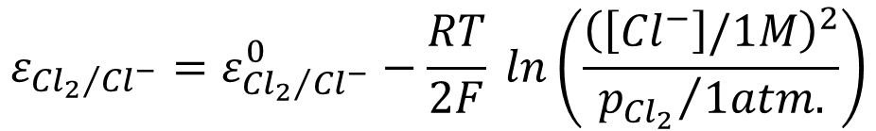


Nernst equation for gas electrodes
What different phases, like one form is dissolved and the other is in a gaseous state? What will the potential be?
For example, the chlorine electrode, in which a platinum plate is immersed in a solution containing dissolved chloride ions and chlorine gas is bubbled through it.
The half reaction:
The reaction quotient:
The potential of the electrode depends not only on the second power of the concentration of chloride ions, but also on the partial pressure of chlorine gas.
$${Cl}_{2(g)}+{2e}^{−}={2Cl}_{(aq.)}^{−}$$
$$ε_{{{Cl}_{2}}/{{Cl}^{−}}}=ε_{{{Cl}_{2}}/{{Cl}^{−}}}^{0}−\frac{RT}{2F} ln\left(\frac{{\left(\left[{Cl}^{−}\right]/1M\right)}^{2}}{{p_{{Cl}_{2}}}/{1atm.}}\right)$$
$$Q=\frac{{\left(\left[{Cl}^{−}\right]/1M\right)}^{2}}{{p_{{Cl}_{2}}}/{1atm.}}$$

Slide 23
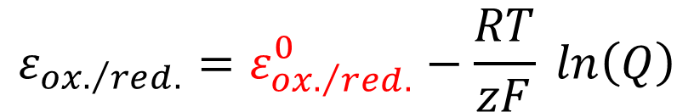
Standard electrode potential
What about the constant characteristic for the type of the electrode it the Nernst equation? It is the standard electrode potential.
To understand it, one needs to go back to the definition of electrode potential:
electrode potential: (sign: ε; unit: 1 V) the potential difference between the electron conductor and the ion conductor, i.e., the metal and the solution. It cannot be measured directly, it has no natural zero point. Its value corresponds to the cell potential of the electrochemical cell whose anode is the standard hydrogen electrode in equilibrium, and the cathode is the electrode with the potential studied.
$$ε_{{ox.}/{red.}}=ε_{{ox.}/{red.}}^{0}−\frac{RT}{zF} ln\left(Q\right)$$

Slide 24
Standard hydrogen electrode - SHE
standard hydrogen electrode:
arbitrarily chosen reference electrode for the electrode potential. In it, a platinum plate is immersed in a solution, in which the activity of hydrogen ions is 1 mol/dm³, and hydrogen gas, at a pressure of 1 atm, is bubbled through the solution..
Pt
H₂ p = 1atm
2H⁺_{(aq)} + 2e⁻ = H_{2(g)}
half-cell reaction
[H⁺]= 1 mol/dm³
The potential of the standard hydrogen electrode is, by definition, zero!

Slide 25
Nernst equation for metal-insoluble salt electrodes
One has to mention one more important type of electrodes, because in the case of the electrodes discussed so far, the electrode potential is different when the electrode is in equilibrium, i.e., no current flows through it, so during a unit of time, the half-cell reaction goes both directions at the same speed and when current flows through it, i.e., the equilibrium shifts in one or other direction.
This is called that the electrodes are polarized. The cell potential measured in this way "during work" is not equal to the difference between the equilibrium potentials, which is called the electromotive force of the cell!
electromotive force: (sign: E_{MF}; unit: 1 V) is the cell potential that can be measured, when no current flows through the cell. Its sign is always positive, since E_{MF} = ε_{cathode} - ε_{anode} > 0.

Slide 26
Nernst equation for metal-insoluble salt electrodes
However, one often needs to know how the potential of an electrode changes during it "does work". This can only be measured if one of the two electrodes is polarized, i.e., potential changes due to the current flowing through it.
This problem is solved by the use of:
metal-insoluble salt electrodes: an electrode, in which the metallic conductor is immersed in a solution that contains its own ions in the form of a poorly soluble salt. In the solution, in addition to the solid form of the poorly soluble salt, a well-soluble salt, whose anion matches the poorly soluble salt is also present in a known concentration. The Nernst equation must be valid for the electrode potential.

Slide 27
Nernst equation for metal-insoluble salt electrodes
The two most commonly used such electrodes are the silver-silver chloride (Ag/AgCl)) and calomel (Hg/Hg₂Cl₂) electrodes.
In the Ag/AgCl electrode, a silver plate is immersed in a potassium chloride solution, to which solid silver chloride has been added. The concentration of potassium chloride is high, 0.1M, 1M or staurated solution (i.e., it may also contain solid KCl).
Added silver chloride saturates this solution. The solubility product is K_{sp}(AgCl)=1.77·10⁻¹⁰ is very low, so the concentration of the chloride ion in the KCl solution does not change due to saturation and hence, it can be entered in the solubility product.
The concentration of silver ions can be calculated from this.
$${\left[{Ag}^{+}\right]}/{1M}={K_{sp}\left(AgCl\right)}/{\left({\left[{Cl}^{−}\right]}/{1M}\right)}$$

Slide 28
Nernst equation for metal-insoluble salt electrodes
Substituting this into the Nernst equation for the silver electrode:
According to the relationship obtained, the electrode potential is determined by the known KCl concentration!
In addition, the electrode is not polarized, because the current flowing through the electrode can neither enrich nor reduce the concentration of silver ions at the surface of the metal due to the presence of solid AgCl(s), because the excess of silver ions precipitates in the form of AgCl(s), and if silver ion concentration decreases, the dissolution of AgCl(s) begins.
The amounts in the above processes are so small that the chloride ion concentration practically does not change, so the concentration of the silver ions, i.e., the electrode potential, is constant.
$$ε_{{Ag}/{{Ag}^{+}}}=ε_{{Ag}/{{Ag}^{+}}}^{0}+\frac{RT}{F} ln\left(\frac{\left[{Ag}^{+}\right]}{1M}\right)=ε_{{Ag}/{{Ag}^{+}}}^{0}+\frac{RT}{F} ln\left(\frac{K_{sp}\left(AgCl\right)}{\left({\left[{Cl}^{−}\right]}/{1M}\right)}\right)$$

Slide 29
Combined glass electrode
Everyone, who works in a lab will probably meet with the combined glass electrode.
KCl_{(l)}
AgCl_{(s)}
solution to be studied
Ag_{(s)}
sintered glass
+
+
+
+
+
+
pH_{buffer} < pH_{solution}
[H⁺]_{buffer} > [H⁺]_{solution}
buffer
+
+
+
+
+
+
+
+
+
+
+
+
+

Slide 30
Cell diagrams
Left side - anode
Right side - cathode
diffusion/liquid junction potential applies
interface
interface
no diffusion/liquid junction potential
Zn
[Zn²⁺]=1M
[Cu²⁺]=1M
Cu
metal
conductor
ion
conductor
border of
solutions
ion
conductor
metal
conductor

Slide 31
Cell diagrams
[Fe²⁺]=0.2M
Pt
c_{KCl}=1M
AgCl_{(s)}
Ag
[Fe³⁺]=0.7M
[Cl⁻]=0.2M
Pt
H_{2(g)}
[H⁺]=1M
[ClO⁻]=0.1M
Pt
[H⁺]=2·10⁻¹³M
p=1atm
SHE
$${ClO}^{−}+H_{2}O+2e^{−}={Cl}^{−}+2{OH}^{−}$$

Slide 32

Electric work and direction of redox reactions
With the help of galvanic cells, one can generate an electric voltage, the resulting current can perform work, for which the necessary energy is provided by the redox reaction taking place in the cell.
The maximum work can be calculated from electromotive force of the cell:
The electromotive force is the difference of the cathode and anode potential:
Which also gives the direction of the reaction, because reduction occurs at the cathode with a higher potential, while oxidation occurs at the anode with a lower potential.
Accordingly, knowing the half-reactions occurred and their standard electrode potentials, it is possible to decide in which direction the reaction takes place!
$$w=−zF∙E_{MF}<0$$
$$E_{MF}=ε_{cathode}−ε_{anode}>0$$

Slide 33







Electric work and direction of redox reactions
For example, dissolution of metals in solutions of strong mineral acids.
$${2H}^{+}+2e^{−}=H_{2} ε_{SHE}^{o}=0.00V$$
$$M^{k+}+ke^{−}=M{ ε}_{M/{M^{k+}}}^{o}= ?V$$
$$ε_{{Na}/{{Na}^{+}}}^{o}=−2.713V$$
It produces hydrogen quickly from water.
$$ε_{{Zn}/{{Zn}^{2+}}}^{o}=−0.763V$$
It produces hydrogen from dilute, weak acids.
$$ε_{{Fe}/{{Fe}^{2+}}}^{o}=−0.44V$$
It produces hydrogen from medium-strength acids.
$$ε_{{Cu}/{{Cu}^{2+}}}^{o}=+0.34V$$
It does not react with concentrated acids.
$$ε_{{Pt}/{{Pt}^{2+}}}^{o}=+1.2V$$
Inert metal in the electrodes.
$$ε_{{Au}/{{Au}^{3+}}}^{o}=+1.42V$$
It is one of the most difficult metals to dissolve.

Slide 34
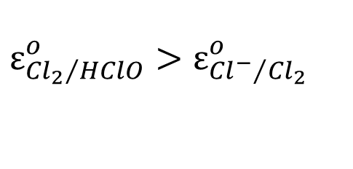
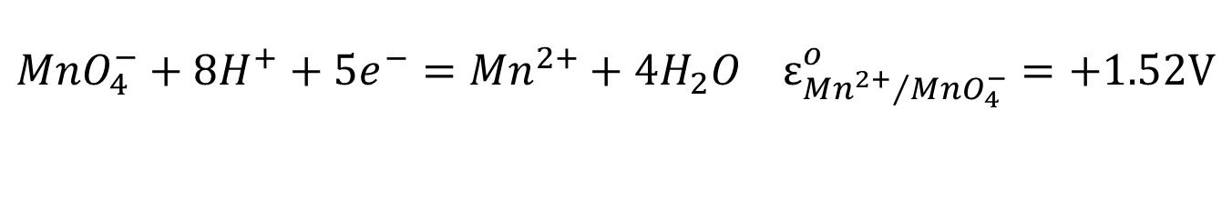
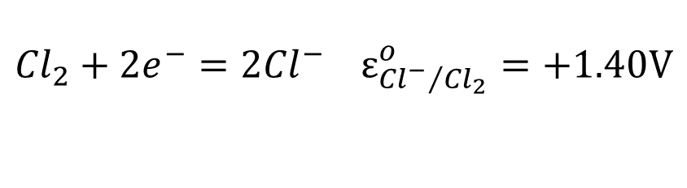
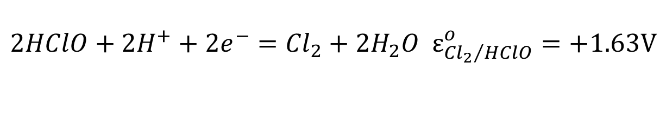
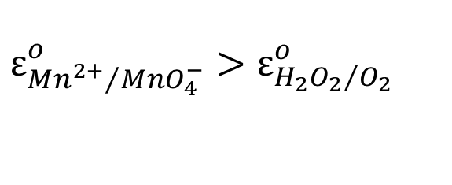
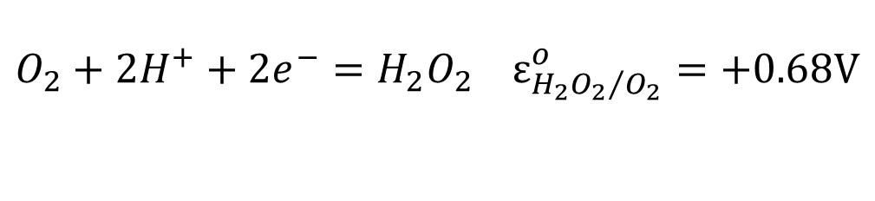
Electric work and direction of redox reactions
Let's look at two already known redox reactions!
$${MnO}_{4}^{−}+8H^{+}+5e^{−}={Mn}^{2+}+4H_{2}O ε_{{{Mn}^{2+}}/{{MnO}_{4}^{−}}}^{o}=+1.52V$$
$$O_{2}+2H^{+}+2e^{−}=H_{2}O_{2} ε_{{{H_{2}O}_{2}}/{O_{2}}}^{o}=+0.68V$$
$$ε_{{{Mn}^{2+}}/{{MnO}_{4}^{−}}}^{o}>ε_{{{H_{2}O}_{2}}/{O_{2}}}^{o}$$
The permanganate is the cathodic half-reaction, the peroxide is the anodic half-reaction, i.e., the permanganate ion is reduced, while the peroxide is oxidized.
$$2HClO+{2H}^{+}+2e^{−}={Cl}_{2}+2H_{2}O ε_{{{Cl}_{2}}/{HClO}}^{o}=+1.63V$$
$${Cl}_{2}+2e^{−}=2{Cl}^{−} ε_{{{Cl}^{−}}/{{Cl}_{2}}}^{o}=+1.40V$$
$$ε_{{{Cl}_{2}}/{HClO}}^{o}>ε_{{{Cl}^{−}}/{{Cl}_{2}}}^{o}$$
Both half-reactions take place in the direction of chlorine evolution!
Do not pour Hypo (NaOCl) and hydrochloric acid (HCl) into the toilet at the same time!

Slide 35
Galvanic/voltaic cells
The appearance of the galvanic cells used today was preceded by a long development of the technical design of the electrodes.
The first portable batteries appeared by gelling electrolytes. For the longest time (from 1870), the so-called Lechlanché cell was used.
In the longer-life alkaline cell, the electrolyte was changed to KOH (from 1950).
In lithium-batteries, anode is Li metal and the cathode consists of FeS₂, I₂ and (CF)_{n}. They are lighter and provide higher charge density.
...and the product developments did not stop!
copper
graphite
MnO₂
Gelled
NH₄Cl,
ZnCl₂
zinc

Slide 36
Batteries
In recent decades, it has been one of the areas showing the greatest development - also due to the appearance of portable electronic devices!
Historical overview of only the most important steps:
  lead-acid battery - the first battery that can be used in everyday practice, and even today most of them are produced - it is heavy, polluting, but it is durable and can be well-loaded. The largest market is the traditional car manufacturing industry.
  NiCd battery - anode: metal cadmium, cathode: Ni(III)OOH, the electrolyte is KOH - can be recharged many times, the charge barely "leaks" from it, but it is expensive, has a lower charge density, the "memory effect" is known (charging when not fully discharged, the battery "notices" that its full capacity has not been used and this leads to a voltage drop)!
  NiMH batteries - cadmium is replaced by a hydrogen binding alloy - have 2-3 times the capacity of NiCd, but the electrolyte "leakage" is more significant.
  Lithium-ion battery - lighter, higher charge density, no "memory effect", hardly "leaks", does not contain polluting components, and possesses high cell potential. Nevertheless, it can explode if overcharged, requires protective circuits and aging problems occur during storage.
  ...and the development is even faster than with galvanic cells!

Slide 37
Electrolysis
Redox reactions that do not take place spontaneously can be triggered by applying a suitable voltage. This is applied during charging the batteries! Such processes are called electrolysis.
Such procedures exist in chemical synthesis and industrial processes! E.g., production of metals, creation of metal or oxide coatings, production of NaOH and Cl₂ by electrolysis of NaCl, etc.
The laws describing the phenomenon are the so-called Faraday's laws:
  Faraday I. – the mass of the converted material is proportional to the charge passing through the electrolytic cell, i.e., m=k·Q, if the current is constant, m=k·I·t
  Faraday II. – the proportionality factor can be calculated from the molecular (M)/atomic (A) mass of the substance involved in the transformation, the change in electron number (z) and the Faraday constant as:
  k = M/zF for molecules, and k = A/zF for atoms.

