Slide 1
General Chemistry
6. Chemical equilibria
Dr. István Szilágyi
Department of Physical Chemistry and Materials Science
2024.

Slide 2
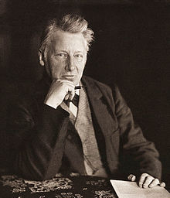
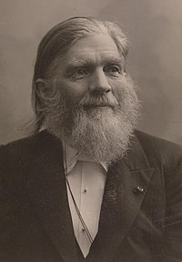
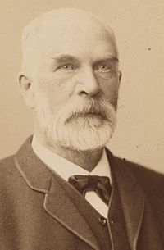
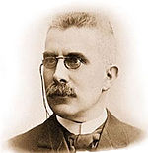
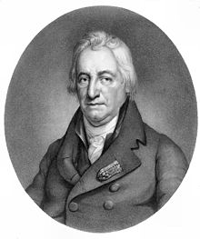
Chemical reactions
So far, it was assumed that chemical reactions take place in one way and are completely transformed into products.
However, opposite experiences were observed!
  C.L. Bertolett → 1803 Two-ways reactions exist!
  C.M. Guldberg és P. Waage → 1865 The law of mass action is created explaining equilibrium on the basis of reaction rates, and introduce the equilibrium constant!
  J.H. van’t Hoff → 1884 He gave a relation for the temperature dependence of the equilibrium constant.
  H.L. Le Chatelier →1884 Development of a general principle on the effect of experimental factors on equilibrium processes.
H.L. Le Chatelier
J.H. van’t Hoff
P.Waage
C.M.Guldberg
C. L. Bertholett

Slide 3
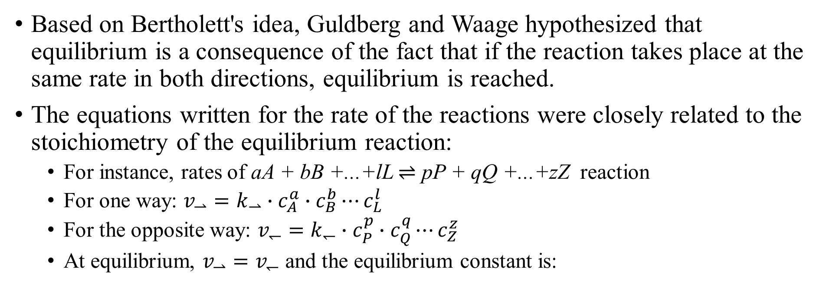
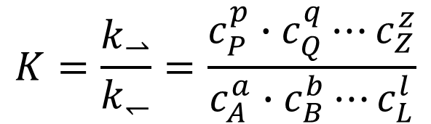
The law of mass action
Based on Bertholett's idea, Guldberg and Waage hypothesized that equilibrium is a consequence of the fact that if the reaction takes place at the same rate in both directions, equilibrium is reached.
The equations written for the rate of the reactions were closely related to the stoichiometry of the equilibrium reaction:
  For instance, rates of aA + bB +...+lL $⇌$ pP + qQ +...+zZ reaction
  For one way: $v_{⇀}=k_{⇀}∙c_{A}^{a}∙c_{B}^{b}⋯c_{L}^{l}$
  For the opposite way: $v_{↽}=k_{↽}∙c_{P}^{p}∙c_{Q}^{q}⋯c_{Z}^{z}$
  At equilibrium, $v_{⇀}=v_{↽}$ and the equilibrium constant is:
$$K=\frac{k_{⇀}}{k_{↽}}=\frac{c_{P}^{p}∙c_{Q}^{q}⋯c_{Z}^{z}}{c_{A}^{a}∙c_{B}^{b}⋯c_{L}^{l}}$$

Slide 4
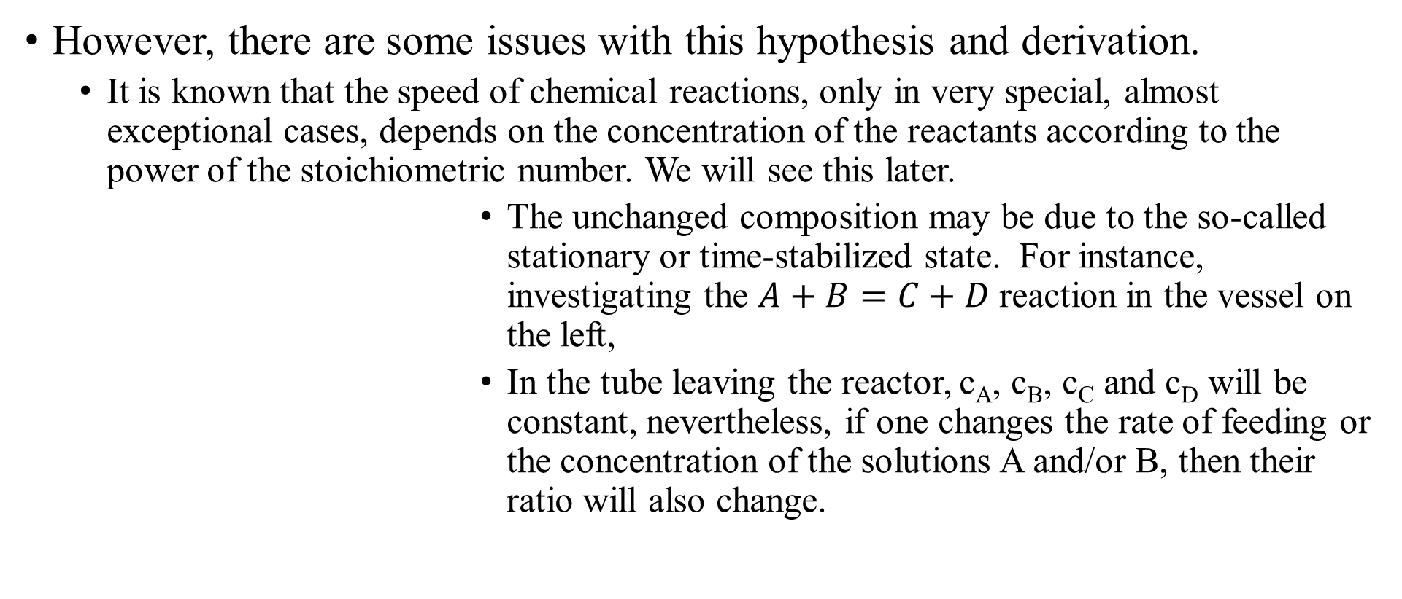

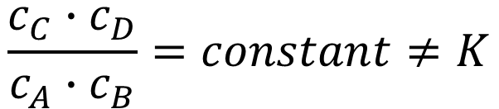
The law of mass action
However, there are some issues with this hypothesis and derivation.
  It is known that the speed of chemical reactions, only in very special, almost exceptional cases, depends on the concentration of the reactants according to the power of the stoichiometric number. We will see this later.
  The unchanged composition may be due to the so-called stationary or time-stabilized state. For instance, investigating the $A+B=C+D$ reaction in the vessel on the left,
  In the tube leaving the reactor, c_{A}, c_{B}, c_{C} and c_{D} will be constant, nevertheless, if one changes the rate of feeding or the concentration of the solutions A and/or B, then their ratio will also change.
A
B
$$\frac{c_{C}∙c_{D}}{c_{A}∙c_{B}}=constant≠K$$
$c_{A};c_{B};$ $c_{C};$ $c_{D} are measured$

Slide 5
The equilibrium constant
Considering the current state of chemistry, the state of equilibrium occurs due to the equalization of the chemical potential driving the processes. The discussion of chemical potential is the subject of physical chemistry courses. For those interested, the textbook recommended for this course also provides information.
The consequence of this thermodynamic interpretation is that the equilibrium constant is unitless, unlike in the case of the ones derived from the law of mass action.
Hence, note that the equilibrium constant can be defined in several ways, depending on the unit of the composition.

Slide 6
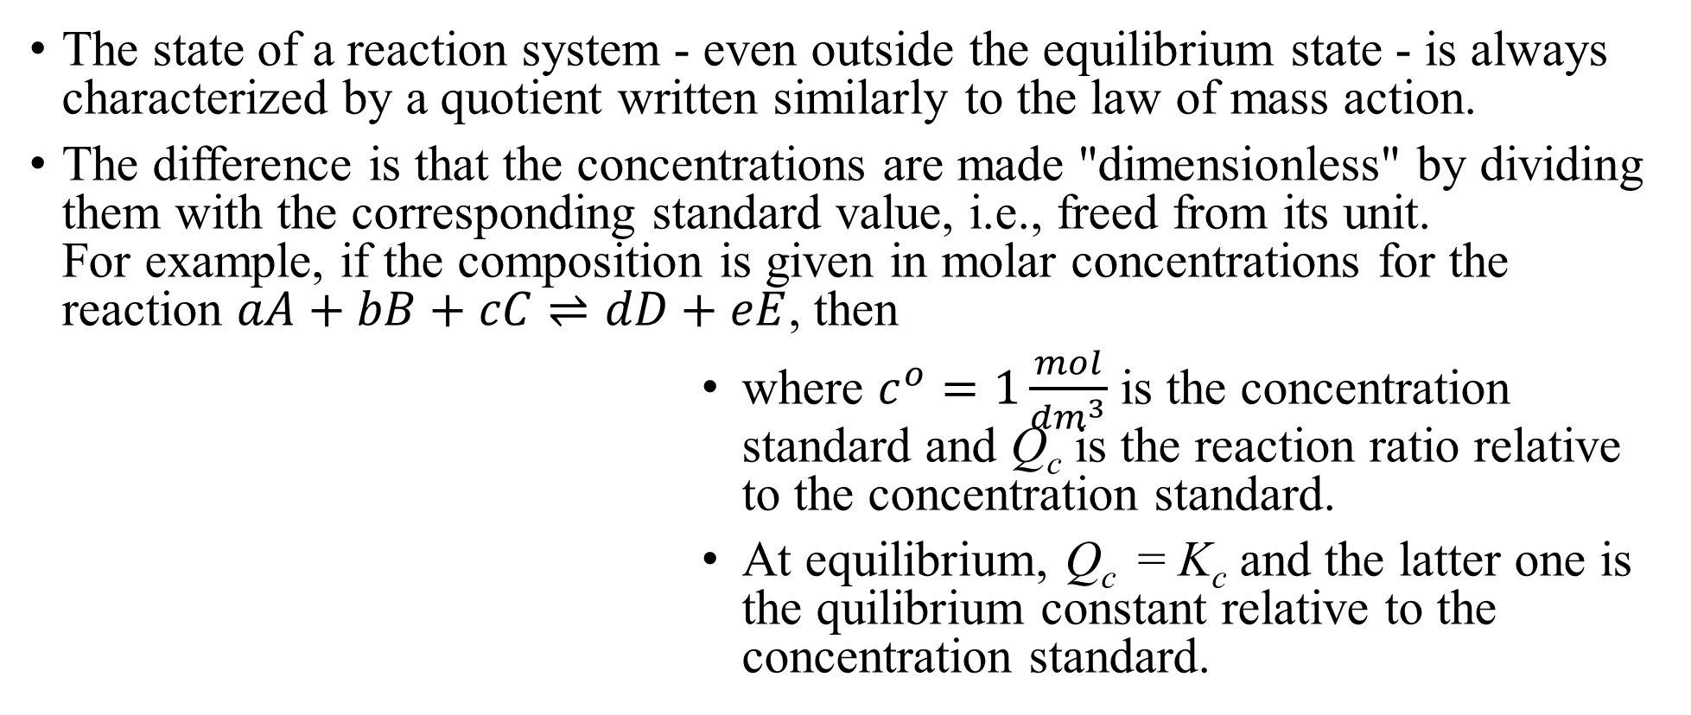

The reaction ratio
The state of a reaction system - even outside the equilibrium state - is always characterized by a quotient written similarly to the law of mass action.
The difference is that the concentrations are made "dimensionless" by dividing them with the corresponding standard value, i.e., freed from its unit.
For example, if the composition is given in molar concentrations for the reaction $aA+bB+cC⇌dD+eE$, then
where $c^{o}=1\frac{mol}{{dm}^{3}}$ is the concentration standard and Q_{c} is the reaction ratio relative to the concentration standard.
At equilibrium, Q_{c} = K_{c} and the latter one is the quilibrium constant relative to the concentration standard.
$$Q_{c}=\frac{{\left(\frac{c_{D}}{c^{o}}\right)}^{d}∙{\left(\frac{c_{E}}{c^{o}}\right)}^{e}}{{\left(\frac{c_{A}}{c^{o}}\right)}^{a}∙{\left(\frac{c_{B}}{c^{o}}\right)}^{b}∙{\left(\frac{c_{C}}{c^{o}}\right)}^{c}}$$

Slide 7
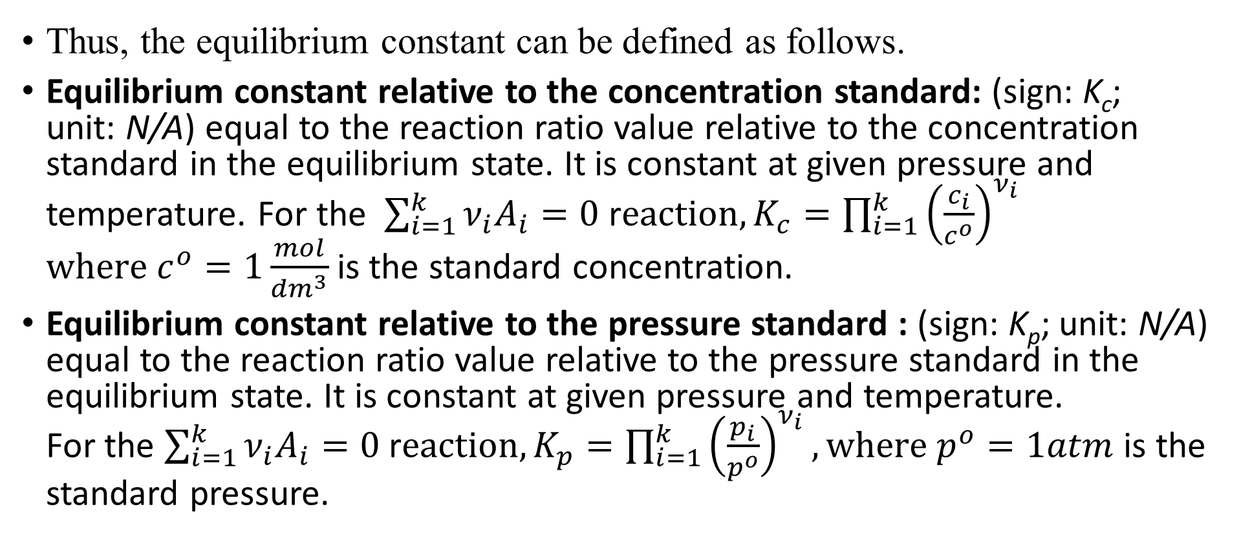
The equilibrium constant
Thus, the equilibrium constant can be defined as follows.
Equilibrium constant relative to the concentration standard: (sign: K_{c}; unit: N/A) equal to the reaction ratio value relative to the concentration standard in the equilibrium state. It is constant at given pressure and temperature. For the $\sum_{i=1}^{k}{{ν_{i}A}_{i}=0 }$r$eaction, K_{c}=\prod_{i=1}^{k}{{\left(\frac{c_{i}}{c^{o}}\right)}^{ν_{i}}}$
$where c^{o}=1\frac{mol}{{dm}^{3}}$is the standard concentration.
Equilibrium constant relative to the pressure standard : (sign: K_{p}; unit: N/A) equal to the reaction ratio value relative to the pressure standard in the equilibrium state. It is constant at given pressure and temperature.
For the $\sum_{i=1}^{k}{{ν_{i}A}_{i}=0 }$r$eaction, K_{p}=\prod_{i=1}^{k}{{\left(\frac{p_{i}}{p^{o}}\right)}^{ν_{i}}}, where p^{o}=1atm$ is the standard pressure.

Slide 8




Effect of components on the equilibrium
Student laboratory exercises worldwide include the investigation of the dissociation equilibrium of iron(III) cyanide:
${Fe\left(SCN\right)}_{3(aq)}⇌{Fe}_{(aq)}^{3+}+3 {SCN}_{(aq)}^{−}$
red yellow colorless
$${FeCl}_{3(s)}$$
$$+{KSCN}_{(s)}$$
$$+{Hg\left({NO}_{3}\right)}_{2(aq)}$$
$$+{NaF}_{(aq)}$$

Slide 9
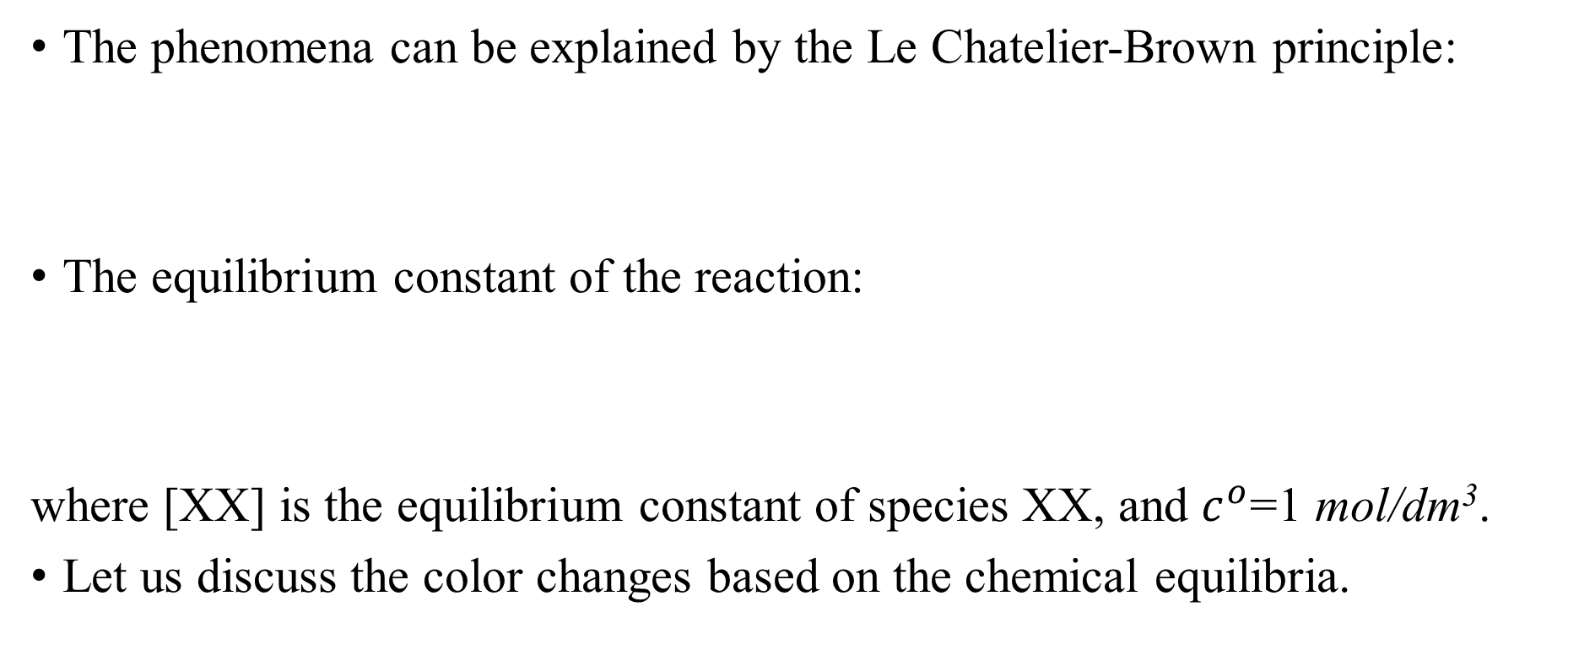
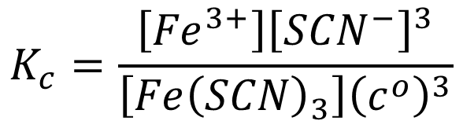
Effect of components on the equilibrium
The phenomena can be explained by the Le Chatelier-Brown principle:
The equilibrium constant of the reaction:
where [XX] is the equilibrium constant of species XX, and $c^{o}$=1 mol/dm³.
Let us discuss the color changes based on the chemical equilibria.
$${Fe\left(SCN\right)}_{3(aq)}⇌{Fe}_{(aq)}^{3+}+3{SCN}_{(aq)}^{−}$$
$$K_{c}=\frac{\left[{Fe}^{3+}\right]{\left[{SCN}^{−}\right]}^{3}}{\left[{Fe\left(SCN\right)}_{3}\right]{\left(c^{o}\right)}^{3}}$$

Slide 10

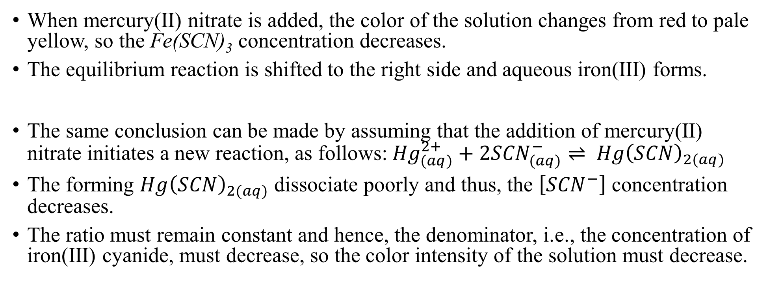


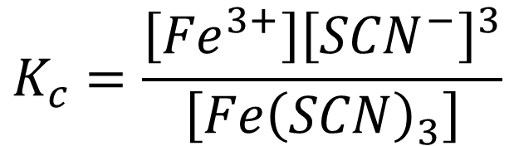
Effect of components on the equilibrium
When mercury(II) nitrate is added, the color of the solution changes from red to pale yellow, so the Fe(SCN)₃ concentration decreases.
The equilibrium reaction is shifted to the right side and aqueous iron(III) forms.
The same conclusion can be made by assuming that the addition of mercury(II) nitrate initiates a new reaction, as follows:${Hg}_{(aq)}^{2+}+2{SCN}_{(aq)}^{−}⇌ {Hg\left(SCN\right)}_{2(aq)}$
The forming ${Hg\left(SCN\right)}_{2(aq)}$ dissociate poorly and thus, the $\left[{SCN}^{−}\right]$ concentration decreases.
The ratio must remain constant and hence, the denominator, i.e., the concentration of iron(III) cyanide, must decrease, so the color intensity of the solution must decrease.
$$⇀$$
$${Fe\left(SCN\right)}_{3(aq)}⇌{Fe}_{(aq)}^{3+}+3{SCN}_{(aq)}^{−}$$
$$K_{c}=\frac{\left[{Fe}^{3+}\right]{\left[{SCN}^{−}\right]}^{3}}{\left[{Fe\left(SCN\right)}_{3}\right]}$$
$$↓$$
$$↓$$

Slide 11

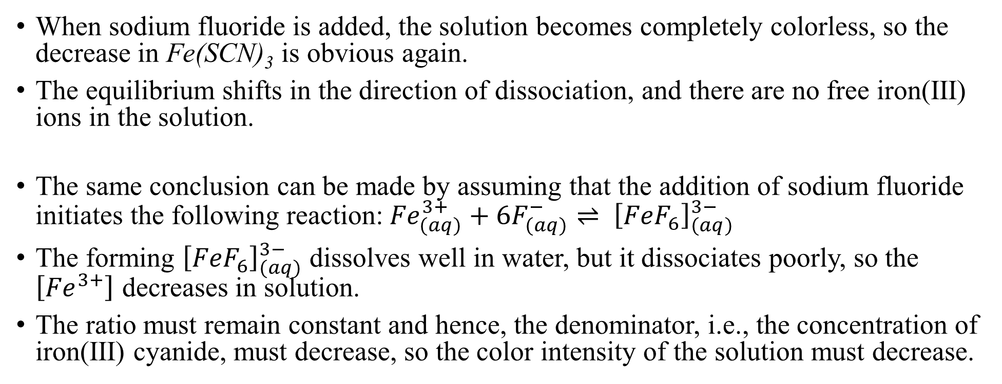


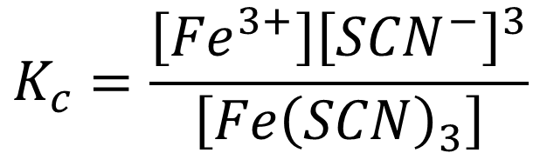
Effect of components on the equilibrium
When sodium fluoride is added, the solution becomes completely colorless, so the decrease in Fe(SCN)₃ is obvious again.
The equilibrium shifts in the direction of dissociation, and there are no free iron(III) ions in the solution.
The same conclusion can be made by assuming that the addition of sodium fluoride initiates the following reaction:${Fe}_{(aq)}^{3+}+6F_{(aq)}^{−}⇌ {\left[{FeF}_{6}\right]}_{(aq)}^{3−}$
The forming ${\left[{FeF}_{6}\right]}_{(aq)}^{3−}$ dissolves well in water, but it dissociates poorly, so the $\left[{Fe}^{3+}\right]$ decreases in solution.
The ratio must remain constant and hence, the denominator, i.e., the concentration of iron(III) cyanide, must decrease, so the color intensity of the solution must decrease.
$$⇀$$
$${Fe\left(SCN\right)}_{3(aq)}⇌{Fe}_{(aq)}^{3+}+3{SCN}_{(aq)}^{−}$$
$$↓$$
$$K_{c}=\frac{\left[{Fe}^{3+}\right]{\left[{SCN}^{−}\right]}^{3}}{\left[{Fe\left(SCN\right)}_{3}\right]}$$
$$↓$$

Slide 12
Development in equilibrium chemistry
A crucial milestone was in the 19th century that Le Chatelier stated his principle about factors influencing equilibrium:
Le Chatelier-Braun principle: if a system in equilibrium changes due to an external effect (change in pressure, temperature, concentration of components), then among the processes taking place in the system, those that reduce the result of the external effect predominate.
The theory of equilibrium was significantly the addressed in the 20th century as a result of an industrial problem, as follows.
The industrial and the military processes used more and more explosives, but nitric acid came almost exclusively from the mining of Chilean saltpeter (NaNO₃), even though nitrogen in the air was freely available everywhere.

Slide 13
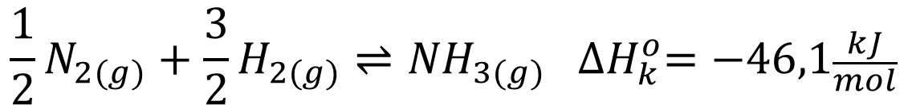
Development in equilibrium chemistry
The oxidation of ammonia to nitric acid on an industrial scale had already been available since 1902, but the industrial synthesis of its raw material, ammonia, had not been solved..
Fritz Haber in Germany studied the direct reaction of nitrogen and hydrogen, leading to equilibrium at high pressure, on a catalyst made of iron instead of the previously applied nickel, and clarified the reaction parameters in a scientific level.
According to the Le Chatelier-Brown principle, increasing the partial pressure of hydrogen or nitrogen increases the partial pressure of ammonia in the equilibrium mixture.
$${\frac{1}{2}N}_{2(g)}+\frac{3}{2}H_{2(g)}⇌{NH}_{3(g)} {∆H}_{k}^{o}=−46,1\frac{kJ}{mol}$$

Slide 14
Haber-Bosch process
The reaction results in one mole of ammonia from two moles of a stoichiometric gas mixture, i.e., it involves a pressure drop if it is carried out at a constant volume. In other words, if the total pressure of the system is increased, ammonia formation comes to the fore owing to the Le Chatelier-Brown principle. Thus, the equilibrium shifts towards the direction of product formation.
How does the change in temperature affect the reaction?
The formation enthalpy of ammonia is negative, i.e., the system releases energy. If one heats the system, the process that absorbs the supplied heat must come to the fore, i.e. the balance shifts towards the decomposition of ammonia.
$$if p_{total} increases, the product formation is favourable$$
$${1/2N}_{2(g)}+3/2H_{2(g)}⇌{NH}_{3(g)} {∆H}_{k}^{o}=−46.1{kJ}/{mol}$$
$$if T increases, the product decomposition is favourable$$

Slide 15
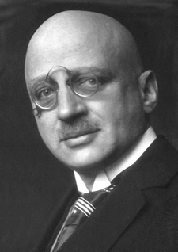
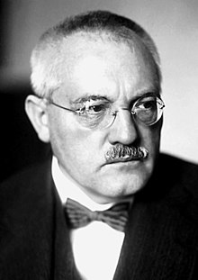
Haber-Bosch process
Haber contacted the German industry and BASF bought the rights/patents and commissioned Bosch to scale up the process to an industrial level.
They successfully found the pressure and temperature range, in which ammonia could be produced economically using hydrogen (produced from water vapor) and nitrogen (from the air).
They are considered the most influential chemists in the history of mankind, both of them received the Nobel Prize in chemistry.
NP-1918 NP-1931
Fritz Haber
Carl Bosch

Slide 16
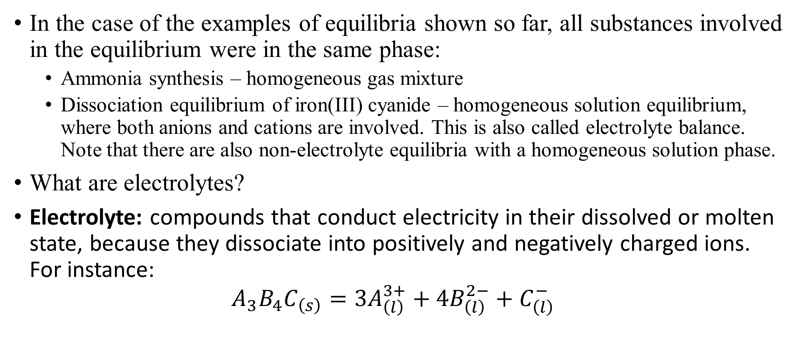
Classification of equilibria
6/11/2024
In the case of the examples of equilibria shown so far, all substances involved in the equilibrium were in the same phase:
  Ammonia synthesis – homogeneous gas mixture
  Dissociation equilibrium of iron(III) cyanide – homogeneous solution equilibrium, where both anions and cations are involved. This is also called electrolyte balance. Note that there are also non-electrolyte equilibria with a homogeneous solution phase.
What are electrolytes?
Electrolyte: compounds that conduct electricity in their dissolved or molten state, because they dissociate into positively and negatively charged ions.
For instance:
${A_{3}B_{4}C}_{\left(s\right)}=3A_{\left(l\right)}^{3+}+{4B}_{\left(l\right)}^{2−}+C_{\left(l\right)}^{−}$

Slide 17
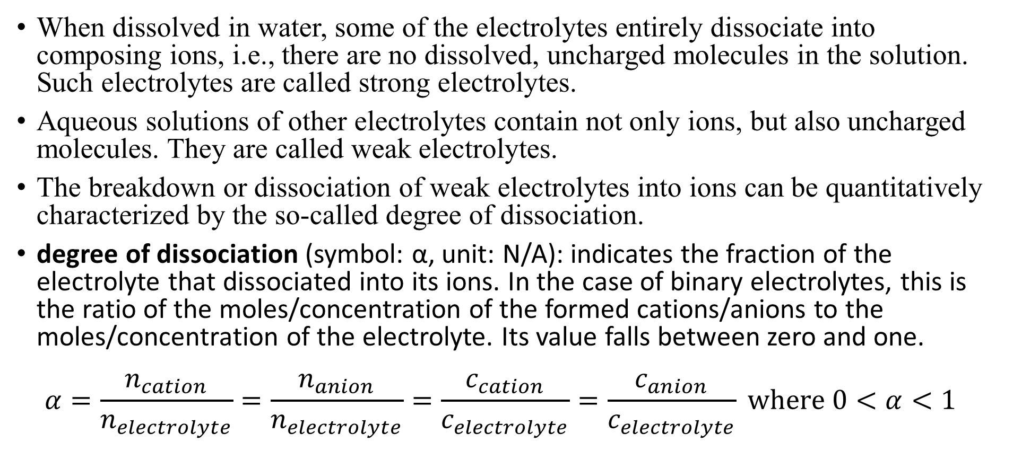
Electrolytes in aqueous solutions
When dissolved in water, some of the electrolytes entirely dissociate into composing ions, i.e., there are no dissolved, uncharged molecules in the solution. Such electrolytes are called strong electrolytes.
Aqueous solutions of other electrolytes contain not only ions, but also uncharged molecules. They are called weak electrolytes.
The breakdown or dissociation of weak electrolytes into ions can be quantitatively characterized by the so-called degree of dissociation.
degree of dissociation (symbol: α, unit: N/A): indicates the fraction of the electrolyte that dissociated into its ions. In the case of binary electrolytes, this is the ratio of the moles/concentration of the formed cations/anions to the moles/concentration of the electrolyte. Its value falls between zero and one.
$α=\frac{n_{cation}}{n_{electrolyte}}=\frac{n_{anion}}{n_{electrolyte}}=\frac{c_{cation}}{c_{electrolyte}}=\frac{c_{anion}}{c_{electrolyte}} where 0<α<1$

Slide 18
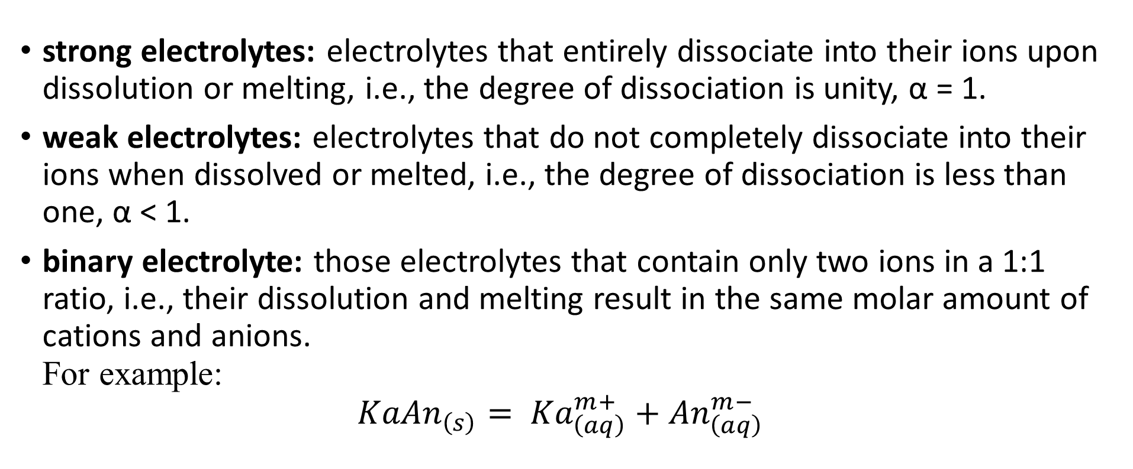
Electrolytes in aqueous solutions
strong electrolytes: electrolytes that entirely dissociate into their ions upon dissolution or melting, i.e., the degree of dissociation is unity, α = 1.
weak electrolytes: electrolytes that do not completely dissociate into their ions when dissolved or melted, i.e., the degree of dissociation is less than one, α < 1.
binary electrolyte: those electrolytes that contain only two ions in a 1:1 ratio, i.e., their dissolution and melting result in the same molar amount of cations and anions.
For example:
${KaAn}_{\left(s\right)}= {Ka}_{\left(aq\right)}^{m+}+{An}_{\left(aq\right)}^{m−}$

Slide 19
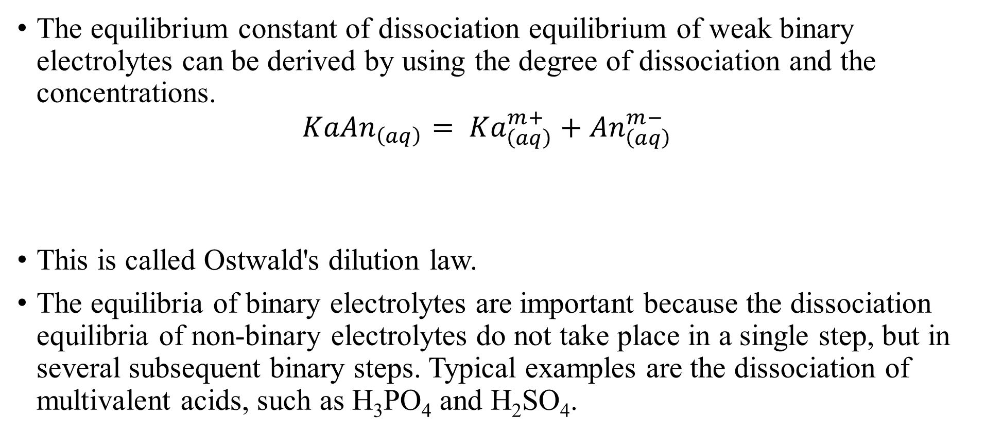
Electrolytes in aqueous solutions
The equilibrium constant of dissociation equilibrium of weak binary electrolytes can be derived by using the degree of dissociation and the concentrations.
${KaAn}_{\left(aq\right)}= {Ka}_{\left(aq\right)}^{m+}+{An}_{\left(aq\right)}^{m−}$
This is called Ostwald's dilution law.
The equilibria of binary electrolytes are important because the dissociation equilibria of non-binary electrolytes do not take place in a single step, but in several subsequent binary steps. Typical examples are the dissociation of multivalent acids, such as H₃PO₄ and H₂SO₄.
$$K_{c}=\frac{\left[{Ka}_{}^{m+}\right]∙\left[{An}_{}^{m−}\right]}{\left[KaAn\right]∙c^{o}}= \frac{αc∙αc}{\left(c−αc\right)∙c^{o}}=\frac{α^{2}c^{2}}{c\left(1−α\right)∙c^{o}}=\frac{α^{2}c^{}}{\left(1−α\right)∙c^{o}}$$

Slide 20
Electrolytes in aqueous solutions
Phosphoric acid dissolves well in water, but does not dissociate completely, it is a weak acid. Dissociation involves three steps according to the Brönstedt-Lowry theory:
The dissociation constant of all three steps can be measured, and the equilibrium solution contains not only bare phosphate ion, but also the partially protonated form of the other two.
$$H_{3}{PO}_{4(aq)}+H_{2}O_{(l)}⇌ H_{2}{PO}_{4(aq)}^{−}+H_{3}O_{\left(aq\right)}^{+} K_{1}=7.5∙{10}^{−3}$$
$$H_{2}{PO}_{4(aq)}^{−}+H_{2}O_{(l)}⇌ {HPO}_{4(aq)}^{2−}+H_{3}O_{(aq)}^{+} K_{2}=6.2∙{10}^{−8}$$
$${HPO}_{4(aq)}^{2−}+H_{2}O_{(l)}⇌ {PO}_{4(aq)}^{3−}+H_{3}O_{(aq)}^{+} K_{3}=2.2∙{10}^{−13}$$

Slide 21




n_{i}/∑n_{i}·100%
Undissociated phosphoric acid is only present in acidic solution.
100
$$H_{2}{PO}_{4}^{−}$$
$$H{PO}_{4}^{2−}$$
90
80
The phosphate ion, on the other hand, is only present in an alkaline solution.
$${PO}_{4}^{3−}$$
70
$$H_{3}{PO}_{4}$$
60
In moderately acidic solutions, the most abundant species is the dihydrogen phosphate.
50
40
30
20
In moderately alkaline solutions, the most abundant species is the hydrogen phosphate.
10
0
0.00
1.00
2.00
3.00
4.00
5.00
6.00
7.00
8.00
9.00
10.00
11.00
12.00
13.00
14.00
pH

Slide 22
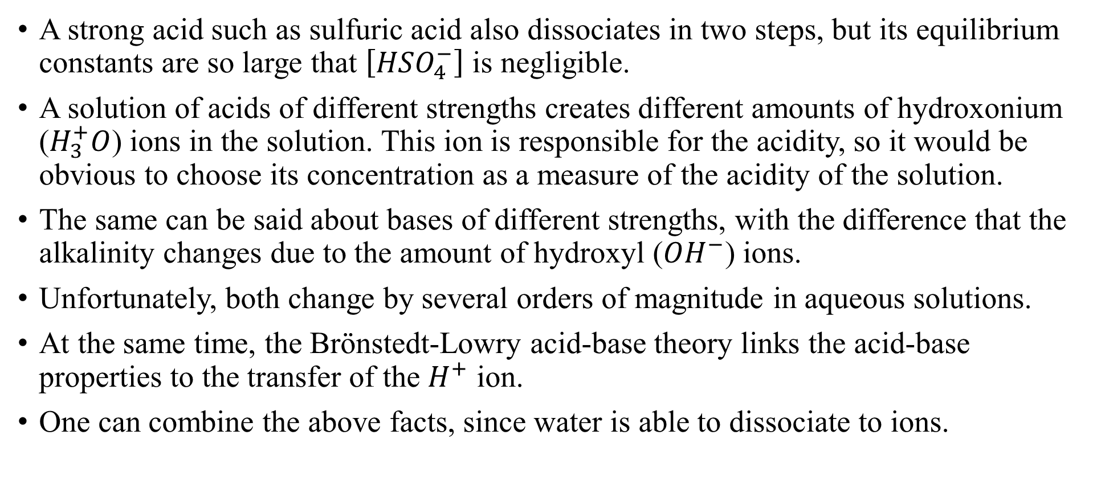
Electrolytes in aqueous solutions
A strong acid such as sulfuric acid also dissociates in two steps, but its equilibrium constants are so large that $\left[{HSO}_{4}^{−}\right]$ is negligible.
A solution of acids of different strengths creates different amounts of hydroxonium ($H_{3}^{+}O$) ions in the solution. This ion is responsible for the acidity, so it would be obvious to choose its concentration as a measure of the acidity of the solution.
The same can be said about bases of different strengths, with the difference that the alkalinity changes due to the amount of hydroxyl (${OH}^{−}$) ions.
Unfortunately, both change by several orders of magnitude in aqueous solutions.
At the same time, the Brönstedt-Lowry acid-base theory links the acid-base properties to the transfer of the $H^{+}$ ion.
One can combine the above facts, since water is able to dissociate to ions.

Slide 23
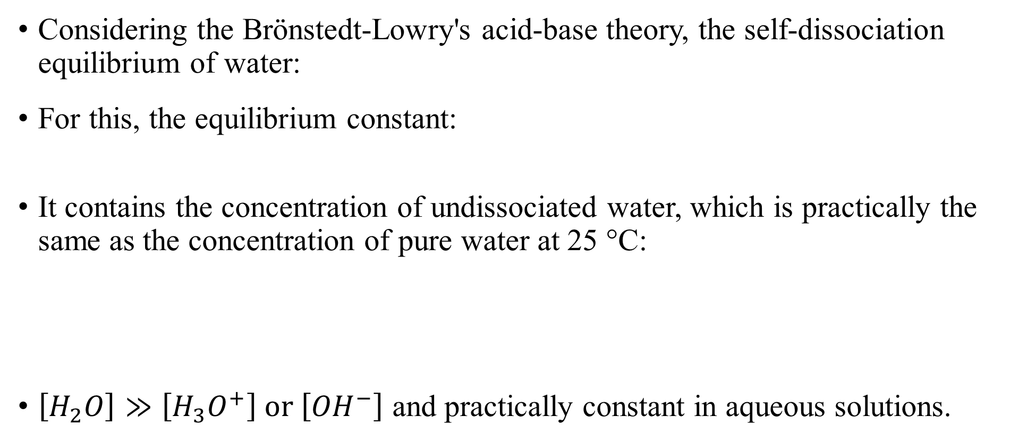
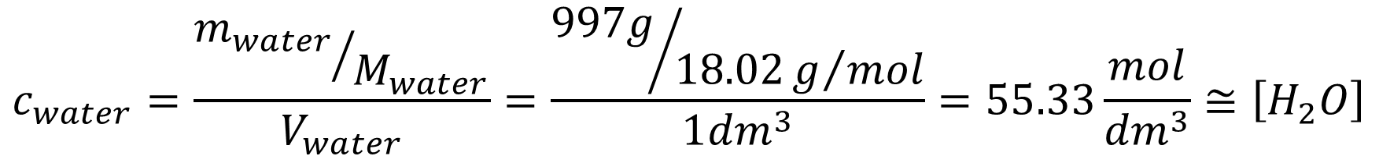
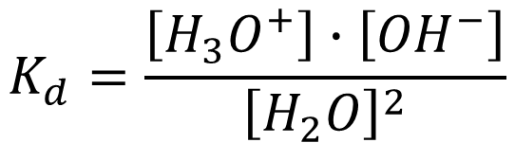

Self-dissociation of water
Considering the Brönstedt-Lowry's acid-base theory, the self-dissociation equilibrium of water:
For this, the equilibrium constant:
It contains the concentration of undissociated water, which is practically the same as the concentration of pure water at 25 °C:
$\left[H_{2}O\right]≫\left[H_{3}O^{+}\right] or \left[{OH}^{−}\right]$ and practically constant in aqueous solutions.
$$2H_{2}O_{(l)}⇌H_{3}O_{(aq)}^{+}+{OH}_{(aq)}^{−}$$
$$K_{d}=\frac{\left[H_{3}O^{+}\right]∙\left[{OH}^{−}\right]}{{\left[H_{2}O\right]}^{2}}$$
$$c_{water}=\frac{{m_{water}}/{M_{water}}}{V_{water}}=\frac{{997g}/{18.02g/{mol}}}{1{dm}^{3}}=55.33\frac{mol}{{dm}^{3}}≅\left[H_{2}O\right]$$

Slide 24
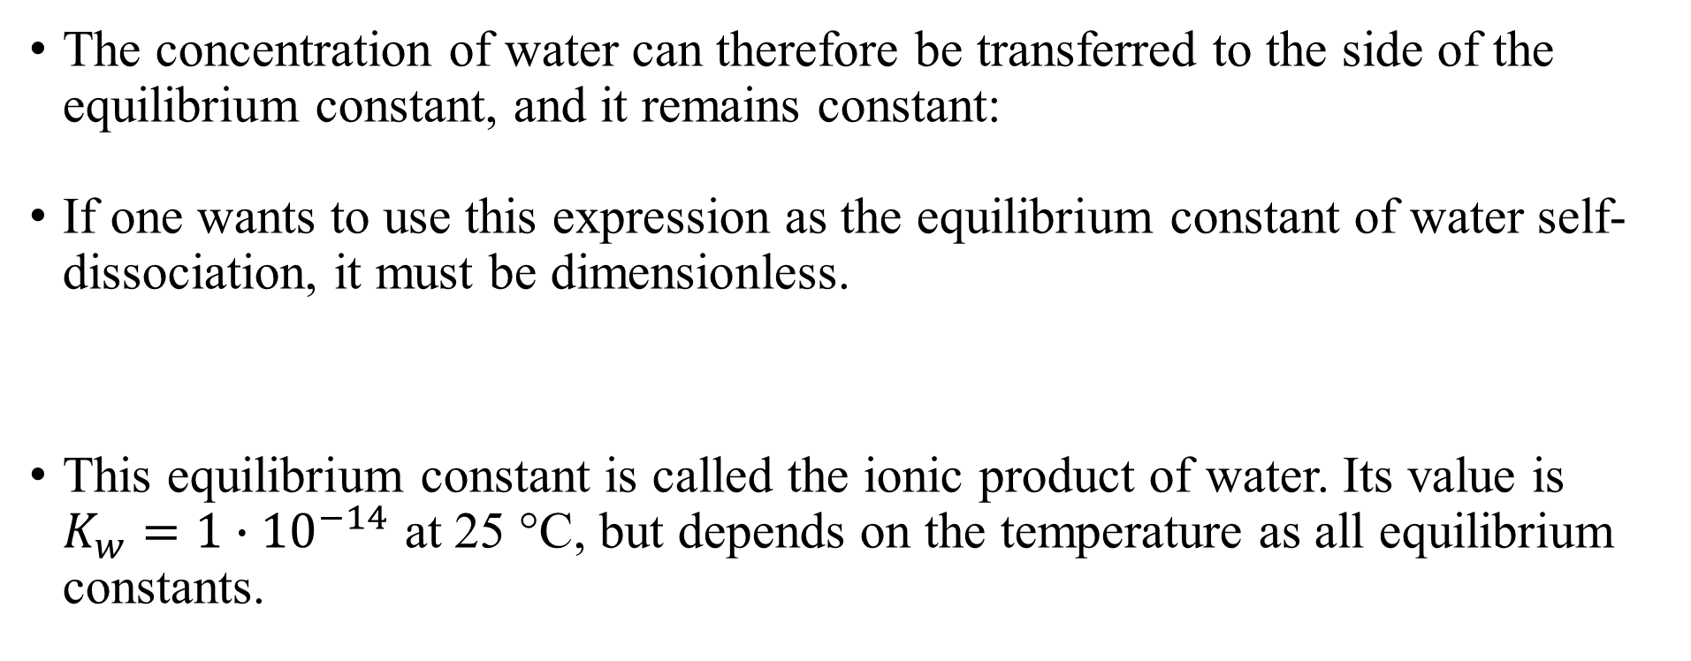
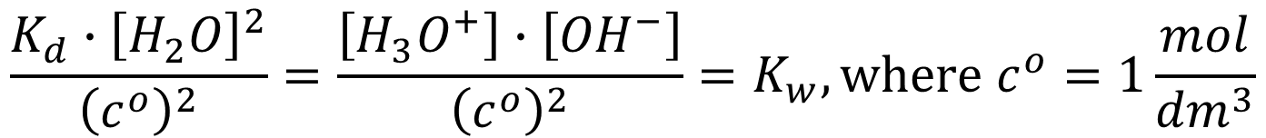
Ionic product of water - K_{w}
The concentration of water can therefore be transferred to the side of the equilibrium constant, and it remains constant:
If one wants to use this expression as the equilibrium constant of water self-dissociation, it must be dimensionless.
This equilibrium constant is called the ionic product of water. Its value is $K_{w}=1∙{10}^{−14}$ at 25 °C, but depends on the temperature as all equilibrium constants.
$$K_{d}∙{\left[H_{2}O\right]}^{2}=\left[H_{3}O^{+}\right]∙\left[{OH}^{−}\right]$$
$$\frac{K_{d}∙{\left[H_{2}O\right]}^{2}}{{\left(c^{o}\right)}^{2}}=\frac{\left[H_{3}O^{+}\right]∙\left[{OH}^{−}\right]}{{\left(c^{o}\right)}^{2}}=K_{w}, where c^{o}=1\frac{mol}{{dm}^{3}}$$

Slide 25
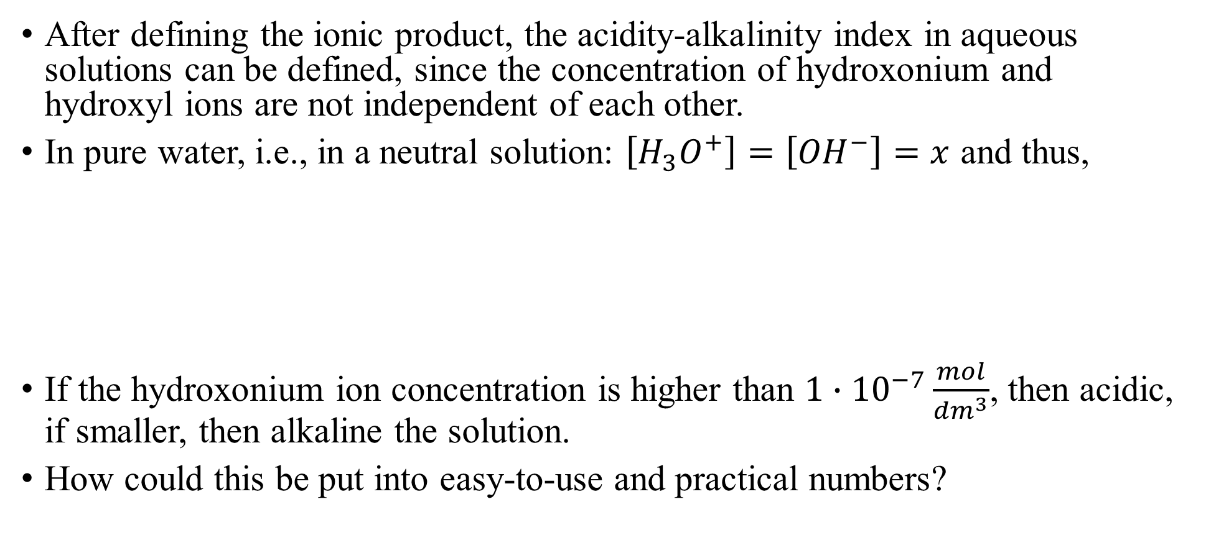
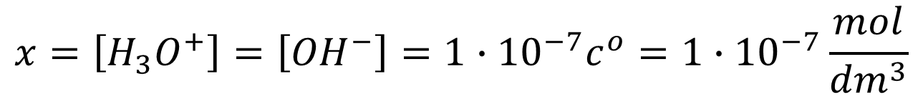
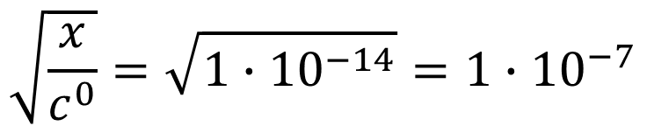
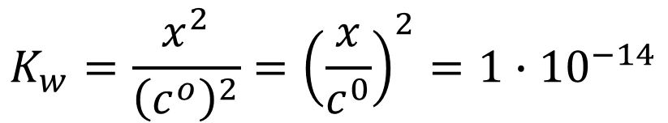
Indication of acidity-basicity by the pH
After defining the ionic product, the acidity-alkalinity index in aqueous solutions can be defined, since the concentration of hydroxonium and hydroxyl ions are not independent of each other.
In pure water, i.e., in a neutral solution: $\left[H_{3}O^{+}\right]=\left[{OH}^{−}\right]=x$ and thus,
If the hydroxonium ion concentration is higher than $1∙{10}^{−7}\frac{mol}{{dm}^{3}}$, then acidic, if smaller, then alkaline the solution.
How could this be put into easy-to-use and practical numbers?
$$K_{w}=\frac{x^{2}}{{\left(c^{o}\right)}^{2}}={\left(\frac{x}{c^{0}}\right)}^{2}=1∙{10}^{−14}$$
$$\sqrt{\frac{x}{c^{0}}}=\sqrt{1∙{10}^{−14}}=1∙{10}^{−7}$$
$$x=\left[H_{3}O^{+}\right]=\left[{OH}^{−}\right]=1∙{10}^{−7}c^{o}=1∙{10}^{−7}\frac{mol}{{dm}^{3}}$$

Slide 26
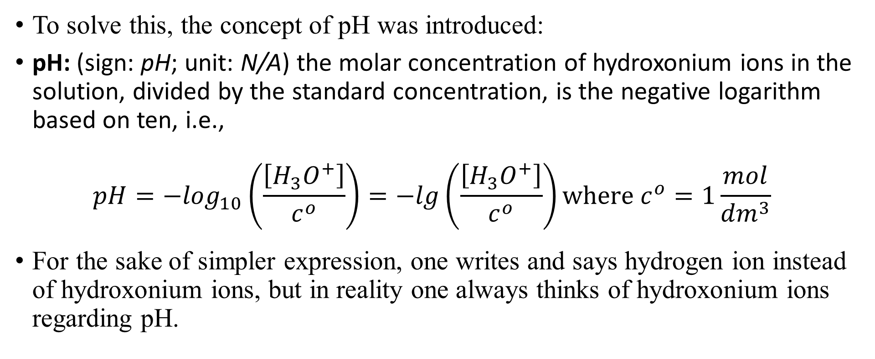
Indication of acidity-basicity by the pH
To solve this, the concept of pH was introduced:
pH: (sign: pH; unit: N/A) the molar concentration of hydroxonium ions in the solution, divided by the standard concentration, is the negative logarithm based on ten, i.e.,
$pH=−\log_{10}\left(\frac{\left[H_{3}O^{+}\right]}{c^{o}}\right)=−lg\left(\frac{\left[H_{3}O^{+}\right]}{c^{o}}\right)where c^{o}=1\frac{mol}{{dm}^{3}}$
For the sake of simpler expression, one writes and says hydrogen ion instead of hydroxonium ions, but in reality one always thinks of hydroxonium ions regarding pH.

Slide 27
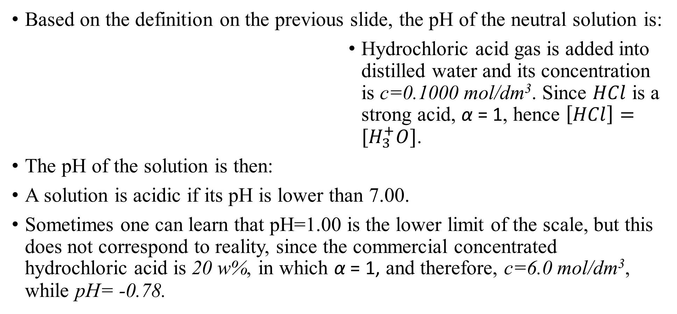
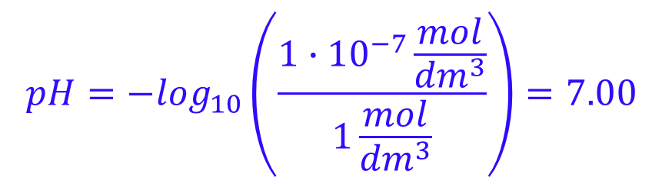
The pH of solutions
Based on the definition on the previous slide, the pH of the neutral solution is:
Hydrochloric acid gas is added into distilled water and its concentration is c=0.1000 mol/dm³. Since $HCl$ is a strong acid, α = 1, hence $\left[HCl\right]=[H_{3}^{+}O]$.
The pH of the solution is then:
A solution is acidic if its pH is lower than 7.00.
Sometimes one can learn that pH=1.00 is the lower limit of the scale, but this does not correspond to reality, since the commercial concentrated hydrochloric acid is 20 w%, in which α = 1, and therefore, c=6.0 mol/dm³, while pH= -0.78.
$$pH=−\log_{10}\left(\frac{1∙{10}^{−7}\frac{mol}{{dm}^{3}}}{1\frac{mol}{{dm}^{3}}}\right)=7.00$$
$${HCl}_{\left(g\right)}+H_{2}O_{(l)}=H_{3}O_{(aq)}^{+}+{Cl}_{(aq)}^{−}$$
$$pH=−\log_{10}\left(0.1000\right)=−\log_{10}\left(1∙{10}^{−1}\right)=1.00$$

Slide 28

The pH of solutions
Let's look at the alkaline side! Everyone knows sodium hydroxide, from which one makes c=0.1000mol/dm³ solution. It is a strong electrolyte, so 100% dissociation and hence, [OH⁻] = c=0.1000mol/dm³. The concentration of the hydroxonium ion can be calculated with the ionic product of water:
A solution with a pH higher than 7 is therefore alkaline.
The other end of the pH scale, pH=14, is sometime called as the upper limit of pH. Not true, because it is actually quite easy to prepare a solution with a higher pH. For example, 20w% NaOH solution, which is c=6.1mol/dm³, and pH=-log₁₀(1·10⁻¹⁴/6.1)=14.79.
$${\left[H_{3}O^{+}\right]}/{c^{o}}=\frac{K_{w}}{{\left[{OH}^{−}\right]}/{c^{o}}}=\frac{1∙{10}^{−14}}{0.1000}=1∙{10}^{−13} and \left[H_{3}O^{+}\right]=1∙{10}^{−13}\frac{mol}{{dm}^{3}}$$
$$pH=−\log_{10}\left(1∙{10}^{−13}\right)=13.00$$

Slide 29
The pH of solutions
One might think that the calculation is therefore simple in the case of strong electrolytes!
In the case of acids, the concentration of the hydroxonium ion can be calculated from the concentration of the measured acid, and from that the pH.
From the concentration of the strong base, the concentration of the hydroxyl ion, and from this, with the help of the ionic product, that of the hydroxonium ion, and from that the pH can be calculated.
If we mix a strong acid and a base, the pH of the solution is determined by which is left after the neutralization reaction, and this amount of acid/alkali should be treated as the acid/alkali measured in the entire volume.
Unfortunately, this is not true for solutions with very low concentrations!
Let's look at an example!

Slide 30
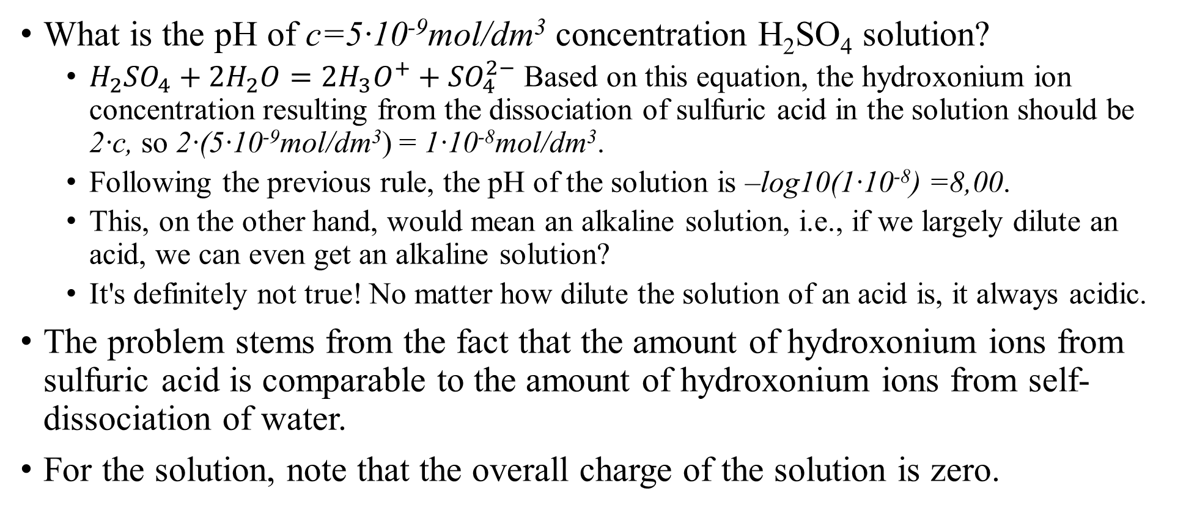
The pH of solutions
What is the pH of c=5·10⁻⁹mol/dm³ concentration H₂SO₄ solution?
  $H_{2}{SO}_{4}+2H_{2}O=2H_{3}O^{+}+{SO}_{4}^{2−}$ Based on this equation, the hydroxonium ion concentration resulting from the dissociation of sulfuric acid in the solution should be 2·c, so 2·(5·10⁻⁹mol/dm³) = 1·10⁻⁸mol/dm³.
  Following the previous rule, the pH of the solution is –log10(1·10⁻⁸) =8,00.
  This, on the other hand, would mean an alkaline solution, i.e., if we largely dilute an acid, we can even get an alkaline solution?
  It's definitely not true! No matter how dilute the solution of an acid is, it always acidic.
The problem stems from the fact that the amount of hydroxonium ions from sulfuric acid is comparable to the amount of hydroxonium ions from self-dissociation of water.
For the solution, note that the overall charge of the solution is zero.

Slide 31

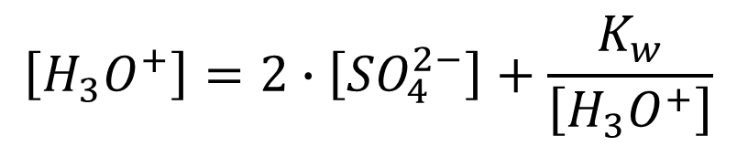
The pH of solutions
Due to the equality of charges, the charge of the hydroxonium ions in the solution, which comes partly from the dissolved strong acid and partly from the self-dissociation of water, must balance the charge of the anion of the strong acid and the hydroxyl ions resulting from the self-dissociation of water.
With the concentrations, one can express this in the following way:
By eliminating the concentration of the hydroxyl ion using the ionic product :
One obtains a quadratic equation for the concentration of hydroxonium ions.
$$\left[H_{3}O^{+}\right]=2∙\left[{SO}_{4}^{2−}\right]+\left[{OH}^{−}\right]$$
$$\left[H_{3}O^{+}\right]=2∙\left[{SO}_{4}^{2−}\right]+\frac{K_{w}}{\left[H_{3}O^{+}\right]}$$

Slide 32

The pH of solutions
$${\left[H_{3}O^{+}\right]}^{2}−2∙\left[{SO}_{4}^{2−}\right]∙\left[H_{3}O^{+}\right]−K_{v}=0$$
Such as:
Thus:
Solutions:
Then:
The same scenario can be applied for very dilute solutions of bases.
The question may arise, where is the concentration limit where the dissociation of water is already negligible in strong acid/base solutions?
$$x^{2}−1∙{10}^{−8}x−1∙{10}^{−14}=0$$
$$x_{1,2}=\frac{1∙{10}^{−8}±\sqrt{{\left(1∙{10}^{−8}\right)}^{2}+4∙{10}^{−14}}}{2}=\frac{1∙{10}^{−8}±\sqrt{1,01∙{10}^{−14}}}{2}=\frac{1∙{10}^{−8}±2,00249…∙{10}^{−7}}{2}$$
$$x_{1}=\left[H_{3}O^{+}\right]=1.051249…∙{10}^{−7}{mol}/{{dm}^{3}}, but x_{2}<0$$
$$pH=−\log_{10}\left(1.051249…∙{10}^{−7}\right)=6.97829…=6.98$$

Slide 33
The pH of solutions
In the c_{HCl}=5·10⁻⁵ - 2·10⁻⁹ mol/dm³ range, let us calculate the –log c_{HCl} and pH values (the latter one with the second order equation) and plot them.
Deviation can be observed already around pH = 6-6.5 between the values.
To be exact, the deviation appears at c=1·10⁻⁶mol/dm³.
At c=9.0·10⁻⁷mol/dm³, the difference is ΔpH = 0.01. Then the contribution of water already reaches 10%.
pH
ΔpH=pH-(-log c_{HCl})
9.00
2.90
8.50
8.00
2.40
7.50
1.90
7.00
6.50
1.40
6.00
5.50
0.90
5.00
0.40
4.50
4.00
-0.10
4.00
4.50
5.00
5.50
6.00
6.50
7.00
7.50
8.00
8.50
9.00
-log c_{HCl}

Slide 34
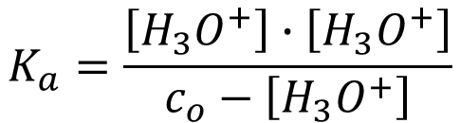

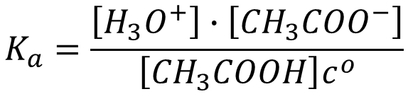
The pH of solutions
What is the pH of c_{o}=1·10⁻⁴ mol/dm³ concentration acetic acid?
This is again a quadratic equation at the end:
$${CH}_{3}{COOH}_{(aq)}+H_{2}O_{(l)}⇌{CH}_{3}{COO}_{(aq)}^{−}+H_{3}O_{(aq)}^{+} K_{a}=1.8∙{10}^{−5}$$
$$K_{a}=\frac{\left[H_{3}O^{+}\right]∙\left[{CH}_{3}{COO}^{−}\right]}{\left[{CH}_{3}COOH\right]c^{o}}$$
$$\left[H_{3}O^{+}\right]=\left[{CH}_{3}{COO}^{−}\right]$$
$$\left[{CH}_{3}COOH\right]=c_{o}−\left[{CH}_{3}{COO}^{−}\right]=c_{o}−\left[H_{3}O^{+}\right]$$
$$K_{a}=\frac{\left[H_{3}O^{+}\right]∙\left[H_{3}O^{+}\right]}{c_{o}−\left[H_{3}O^{+}\right]}$$
$${\left[H_{3}O^{+}\right]}^{2}+K_{a}∙\left[H_{3}O^{+}\right]−K_{a}c_{o}=0$$
$${\left[H_{3}O^{+}\right]}_{1,2}=\frac{−1.8∙{10}^{−5}±\sqrt{{\left(1.8∙{10}^{−5}\right)}^{2}+4∙1.8∙{10}^{−5}·1{·10}^{−4}}}{2}=\frac{−1.8∙{10}^{−5}±8.674…{10}^{−5}}{2}$$
$${\left[H_{3}O^{+}\right]}_{1}=3.4370…{10}^{−5}{mol}/{{dm}^{3}}pH=4.4638…=4.46 and{ \left[H_{3}O^{+}\right]}_{2}<0$$

Slide 35
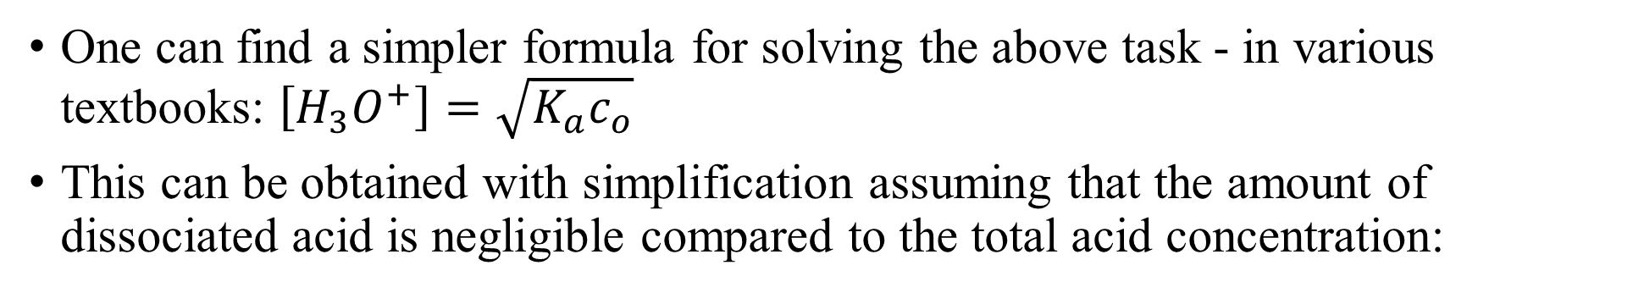
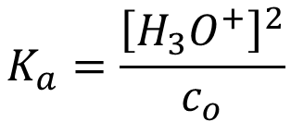

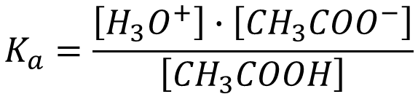
The pH of solutions
One can find a simpler formula for solving the above task - in various textbooks: $\left[H_{3}O^{+}\right]=\sqrt{K_{a}c_{o}}$
This can be obtained with simplification assuming that the amount of dissociated acid is negligible compared to the total acid concentration:
$$K_{a}=\frac{\left[H_{3}O^{+}\right]∙\left[{CH}_{3}{COO}^{−}\right]}{\left[{CH}_{3}COOH\right]}$$
$$\left[H_{3}O^{+}\right]=\left[{CH}_{3}{COO}^{−}\right]$$
$$\left[{CH}_{3}COOH\right]=c_{o}−\left[H_{3}O^{+}\right]≈c_{o}$$
$$K_{a}=\frac{{\left[H_{3}O^{+}\right]}^{2}}{c_{o}}$$
$$\left[H_{3}O^{+}\right]=\sqrt{1.8∙{10}^{−5}∙1{·10}^{−4}}=4.2426…{·10}^{−5}{mol}/{{dm}^{3}}$$
$$pH=4.3723…=4.37, but we calculated 4.46 before.$$

Slide 36
The pH of solutions
It is quite difficult to establish a general rule for judging when the amount of dissociated acid becomes negligible.
Let us assess this for acetic acid using pH calculations with both methods:
pH > 3 the results of the two types of calculations already differ measurably, i.e., above c_{o}=5·10⁻² mol/dm³ total concentration, one may use the simplified form.
For instance, using formic acid (HCOOH, K_{a}=1.8·10⁻⁴), a stronger acid, the limit is at c_{o}= 0.35 mol/dm³.
pH vagy pH_{(simple)}
ΔpH =pH-pH_{(simple)}
6.00
5.50
0.70
5.00
0.60
4.50
0.50
4.00
0.40
3.50
0.30
3.00
0.20
2.50
0.10
2.00
0.00
1.50
-0.10
2.00
2.50
3.00
3.50
4.00
4.50
5.00
5.50
pH_{(simple)}

Slide 37
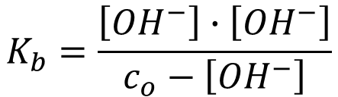


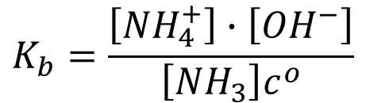
The pH of solutions
The pH of an ammonia, a weak base, solution with c_{o}=1·10⁻⁴ mol/dm³:
$${NH}_{3(g)}+H_{2}O_{(l)}⇌{NH}_{4(aq)}^{+}+{OH}_{(aq)}^{−} K_{b}=1.8∙{10}^{−5}$$
$$K_{b}=\frac{\left[{NH}_{4}^{+}\right]∙\left[{OH}^{−}\right]}{\left[{NH}_{3}\right]c^{o}}$$
$$\left[{NH}_{4}^{+}\right]=\left[{OH}^{−}\right]$$
$$\left[{NH}_{3}\right]=c_{o}−\left[{NH}_{4}^{+}\right]=c_{o}−\left[{OH}^{−}\right]$$
$$K_{b}=\frac{\left[{OH}^{−}\right]∙\left[{OH}^{−}\right]}{c_{o}−\left[{OH}^{−}\right]}$$
$${\left[{OH}^{−}\right]}^{2}+K_{b}∙\left[{OH}^{−}\right]−K_{b}c_{o}=0$$
$${\left[{OH}^{−}\right]}_{1,2}=\frac{−1.8∙{10}^{−5}±\sqrt{{\left(1.8∙{10}^{−5}\right)}^{2}+4∙1.8∙{10}^{−5}·1{·10}^{−4}}}{2}=\frac{−1.8∙{10}^{−5}±8.674…{10}^{−5}}{2}$$
$${\left[{OH}^{−}\right]}_{1}=3.4370…{10}^{−5}{mol}/{{dm}^{3}}{ \left[{OH}^{−}\right]}_{2}<0$$
$$pH=9.5361…=9.54$$
$$\left[H_{3}O^{+}\right]=\frac{K_{w}}{\left[{OH}^{−}\right]}=\frac{1{·10}^{−14}}{3.4370…{10}^{−5}}=2.9094…{10}^{−10}{mol}/{{dm}^{3}}$$

Slide 38
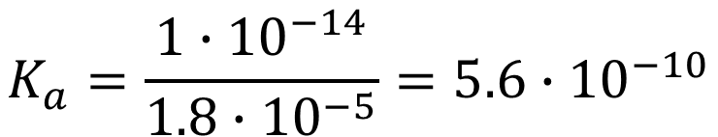
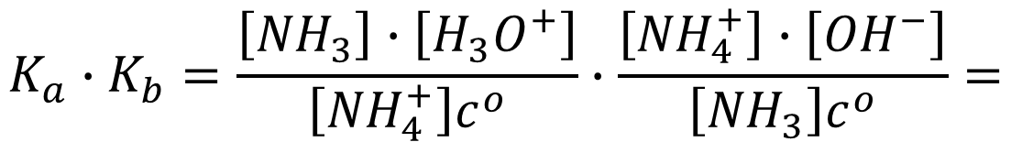
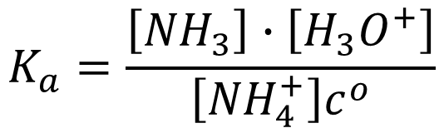


The pH of solutions
The starting material and the product are actually interchangeable at equilibrium, e.g., acid-base balances can be written in two ways.
$${NH}_{3(g)}+H_{2}O_{(l)}⇌{NH}_{4(aq)}^{+}+{OH}_{(aq)}^{−} K_{b}=1.8∙{10}^{−5}$$
$${NH}_{4(aq)}^{+}+H_{2}O_{(l)}⇌{NH}_{3(g)}+{H_{3}O}_{(aq)}^{+} K_{a}= ???$$
$$K_{b}=\frac{\left[{NH}_{4}^{+}\right]∙\left[{OH}^{−}\right]}{\left[{NH}_{3}\right]c^{o}}$$
$$K_{a}=\frac{\left[{NH}_{3}\right]∙\left[H_{3}O^{+}\right]}{\left[{NH}_{4}^{+}\right]c^{o}}$$
$$K_{a}∙K_{b}=\frac{\left[{NH}_{3}\right]∙\left[H_{3}O^{+}\right]}{\left[{NH}_{4}^{+}\right]c^{o}}∙\frac{\left[{NH}_{4}^{+}\right]∙\left[{OH}^{−}\right]}{\left[{NH}_{3}\right]c^{o}}=$$
$$\frac{\left[H_{3}O^{+}\right]∙\left[{OH}^{−}\right]}{{\left(c^{o}\right)}^{2}}=K_{w}$$
$$K_{a}=\frac{1∙{10}^{−14}}{{1.8∙10}^{−5}}=5.6∙{10}^{−10}$$

Slide 39
Buffers
Biological systems are full of chemical equilibrium, since all living beings are a complex chemical system, where the maintenance of vital functions and regulation use many equilibrium, and the operation of the entire system is possible in a very narrow range around pH=7.4.
These conditions are maintained by so-called buffers in all living organisms.
buffer: a compound that is capable of significantly reducing the effect of pH changing processes in the solution. A buffer can be formed by mixing a weak acid with a strong base (buffer operating in the acidic regime), or a weak base with a strong acid (buffer operating in the alkaline regime) at appropriate molar ratios.
Let us see some examples how they operate!

Slide 40



Buffers
The operation of all buffers is ensured by the dissociation equilibrium of a weak acid/base! E.g., acetic acid (HAc)-sodium acetate (NaAc) buffer:
What happens to the equilibrium when sodium acetate (CH₃COONa, NaAc) is added to the solution of weak acid. NaAc dissolves and dissociates 100%.
As the concentration of acetate ions increases in the solution, the balance shifts towards their protonation and the formation of undissociated acetic acid.
With a good approximation, one can say that the acetate ions formed during the dissolution of the acid are all protonated, hence $\left[{CH}_{3}COOH\right]≅c_{HAc}$. This is the total HAc concentration added during preparation of the initial solution.
$${CH}_{3}{COOH}_{(aq)}+H_{2}O_{(l)}⇌{CH}_{3}{COO}_{(aq)}^{−}+H_{3}O_{(aq)}^{+}$$
$$↽$$
$$K_{a}=\frac{\left[H_{3}O^{+}\right]∙\left[{CH}_{3}{COO}^{−}\right]}{\left[{CH}_{3}COOH\right]c^{o}}=1.8∙{10}^{−5}$$

Slide 41




Buffers
At the same time, one can assume that $\left[{CH}_{3}{COO}^{−}\right]≅c_{NaAc}$, so this is the added total amount of NaAc.
Placing this into the equation for the equilibrium constant:
Then taking the negative logarithm:
Re-arranged:
The pH value depends on the logarithm of the ratio of the salt and weak acid added to the solution, i.e. the buffer can be diluted!
$$K_{a}=\frac{\left[H_{3}O^{+}\right]∙c_{NaAc}}{c_{HAc} c^{o}}=\frac{\left[H_{3}O^{+}\right]}{ c^{o}}∙\frac{c_{NaAc}}{c_{HAc} }≅1.8∙{10}^{−5}$$
$$−\log_{10}\left(K_{a}\right)={pK}_{a}≅pH−log\left(\frac{c_{NaAc}}{c_{HAc} }\right)$$
$$pH≅{pK}_{a}+log\left(\frac{c_{NaAc}}{c_{HAc} }\right)={pK}_{a}+log\left(\frac{{n_{NaAc}}/{V_{old.}}}{{n_{HAc}}/{V_{old.}}}\right)={pK}_{a}+log\left(\frac{n_{NaAc}}{n_{HAc} }\right)$$

Slide 42





Buffer pH calculation – An example
Calculate the pH of the buffer solution that was made by mixing 150.2 cm³ of 0.5437 mol/dm³ HAc and 50.23 cm³ of 0.6944 mol/dm³ NaOH. K_{a}=1.753·10⁻⁵; K_{w}=1.00·10⁻¹⁴
(Give the result with two decimal places!)
$$pH≅{pK}_{a}+log\left(\frac{n_{salt}}{n_{acid} }\right)$$
$$pOH≅{pK}_{b}+log\left(\frac{n_{salt}}{n_{base} }\right)$$
$${pK}_{a}=−\log_{10}\left({1.753∙10}^{−5}\right)=4.7562…$$
$$n_{{CH}_{3}COONa}=0.05023 {dm}^{3}∙0.6944 {mol}/{{dm}^{3}}=0.034879…mol$$
$$n_{{CH}_{3}COOH}= 0.1502 {dm}^{3}∙0.5437 {mol}/{{dm}^{3}−0.034879…}=0.046784…mol$$
$$pH=4.7562…+log\left({0.034874…}/{0.046784…}\right)=4.63$$

Slide 43




Buffers
What is the effect of a buffer? How does it work?
Dissolve 0.1 mol HCl gas in 1 dm³ distilled water! What is the change in pH?
Dissolve the same amount of HCl gas in 1 dm³ HAc-NaAc buffer, where 1-1 mol HAc and NaAc have already been dissolved. What is the change in pH?
First, let us calculate the pH of the original buffer!
$$c_{HCl}=\frac{0.1 mol}{{1 dm}^{3}}=0.1\frac{mol}{{dm}^{3}}$$
$$pH=−log\left(\frac{c_{HCl}}{c^{o}}\right)=−\log\left(\frac{{0.1 mol}/{{dm}^{3}}}{{1 mol}/{{dm}^{3}}}\right)=1$$
$$∆pH=1−7=−6$$
$$pH={pK}_{a}+log\left(\frac{n_{NaAc}}{n_{HAc} }\right)=4.74+log\left(\frac{1 mol}{1 mol}\right)=4.74$$

Slide 44

Buffers
What happens with the buffer when we dissolve hydrochloric acid gas in it?
It increases the hydroxonium ion concentration of the solution. The equilibrium system reacts to this in such a way that the acetate ions present bind the added protons and turn into acetic acid, i.e. the equilibrium shifts:
Hence, the amount of NaAc decreases with the amount of hydrochloric acid, while HAc increases by the same amount, i.e., the pH:
$${CH}_{3}{COOH}_{(aq)}+H_{2}O_{(l)}⇌{CH}_{3}{COO}_{(aq)}^{−}+H_{3}O_{(aq)}^{+}$$
$$↽$$
$$pH={pK}_{a}+log\left(\frac{n_{NaAc}−n_{HCl}}{n_{HAc}+n_{HCl} }\right)=4.74+log\left(\frac{\left(1−0.1\right)mol}{\left(1+0.1\right)mol}\right)=$$
$$=4.74+log\left({0.9}/{1.1}\right)=4.74−0.08715…$$
$$∆pH=4.74−0.08715…−4.74=−0.08715…=−0.09$$
It was -6 with water!

Slide 45



Buffers
To estimate the efficiency and usability of the buffer, one plots the pH of the buffer versus the molar fraction calculated from the amount of the buffer making acid and conjugate base.
The buffer is the most effective on the linear range of the plot!
At 1:1 ratio, pH=pK_{a}.
$$pH$$
8
7
6
5
$${pK}_{a}$$
4
3
2
0
0.1
0.2
0.3
0.4
0.5
0.6
0.7
0.8
0.9
1
1:1
$$x_{só}=\frac{n_{salt}}{n_{salt}+n_{acid}}$$

Slide 46
The pH of salt solutions
Based on the previously learned acid-base theories, one would expect that the solution of salts resulting from the reaction of chemically equivalent amounts of acid and base would be neutral, i.e. around pH=7.
Is that really the case? Have a look at this video:
Solutions of different salts may possess different pH! Why?
The answer is easy to give with the Brönstedt-Lowry acid-base theory, with the help of proton exchange equilibria between conjugated acid-base pairs formed in solutions:
The conjugate acid form of a strong base is a weak acid, and the conjugate base form of a strong acid is a weak base and vice versa.
https://www.youtube.com/watch?v=-vIwTn7LZiM
$${acid}_{1}+{base}_{2}⇌{base}_{1}+{acid}_{2}$$

Slide 47
The pH of salt solutions
In the movie, salts can be classified in 2 groups by the pH of their solution:
  which made the solution alkaline - dark green and blue
    K₂CO₃, NaHCO₃, Na₃PO₄, Na₂HPO₄
  which made the solution acidic - red and yellow shades
    AlCl₃, NH₄Cl, NaH₂PO₄
There were no salts on the film that did not change the pH of distilled water, but there are. Look at the next video:
  which do not change the pH of the solution – the light green color remains.
    NaCl, KCl, etc.
Let us examine what ions are found in the aqueous solution of each salt!
https://www.youtube.com/watch?v=VfPMEs1nxgY

Slide 48
The pH of salt solutions
In the case of salts that make the solution alkaline, the anion of a weak acid, which is expected to be a strong base, and the cation of a strong base, which is expected to be a weak acid, are present.
A weak acid cannot act on water, it cannot protonate it.
A strong base, on the other hand, can take a proton from the water molecule.
$${CO}_{3(aq)}^{2−}+H_{2}O_{(l)}⇌{HCO}_{3(aq)}^{−}+ {OH}_{(aq)}^{−}$$
$${HCO}_{3(aq)}^{−}+H_{2}O_{(l)}⇌{H_{2}CO}_{3(aq)}^{}+ {OH}_{(aq)}^{−}$$
$${PO}_{4(aq)}^{3−}+H_{2}O_{(l)}⇌{HPO}_{4(aq)}^{2−}+ {OH}_{(aq)}^{−}$$
$${HPO}_{4(aq)}^{2−}+H_{2}O_{(l)}⇌H_{2}{PO}_{4(aq)}^{−}+ {OH}_{(aq)}^{−}$$

Slide 49

The pH of salt solutions
For most salts that make a solution acidic, the anion of a strong acid, which is expected to be a weak base, and the cation of a weak base, which is expected to be a strong acid, are present.
A weak base cannot act on water, it cannot take one of its protons.
A strong acid, on the other hand, can protonate water.
Phosphoric acid is considered as a weak acid, but the first dissociation constant is pK_{s1}= 2.12 and hence, water cannot protonate the $H_{2}{PO}_{4(aq)}^{−}$ anion.
$${\left[Al{\left(H_{2}O\right)}_{6}\right]}_{(aq)}^{3+}+H_{2}O_{(l)}⇌{\left[Al{\left(H_{2}O\right)}_{5}\left(OH\right)\right]}_{(aq)}^{2+}+ {H_{3}O}_{(aq)}^{+}$$
$${NH}_{4(aq)}^{+}+H_{2}O_{(l)}⇌{NH}_{3(aq)}+{H_{3}O}_{(aq)}^{+}$$
$$H_{2}{PO}_{4(aq)}^{−}+H_{2}O_{(l)}⇌{HPO}_{4(aq)}^{2−}+{H_{3}O}_{(aq)}^{+}$$

Slide 50
The pH of salt solutions
In the case of those salts that were formed from the reaction of a strong acid and a strong base, the resulting conjugate base and conjugate acid are also weak, i.e., they are not able to interact with water, so the concentration of neither the hydroxonium nor the hydroxyl ion increases and thus, the pH does not change.
The phenomenon that certain salts change the pH of distilled water when dissolved is called "hydrolysis of salts", but this is incorrect, because there is no mention of the salts breaking down under the influence of water.
The pH in buffer solution changes due to acid-base equilibriua!

Slide 51
Heterogeneous equilibria
Equilibria can occur not only in fluid phases, but also between different phases!
During the lectures, the concept of equilibrium vapor pressure was introduced, but also heterogeneous physical equilibrium with the presence of two phases, e.g., the melting/freezing of water at its melting/freezing point, or its evaporation/condensation at its boiling point were discussed.
The dissolution of gases in liquids can occur with the development of a physical equilibrium and may also be followed by a chemical reaction.
  Dissolution without chemical raction is described by Henry's law:
  Henry's law: for dilute solutions, the partial pressure of the solute (p_{i}) above the solution, is proportional to its mole fraction (x_{i}), but the proportionality factor is not the vapor pressure of the pure solute, but the Henry coefficient (K_{H}) and p_{i} = K_{H}·x_{i}
  Solutions that behave in this way are called ideally dilute solutions.
  Dissolution of gases in liquids followed by chemical interaction: HCl, CO₂, NH₃, etc.

Slide 52

Heterogeneous equilibria
Dissolution of hydrochloric acid gas and subsequent chemical reaction:
The maximum concentration of the solution at room temperature and 1 atm pressure, is 37w%, which is quite significant.
The composition of the fluid phases is included in the equilibrium constant, i.e., the partial pressure in the gas phase and the concentrations in the liquid phase, in all cases in dimensionless form.
$${HCl}_{(g)}+H_{2}O_{(l)}⇌H_{3}O_{(aq)}^{+}+{Cl}_{(aq)}^{−}$$
$$K=\frac{\frac{\left[H_{3}O^{+}\right]}{c^{o}}∙\frac{\left[{Cl}^{−}\right]}{c^{o}}}{\frac{p_{HCl}}{p^{o}}}$$

Slide 53


Heterogeneous equilibria
No matter how well soluble a salt is, their solubility is not unlimited, i.e., at a given temperature, no more solid substances dissolve at a certain amount – a solid phase appears.
The so-called solubility equilibrium forms on the surface of the excess solid salt. For instance,
The solid phase is not included in the equilibrium constant, because its concentration has no meaning in this context.
where $c^{o}=1\frac{mol}{{dm}^{3}}$
Kidney stone formation: Ca(COO)₂·H₂O/2H₂O, Ca₃(PO₄)₂ etc.
$${Al}_{2}{\left({SO}_{4}\right)}_{3(s)}⇌2{Al}_{(aq)}^{3+}+3{SO}_{4(aq)}^{2−}$$
$$L={\left(\frac{\left[{Al}^{3+}\right]}{c^{o}}\right)}^{2}∙{\left(\frac{\left[{SO}_{4}^{2−}\right]}{c^{o}}\right)}^{3}$$

