Slide 1
General Chemistry
5. Thermodynamics and thermochemistry
Dr. István Szilágyi
Department of Physical Chemistry and Materials Science
2023.

Slide 2
Fundamentals of thermodynamics
The fundamental question of science is why and in what direction the natural processes take place.
Thermodynamics looks for the answer to this question by examining the energy conditions of such processes :
thermodynamics: the science discipline that examines energy changes contributing to physical and chemical processes and their relationship with other thermodynamic quantities.
Examining the various states of matter, one finds that the state of the system, the quantities p, V, T and n, are determined by the state indicators, and the relationships between them are called equations of state.
However, what about the energy of the system?

Slide 3
Fundamentals of thermodynamics
What affects the energy of the system? How can it be changed? How does this change when a process takes place spontaneously?
Humanity tried to answer these questions based on its experiences.
It was observed, e.g. that the water always flows downwards, and if it is channeled through suitable equipment, it can be made to work for us (e.g., water mills).
At the same time, if one wants to bring the water from a lower place to a higher one, one has to work and pump it.

Slide 4
Fundamentals of thermodynamics
The energy of the system is therefore necessarily related to work, which is defined by physics :
work: (sign: w; unit: 1 J) is the physical quantity obtained as the product of the force and the displacement in the direction of the force. (It assumes ordered movement!)
The system can perform work in several ways, and we can perform work on the system. For instance:
  the volume-pressure work – the system may expand against the external pressure, or its volume may decrease due to the external pressure: w= -p·ΔV
  surface work – increasing the surface area of the liquid requires work, decreasing it brings the liquid to a more favorable energy state: w= γ·ΔA
The sign of work: once the system is doing work is negative, if we are doing work on it, it is positive! – e.g., sign of ΔV and ΔA.

Slide 5
Fundamentals of thermodynamics
Work is always performed under the influence of some intensive quantities, resulting in a change of some extensive quantity.
For instance,
  The water flows down from the mountain because the gravitational field (intensive) exerts a force on it and its height changes (extensive).
  One can pump the water up by increasing the pressure (intensive), force are exerted on it, and its height changes (extensive).
  Charged particles in conductors under the influence of an electric field (intensive), because it exerts a force on it, move (extensive), and an electric current (extensive) is generated.

Slide 6
Fundamentals of thermodynamics
The other experience is that whether it is a change that takes place spontaneously or it is forced by work? The system and its environment heat up or cool down giving rise to a temperature difference or equalization.
At the same time, one can also find that by raising the temperature, the material can be transferred in a state that such a material can perform work.
So something is exchanged between the system and its surroundings or environment during heating/cooling.
It was once thought to be a special substance with a particle, but we now know that there is no such particle!

Slide 7
Fundamentals of thermodynamics
This other quantity was called heat:
heat: (sign: q; unit: 1 J) the form of energy that is exchanged between the system and its environment, or between two systems, due to the difference in their temperature. (Disordered movement is assumed!)
The driving force of heat exchange is the difference in temperature.
temperature: (sign: T; unit: 1 K) it originates from the disordered movement of particles in a system. It is characteristic to their kinetic energy. It has a natural zero point. It is the driving force of processes resulting in heat transfer.
The sign convention also applies here! If the heat taken up by the system, it has a positive sign, and if the heat is released, it has a negative sign.

Slide 8

Fundamentals of thermodynamics
16/10/2024
The amount of heat taken/released must be specified somehow!
One knows that 𝑞~∆𝑇 and ΔT is positive upon heating up something, i.e., heat is transferred to it, and negative otherwise.
Therefore, the proportionality factor does not need to be preceded by a negative sign, as in the case of volume work.
The proportionality factor is denoted by K.
One knows from experience that different materials require different amounts of heat to change their temperature.
It has also been experienced that in order to achieve a given temperature change with a different amount of the same substance, one also needs different amount of heat.
$$q=K∙∆T$$

Slide 9
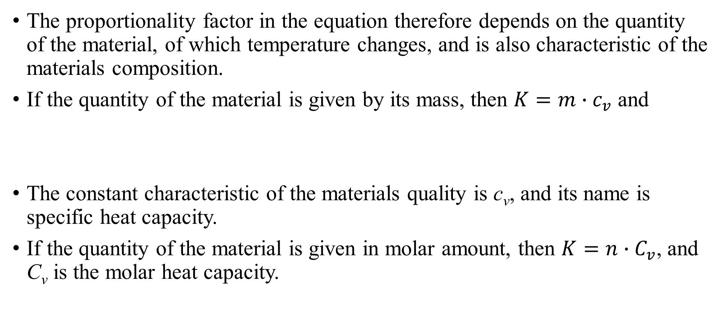



Fundamentals of thermodynamics
The proportionality factor in the equation therefore depends on the quantity of the material, of which temperature changes, and is also characteristic of the materials composition.
If the quantity of the material is given by its mass, then $K=m∙c_{v}$ and
The constant characteristic of the materials quality is c_{v}, and its name is specific heat capacity.
If the quantity of the material is given in molar amount, then $K=n∙C_{v}$, and C_{v} is the molar heat capacity.
$$c_{v}=\frac{q_{v}}{m∙∆T}$$
$$q_{v}=m∙c_{v}∙∆T$$
$$q_{v}=n∙C_{v}∙∆T$$

Slide 10
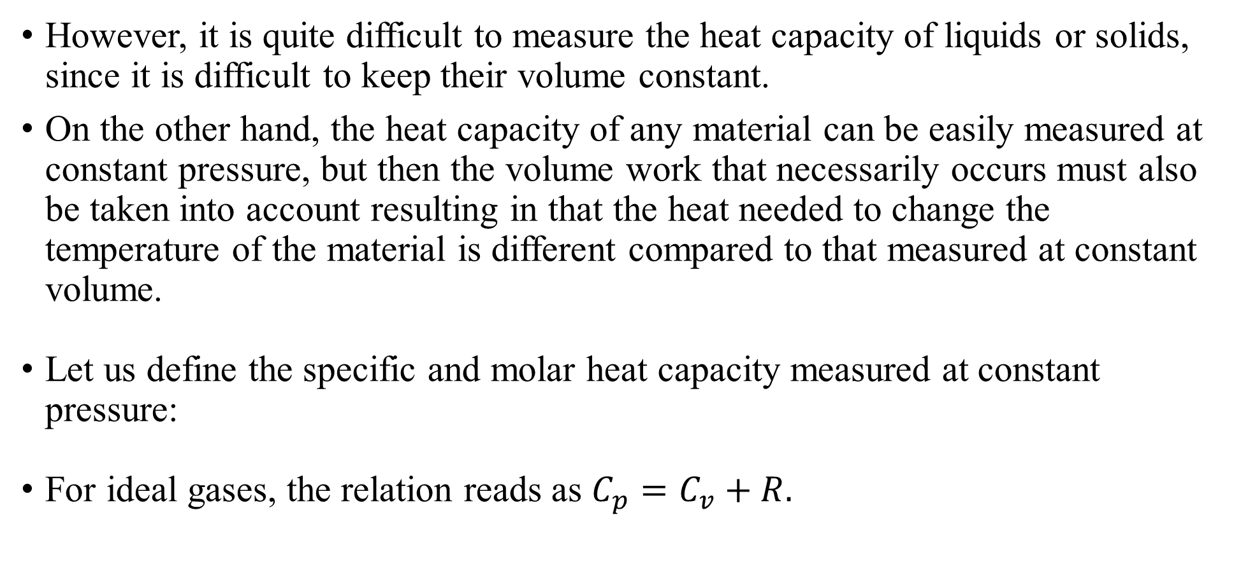



Fundamentals of thermodynamics
However, it is quite difficult to measure the heat capacity of liquids or solids, since it is difficult to keep their volume constant.
On the other hand, the heat capacity of any material can be easily measured at constant pressure, but then the volume work that necessarily occurs must also be taken into account resulting in that the heat needed to change the temperature of the material is different compared to that measured at constant volume.
Let us define the specific and molar heat capacity measured at constant pressure:
For ideal gases, the relation reads as $C_{p}=C_{v}+R.$
$$q_{p}≠q_{v}$$
$$q_{p}=n∙C_{p}∙∆T$$
$$q_{p}=m∙c_{p}∙∆T$$

Slide 11
Fundamentals of thermodynamics
Using the quantities discussed previously, the energy can be defined.
energy: (sign: E; unit: 1 J) the system's ability to perform work. (Energy can be both potential and kinetic energy.)
The question is: what is included in the energy of a chemical system?
  which floor the laboratory is on? – no!
  the test tubes are being taken on a wheeled cart? – no!
  is the rotational speed of the Earth? – no!
  is the speed at which the Earth moves in its orbital? – no!
  interactions between the particles in the system? – yes!

Slide 12
Fundamentals of thermodynamics
So only the so-called internal energy matters.
internal energy: (sign: U; unit: 1 J) the energy content of the system derived from the interaction (potential) and movement (kinetic) energy of the particles. It has no natural zero point, only the difference and change between two states can be measured. An extensive quantity whose change is described by the first law of thermodynamics (see later).
It follows from the above that the internal energy of a system can be changed in two ways:
  perform work on it or it is forced to perform work
  induce heat exchange between system and environment

Slide 13
The 1st law of thermodynamics
1st law of thermodynamics: the internal energy of a closed system is constant until it is changed by work or heat exchange: ΔU = w + q
This law is also called as the principle of energy conservation, i.e., if the system returns to the same state, its internal energy must also be the same.
Such thermodynamic quantities are called state functions/potential functions – not state equation (state equation = relationship between state indicators discussed before).

Slide 14
State functions
state function/potential function : a characteristic quantity of the system, which is determined by the status indicators. Its change can be calculated from the difference between the state indicator values at the final and initial state of a process, and does not depend on the way how the system reached the final state from the initial one, i.e., on the intermediate values of the state indicators.
For example, U₂-U₁=ΔU
The ones do not show the above properties are the path functions. Let's look at an example, the case of a ideal gas closed in a piston.

Slide 15












70000
$$p/Pa$$
T_{D} > T_{A} > T_{C} > T_{B}
65000
T_{D}
60000
T_{A}
$$V_{CD}$$
55000
A
D
$$p_{AD}$$
C
$$p_{BC}$$
T_{C}
T_{C}
50000
D
$$p_{AD}$$
T_{D}
T_{B}
$$V_{AB}$$
45000
$$p_{BC}$$
B
$$p_{BC}$$
T_{B}
B
C
40000c
A
$$p_{AD}$$
T_{A}
35000
0.040
0.060
0.080
0.100
0.120
$$V_{AB}$$
$$V_{CD}$$
$$V/m^{3}$$

Slide 16












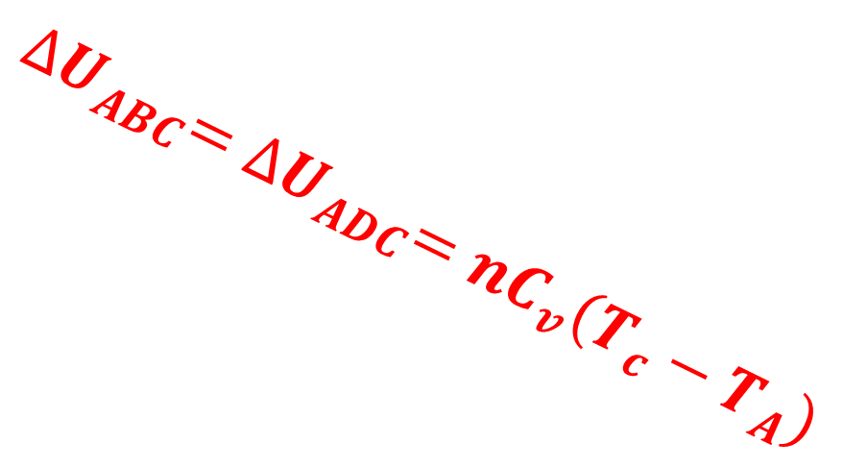







Based on the universal gas law: $pV=nRT_{C}$
$${∆U}_{ABC}=w_{AB}+q_{AB}+w_{BC}+q_{BC}$$
70000
$$w_{AB}=0 since ∆V=0$$
$$w_{BC}=−p_{BC}\left(V_{CD}−V_{AB}\right)<0$$
$$p/Pa$$
T_{D} > T_{A} > T_{C} > T_{B}
$$q_{AB}=nC_{v}\left(T_{B}−T_{A}\right)<0$$
$$q_{BC}=nC_{p}\left(T_{C}−T_{B}\right)>0$$
65000
T_{D}
$$C_{p}=C_{v}+R$$
$${∆U}_{ABC}={∆U}_{ADC}=nC_{v}\left(T_{c}−T_{A}\right)$$
$${∆U}_{ABC}=nC_{v}\left(T_{c}−T_{A}\right)−p_{BC}\left(V_{CD}−V_{AB}\right)+nR\left(T_{C}−T_{B}\right)$$
60000
$$p_{BC}V_{CD}=nRT_{C}$$
$$p_{BC}V_{AB}=nRT_{B}$$
T_{A}
A
D
$nR\left(T_{C}−T_{B}\right)=p_{BC}V_{CD}−p_{BC}V_{AB}=$ $p_{BC}\left(V_{CD}−V_{AB}\right)$
55000
$$p_{AD}$$
$${∆U}_{ABC}=nC_{v}\left(T_{c}−T_{A}\right)$$
T_{C}
50000
$${∆U}_{ADC}=w_{AD}+q_{AD}+w_{DC}+q_{DC}$$
T_{B}
$$w_{AD}=−p_{AD}\left(V_{CD}−V_{AB}\right)<0$$
$$q_{DC}=nC_{v}\left(T_{C}−T_{D}\right)<0$$
45000
$$q_{AD}=nC_{p}\left(T_{D}−T_{A}\right)>0$$
$$w_{DC}=0 mivel ∆V=0$$
$$p_{BC}$$
B
C
$$C_{p}=C_{v}+R$$
40000c
$${∆U}_{ADC}=nC_{v}\left(T_{c}−T_{A}\right)−p_{AD}\left(V_{CD}−V_{AB}\right)+nR\left(T_{D}−T_{A}\right)$$
$$p_{AD}V_{CD}=nRT_{D}$$
$$p_{AD}V_{AB}=nRT_{A}$$
35000
$nR\left(T_{D}−T_{A}\right)=p_{AD}V_{CD}−p_{AD}V_{AB}=$ $p_{AD}\left(V_{CD}−V_{AB}\right)$
0.040
0.060
0.080
0.100
0.120
$$V_{AB}$$
$$V_{CD}$$
$$V/m^{3}$$
$${∆U}_{ADC}=nC_{v}\left(T_{c}−T_{A}\right)$$

Slide 17
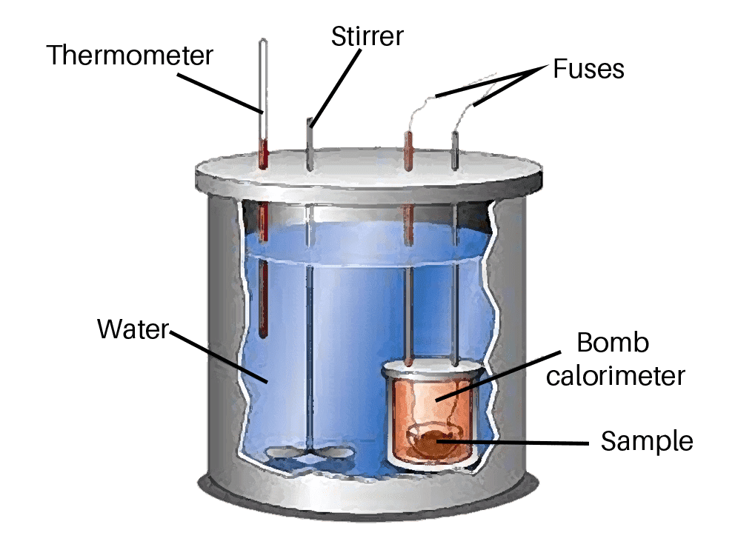
Measurement of ΔU - calorimetry
The energy of the processes taking place in the systems can be measured in calorimeters. If the volume of the system does not change, then the heat measured in this way is the same as the change in the internal energy of the system (ΔU).
The best-known such device is the bomb calorimeter/calorimeter bomb.
  The reaction, e.g., the combustion of a material, in the pressure-sealed internal space (the bomb) is started after the thermal equilibrium is reached.
  The temperature change in a surrounding liquid of known heat capacity is measured.
  The whole system is separated by a thermally insulated wall and the reaction warms/cools the liquid and the bomb. The heat of the reaction (= ΔU) can be then calculated by knowing the heat capacity of the bomb.
https://www.vedantu.com/chemistry/bomb-calorimeter

Slide 18
Enthalpy
Measuring at a constant volume is not always feasible, and it is also rather inconvenient, so the question arises as to how much the result one measures differs from what we would get at a constant pressure?
It was mentioned before that for ideal gases, a significantly different value is obtained, because the gas expands during heating, so volume work appears. Besides, when it cools down, the environment does work on the system.
What do we actually measure at constant pressure? The change in enthalpy!
It can be proven that this is also a state function, it does not have a natural zero point just like the internal energy, and if there is no useful work, then the sum of the internal energy and pV is equal to H=U+pV

Slide 19
Enthalpy
enthalpy: (sign: H; unit: 1 J) a characteristic quantity of the system, which defines the heat exchanged between the system and its environment at constant pressure, if there is no useful work. It has no natural zero point, only the difference between two states can be measured. State function, extensive quantity and it is the sum of internal energy and pV, i.e., H = U + pV.
Its introduction serves to separate the volume work that anyway occurs due to the volume change of the system at constant pressure from the total work accomplished. Thus, the useful work can be calculated as follows.
w_{useful} -p_{external}·ΔV = w_{total}
One can only measure the change in enthalpy (ΔH).

Slide 20
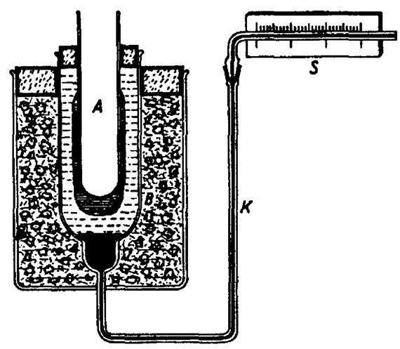
Measurement of change in enthalpy - ΔH
The earliest device for measuring enthalpy was the so-called ice calorimeter.
The surrounding of the closed and well-insulated space of the calorimeter is filled with a mixture of ice and water.
At the same time, this space is connected, via a capillary filled with mercury, to a scale that can measure the volume change of the ice-water mixture.
Insertion and equilibration of the sample and/or the heat of reaction studied, changes the ice/water ratio, resulting in a change in volume.
Hence, the exchanged heat and the ΔH can be calculated.

Slide 21
Modern calorimetry
The technology has developed a lot since the 19th century, so electronic equipment has already taken over the role of the ice calorimeter for scientific precision measurements.
Developments are going towards reducing the sample volume and that as small as possible quantities could be determined.
Nowadays the so-called microcalorimeters can be used to perform titrations in microliter (10⁻⁶ L) volumes, e.g., to measure the thermal effects of micelle formation or conformational changes in macromolecular solutions.
Nevertheless, quality measurements can be carried out in student laboratories with very simple tools.
https://www.youtube.com/watch?v=EAgbknIDKNo

Slide 22
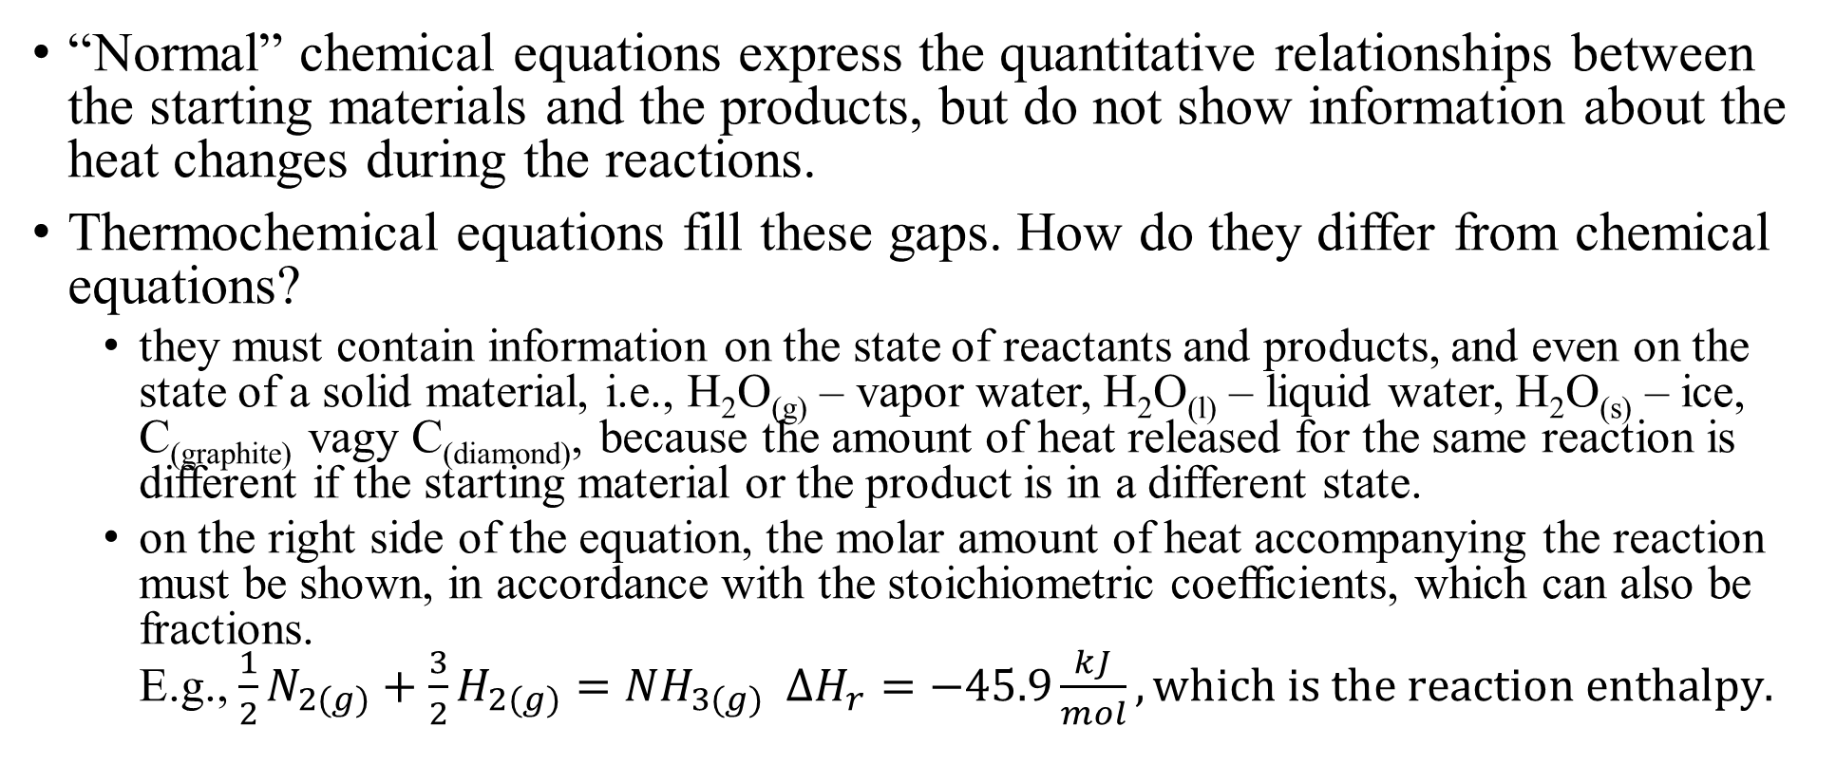
Thermochemical equations
“Normal” chemical equations express the quantitative relationships between the starting materials and the products, but do not show information about the heat changes during the reactions.
Thermochemical equations fill these gaps. How do they differ from chemical equations?
  they must contain information on the state of reactants and products, and even on the state of a solid material, i.e., H₂O_{(g)} – vapor water, H₂O_{(l)} – liquid water, H₂O_{(s)} – ice, C_{(graphite)} vagy C_{(diamond)}, because the amount of heat released for the same reaction is different if the starting material or the product is in a different state.
  on the right side of the equation, the molar amount of heat accompanying the reaction must be shown, in accordance with the stoichiometric coefficients, which can also be fractions.
  E.g., $\frac{1}{2}N_{2(g)}+\frac{3}{2}H_{2(g)}={NH}_{3(g)} ∆H_{r}=−45.9\frac{kJ}{mol}, which is the reaction enthalpy.$

Slide 24



Thermochemical equations
If one subtracts the third from the second equation applying the stoichiometric coefficients, the first reaction can be obtained.
The question is whether we can do this with the heats of reaction or not?
The answer is yes, because based on the general principle of energy conservation and the example presented for ideal gases, it is expected that the state functions, e.g., enthalpy, depend only on the initial and final states regardless of the reaction path.
Therefore, the change in enthalpy during production of CO_{2(g)} is the same as during the case, when CO_{(g)} is present, which is further converted into CO_{2(g)}.
$$C_{graphite}$$
$${CO}_{2(g)}$$
$${CO}_{(g)}$$

Slide 26
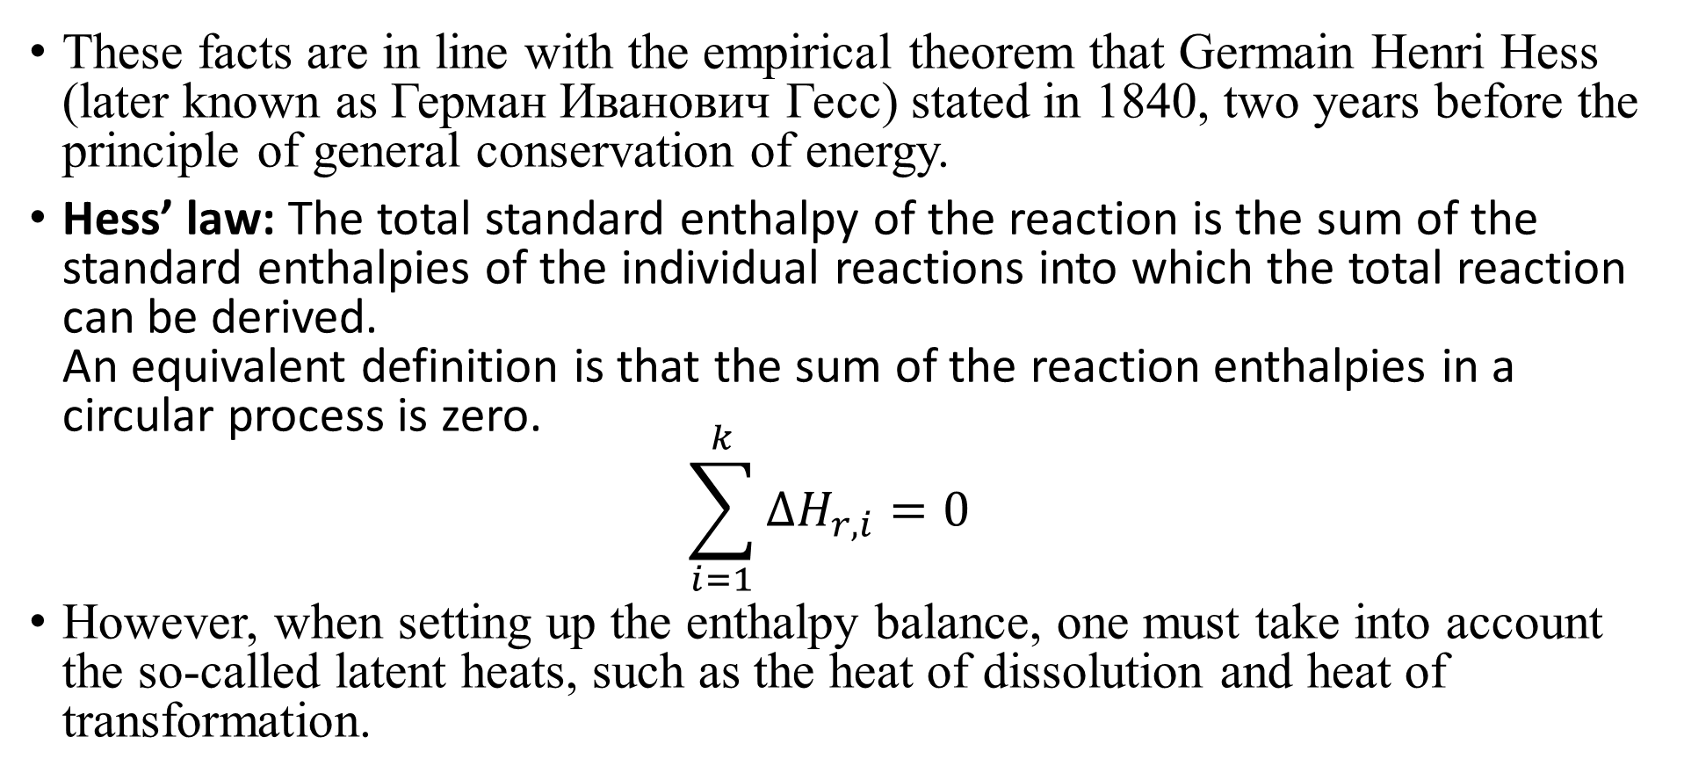
Hess's law
These facts are in line with the empirical theorem that Germain Henri Hess (later known as Герман Иванович Гесс) stated in 1840, two years before the principle of general conservation of energy.
Hess’ law: The total standard enthalpy of the reaction is the sum of the standard enthalpies of the individual reactions into which the total reaction can be derived.
An equivalent definition is that the sum of the reaction enthalpies in a circular process is zero.
$\sum_{i=1}^{k}{{ΔH}_{r,i}}=0$
However, when setting up the enthalpy balance, one must take into account the so-called latent heats, such as the heat of dissolution and heat of transformation.

Slide 27
Thermochemical equations
If enthalpy had a natural zero point, then one would be able to determine the enthalpy content of individual substances and compounds, and knowing this, the heat of any reaction could be determined.
However, we can help ourselves with a clever trick! Consider the elementary state as the reference state, i.e., the reaction enthalpy during which one mole of substance is formed from its stable elements. One assigns its enthalpy of formation as the enthalpy content of the substance.
But temperature, pressure or composition have not been fixed – complicated model and too many data.
Therefore, at controlled pressure and composition, the standard enthalpy of formation can be assigned to every compound.

Slide 28
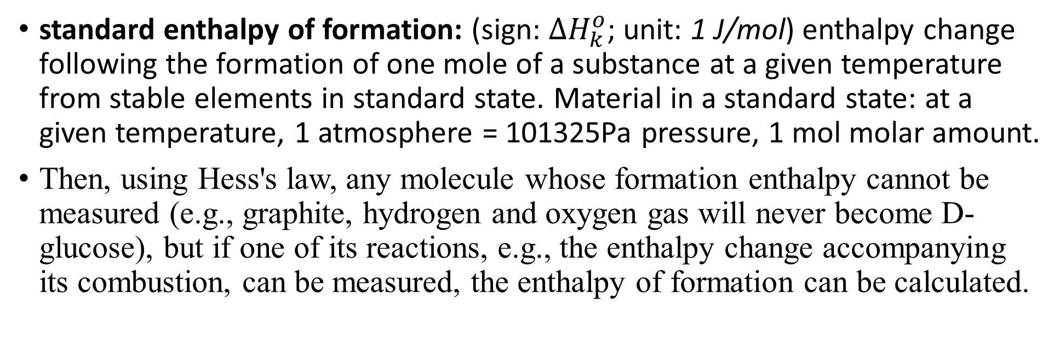
The standard enthalpy of formation
standard enthalpy of formation: (sign: ${∆H}_{k}^{o}$; unit: 1 J/mol) enthalpy change following the formation of one mole of a substance at a given temperature from stable elements in standard state. Material in a standard state: at a given temperature, 1 atmosphere = 101325Pa pressure, 1 mol molar amount.
Then, using Hess's law, any molecule whose formation enthalpy cannot be measured (e.g., graphite, hydrogen and oxygen gas will never become D-glucose), but if one of its reactions, e.g., the enthalpy change accompanying its combustion, can be measured, the enthalpy of formation can be calculated.
$$C_{6}H_{12}O_{6(s)}+6O_{2(g)}=6{CO}_{2(g)}+6H_{2}O_{(l)} ∆H_{combustion}^{o}=−2803\frac{kJ}{mol}$$

Slide 30


Thermochemical equations
So by assigning a fourth meaning (particle, 1 mole, atomic/molecular mass) to the formulas in the stoichiometric equation, one gets the thermochemical equations.
the fourth, thermochemical meaning of the chemical formula: in chemical equations given for thermochemical purposes, the chemical formulas also represent the standard enthalpy of formation of a given substance. In case of symbols, this is zero if the element is in a stable state under standard conditions. If they are in a non-stable state, then they may represent the enthalpies of the state changes (see melting of sulfur) or the transformations between the allotropic forms (see carbon).
Any unknown formation heat or reaction heat can be determined by knowing it!
$$\sum_{i=1}^{k}{ν_{i}A_{i}}=0$$
$$\sum_{i=1}^{k}{ν_{i}{ΔH}_{k}^{o}}=ΔH_{r}^{o}$$

