Slide 1
General Chemistry
4. Stochiometry
Dr. István Szilágyi
Department of Physical Chemistry and Materials Science
2024.

Slide 2
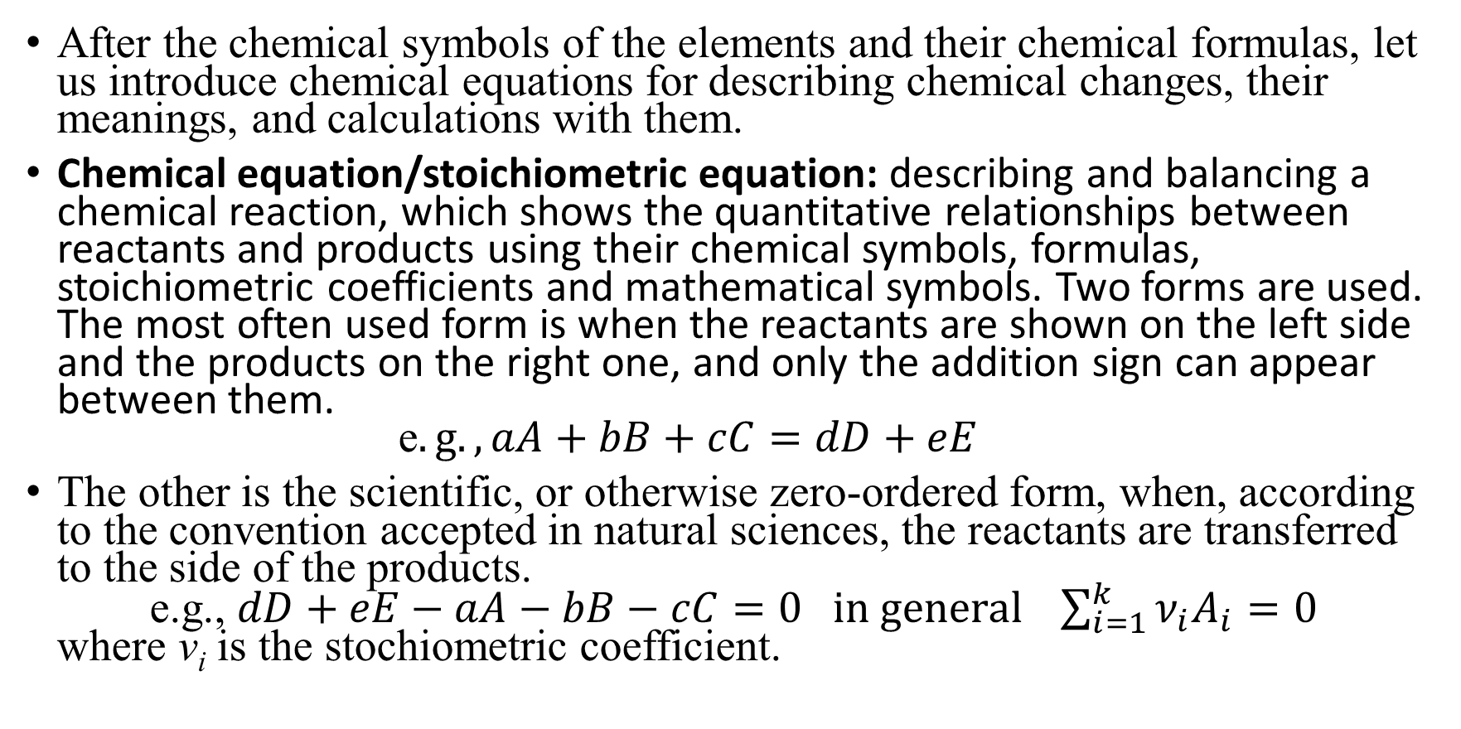
The chemical equation
After the chemical symbols of the elements and their chemical formulas, let us introduce chemical equations for describing chemical changes, their meanings, and calculations with them.
Chemical equation/stoichiometric equation: describing and balancing a chemical reaction, which shows the quantitative relationships between reactants and products using their chemical symbols, formulas, stoichiometric coefficients and mathematical symbols. Two forms are used. The most often used form is when the reactants are shown on the left side and the products on the right one, and only the addition sign can appear between them.
e$.g., aA+bB+cC=dD+eE$
The other is the scientific, or otherwise zero-ordered form, when, according to the convention accepted in natural sciences, the reactants are transferred to the side of the products.
e.g., $dD+eE−aA−bB−cC=0 in general \sum_{i=1}^{k}{ν_{i}A_{i}=0}$
where v_{i} is the stochiometric coefficient.

Slide 3
The chemical equation
stoichiometric coefficient: (sign: ν; unit: N/A) the coefficients of the formulas of the components in the zero-ordered version of the stoichiometric equation. Those relating to products are positive, those relating to reactants are negative.
The first task in order to be able to perform calculations based on chemical equations is to learn how to balance and arrange them.
Applying the principle of conservation of matter and conservation of charge is the basis of the arrangement.
Let us introduce 2 types of very important reactions:
              acid-base reaction
              redox reaction

Slide 4




Redox reactions
Redox reactions can be understood more simply by using the terms oxidation state or oxidation number:
oxidation number: a parameter of an element in a compound, which indicates how much electron surplus or deficit the atom would have compared to the neutral atom, if the bonds were completely ionic, i.e., the electrons forming the bond belonged to the atom with higher electronegativity. A positive value indicates an oxidized state, while a negative value indicates a reduced state.
]
Atom EN
O 3.5
Mn 1.5
-
$$4∙\left(−2\right)+X=−1$$
δ-
δ-
2-
2-
$${MnO}_{4}^{−}$$
δ+
δ-
X
2-
$$−8+X=−1$$
δ-
2-
$$X=+7$$

Slide 5
Oxidation number
If the oxidation number of an atom is positive, it has lost electron(s) compared to its elemental state, i.e., it is oxidized, it is in an oxidized state.
If the atom's oxidation number is negative, it received electron(s), i.e., it is reduced, it is in a reduced state.
The elemental state is indicated by the zero oxidation number, regardless of whether it is in an atomic or molecular form. E.g., He, H₂, P₄, S₈, (Fe)_{n}
Oxidized and reduced states are relative terms. A state with a higher oxidation number of the same atom is an oxidized state compared to a reduced state with a lower oxidation number, regardless of the sign of the oxidation numbers.
$$e.g., manganese −{Mn}^{2+}↔{MnO}_{2}↔{MnO}_{4}^{2−}↔{MnO}_{4}^{−}$$
+2 +4 +6 +7

Slide 6
Oxidation number
To determine the oxidation number, we therefore need the values of the electronegativity and we must know the structure of the molecule.
Electronegativity (sign: χ or EN; unit: N/A) is a chemical property that describes the tendency of an atom or a functional group to attract electrons.
It can be read in handbooks and internet sites: https://en.wikipedia.org/wiki/Electronegativity
Knowing the structure of the molecule and the chemical nomenclature is needed to correctly determine the oxidation number of individual atoms. For instance:
  Iron oxides: FeO, Fe₂O₃, Fe₃O₄ (at least 16 are known)
  +2 +3 +8/3? answer is 2(+3)+(+2)=8
https://www.researchgate.net/figure/a-Face-centred-cubic-spinel-structure-of-magnetite-b-Magnification-of-one_fig1_30048605

Slide 7
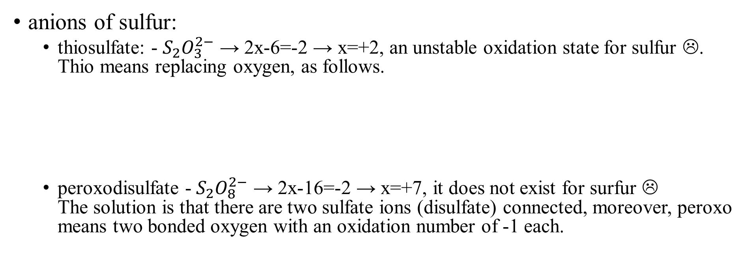
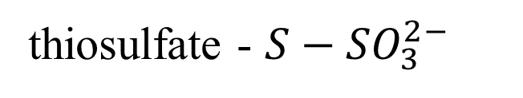
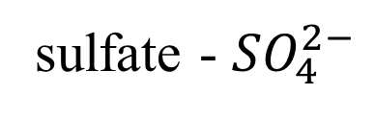
Oxidation number
anions of sulfur:
  thiosulfate: - $S_{2}O_{3}^{2−}$ → 2x-6=-2 → x=+2, an unstable oxidation state for sulfur ☹.
  Thio means replacing oxygen, as follows.
  peroxodisulfate - $S_{2}O_{8}^{2−}$ → 2x-16=-2 → x=+7, it does not exist for surfur ☹
  The solution is that there are two sulfate ions (disulfate) connected, moreover, peroxo means two bonded oxygen with an oxidation number of -1 each.
-2
-2
-2
-2
thiosulfate - ${S−SO}_{3}^{2−}$
sulfate - ${SO}_{4}^{2−}$
+6
+6
-2
-2
-2
-2
-2
-2
-2
+6
-2
-2
-1
-1
-2
-2
+6
-2

Slide 8
Oxidation number - Rules
  The oxidation number of an atom in its elementary state is 0.
  The oxidation number of the alkali metal ions is +1, the alkaline earth metals ions is +2.
  The oxidation number of fluorine in all compounds is -1.
  Oxidation number of other halogenides (chlorine, bromine and iodine) is -1 only in molecules of two elements and if the EN of the other element is lower.
  Oxidation number of oxygen is -2, except peroxides -1, and superoxides -1/2.
  The usual oxidation number of hydrogen is +1, except metal hydrides -1.
  The sum of the oxidation numbers should give the charge of the molecule.

Slide 9
Oxidation state – Organic chemistry
The oxidation state in organic chemistry is a little different.
  the zero oxidation state of the carbon atom that is connected to other carbon atoms or hydrogens by σ-bonds.
  the first oxidation state of the carbon atom that is connected to a single heteroatom by a σ-bond (not C and H, but e.g., -O-, -Cl, etc.) or by a double bond (i.e., σ- and π-bond) to another carbon atom.
  the carbon atom is in the second oxidation state if it is connected to two heteroatoms by a σ-bond, or by a double (i.e., σ- and π-) bond to one heteroatom, or by a triple (i.e., one σ- and two π-) bond to another to a carbon atom.
  the third oxidation state of the carbon atom that is connected to three heteroatoms with a σ-bond, or with one σ-bond and one double (i.e., σ- and π-) bond to two heteroatoms, or triple (i.e., one σ- and two π-) bond to a heteroatom.
  the fourth oxidation state of the carbon atom that is connected to four heteroatoms by σ-bonds, or by double (i.e., σ- and π-) bonds to two heteroatoms.

Slide 10
Oxidation state – Oxidation number
4
3
2
1
0
pl. CCl₄; O=C=O
+4
+2
0
-2
-4
e.g., RC-Cl₃; O=C(R)-O(H/R); RC≡N
oxidation
reduction
e.g., R₂C-Cl₂; (H/R)₂C=O; (H/R)C≡C(H/R’)
oxidation state of carbon
oxidation number of carbon
e.g., R₃C-Cl; R₃C-O-(H/R’); (H/R)₂C=C(H/R’)₂
All saturated hydrocarbons: C_{n}H_{2n+2}

Slide 11
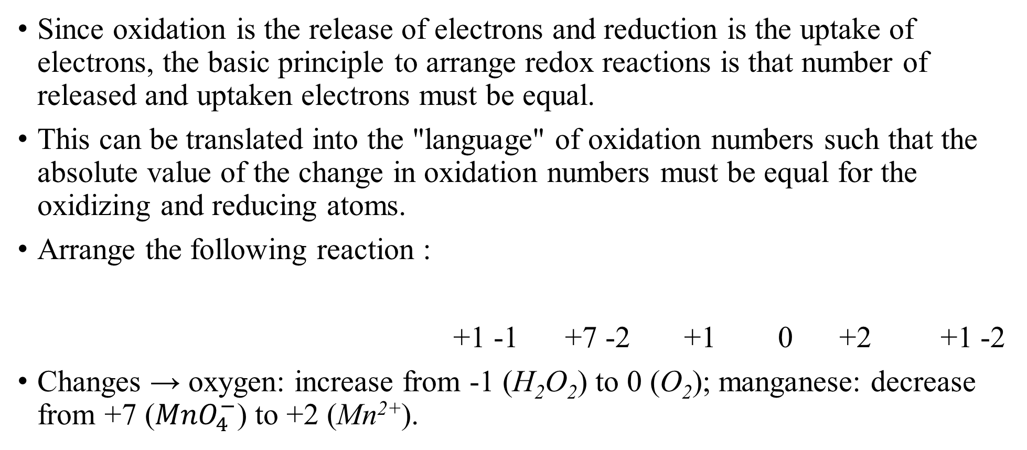
Redox reactions
Since oxidation is the release of electrons and reduction is the uptake of electrons, the basic principle to arrange redox reactions is that number of released and uptaken electrons must be equal.
This can be translated into the "language" of oxidation numbers such that the absolute value of the change in oxidation numbers must be equal for the oxidizing and reducing atoms.
Arrange the following reaction :
+1 -1 +7 -2 +1 0 +2 +1 -2
Changes → oxygen: increase from -1 (H₂O₂) to 0 (O₂); manganese: decrease from +7 (${MnO}_{4}^{−}$) to +2 (Mn²⁺).
$$H_{2}O_{2}+{MnO}_{4}^{−}+H^{+}→O_{2}+{Mn}^{2+}+H_{2}O$$

Slide 12
Arrangement by change in oxidation numbers
oxidation Δ=+2 (2e⁻ release)
2(-1)=-2
2(0)=0
$$H_{2}O_{2}+{MnO}_{4}^{−}+H^{+}→O_{2}+{Mn}^{2+}+H_{2}O$$
reduction Δ=-5 (5e⁻ uptake)
+7
+2
The lowest common multiple must be found, which is in this case 2·5=10
$$5H_{2}O_{2}+{2MnO}_{4}^{−}+H^{+}→{5O}_{2}+{2Mn}^{2+}+H_{2}O$$
Some of the oxygen atoms have changed their oxidation number, but their quantity must match on both sides.

Slide 13

Arrangement by change in oxidation numbers
$$5H_{2}O_{2}+{2MnO}_{4}^{−}+H^{+}→{5O}_{2}+{2Mn}^{2+}+H_{2}O$$
oxygen: 5·2+2·4=18→ 5·2+1=11 missing 7
$$5H_{2}O_{2}+{2MnO}_{4}^{−}+H^{+}→{5O}_{2}+{2Mn}^{2+}+{8H}_{2}O$$
hydrogen: 5·2+1=11→ 8·2=16
missing 5
Oxidation number of all hydrogen is +1.
$$5H_{2}O_{2}+{2MnO}_{4}^{−}+6H^{+}→{5O}_{2}+{2Mn}^{2+}+{8H}_{2}O$$
$$=$$
2·(-1)+(+6)=+4→ 2·(+2)=+4.
What about charge?

Slide 14
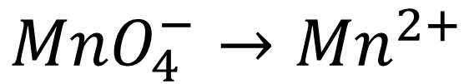
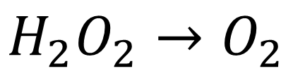
Arrangement by the half-reaction method
Even less data about the reaction is sufficient for correct ordering. It is enough to know the substances, in which the oxidation numbere of the atoms changes.
One does not even need to know the oxidation number of individual particles.
First, the reaction is separated into two half-reactions and sorted separately.
Ordering is carried out first by atoms, with the help of water composing ions, i.e., one can add H₂O molecules, H⁺ and OH⁻ ions to both half-reactions.
$$H_{2}O_{2}+{MnO}_{4}^{−}→O_{2}+{Mn}^{2+}$$
$$H_{2}O_{2}→O_{2}$$
$${MnO}_{4}^{−}→{Mn}^{2+}$$

Slide 15
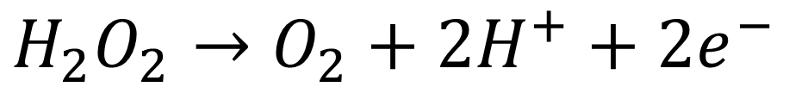
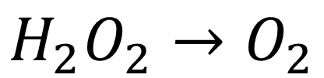
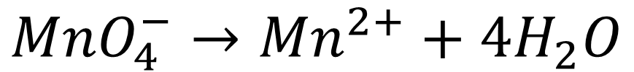
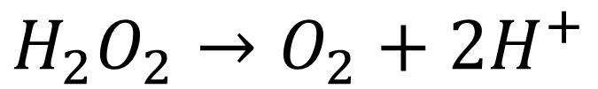
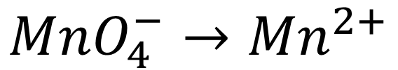
Arrangement by the half-reaction method
$$H_{2}O_{2}→O_{2}$$
missing 2 hydrogen
$${MnO}_{4}^{−}→{Mn}^{2+}$$
missing 4 oxygen
$$H_{2}O_{2}→O_{2}+2H^{+}$$
$${MnO}_{4}^{−}→{Mn}^{2+}+4H_{2}O$$
0→ 2·(+1)=+2
missing 8 hydrogen
Charges are not equal!
$${MnO}_{4}^{−}+8H^{+}→{Mn}^{2+}+4H_{2}O$$
Electrons are added to the more positive side.
(-1)+8·(+1)= +7→ +2
oxidation
$$H_{2}O_{2}→O_{2}+2H^{+}+2e^{−}$$
$${MnO}_{4}^{−}+8H^{+}+5e^{−}→{Mn}^{2+}+4H_{2}O$$
reduction
However, the number of electrons in oxidation and reduction is not equal.

Slide 16
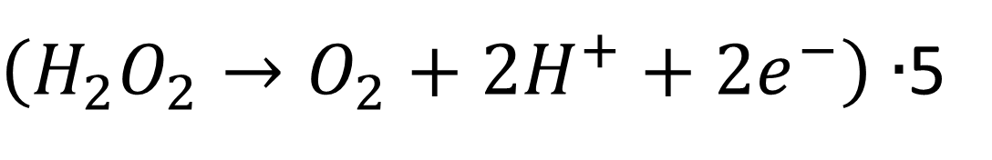
Arrangement by the half-reaction method
The lowest common multiple must be found now : 2·5=10
$\left(H_{2}O_{2}→O_{2}+2H^{+}+2e^{−}\right)∙$5
$$\left({MnO}_{4}^{−}+8H^{+}+5e^{−}→{Mn}^{2+}+4H_{2}O\right)∙2$$
so
$$5H_{2}O_{2}→{5O}_{2}+10H^{+}+10e^{−}$$
+
$${2MnO}_{4}^{−}+16H^{+}+10e^{−}→{2Mn}^{2+}+8H_{2}O$$
$$5H_{2}O_{2}+{2MnO}_{4}^{−}+16H^{+}+10e^{−}=$$
$$={5O}_{2}+{2Mn}^{2+}+8H_{2}O+10H^{+}+10e^{−}$$
$$5H_{2}O_{2}+{2MnO}_{4}^{−}+6H^{+}={5O}_{2}+{2Mn}^{2+}+{8H}_{2}O$$

Slide 17
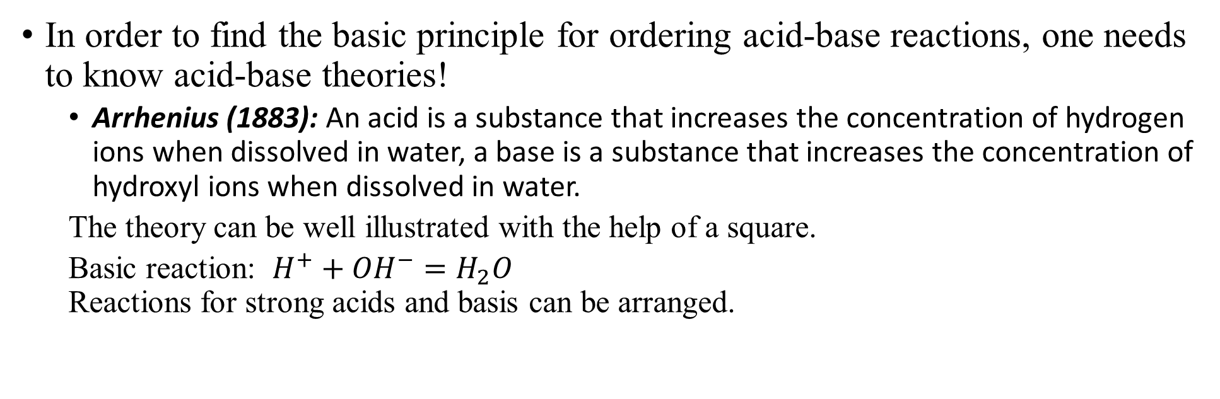
Acid-base reactions
In order to find the basic principle for ordering acid-base reactions, one needs to know acid-base theories!
  Arrhenius (1883): An acid is a substance that increases the concentration of hydrogen ions when dissolved in water, a base is a substance that increases the concentration of hydroxyl ions when dissolved in water.
  The theory can be well illustrated with the help of a square.
  Basic reaction: $H^{+}+{OH}^{−}=H_{2}O$
  Reactions for strong acids and basis can be arranged.
{
acid
{
}
H⁺
A⁻
$$H_{2}{SO}_{4}+NaOH→{Na}_{2}{SO}_{4}+H_{2}O$$
water
salt
HO⁻
B⁺
Two H⁺ ions of sulfuric acid are neutralized by two OH⁻ ions, which requires two NaOH and produces two water :
{
$$H_{2}{SO}_{4}+2NaOH={Na}_{2}{SO}_{4}+2H_{2}O$$
base

Slide 18
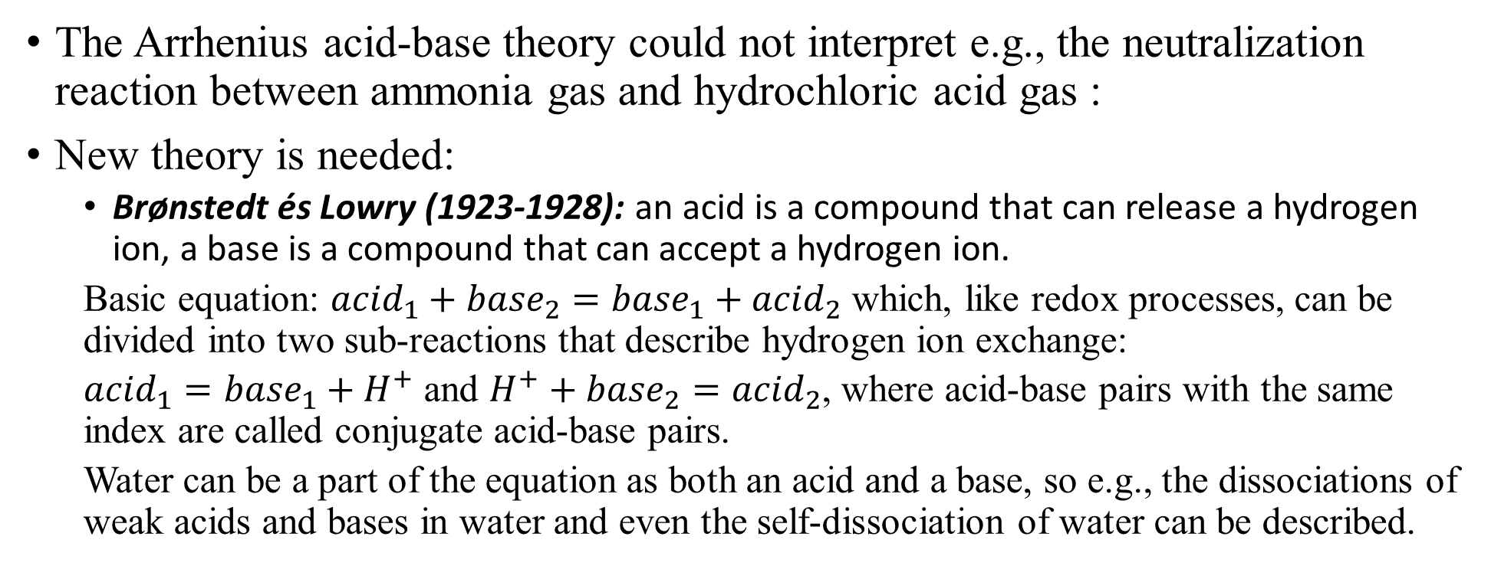



Acid-base reactions
The Arrhenius acid-base theory could not interpret e.g., the neutralization reaction between ammonia gas and hydrochloric acid gas :
New theory is needed:
  Brønstedt és Lowry (1923-1928): an acid is a compound that can release a hydrogen ion, a base is a compound that can accept a hydrogen ion.
  Basic equation: ${acid}_{1}+{base}_{2}={base}_{1}+{acid}_{2}$ which, like redox processes, can be divided into two sub-reactions that describe hydrogen ion exchange:
  ${acid}_{1}={base}_{1}+H^{+}$ and $H^{+}+{base}_{2}={acid}_{2}$, where acid-base pairs with the same index are called conjugate acid-base pairs.
  Water can be a part of the equation as both an acid and a base, so e.g., the dissociations of weak acids and bases in water and even the self-dissociation of water can be described.
$${NH}_{3(g)}+{HCl}_{(g)}={NH}_{4}{Cl}_{(s)}$$
$${CH}_{3}COOH+H_{2}O⇌{CH}_{3}{COO}^{−}+H_{3}O^{+}$$
$${NH}_{3}+H_{2}O⇌{NH}_{4}^{+}+{OH}^{−}$$
$$2H_{2}O⇌{HO}^{−}+H_{3}O^{+}$$

Slide 19

Acid-base reactions
The Brönstedt-Lowry theory was also not able to describe all the acid-base processes. For example,
The first step is an acid-base reaction:
However, the second step takes place only with ammonia, not with NaOH...
Its salt can be crystallized and no change in oxidation numbers.
  Lewis (1938): an acid is a molecule/ion that can accept an electron pair, a base is a molecule/ion that can donate an electron pair.
  Originally, the theory of covalent bonding, which, supplemented with Pearson's hard-soft theory (1963), can still be properly used to describe the stability of the obtained products.
https://www.youtube.com/watch?v=IDDrf8vKtcU
$${Cu}_{(aq)}^{2+}+2{OH}_{(aq)}^{−}={Cu\left(OH\right)}_{2(s)}$$
$${Cu}_{(aq)}^{2+}+4{NH}_{3\left(aq\right)}={\left[Cu{\left({NH}_{3}\right)}_{4}\right]}_{(aq)}^{2+}$$
$${Cu}_{(aq)}^{2+}+{∶NH}_{3(aq)}⇌ {\left[Cu\left({NH}_{3}\right)\right]}_{(aq)}^{2+}$$
$${\left[Cu\left({NH}_{3}\right)\right]}_{(aq)}^{2+}{∶NH}_{3(aq)}⇌{\left[Cu{\left({NH}_{3}\right)}_{2}\right]}_{(aq)}^{2+} etc.$$

Slide 20
Calculations with correct chemical equations
The basis of calculations with chemical reaction equations is that the chemical formula or the symbol of atoms can have three meanings:
  the chemical symbol and the triple meaning of the chemical formula:
  (i) one particle (molecule/ion/atom) of a given material, once the chemical process is described; (ii) one mole of the material to describe the molar ratio between reactants and products; (iii) as many grams of the given substance as its relative atomic or molecular weight, needed to convert molar amount to mass.
Based on the correctly arranged chemical equations, it is therefore possible to calculate the mass of substances that react with each other.

Slide 21
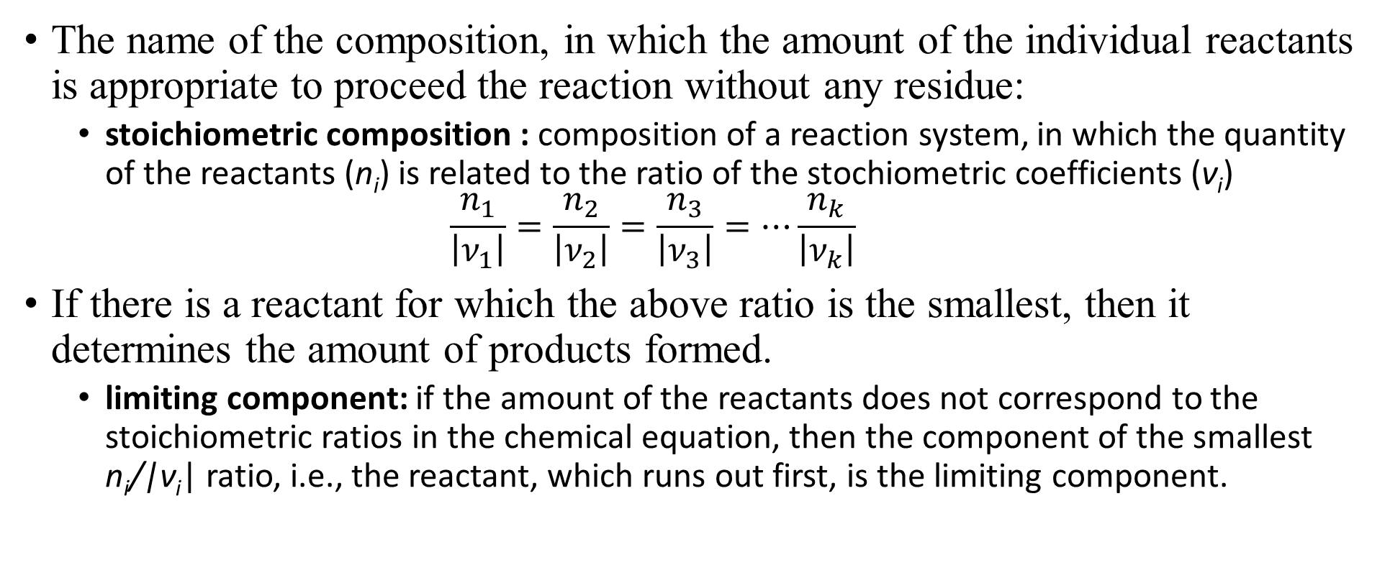
Calculations with correct chemical equations
The name of the composition, in which the amount of the individual reactants is appropriate to proceed the reaction without any residue:
  stoichiometric composition : composition of a reaction system, in which the quantity of the reactants (n_{i}) is related to the ratio of the stochiometric coefficients (ν_{i})
  $\frac{n_{1}}{\left|ν_{1}\right|}=\frac{n_{2}}{\left|ν_{2}\right|}=\frac{n_{3}}{\left|ν_{3}\right|}=⋯\frac{n_{k}}{\left|ν_{k}\right|}$
If there is a reactant for which the above ratio is the smallest, then it determines the amount of products formed.
  limiting component: if the amount of the reactants does not correspond to the stoichiometric ratios in the chemical equation, then the component of the smallest n_{i}/|ν_{i}| ratio, i.e., the reactant, which runs out first, is the limiting component.

Slide 22
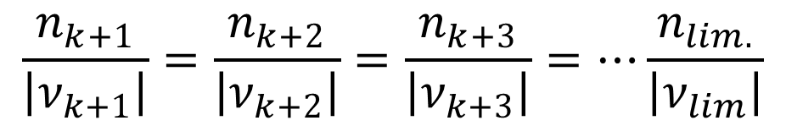
Calculations with correct chemical equations
In the case of the resulting products, it is true that the
ratio is constant.
Let's look at an example, the combustion of benzene in air.
What is the volume of oxygen (p=101325Pa and T=298.15K) consumed during the combustion of 12.36g benzene (C₆H₆)? What is the mass of carbon dioxide (CO₂) and water (H₂O) produced?
The first step is to get the chemical equation in order. Numbers...
$$\frac{n_{k+1}}{\left|ν_{k+1}\right|}=\frac{n_{k+2}}{\left|ν_{k+2}\right|}=\frac{n_{k+3}}{\left|ν_{k+3}\right|}=⋯\frac{n_{lim.}}{\left|ν_{lim}\right|}$$
$$C_{6}H_{6(l)}+O_{2(g)}→{CO}_{2(g)}+H_{2}O_{(g)}$$

Slide 23
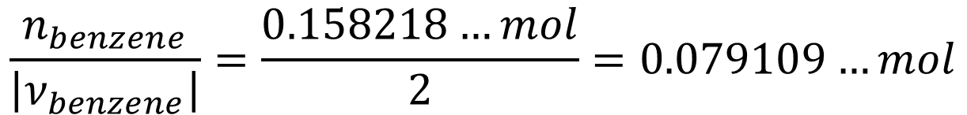
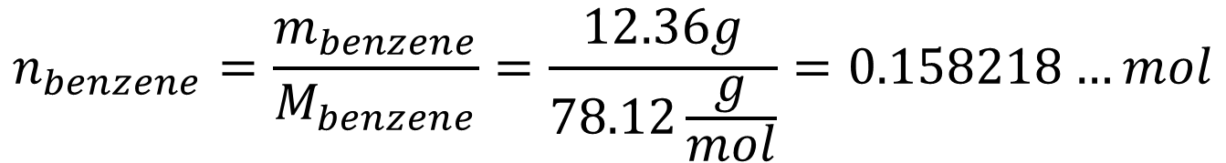
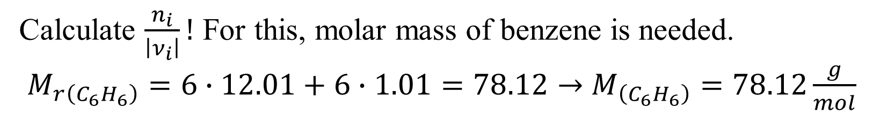
Calculations with correct chemical equations
$$C_{6}H_{6(l)}+O_{2(g)}→6{CO}_{2(g)}+3H_{2}O_{(g)}$$
$$C_{6}H_{6(l)}+{15}/2O_{2(g)}=6{CO}_{2(g)}+3H_{2}O_{(g)}$$
$${2C}_{6}H_{6(l)}+15O_{2(g)}=12{CO}_{2(g)}+6H_{2}O_{(g)}$$
Calculate $\frac{n_{i}}{\left|ν_{i}\right|}!$ For this, molar mass of benzene is needed.
$M_{r\left(C_{6}H_{6}\right)}=6∙12.01+6∙1.01=78.12→$ $M_{\left(C_{6}H_{6}\right)}=78.12\frac{g}{mol}$
$$n_{benzene}=\frac{m_{benzene}}{M_{benzene}}=\frac{12.36g}{78.12\frac{g}{mol}}=0.158218…mol$$
$$\frac{n_{benzene}}{\left|ν_{benzene}\right|}=\frac{0.158218…mol}{2}=0.079109…mol$$

Slide 24
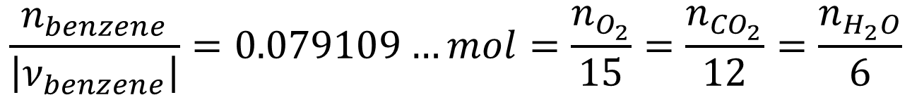
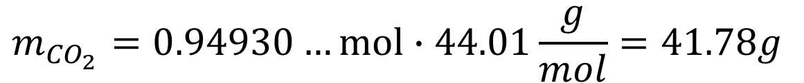
Calculations with correct chemical equations
$$\frac{n_{benzene}}{\left|ν_{benzene}\right|}=0.079109…mol=\frac{n_{O_{2}}}{15}=\frac{n_{{CO}_{2}}}{12}=\frac{n_{H_{2}O}}{6}$$
From this, the consumed oxygen gas and the molar amount of carbon dioxide and water produced can be calculated.
$$n_{O_{2}}=15∙0.079109…mol=1.186635…mol$$
$$V_{O_{2}}=\frac{0.158218…mol 8.314\frac{J}{mol K}298,15K}{101325Pa}=3.8706∙{10}^{−3}m^{3}=3.871{dm}^{3}$$
$$n_{{CO}_{2}}=12∙0.079109…mol=0.94930…mol$$
$$m_{{CO}_{2}}=0.94930…mol∙44.01\frac{g}{mol}=41.78g$$

Slide 25
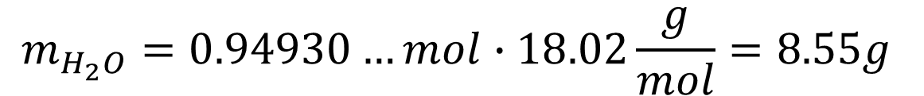
Calculations with correct chemical equations
$$n_{H_{2}O}=6∙0.079109…mol=0.474654…mol$$
$$m_{H_{2}O}=0.94930…mol∙18.02\frac{g}{mol}=8.55g$$
Titration is the most used method to determine chemical quantitites on the basis of chemical reactions. Key steps during titration:
  accurate volume of the solution (analyte) is measured with a pipette:
  https://www.youtube.com/watch?v=5DzybtC0Brk
  adding the measuring solution (titrant) to the analyte, determining the end point:
  https://www.youtube.com/watch?v=sFpFCPTDv2w

Slide 26
Calculation of titration results
What is the concentration of the hydrogen peroxide (H₂O₂) solution, from which 20.00 cm³ volume reacted quantitatively with potassium permanganate titrant of 0.02113 mol/dm³ concentration and of 21.25 cm³, 21.15 cm³ and 21.20 cm³ volume in three titrations? The reaction:
First, the average volume of titrant must be calculated:
From this, the molar amount can be calculated:
$$5H_{2}O_{2}+{2MnO}_{4}^{−}+6H^{+}={5O}_{2}+{2Mn}^{2+}+{8H}_{2}O$$
$$V_{average}=\frac{{21.25 cm}^{3}+{21.15 cm}^{3}+{21.20 cm}^{3}}{3}=21.20{ cm}^{3}$$
$n_{{KMnO}_{4}}=21.20∙{10}^{−3}{dm}^{3}∙0.02113\frac{mol}{{dm}^{3}}=4.47956$ $∙{10}^{−4}mol$

Slide 27
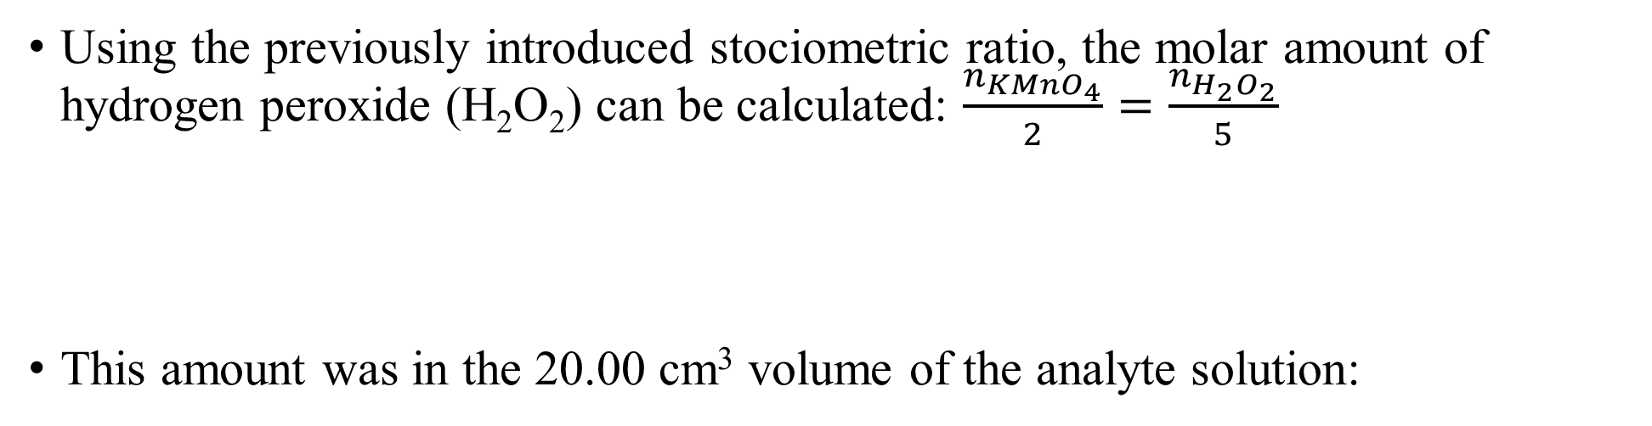
Calculation of titration results
Using the previously introduced stociometric ratio, the molar amount of hydrogen peroxide (H₂O₂) can be calculated: $\frac{n_{{KMnO}_{4}}}{2}=\frac{n_{H_{2}O_{2}}}{5}$
This amount was in the 20.00 cm³ volume of the analyte solution:
$$n_{H_{2}O_{2}}=\frac{5∙n_{{KMnO}_{4}}}{2}=\frac{5∙4.47956∙{10}^{−4}mol}{2}=1.11989{∙10}^{−3}mol$$
$$c_{H_{2}O_{2}}=\frac{n_{H_{2}O_{2}}}{V_{H_{2}O_{2}}}=\frac{1.11989{∙10}^{−3}mol}{20.00∙{10}^{−3}{dm}^{3}}=0.0559945\frac{mol}{{dm}^{3}}=0.05599\frac{mol}{{dm}^{3}}$$
Virtual titration experience can be gained:
http://www.chemcollective.org/vlab/vlab.php
http://chemcollective.org/vlab_download

