Slide 1
General Chemistry
3. Composition of chemical systems
Dr. István Szilágyi
Department of Physical Chemistry and Materials Science
2025.

Slide 2
Origin of chemical properties
The formation of today's concept of the atom was the result of a long historical process:
atom: the smallest carrier of chemical properties, the particle that makes up the substance, which cannot be broken down into further parts by chemical methods.
Of course, chemistry deals not only with the study of interactions between elements, but also with the species formed from them, which can be:
  molecule: a particle made up of two or more atoms in a well-defined ratio.
  ion: charged atom or molecule.
  radical: a molecule with an unpaired electron.

Slide 3
Carriers of chemical properties
However, the substances used in chemical experiments are not individual atoms or molecules, but rather elements and/or compounds:
element: the type of substance that consists of atoms with the same atomic number.
compound: a substance made up of two or more different elements in definite proportion.
The atom and the element, or the molecule and the compound, are therefore not interchangeable concepts, the element is atoms, while the compound is a set of molecules. The individual atoms or molecules do not carry all the properties of the element or the compound, because in the case of the compound, to understand the properties, one also has to take into account the interactions between the atoms and molecules.

Slide 4
Chemical composition of the system
In common sense, when one asks "What is it made of?", the answer is the listing of components. The same is valid for chemical systems:
constituent: the types of chemical substances in the system can be atoms, molecules, ions, radicals.
One may uses another term: component. However, this is not the same as the constituent. Let's look at the example of chemically pure water (H₂O – component; H₃O⁺, OH⁻ and H₂O – constituents).
O
O
H
O
O
O
H
H
O
O
-
O
O
O
O
O
H
H
+
H
-
H
H
H
H
H
H
H
H
H
H
O
H
H
H
H
H
O
H
O
O
O
H
H
+
H
+
O
H
H
H
O
H
H
O
O
H
O
O
H
H
H
H
H
-
H
H
H
H
H
H
H
H
H
H

Slide 5
Definition of component
There are three constituents in water: neutral water molecule (H₂O), positively charged hydronium ion (H₃O⁺) and negative hydroxide ion (HO⁻ or OH⁻).
At the same time, the only component of chemically pure water is H₂O, because upon distillation, one recovers the ionic structure, so the constituents cannot be separated.
So the component: the chemically independent molecules of the system, which cannot be separated by physical methods and can appropriately describe the composition of each phase.
The components are usually linked by some sort of equilibrium process.

Slide 6
Description of the chemical composition
Historical development of the description of chemical composition of materials, mixtures or solutions.
  the first step was to define the names and symbols of the elements -
  the atomic symbols.
  description of the composition of compounds using the atomic symbols occurred with chemical formulas. There are also rules for the correct description of their name.
Nowadays, these are defined by the IUPAC (International Union of Pure and Applied Chemistry)

Slide 7
Marking of elements - symbol
symbol: a one- or two-letter combination used to denote an element. The first letter is uppercase, the second is lowercase. The chemical symbol clearly defines the atomic number (Z). – e.g., C, P, Ba, Co or Br.
atomic number: (sign: Z; unit: N/A) the parameter that determines the quality of the atom, it gives the number of positively charged protons (one of the nucleons with a relative mass of unity). The symbol indicates the atomic number by itself, but if necessary, it can be also indicated in the left subscript of the symbol such as ₁H or ₉₂U etc.
mass number: (sign: A; unit: N/A) the parameter that determines the mass of an atom, the sum of the number of positively charged protons and uncharged neutrons. These nucleons (they are in the nucleus of atoms) possess a relative mass of approximately one unit. The mass number is given in left superscript of the symbol, e.g., ²H or ¹²C.

Slide 8
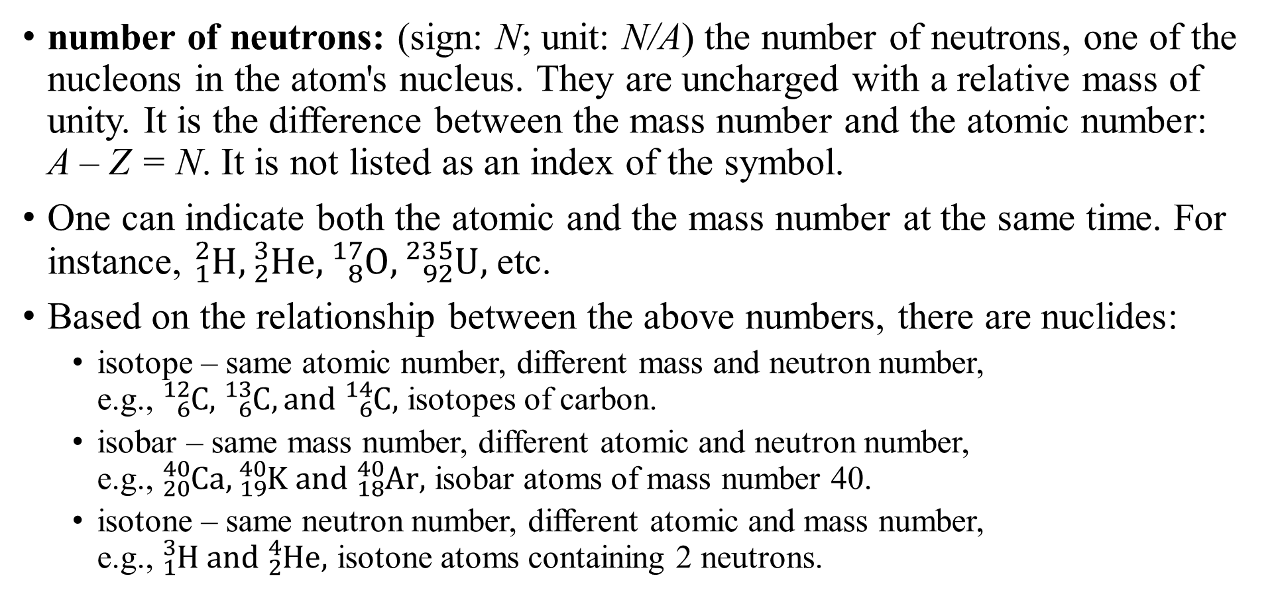
Marking of elements - symbol
number of neutrons: (sign: N; unit: N/A) the number of neutrons, one of the nucleons in the atom's nucleus. They are uncharged with a relative mass of unity. It is the difference between the mass number and the atomic number: A – Z = N. It is not listed as an index of the symbol.
One can indicate both the atomic and the mass number at the same time. For instance, ${}_{1}^{2}{H, {}_{2}^{3}{He,{}_{8}^{17}O, {}_{92}^{235}U}},$ etc.
Based on the relationship between the above numbers, there are nuclides:
  isotope – same atomic number, different mass and neutron number,
  e.g., ${}_{6}^{12}{C, }{}_{6}^{13}C, and {}_{6}^{14}{C,}$ isotopes of carbon.
  isobar – same mass number, different atomic and neutron number,
  e.g., ${}_{20}^{40}{Ca}, {}_{19}^{40}K and {}_{18}^{40}{Ar},$ isobar atoms of mass number 40.
  isotone – same neutron number, different atomic and mass number,
  e.g., ${}_{1}^{3}H and {}_{2}^{4}{He},$ isotone atoms containing 2 neutrons.

Slide 9
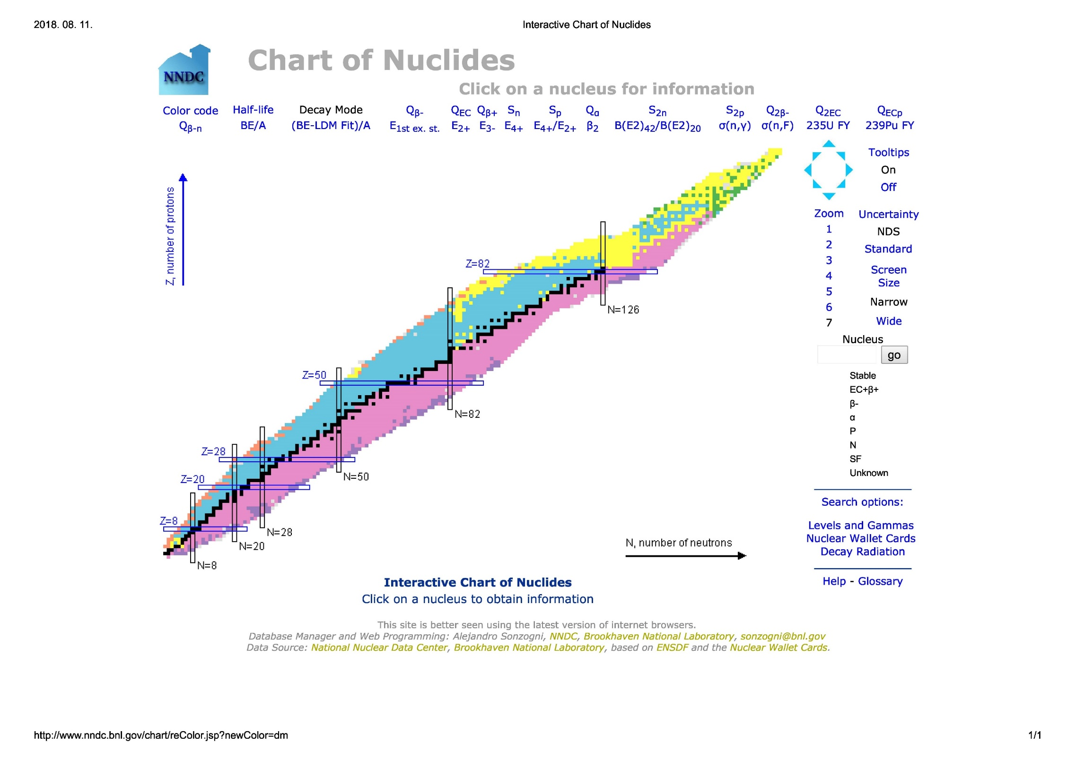









































Chart of nuclides
http://www.nndc.bnl.gov/
8
7
6
5
4
3
2
1
$${}_{8}^{13}O$$
$${}_{8}^{14}O$$
$${}_{8}^{15}O$$
$${}_{8}^{16}O$$
Z →
isobars
$${}_{7}^{12}N$$
$${}_{7}^{13}N$$
$${}_{7}^{14}N$$
$${}_{7}^{15}N$$
$${}_{6}^{9}C$$
$${}_{6}^{10}C$$
$${}_{6}^{11}C$$
$${}_{6}^{12}C$$
$${}_{6}^{13}C$$
$${}_{6}^{14}C$$
$${}_{5}^{8}B$$
$${}_{5}^{9}B$$
$${}_{5}^{10}B$$
$${}_{5}^{11}B$$
$${}_{5}^{12}B$$
$${}_{5}^{13}B$$
$${}_{4}^{7}{Be}$$
$${}_{4}^{8}{Be}$$
$${}_{4}^{9}{Be}$$
$${}_{4}^{10}{Be}$$
$${}_{4}^{11}{Be}$$
$${}_{4}^{12}{Be}$$
isotones
$${}_{3}^{5}{Li}$$
$${}_{3}^{6}{Li}$$
$${}_{3}^{7}{Li}$$
$${}_{3}^{8}{Li}$$
$${}_{3}^{9}{Li}$$
$${}_{3}^{11}{Li}$$
$${}_{2}^{3}{He}$$
$${}_{2}^{4}{He}$$
$${}_{2}^{5}{He}$$
$${}_{2}^{6}{He}$$
$${}_{2}^{7}{He}$$
$${}_{2}^{8}{He}$$
$${}_{1}^{1}H$$
$${}_{1}^{2}H$$
$${}_{1}^{3}H$$
isotopes
0 1 2 3 4 5 6 7 8
N →

Slide 10
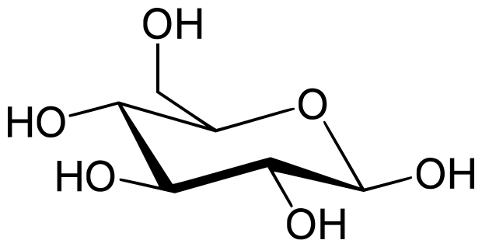
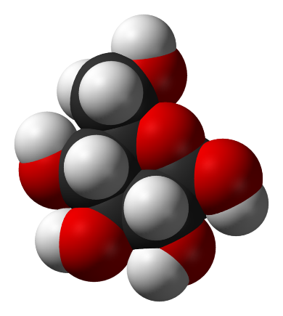
Description of compounds with chemical formula
chemical formula: a sign to specify compounds based on the symbols of the atoms in it and also reflects the quantitative relationships of the atoms in the compound. Such quantitative relationships are indicated by the numbers given in the right subscript after the symbols. The order of the symbols depends on the type of compound - inorganic or organic - and the type of formula, whether it is an empirical, molecular or structural formula. For example, KHCO₃, CH₄, C₆H₁₂O₆ and CH₃CH₂COOH.
  empirical formula: gives the ratio of the the atoms that make up the compound, with the smallest possible numbers after the symbols. It is not always unambigous. E.g., CH can be acetylene, HC≡CH, or benzene, C₆H₆. Crystalline ionic compounds are described with such a formula. E.g., NaCl, which could be also (NaCl)_{n}.
  molecular formula: gives the ratio of the atoms that make up the compound by showing how many atoms are in it. For instance, HCl, C₆H₁₂O₆, C₆H₆.
  structural formula: it contains information about the connection of different atoms to each other, possibly also about the spatial structure of the molecule. The easiest way is to list the groups one after the other. For example, CH₃CH₂OH can be also shown with chemical bonds,
  H–C≡C–H implies the spatial structure, or D-glucose, which can be also shown by the 3D structure.

Slide 11
Classification of materials
element
Single component material
gas mixture
solution
alloy, double salt
compound
phyiscal separation
homogeneous
mist
smog
foam
emulsion
suspension
colloids
Multicomponent material
heterogeneous

Slide 12
Classification of materials - definitions
homogeneous system/single-phase system: the system, in which there are no interfaces, the intensive properties are the same in all parts of the system.
heterogeneous system/multi-phase system: the system, in which the intensive properties undergo significant changes and the individual phases are separated by interfaces within the system.
disperse system: a system consisting of two or more materials, where the constituents are separated by interfaces. They are mixed in the form of particles, droplets, i.e., a multi-component heterogeneous system.
mixture: a system consisting of two or more compounds, in which the components are distributed among each other at the molecular level, i.e., a multi-component homogeneous system.
inhomogeneous system: single-phase system, where the intensive parameters are not the same in all parts of the system, but their changes are continuous, not sudden. There are no macroscopic interfaces.

Slide 13

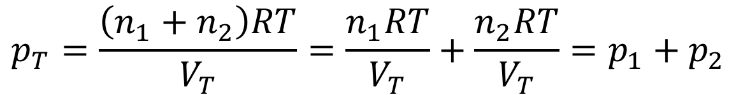
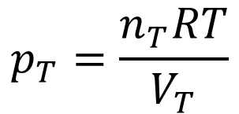
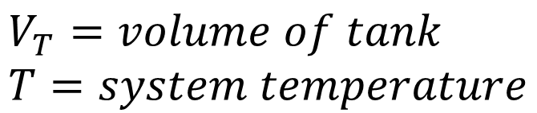
Gas mixtures
In the temperature and pressure ranges, in which the ideal gas approximation works, all gases form homogeneous mixture, for which the universal gas law is valid (also for the components).
$$V_{T}=volume of tank \\ T=system temperature$$
$$p_{T}=\frac{n_{T}RT}{V_{T}}$$
$$n_{T}=n_{1}+n_{2}$$
$$p_{T}=\frac{\left(n_{1}+n_{2}\right)RT}{V_{T}}=\frac{n_{1}RT}{V_{T}}+\frac{n_{2}RT}{V_{T}}=p_{1}+p_{2}$$
(Dalton’s law)
where p₁ and p₂ are the partial pressure of the components:
partial pressure: the pressure exerted by an ideal gas in a gas mixture if it would be alone in the same volume.

Slide 14

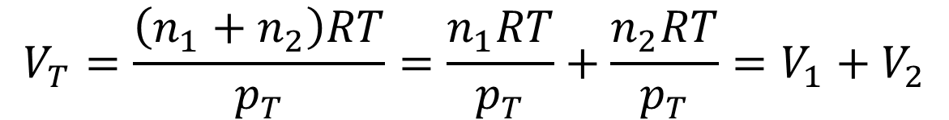

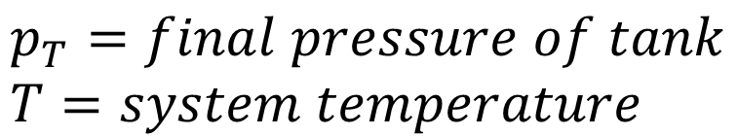
Gas mixtures
One may also ask the question of how many tanks and what pressure are needed to store the gases separately?
$$p_{T}=final pressure of tank \\ T=system temperature$$
$$V_{T}=\frac{n_{T}RT}{p_{T}}$$
$$n_{T}=n_{1}+n_{2}$$
$$V_{T}=\frac{\left(n_{1}+n_{2}\right)RT}{p_{T}}=\frac{n_{1}RT}{p_{T}}+\frac{n_{2}RT}{p_{T}}=V_{1}+V_{2}$$
where V₁ and V₂ are the partial volumes of the components:
partial volume: the volume that would be alone occupied by an ideal mixture-forming gas at the same temperature and pressure as in the gas mixture.

Slide 15
Solutions
2/10/2024
Solutions are made by dissolution of a material in a liquid.
  solution: a liquid mixture, in which one of the components is of particular importance due to its large excess or some other important property. This substance is called the solvent, and the dissolved one is the solute.
Obviously, there must be an interaction between the solvent and the solute leading to a more favorable state. As a result, the solute is surrounded by the solvent molecules and is distributed in the solvent at the molecular level.
This process is the
  solvation: a complex process, in which the solvent molecules surround the solutes and bring them into the solution. Accordingly, solvents molecularly disperse solutes and keep them in the solution.

Slide 16
Dissolution in water – hydration
O
O
O
H
O
- +
- +
H
H
H
H
H
H
H
O
O
- +
- +
- +
O
O
O
H
H
H
O
H
H
H
- +
- +
- +
H
O
H
H
H
H
- +
O
- +
H
H
- +
- +
- +
O
H
O
O
H
H
H
O
H
H
O
- +
- +
O
H
H
H
H
H
H
O
H
H
H
H
O
- +
- +
- +
O
H
H
O
H
H
- +
- +
O
H
H
H
- +
- +
- +
H
H

Slide 17
Solution composition
The properties of solutions strongly depend on the ratio of solute and solvent. Concentrations matter!
  the 10% acetic acid solution does not cause problems in the kitchen, glacial acetic acid is dangerous even in the laboratory!
  The gastric juice contains 0.1 mole of HCl per liter with no problem, while the concentrated one (27%) is very harmful.
Why solute-to-solvent ratio in the solution is important to know?
  One can compare solutions and characterize their effects.
  One can prepare them in the simplest and reproducible way.
Practical issues gave rise to many ways to specify the composition of solutions. Let's take them one by one and see the connections between them.

Slide 18
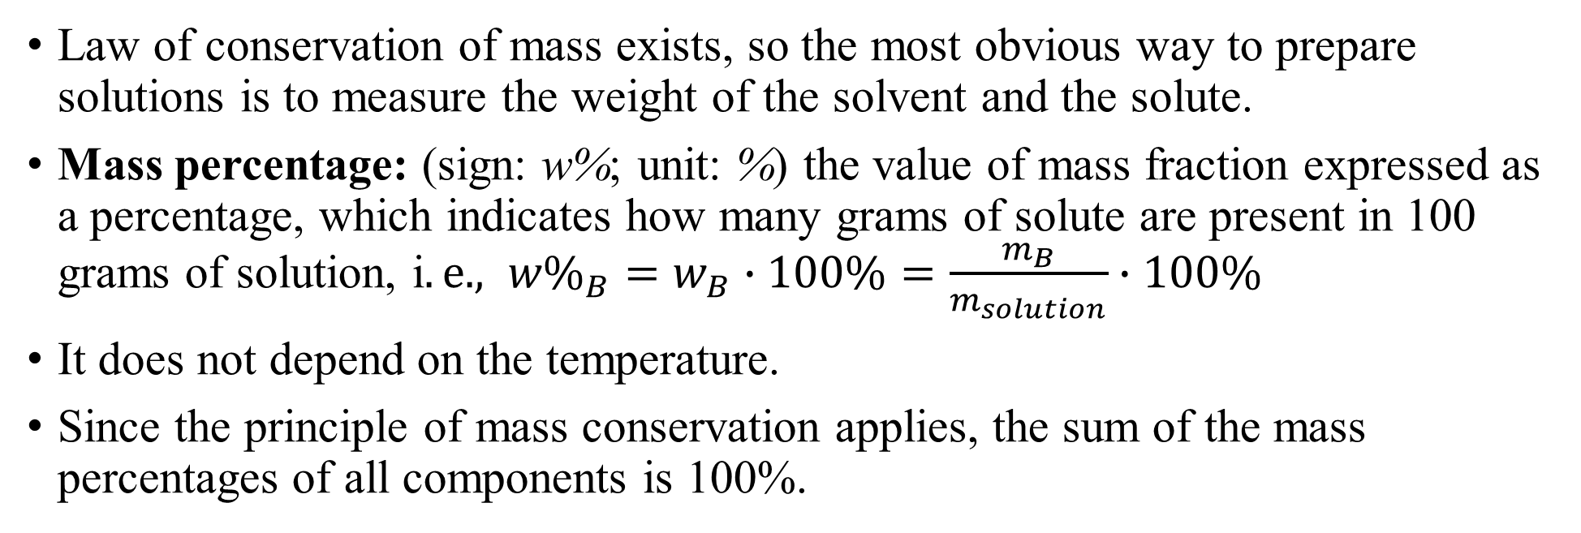
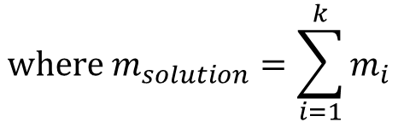
Composition – mass percentage
Law of conservation of mass exists, so the most obvious way to prepare solutions is to measure the weight of the solvent and the solute.
Mass percentage: (sign: w%; unit: %) the value of mass fraction expressed as a percentage, which indicates how many grams of solute are present in 100 grams of solution, i$.e., {w\%}_{B}=w_{B}∙100\%=\frac{m_{B}}{m_{solution}}∙100\%$
It does not depend on the temperature.
Since the principle of mass conservation applies, the sum of the mass percentages of all components is 100%.
$$where m_{solution}=\sum_{i=1}^{k}{m_{i}}$$
$$\frac{m_{A}}{\left(m_{A}+m_{B}\right)}∙100\%+\frac{m_{B}}{\left(m_{A}+m_{B}\right)}∙100\%=\frac{\left(m_{A}+m_{B}\right)}{\left(m_{A}+m_{B}\right)}∙100\%=100\%$$

Slide 19
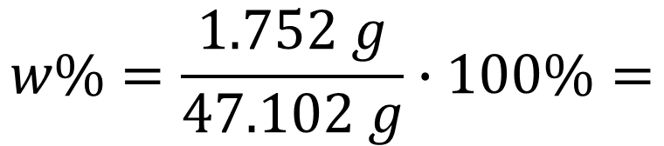

Composition – mass percentage
Problem:
What is the mass percentage of a KMnO₄ solution, if 1.752 g of KMnO₄ was dissolved in 45.35 g of water? M_{r}(KMnO₄ )=158.03; M_{r}(H₂O)=18.02; Give the result with 4 significant figures.
Answer:
$$m_{solution}=1.752 g+45.35 g$$
$$=47.102 g$$
$$w\%=\frac{1.752 g}{47.102 g}∙100\%=$$
$$=\left(3.7195872…\right)\%=3.720 \%$$

Slide 20
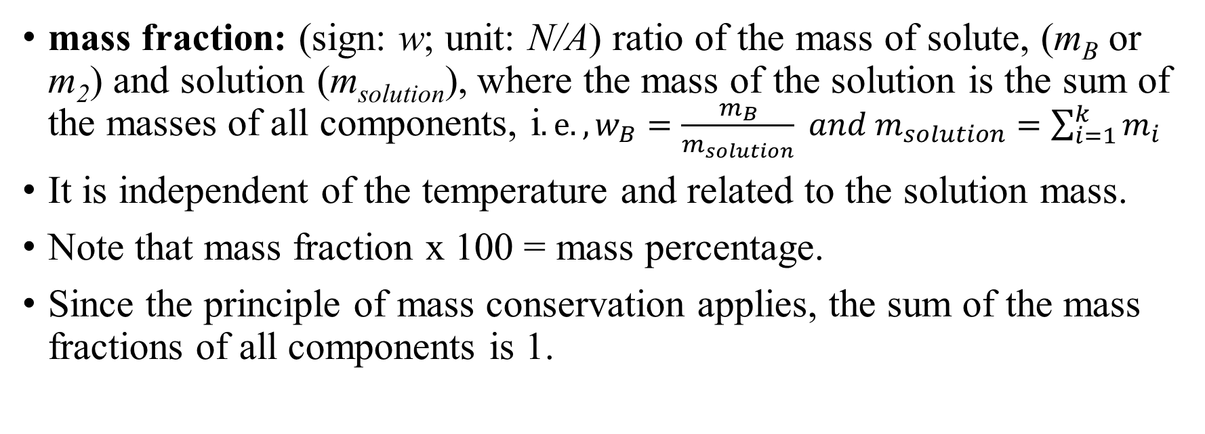
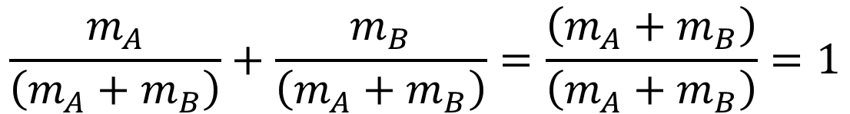
Composition – mass fraction
mass fraction: (sign: w; unit: N/A) ratio of the mass of solute, (m_{B} or m₂) and solution (m_{solution}), where the mass of the solution is the sum of the masses of all components, i$.e. , w_{B}=\frac{m_{B}}{m_{solution}} and m_{solution}=\sum_{i=1}^{k}{m_{i}}$
It is independent of the temperature and related to the solution mass.
Note that mass fraction x 100 = mass percentage.
Since the principle of mass conservation applies, the sum of the mass fractions of all components is 1.
$$\frac{m_{A}}{\left(m_{A}+m_{B}\right)}+\frac{m_{B}}{\left(m_{A}+m_{B}\right)}=\frac{\left(m_{A}+m_{B}\right)}{\left(m_{A}+m_{B}\right)}=1$$

Slide 21


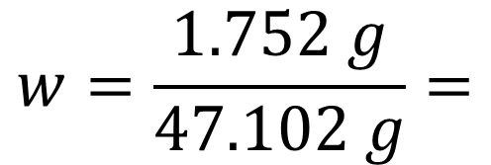

Composition – mass fraction
Problem:
What is the mass fraction of a KMnO₄ solution, if 1.752 g of KMnO₄ is dissolved in 45.35 g of water? M_{r}(KMnO₄ )=158.03; M_{r}(H₂O)=18.02; Give the result with 4 significant figures.
Answer:
$$m_{solution}=1.752 g+45.35 g$$
$$=47.102 g$$
$$w=\frac{1.752 g}{47.102 g}=$$
$$\left(=0.037195872…\right)=$$
$$=0.03720$$

Slide 22
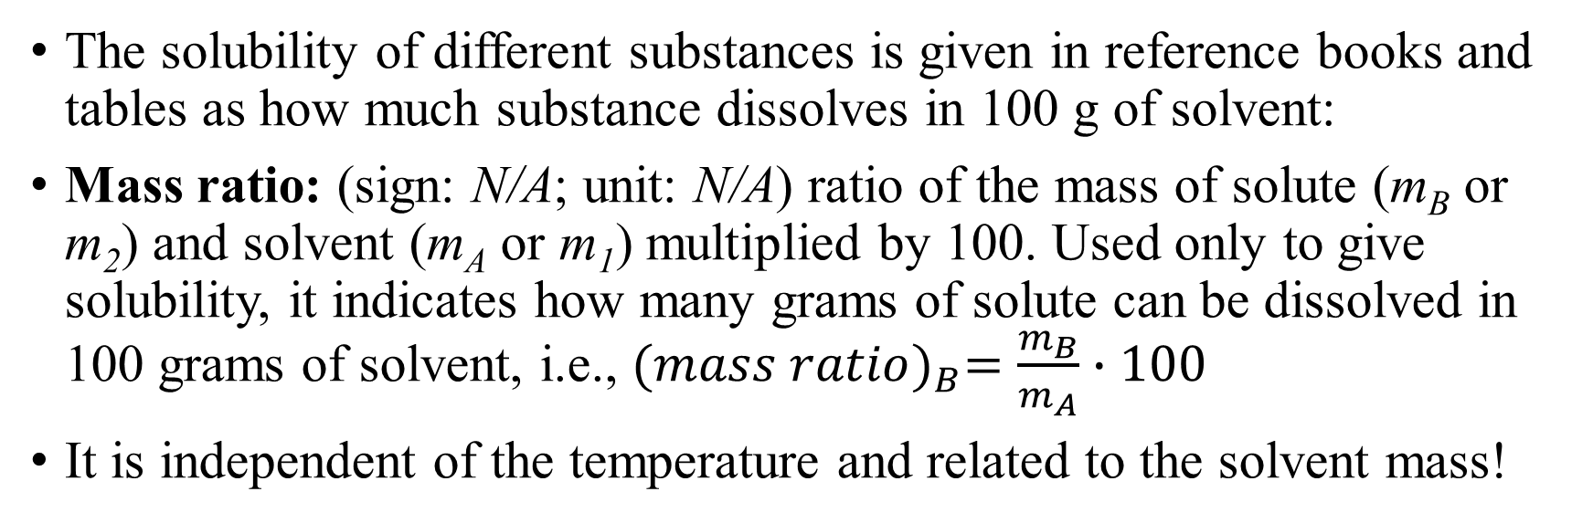
Composition – mass ratio
The solubility of different substances is given in reference books and tables as how much substance dissolves in 100 g of solvent:
Mass ratio: (sign: N/A; unit: N/A) ratio of the mass of solute (m_{B} or m₂) and solvent (m_{A} or m₁) multiplied by 100. Used only to give solubility, it indicates how many grams of solute can be dissolved in 100 grams of solvent, i.e., ${(mass ratio)}_{B}=\frac{m_{B}}{m_{A}}∙100$
It is independent of the temperature and related to the solvent mass!

Slide 23
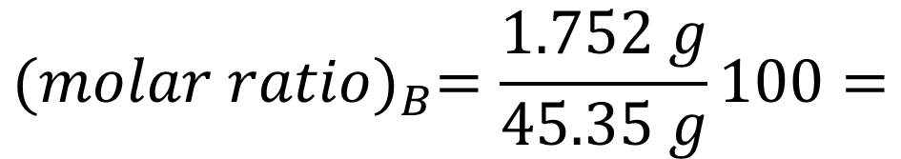


Composition – mass ratio
Problem:
What is the mass ratio in a KMnO₄ solution, if 1.752 g of KMnO₄ is dissolved in 45.35 g of water? M_{r}(KMnO₄ )=158.03; M_{r}(H₂O)=18.02; Give the result with 4 significant figures.
Solution:
$${(molar ratio)}_{B}=\frac{1.752 g}{45.35 g}100=$$
$$\left(3.8632855…\right)=$$
$$=3.863$$

Slide 24
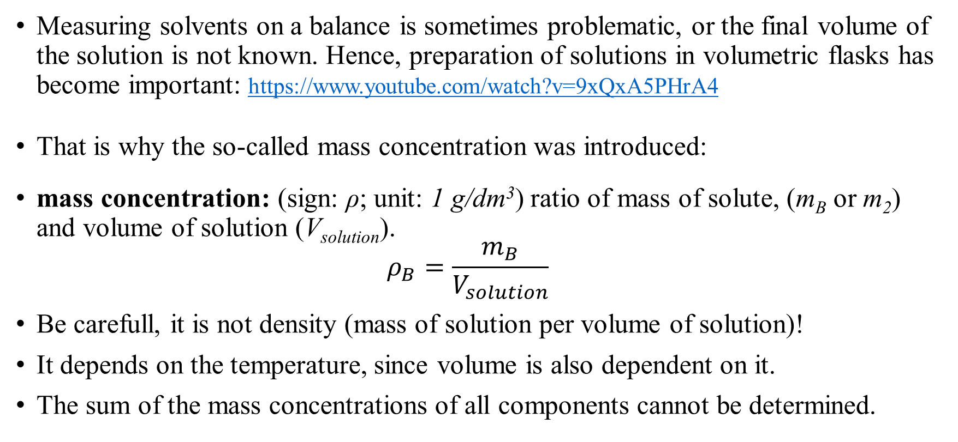
Composition – mass concentration
Measuring solvents on a balance is sometimes problematic, or the final volume of the solution is not known. Hence, preparation of solutions in volumetric flasks has become important: https://www.youtube.com/watch?v=9xQxA5PHrA4
That is why the so-called mass concentration was introduced:
mass concentration: (sign: ρ; unit: 1 g/dm³) ratio of mass of solute, (m_{B} or m₂) and volume of solution (V_{solution}).
$ρ_{B}=\frac{m_{B}}{V_{solution}}$
Be carefull, it is not density (mass of solution per volume of solution)!
It depends on the temperature, since volume is also dependent on it.
The sum of the mass concentrations of all components cannot be determined.

Slide 25
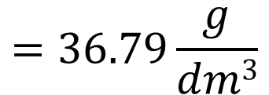
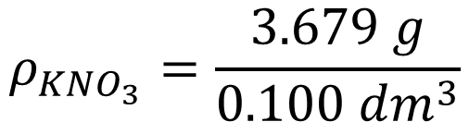
Composition – mass concentration
What is the mass concentration of the solution made by dissolving 3.679 g of KNO₃ in some water followed by its transfer into a volumetric flask of 100 cm³ volume and completing the flask with water after the temperature reached room temperature? M_{r}(KNO₃)=101.10; M_{r}(H₂O)=18.02; and ρ_{solution}=1.0205 g/cm³; ρ(H₂O)=0.9971 g/cm³; Give the result with 4 significant figures.
$$V_{solution}=100{ cm}^{3}=0.100{ dm}^{3}$$
$$ρ_{{KNO}_{3}}=\frac{3.679 g}{0.100 {dm}^{3}}$$
$$=36.79\frac{g}{dm3}$$

Slide 26
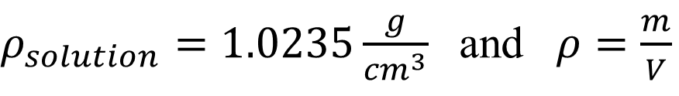
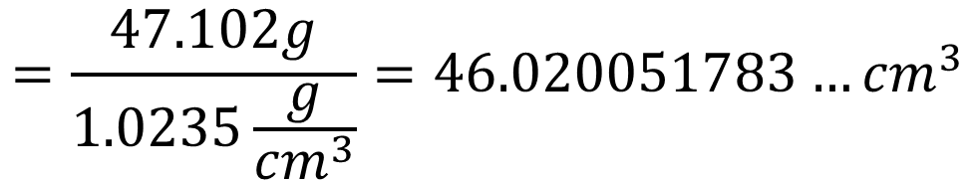
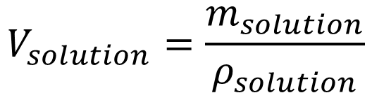
Composition – mass concentration
Using the data of the previously studied KMnO₄ solution, can one calculate the mass concentration?
What is the mass concentration of a KMnO₄ solution, if 1.752 g of KMnO₄ is dissolved in 45.35 g of water? M_{r}(KMnO₄ )=158.03; M_{r}(H₂O)=18.02; Give the result with 4 significant figures.
No, because we cannot calculate its volume. We need to know its density.
$ρ_{solution}=1.0235\frac{g}{{cm}^{3}}$ and $ρ=\frac{m}{V}$
$$V_{solution}=\frac{m_{solution}}{ρ_{solution}}$$
$$=\frac{47.102g}{1.0235\frac{g}{{cm}^{3}}}=46.020051783…{cm}^{3}$$

Slide 27
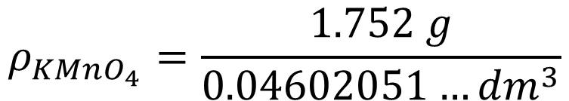
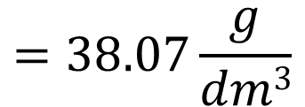
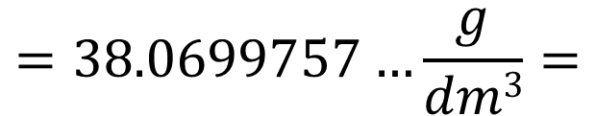
Composition – mass concentration
What is the mass concentration of a KMnO₄ solution, if 1.752 g of KMnO₄ is dissolved in 45.35 g of water? M_{r}(KMnO₄ )=158.03; M_{r}(H₂O)=18.02; Give the result with 4 significant figures.
Continuation from previous slide:
$$ρ_{{KMnO}_{4}}=\frac{1.752 g}{0.04602051…{dm}^{3}}$$
$$=38.0699757…\frac{g}{dm3}=$$
$$=38.07\frac{g}{dm3}$$

Slide 28
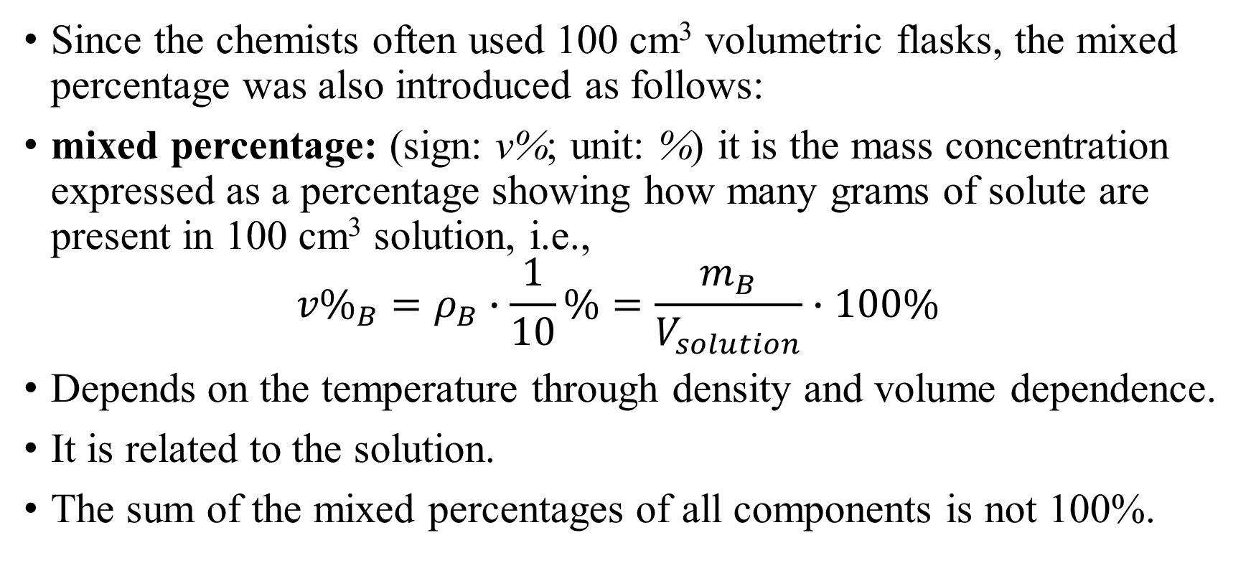
Compostion – mixed percentage
Since the chemists often used 100 cm³ volumetric flasks, the mixed percentage was also introduced as follows:
mixed percentage: (sign: v%; unit: %) it is the mass concentration expressed as a percentage showing how many grams of solute are present in 100 cm³ solution, i.e.,
${v\%}_{B}=ρ_{B}∙\frac{1}{10}\%=\frac{m_{B}}{V_{solution}}∙100\%$
Depends on the temperature through density and volume dependence.
It is related to the solution.
The sum of the mixed percentages of all components is not 100%.

Slide 29
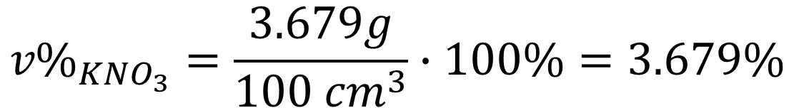
Compostion – mixed percentage
What is the mixed percentage of the solution made by dissolving 3.679 g of KNO₃ in some water followed by its transfer into a volumetric flask of 100 cm³ volume and completing the flask with water after the temperature reached room’s one? M_{r}(KNO₃)=101.10; M_{r}(H₂O)=18.02; and ρ_{solution}=1.0205 g/cm³; ρ(H₂O)=0.9971 g/cm³; Give the result with 4 significant figures.
$${v\%}_{{KNO}_{3}}=\frac{3.679g}{{100 cm}^{3}}∙100\%=3.679\%$$

Slide 30
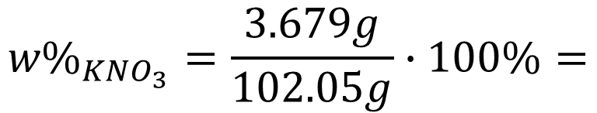
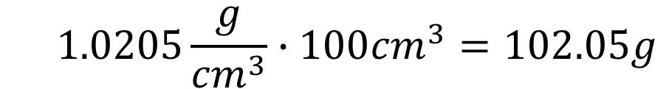
Mixed percentage – Mass percentage
Let us calculate the previous solution’s composition in mass percentage!
$$1.0205\frac{g}{{cm}^{3}}∙100{cm}^{3}=102.05g$$
$$m_{solution}= ρ_{solution}∙V_{solution}=$$
$${w\%}_{{KNO}_{3}}=\frac{3.679g}{102.05g}∙100\%=$$
$$3.605095541…\%=3.605\%$$

Slide 31

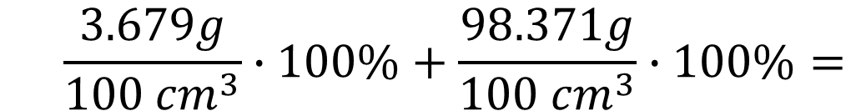
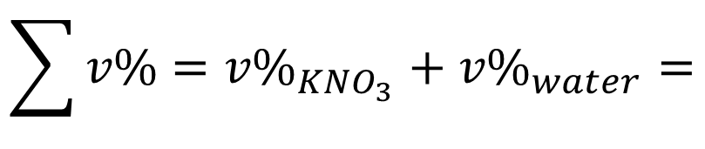
The sum of the mixed percentages is not 100%?
Let's prove it using the previous problem!
$$m_{solution}=102.05g$$
$$m_{water}=m_{solution}−m_{{KNO}_{3}}=$$
$$102.05g−3.679g=98.371g$$
$${\sum{v\%}=v\%}_{{KNO}_{3}}+{v\%}_{water}=$$
$$\frac{3.679g}{{100 cm}^{3}}∙100\%+\frac{98.371g}{{100 cm}^{3}}∙100\%=$$
$$=3.679\%+98.371\%=102.05\%$$

Slide 32
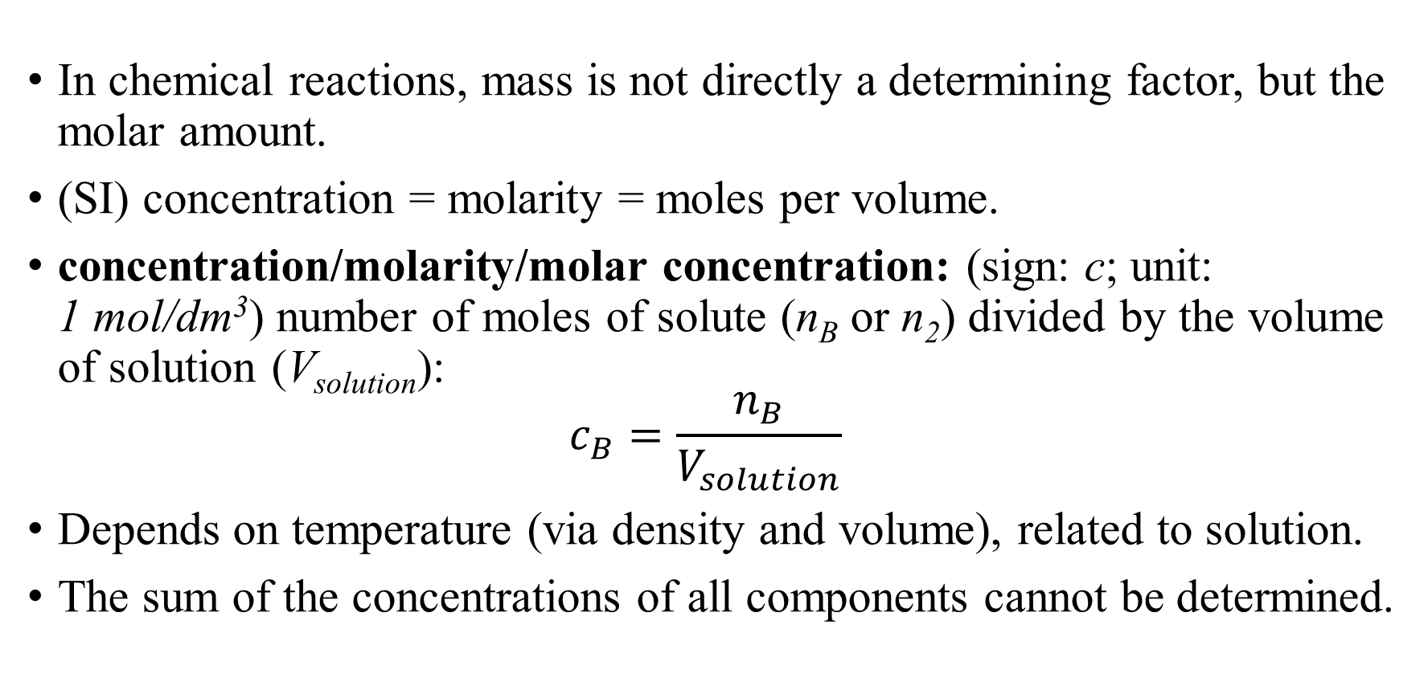
Composition – molarity
In chemical reactions, mass is not directly a determining factor, but the molar amount.
(SI) concentration = molarity = moles per volume.
concentration/molarity/molar concentration: (sign: c; unit: 1 mol/dm³) number of moles of solute (n_{B} or n₂) divided by the volume of solution (V_{solution}):
$c_{B}=\frac{n_{B}}{V_{solution}}$
Depends on temperature (via density and volume), related to solution.
The sum of the concentrations of all components cannot be determined.

Slide 33
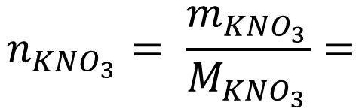
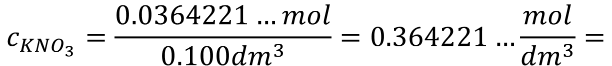
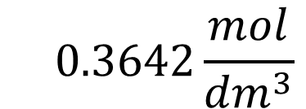
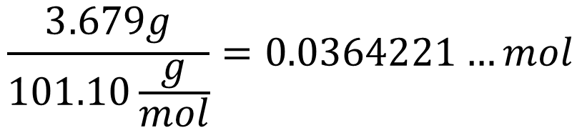
Composition – molarity
What is the molar concentration of the solution made by dissolving 3.679 g of KNO₃ in some water followed by its transfer into a volumetric flask of 100 cm³ volume and completing the flask with water after the temperature reached the room’s one? M_{r}(KNO₃)=101.10; M_{r}(H₂O)=18.02; ρ_{solution}=1.0205 g/cm³; ρ(H₂O)=0.9971 g/cm³; Give the result with 4 significant figures.
$$n_{{KNO}_{3}}= \frac{m_{{KNO}_{3}}}{M_{{KNO}_{3}}}=$$
$$\frac{3.679g}{101.10\frac{g}{mol}}=0.0364221…mol$$
$$c_{{KNO}_{3}}=\frac{0.0364221…mol}{0.100{dm}^{3}}=0.364221…\frac{mol}{{dm}^{3}}=$$
$$0.3642\frac{mol}{{dm}^{3}}$$

Slide 34
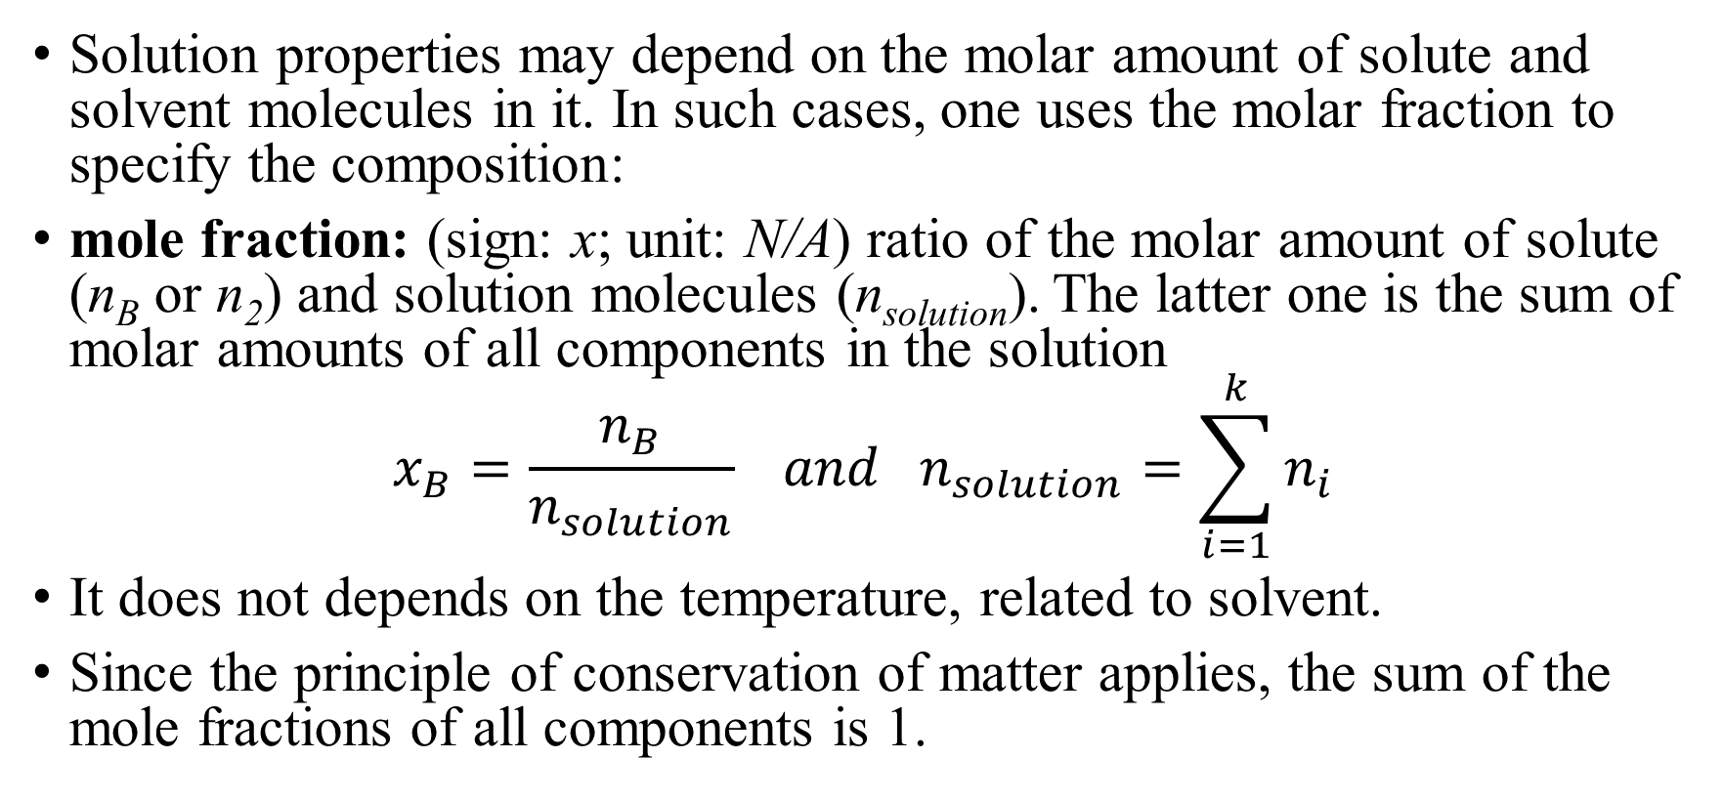
Composition – mole fraction
Solution properties may depend on the molar amount of solute and solvent molecules in it. In such cases, one uses the molar fraction to specify the composition:
mole fraction: (sign: x; unit: N/A) ratio of the molar amount of solute (n_{B} or n₂) and solution molecules (n_{solution}). The latter one is the sum of molar amounts of all components in the solution
$$x_{B}=\frac{n_{B}}{n_{solution}} and n_{solution}=\sum_{i=1}^{k}{n_{i}}$$
It does not depends on the temperature, related to solvent.
Since the principle of conservation of matter applies, the sum of the mole fractions of all components is 1.

Slide 35
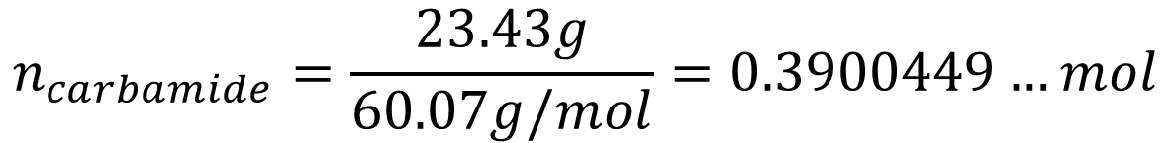
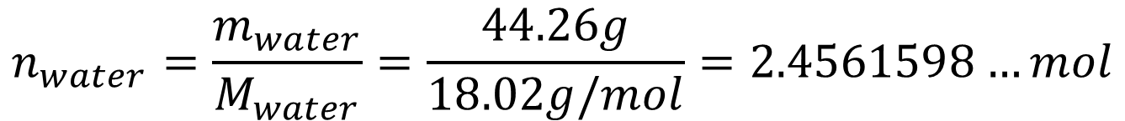
Composition – mole fraction
What is the mole fraction of carbamide (urea, (NH₂)₂C=O) in the solution, which was prepared by dissolving 23.43 g of carbamide in 44.26 g of water? M_{r}((NH₂)₂C=O)=60.07; M_{r}(H₂O)=18.02; ρ(H₂O)=0.9973 g/cm³ Present results with 4 significant digits.
$$n_{water}=\frac{m_{water}}{M_{water}}=\frac{44.26g}{18.02g/mol}=2.4561598…mol$$
$$n_{carbamide}=\frac{23.43g}{60.07g/mol}=0.3900449…mol$$
$$x_{carbamide}=\frac{0.3900449…mol}{0.3900449…mol+2.4561598…mol}=0.13704016…=0.1370$$

Slide 36
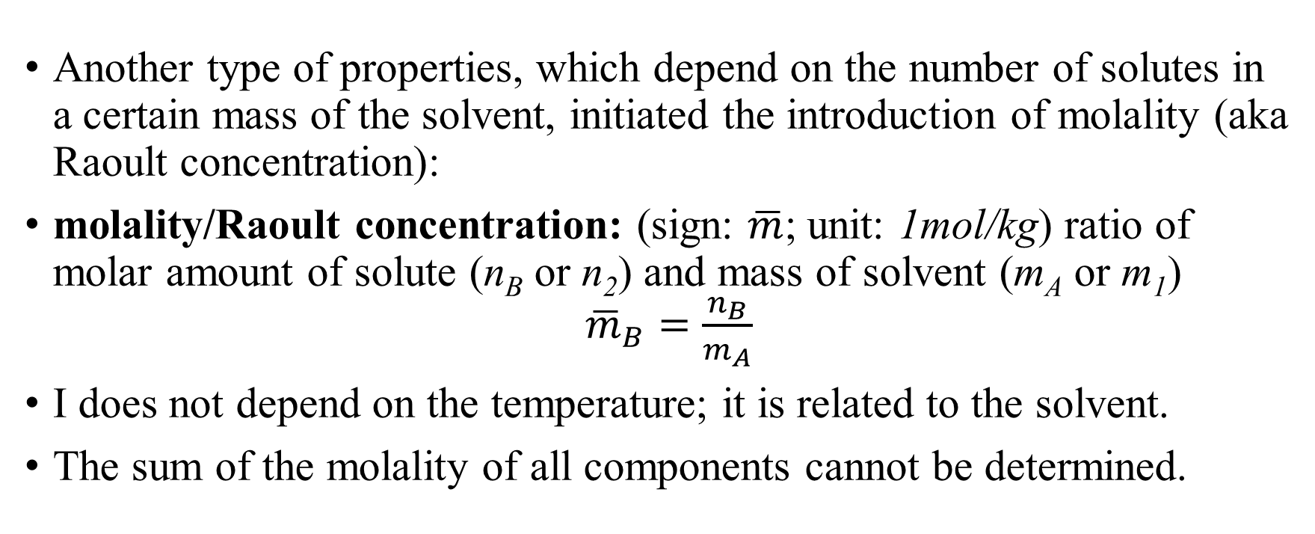
Composition – molality
Another type of properties, which depend on the number of solutes in a certain mass of the solvent, initiated the introduction of molality (aka Raoult concentration):
molality/Raoult concentration: (sign: $\overline{m}$; unit: 1mol/kg) ratio of molar amount of solute (n_{B} or n₂) and mass of solvent (m_{A} or m₁) ${\overline{m}}_{B}=\frac{n_{B}}{m_{A}}$
I does not depend on the temperature; it is related to the solvent.
The sum of the molality of all components cannot be determined.

Slide 37
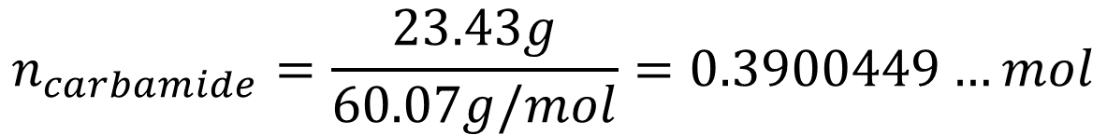


Composition – molality
What is the molality of carbamide (urea, (NH₂)₂C=O) in the solution, which was prepared by dissolving 23.43 g of carbamide in 44.26 g of water? M_{r}((NH₂)₂C=O)=60.07; M_{r}(H₂O)=18.02; ρ(H₂O)=0.9973 g/cm³ Present results with 4 significant digits.
$$m_{water}=44.26g=0.04426kg$$
$$n_{carbamide}=\frac{23.43g}{60.07g/mol}=0.3900449…mol$$
$$=8.813\frac{mol}{kg}$$
$${\overline{m}}_{carbamide}=\frac{n_{carbamide}}{m_{water}}=\frac{0.3900449…mol}{0.04426kg}=8.812583…\frac{mol}{kg}$$

Slide 38
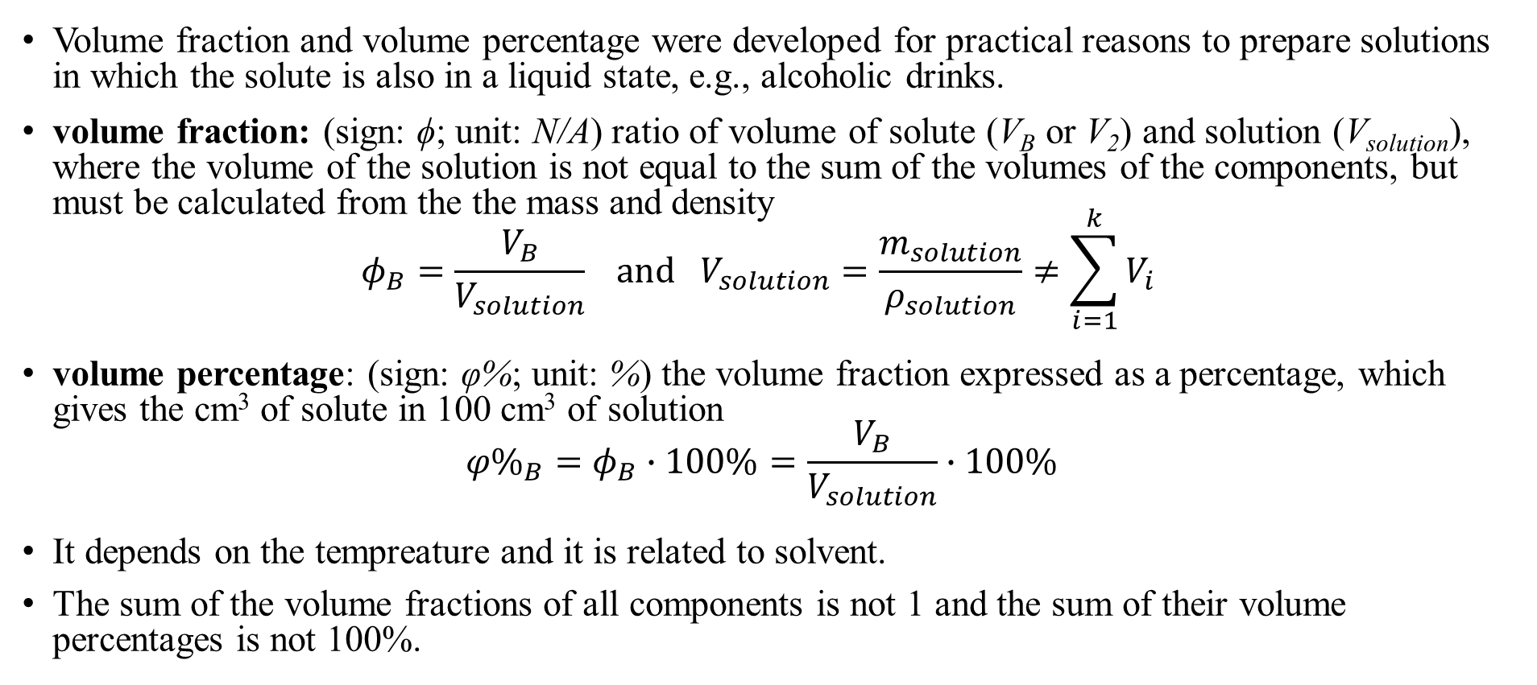
Composition – volume fraction/percentage
Volume fraction and volume percentage were developed for practical reasons to prepare solutions in which the solute is also in a liquid state, e.g., alcoholic drinks.
volume fraction: (sign: ϕ; unit: N/A) ratio of volume of solute (V_{B} or V₂) and solution (V_{solution}), where the volume of the solution is not equal to the sum of the volumes of the components, but must be calculated from the the mass and density
$φ_{B}=\frac{V_{B}}{V_{solution}} and V_{solution}=\frac{m_{solution}}{ρ_{solution}}≠\sum_{i=1}^{k}{V_{i}}$
volume percentage: (sign: φ%; unit: %) the volume fraction expressed as a percentage, which gives the cm³ of solute in 100 cm³ of solution
${φ\%}_{B}=φ_{B}∙100\%=\frac{V_{B}}{V_{solution}}∙100\%$
It depends on the tempreature and it is related to solvent.
The sum of the volume fractions of all components is not 1 and the sum of their volume percentages is not 100%.

Slide 39
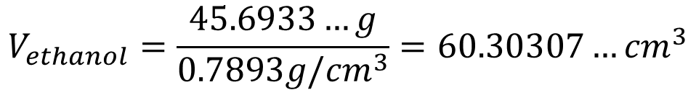

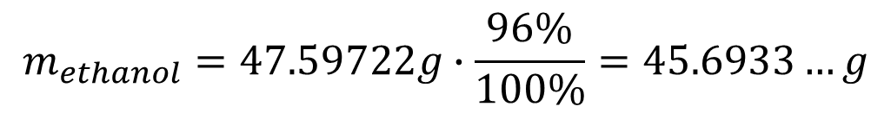
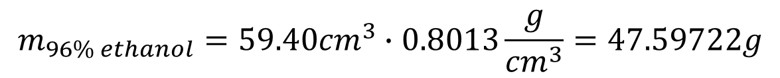
Composition – volume fraction/percentage
What is the volume percentage of a drink made by adding 59.40 cm³ 96 w% ethanol into a 100 cm³ volumetric flask, which was completed to the signal with water thereafter? ρ(96w% ethanol)=0.8013 g/cm³; ρ(ethanol)=0.7893 g/cm³; ρ_{solution}=0.9139 g/cm³; Write the results with 4 significant figures.
$$m_{96\% ethanol}=59.40{cm}^{3}∙0.8013\frac{g}{{cm}^{3}}=47.59722g$$
$$m_{ethanol}=47.59722g∙\frac{96\%}{100\%}=45.6933…g$$
$$V_{ethanol}=\frac{45.6933…g}{0.7893g/{cm}^{3}}=60.30307…{cm}^{3}$$
$${φ\%}_{ethanol}=\frac{60.30307…{cm}^{3}}{100{cm}^{3}}∙100\%=60.30307…\%$$
$$=60.30\%$$

Slide 40
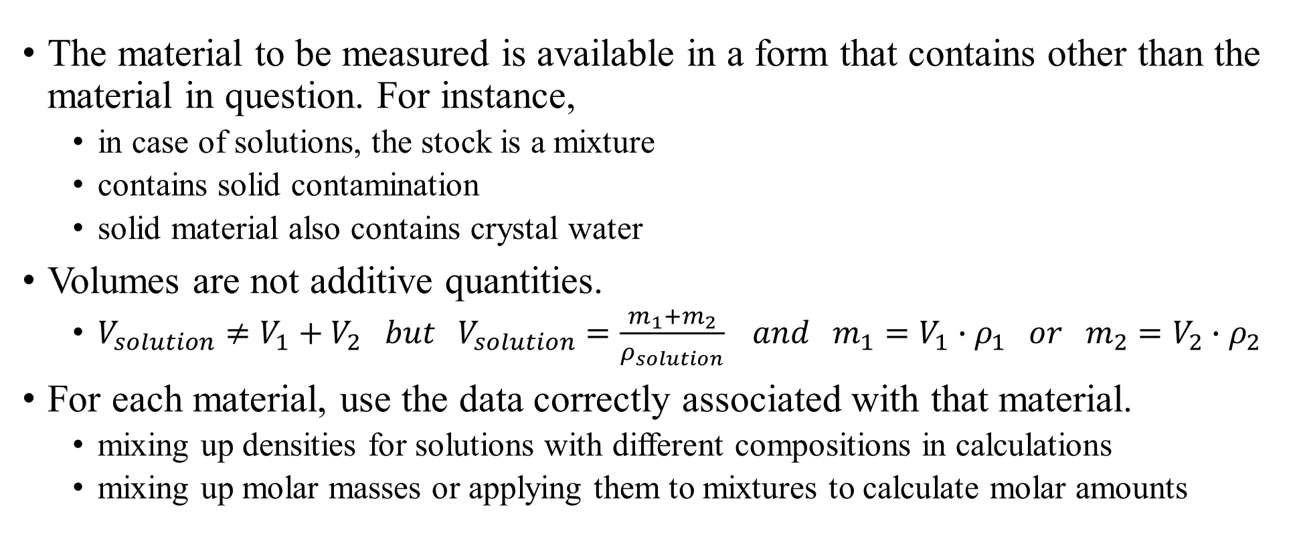
Pitfalls in solving tasks
The material to be measured is available in a form that contains other than the material in question. For instance,
  in case of solutions, the stock is a mixture
  contains solid contamination
  solid material also contains crystal water
Volumes are not additive quantities.
  $V_{solution}≠V_{1}+V_{2} but{ V}_{solution}=\frac{m_{1}+m_{2}}{ρ_{solution}} and m_{1}=V_{1}∙ρ_{1} or m_{2}=V_{2}∙ρ_{2}$
For each material, use the data correctly associated with that material.
  mixing up densities for solutions with different compositions in calculations
  mixing up molar masses or applying them to mixtures to calculate molar amounts

Slide 41
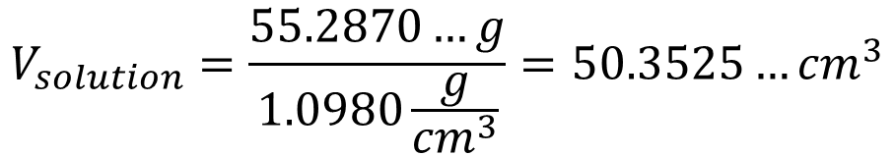
Pitfalls in solving tasks
An example for all previous possible mistakes:
Calculate the HCl concentration in v% and x when 25.05 cm³ of 37 w% HCl solution is mixed with 25.47 cm³ water. ρ(37w% HCl)=1.19315 g/cm³; ρ(21.96v% HCl)=1.0980 g/cm³; ρ(water)=0.9972g/cm³; M_{r}(HCl)=36.46; M_{r}(H₂O)=18.02; Results must be given with 4 significant figures.
  The two volumes cannot be added (50.52 cm³). The volume of the solution correctly:
$$m_{solution}=25.05{cm}^{3}∙1.19315\frac{g}{{cm}^{3}}+25.47{cm}^{3}∙0.9972\frac{g}{{cm}^{3}}=$$
$$=29.8884…g+25.3986…g=55.2870…g$$
$$V_{solution}=\frac{55.2870…g}{1.0980\frac{g}{{cm}^{3}}}=50.3525…{cm}^{3}$$
Error is about 0.3%!

Slide 42



Pitfalls in solving tasks
Continuation:
  calculating the mass of hydrochloric acid correctly :
  in v% mixed percentage:
  For x, one needs molar volumes of both solute and solution:
$$m_{HCl}≠m_{HCl solution}$$
$$m_{HCl}=\left(25.05{cm}^{3}∙1.19315\frac{g}{{cm}^{3}}\right)∙\frac{37\%}{100\%}=11.0587…g$$
$$v\%=\frac{11.0587…g}{50.3525…{cm}^{3}}∙100\%=21.96256…\%=21.96\%$$
$$n_{HCl}=\frac{11.0587…g}{36.46\frac{g}{mol}}=0.303310…mol$$
$$m_{water}≠m_{added water}$$
$$m_{water}=m_{added water}+ m_{water in HCl solution}$$

Slide 43

Pitfalls in solving tasks
Continuation:
  mass of water correctly:
  molar amount of water:
  calculation of x (mole fraction):
$$m_{water}=25.47{cm}^{3}∙0.9972\frac{g}{{cm}^{3}}+\left(25.05{cm}^{3}∙1.19315\frac{g}{{cm}^{3}}\right)∙\frac{\left(100−37\right)\%}{100\%}=44.2283…g$$
$$n_{water}=\frac{44.2283…g}{18.02\frac{g}{mol}}=2.4544…moles$$
$$x_{HCl}=\frac{n_{HCl}}{n_{HCl}+n_{water}}=\frac{0.303310…mol}{0.303310…mol+2.4544…mol}=0.109986…=0.1100$$

Slide 44

Limitations in the composition of solutions
gas-gas – no limitation – mutually miscible
solid-liquid – saturated solution: a solution whose concentration, at the given temperature, cannot be increased by adding additional solute. If, by changing the temperature or due to a chemical reaction, a higher concentration, so-called supersaturated solution forms. Thereafter, it goes to an equilibrium state via solute precipitation, until the solution reaches the concentration of the saturated solution.
solubility: (sign: S; unit: 1 g/dm³) describes the quantity of the solute and solvent in a saturated solution. Ratio of solute mass (m_{B} or m₂) and volume of solvent (V_{A} ory V₁), i.e., $S_{B}=\frac{m_{B}}{V_{A}}.$
In handbooks, the solubility is often presented in mass ratio, but other type of compositions can befound too: molar concentration, molality, mass concentration, mole fraction, etc.

Slide 45
Limitations in the composition of solutions
Liquid-liquid – unlimited and limited mixtures
unlimited mixing: two substances can be mixed indefinitely, if a mixture of any composition can be produced from them, without forming a new phase, i.e., the system is always homogeneous.
limited mixing: two substances mix to a limited extent if there is a composition range that cannot be produced from them, because the system becomes heterogeneous.
gas-liquid – limited solubility:
Henry’s law: with diluted solutions, the partial pressure of the solute (p_{i}) above the solution is proportional with its molar fraction (x_{i}). The proportionality factor is the Henry’s constant (K_{H}) and thus, p_{i} = K_{H}·x_{i} Solutions that behave in this way are called ideally dilute solutions.

Slide 46
Laws in diluted solutions
The amount of solvent on the surface of the solution decreases, so the vapor pressure decreases. The same is true for the solid phase - phase diagram.
p/Pa
Boiling point increases and freezing point decreases.
solid
liquid
1.01·10⁵
vapor
T_{freezing}
T_{boiling}
T/K

Slide 47

Laws in diluted solutions
The vapor pressure of dilute solutions was studied by Raoult:
Raoult’s law: in diluted solutions, the vapor pressure of the solvent (p_{solvent}) is proportional to the molar fraction of the solvent (x_{solvent}) in the solution. The proportionality factor is the vapor pressure of the pure solvent (pº_{solvent}) $p_{solvent}=p_{solvent}^{o}∙x_{solvent}$
The resulting freezing point depression is proportional to the molality (Raoult’s concentration) of the solution:
freezing point depression: (sign: ΔT_{freezing}; unit: 1 K) decrease of freezing point in diluted solutions (ΔT_{freezing}= T_{freezing,solvent}-T_{freezing,solution}) is proportional to the molality $\left(\overline{m}\right)$. The proportionality factor is the molal freezing point depression (${ΔT}_{\overline{m},freezing}$), which is characteristic for the solvent and thus, ${ΔT}_{freezing}={ΔT}_{\overline{m},freezing}∙\overline{m}$

Slide 48


Laws in diluted solutions
The boiling point elevation by the Raoult's law is proportional to the molality of the solution (Raoult’s concentration):
boiling point elevation: (sign: ΔT_{boiling}; unit: 1 K) increase in boiling point for diluted solutions (ΔT_{boiling}= T_{boiling,solution}-T_{boiling,solvent}) is propotional to the molality $\left(\overline{m}\right)$. The proportionality factor is the molal boiling point elevation (${ΔT}_{\overline{m},boiling}$), which is related to the solvent, i.e., ${ΔT}_{boiling}={ΔT}_{\overline{m},boiling}∙\overline{m}$
Raoult's law and the colligative properties derived from it depend on the concentration of the solute but not on the chemical quality of the solute.
$p_{solvent}=p_{solvent}^{o}∙x_{solvent}=p_{solvent}^{o}∙\left(1−\sum{x_{solute}}\right)=p_{solution}^{o}−\sum{x_{solute}}∙p_{solvent}^{o}$
${∆p}_{solvent}=p_{solvent}^{o}−p_{solvent}=\sum{x_{solute}}∙p_{solvent}^{o}$

Slide 49



Laws in diluted solutions
There is one more phenomenon originates from the Raoult’s law:
osmosis: it is related to the flow of the solvent through a semipermeable membrane, once the membrane separates two solutions with different concentrations, and the dissolved substances are unable to penetrate the membrane. The solvent flows from the solution containing the solute in a lower concentration to the solution containing it in a higher concentration.
$$F=mg=ρ∙V=ρ∙A∙h$$
$$p=\frac{F}{A}=\frac{ρ∙Ah}{A}=ρ∙h$$
h
$$p=ρ∙h=π$$

Slide 50

Laws in diluted solutions
Accordingly, there is a pressure rises during osmosis:
osmotic pressure: (sign: π; unit: 1 Pa) the mechanical pressure, which should be applied for a solution containing a higher concentration of solute to prevent the flow of the solvent through the semipermeable membrane. Its value, is proportional to the product of the molar concentrations of all dissolved substances ($c_{total}=\sum_{i=1}^{k−1}{c_{i}}$), universal gas constant (R=8.314 J/(mol K)) and the absolute temperature (T):
$π=\frac{n_{total}}{V}RT=c_{total}RT and c_{total}=\sum_{i=1}^{k−1}{c_{i}}$

Slide 51

Chemical garden
https://www.youtube.com/watch?v=gL6IVNlJkI0

Slide 52

Chemical garden
Sodium silicate solution:
$${Na}_{2}{SiO}_{3(s)}=2{Na}_{(aq)}^{+}+{SiO}_{3(aq)}^{2−}$$
Why it grows upwards?
The saturated salt solution flows out and the semipermeable membrane is formed again!
The pressure of water is the smallest on the top!
The solvent flows through the semipermeable membrane and the pressure inflates it,
Saturated metal salt solution
$${Co}_{(aq)}^{2+}+{SiO}_{3(aq)}^{2−}={CoSiO}_{3(s)}$$
then breaks the membrane
semipermeable membrane
metal salt – e.g., CoCl₂·6H₂O

Slide 53







Applications of colligative properties
Since the effect does not depend on the chemical quality of the solution, these methods are suitable for molecular weight determination.
$$n_{solute}=\frac{m_{solute}}{M_{solute}}=\frac{m_{solvent}}{M_{solvent}}∙\frac{\left(p_{solvent}^{o}−p_{solvent}\right)}{p_{solvent}}$$
$p_{solvent}^{o}−p_{solvent}=x_{solute}∙p_{solvent}^{o}$
$$n_{solute}=\frac{m_{solute}}{M_{solute}}=\frac{m_{solvent}}{1000g/kg}∙\frac{{∆T}_{freezing}}{{∆T}_{\overline{m},freezing}}$$
$${ΔT}_{freezing}={ΔT}_{\overline{m},freezing}∙\overline{m}$$
$$n_{solute}=\frac{m_{solute}}{M_{solute}}=\frac{m_{solvent}}{1000g/kg}∙\frac{{∆T}_{boiling}}{{∆T}_{\overline{m},boiling}}$$
$${ΔT}_{boiling}={ΔT}_{\overline{m},boiling}∙\overline{m}$$
$$n_{solute}=\frac{m_{solute}}{M_{solute}}=\frac{π∙V_{solvent}}{RT}$$
$$π=c_{solute}RT$$

Slide 54

Applications of colligative properties
Osmotic pressure is very important in biological systems because it is very high.
  isotonic saline: 0.9 v% NaCl solution
$$n_{solute}=n_{{Na}^{+}}+n_{{Cl}^{−}}=2∙n_{NaCl}$$
$$c_{solute}=2∙\frac{0.9g}{100{cm}^{3}}∙\frac{1000000{cm}^{3}}{58.44\frac{g}{mol}∙1m^{3}}=308.0\frac{mol}{m^{3}}$$
$$π_{isotonic}=308.0\frac{mol}{m^{3}}∙8.314\frac{J}{mol K}∙309.75K=793181Pa=7.828atm$$
https://www.youtube.com/watch?v=jlKaZlDYzJk
https://www.youtube.com/watch?v=TrZCFCYxpmo

Slide 55
Applications of colligative properties
Treatment - fluid replacement - isotonic saline solution is introduced intravenously
Biological experiments - the osmotic pressure of the solutions used should be close to isotonic
Food industry – sterilization, if heat treatment is not possible, e.g., creamy white cheese in saturated NaCl solution

