Slide 1
General Chemistry
2. Description of chemical systems by state
Dr. István Szilágyi
Department of Physical Chemistry and Materials Science
2025.

Slide 2
The system and its environment
In addition to using the balance, Lavoisier took another important step.
He studied the phenomena by isolating his experimental equipment from the rest of the surroundings.
Today, one can say that the observations and measurements were performed on the "system" to be studied.
The system is therefore the finite part of the space to be examined.
Everything else is the environment.
The environment is thus outside the system, the entire space surrounding it.

Slide 3

Types and properties of the system
Do we always have to isolate the system from its environment?
It depends on the subject of the investigation.
It is also very important that one must pay attention to the limits of the validity of the observations taken during an experiment.
For example, one studies the insects of a grass meadow. Can we close it? No! (tools to study: square net, insect net). Then, a system can be:
- open, when material flow is possible between the system and its environment (wind blows, animals come and go) and energy exchange (heats up, cools down, depending on the weather)!

Slide 4
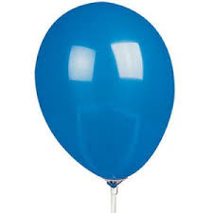
Types and properties of the system
For instance, if one wants to study the law of conservation of mass, as Lavoisier did, then the outflow and inflow of matter between the system and its environment must be prevented.
For example, studying the effect of temperature on the volume of gases and the heat flow is prevented, then nothing happens. Then, a system can be:
- closed, when material flow between the system and its environment is not possible, but energy exchange is possible.
https://www.youtube.com/watch?v=ZvrJgGhnmJo
https://www.youtube.com/watch?v=ZPErStqSSMk

Slide 5
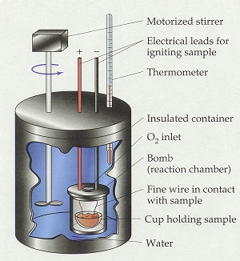
Types and properties of the system
For instance, if one wants to study the law of conservation of mass, as Lavoisier did, then the outflow and inflow of matter between the system and its environment must be prevented.
For example, if one wants to study a process from the point of view of whether it produces or consumes heat, then the exchange of matter and energy must be prevented! Accordingly, a system can be:
- isolated, when neither material flow nor energy exchange between the system and its environment is possible!

Slide 6
Description of the state of matter and system
All materials in our environment have properties-features: color, texture, shape, density, volume, mass, temperature, etc.
Which of these are the ones that clearly define the quality of matter?
The first most obvious property of materials is their state of matter.
Let's examine the possible states of matter.

Slide 7
Solid state
In common sense, one calls solid which has "constant shape and volume".
Chemistry considers substances to be solid in a narrower range than the above one: solids are of crystalline materials!
Thus, the definition:
solid state: the state of matter when it has a definite shape and volume, high density, and is characterized by an ordered internal structure.
What about glass? Is that a solid? It looks like that, but by definition: high viscosity liquid.

Slide 8
Liquid state
There is no difference between everyday and scientific consideration.
Definition:
liquid state: the state of matter when it has a definite volume but no definite shape, it fills the shape of the container. Its density is (usually) a little less than that of the solid state materials, while it does not have an ordered internal structure.

Slide 9
Gas (vapor) state
There is not much difference between the everyday and the scientific consideration.
Definition is then:
gaseous state: the state of matter when it has neither a definite volume nor a definite shape, it fills the entire volume of the container and adopts its shape. Its density is significantly lower than the solid and liquid states. Both vapor and gas is in an air state.
What is then the difference between gas and vapor?
  vapor: the vapor state of the material liquefies under the influence of appropriate pressure at the given temperature.
  gas: the gaseous state of the material cannot be liquefied at the given temperature by increasing the pressure.
More discussion about this issue is coming soon.

Slide 10
Transformations between states of matter
gas
crystallization
condensation
precipitation
condensation
sublimation
evaporation
melting
solid
fluid phase
liquid
freezing
condensed phase

Slide 11
Factors determining the state of matter
When examining the states of matter, it quickly became clear that in the case of a material, the state of matter is determined by the temperature of the material and the external pressure.
Further research revealed that, in addition to these, one has to take into account the volume of the systems and the molar amount of the substance involved to be able to clearly describe the state.
So, the pressure (p), the volume (V), the thermodynamic temperature (T) and the molar amount (n) make up the so-called state parameters or state indicators.
State parameters/state indicator: a quantity that determines the macroscopic property of a physical system.

Slide 12
Classification of physical properties
State parameters (p, V, T, n) change differently if for instance one breaks a solid material into two pieces:
  pressure and temperature (p,T) of the two pieces are the same
  volume and the molar amount are smaller than of the original material.
If two systems are combined, the properties can change in two ways:
  For example, mixing two buckets of water of different temperatures together, the temperature of the water will change to the one between the two temperatures, depending on the amount of water in each bucket.
  However, in the unified system the amount of water is the sum of those in the two initial buckets.

Slide 13
Classification of physical properties
The first type:
intensive property: a property of the system that does not depend on the molar amount of material and the size of the system. It equalizes when the subsystems are combined (e.g., temperature).
The second type:
extensive property: a property of the system that depends on the molar amount of material in the system and the size of the system. It sums up when sub-systems are combined (e.g., mass).

Slide 14
Classification of physical properties
Let us study some parameters!
  mass [kg] – law of conservation of mass - extensive property
  density [kg/m³] – if the temperature does not change and a substance of the same chemical quality is distributed, density does not change, i.e., an intensive property. But...
    If two liquids of different temperatures but of the same chemical quality are mixed, their density will be, in accordance with the resulting temperature, between the original two. It will be averaged.
    We experience the same thing when mixing two liquids of different chemical compositions that are miscible with each other. The density of the mixture will be between the original two.
  The explanation is that the density is the mass in a unit volume, i.e., a specific amount, related to the quotient of two extensive properties (mass and volume) of the system.

Slide 15
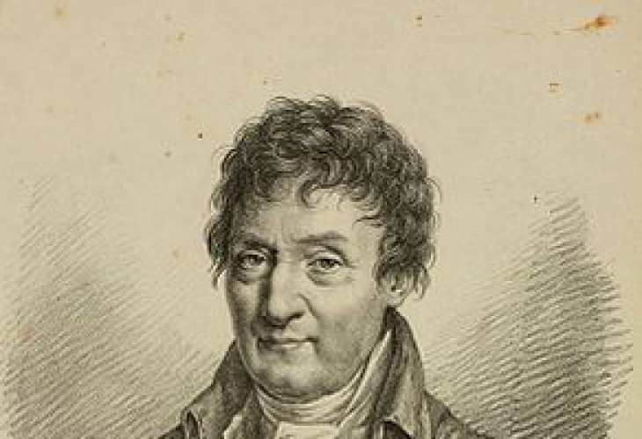
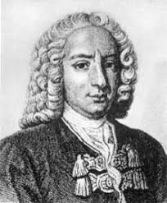
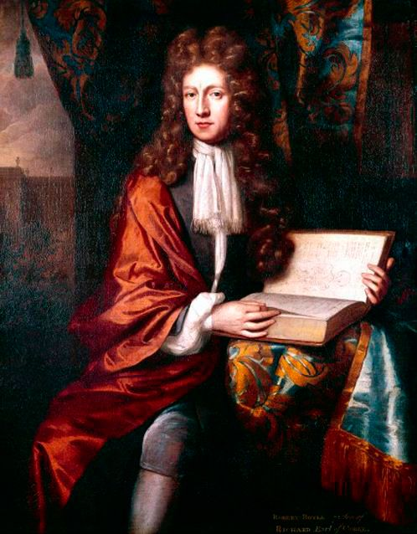
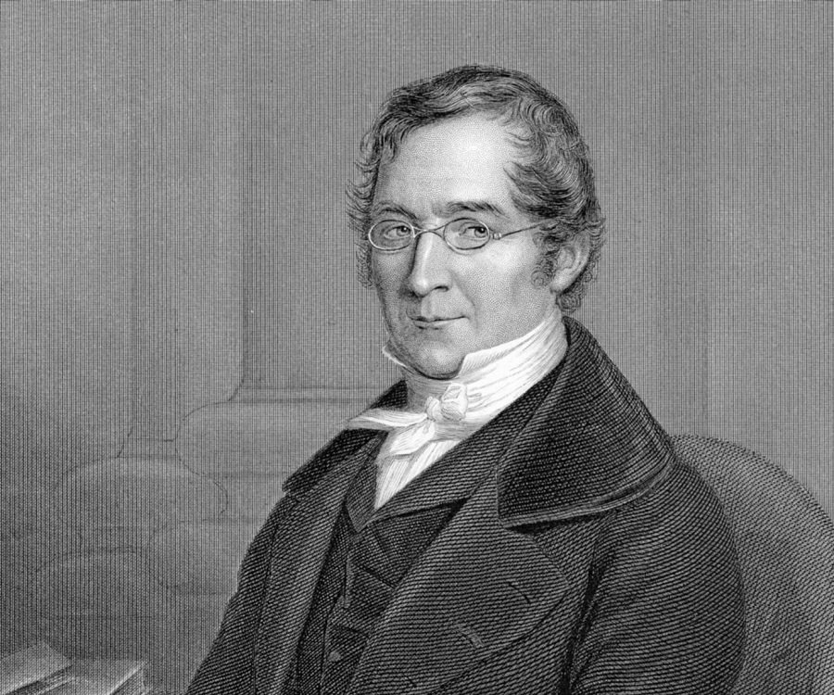
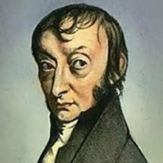
The state and properties of gases
We begin with the characterization of the gas state, due to historical and didactic reasons.
Prerequisites:
  E.Torricelli – mercury manometer (1643)
  D. Farenheit – mercury thermometer (1714)
Leading scientists:
  R. Boyle (1661)
  G. Amontons (1699)
  J. Charles (1780)
  J. Gay-Lussac (1802)
  A. Avogadro (1811)

Slide 16
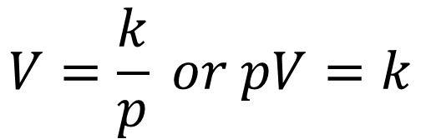
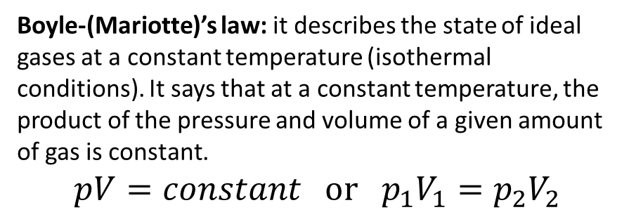
Boyle(-Mariotte)’s law
https://www.youtube.com/watch?v=N5xft2fIqQU
V/m³
$$V=\frac{k}{p} or pV=k$$
0.035
0.033
T₁ > T₂ > T₃
0.031
0.029
Molar amount and temperature are constant!
0.027
0.025
0.023
0.021
Boyle-(Mariotte)’s law: it describes the state of ideal gases at a constant temperature (isothermal conditions). It says that at a constant temperature, the product of the pressure and volume of a given amount of gas is constant.
$$pV=constant or p_{1}V_{1}=p_{2}V_{2}$$
T₁
T₂
T₃
0.019
0.017
0.015
60000
70000
80000
90000
100000
110000
120000
p/Pa

Slide 17
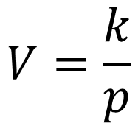
Boyle(-Mariotte)’s law
V/m³
If one plots the original relation, then linear plots with an intercept at the origin (0,0) are obtained.
0.0350
T₁
T₂
T₃
0.0300
T₁ > T₂ > T₃
0.0250
$$V=\frac{k}{p}$$
0.0200
0.0150
0.0100
Hence, gases behave as if they would not have their own volume because if the pressure increases beyond all limits, then both V and 1/p tend to 0.
0.0050
0.0000
0.00E+00
2.00E-06
4.00E-06
6.00E-06
8.00E-06
1.00E-05
1.20E-05
1.40E-05
1.60E-05
1/p/(1/Pa)

Slide 18

Law of Gay-Lussac I. (Charles)
V/m³
$$V=V_{o}\left(1+β∙t\right)$$
0.08
p₃
p₂
p₁
0.07
molar amount and pressure do not change!
p₁ > p₂ > p₃
0.06
0.05
The common ground zero is at
-273.15 °C
0.04
0.03
0.02
Gases behave as if their volume would be zero at this temperature.
So the temperature has a natural zero point!
0.01
0
-0.01
-280
-180
-80
20
120
220
320
t/°C

Slide 19
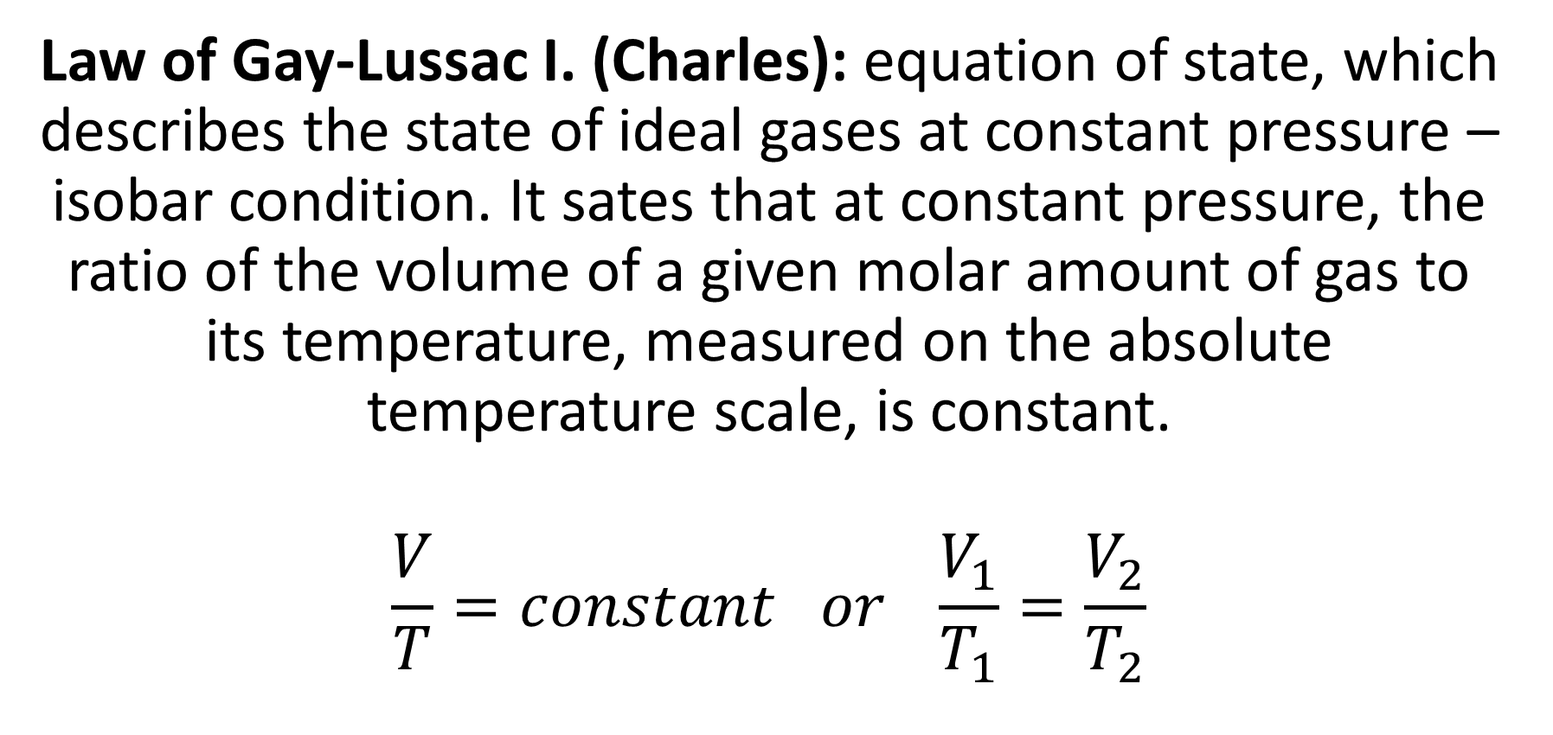
Law of Gay-Lussac I. (Charles)
Law of Gay-Lussac I. (Charles): equation of state, which describes the state of ideal gases at constant pressure – isobar condition. It sates that at constant pressure, the ratio of the volume of a given molar amount of gas to its temperature, measured on the absolute temperature scale, is constant.
$$\frac{V}{T}=constant or \frac{V_{1}}{T_{1}}=\frac{V_{2}}{T_{2}}$$

Slide 20
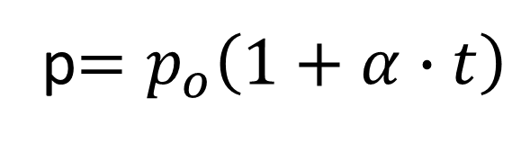
Law of Gay-Lussac II. (Amontons)
https://www.youtube.com/watch?v=1pVVZGOBIVg
p/Pa
p$=p_{o}\left(1+α∙t\right)$
50000
V₃
V₂
V₁
40000
molar amount and volume of the gas are constant
V₁ > V₂ > V₃
30000
Common zero point at -273.15°C
20000
10000
Gases behave as if on this temperature, their pressure would be zero.
So the temperature has a natural zero point!
0
-10000
-280
-180
-80
20
120
220
320
t/°C

Slide 21
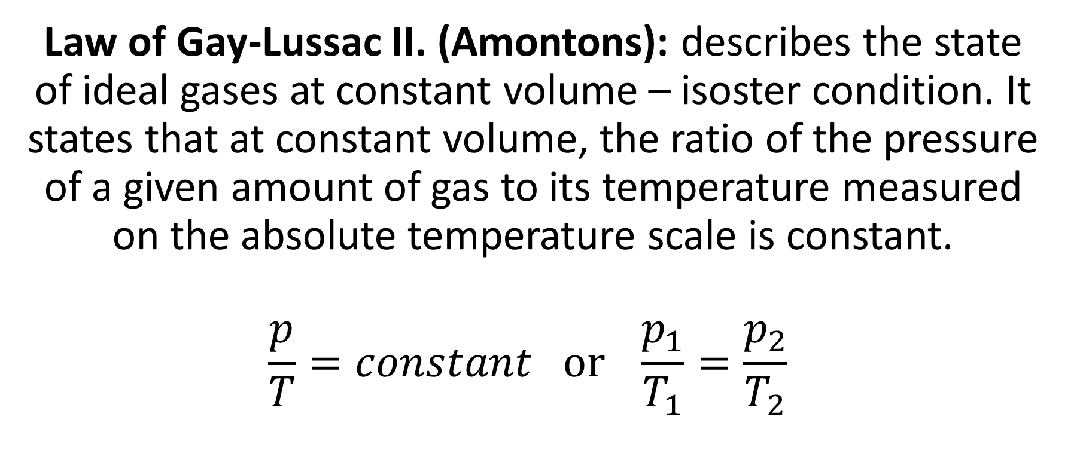
Law of Gay-Lussac II. (Amontons)
Law of Gay-Lussac II. (Amontons): describes the state of ideal gases at constant volume – isoster condition. It states that at constant volume, the ratio of the pressure of a given amount of gas to its temperature measured on the absolute temperature scale is constant.
$$\frac{p}{T}=constant or \frac{p_{1}}{T_{1}}=\frac{p_{2}}{T_{2}}$$

Slide 22
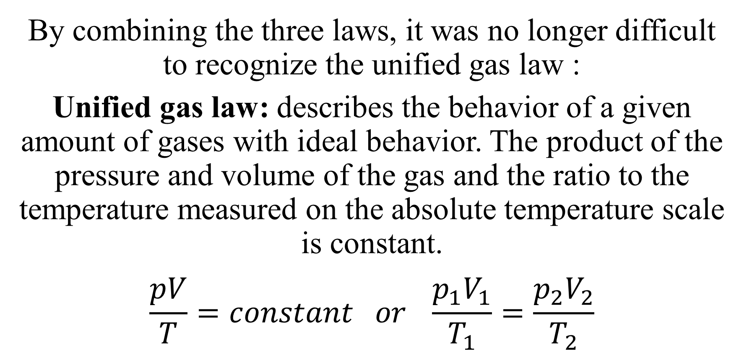
Unified gas law
By combining the three laws, it was no longer difficult to recognize the unified gas law :
Unified gas law: describes the behavior of a given amount of gases with ideal behavior. The product of the pressure and volume of the gas and the ratio to the temperature measured on the absolute temperature scale is constant.
$$\frac{pV}{T}=constant or \frac{p_{1}V_{1}}{T_{1}}=\frac{p_{2}V_{2}}{T_{2}}$$

Slide 23
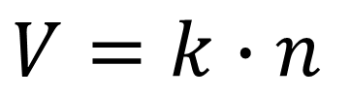
Avogadro’s law
V/m³
0.25
$$V=k∙n$$
0.2
if pressure and temperature of the gas do not change
0.15
0.1
The real novelty was that this proportionality was independent of the gas chemical composition once the amount of gas was changed at the same p, V and T.
0.05
0
0
2
4
6
8
10
12
n/mol
So, gases of different composition behave independently of their mass, only the number of particles matters.

Slide 24
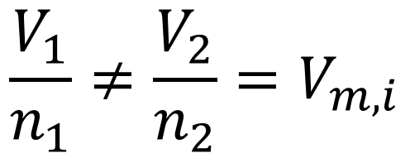
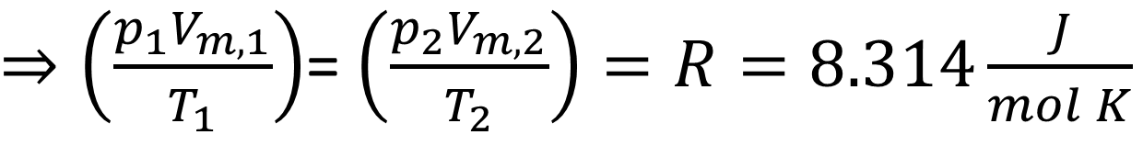

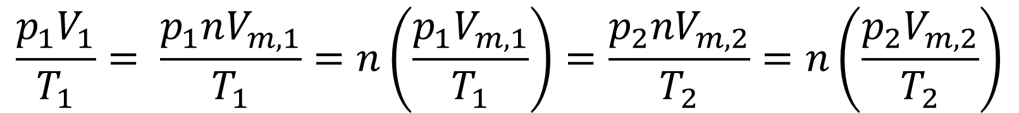
Universal gas law
$$\frac{V_{1}}{n_{1}}≠\frac{V_{2}}{n_{2}}=V_{m,i}$$
molar volume of a gas at a given pressure and temperature
inserting this to the unified gas law:
$$\frac{p_{1}V_{1}}{T_{1}}= \frac{p_{1}nV_{m,1}}{T_{1}}=n\left(\frac{p_{1}V_{m,1}}{T_{1}}\right)=\frac{p_{2}{nV}_{m,2}}{T_{2}}=n\left(\frac{p_{2}V_{m,2}}{T_{2}}\right)$$
$⇒\left(\frac{p_{1}V_{m,1}}{T_{1}}\right)$= $\left(\frac{p_{2}V_{m,2}}{T_{2}}\right)=R=8.314\frac{J}{mol K}$
$$⟹pV=nRT$$
...any types of gas, temperature and pressure...

Slide 25
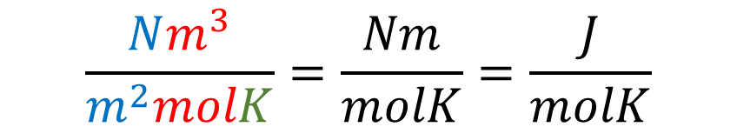
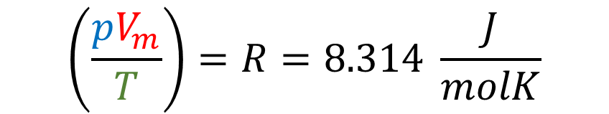
Analysis of dimension/unit
$$\left(\frac{pV_{m}}{T}\right)=R=8.314 \frac{J}{molK}$$
$$\frac{Nm^{3}}{m^{2}molK}=\frac{Nm}{molK}=\frac{J}{molK}$$

Slide 26
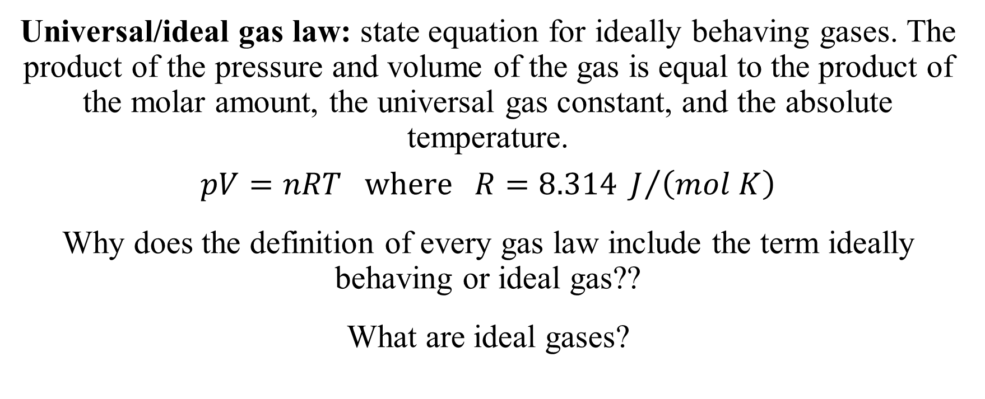
Universal/ideal gas law
Universal/ideal gas law: state equation for ideally behaving gases. The product of the pressure and volume of the gas is equal to the product of the molar amount, the universal gas constant, and the absolute temperature.
$$pV=nRT where R=8.314 J/{\left(mol K\right)}$$
Why does the definition of every gas law include the term ideally behaving or ideal gas??
What are ideal gases?

Slide 27
Ideal/perfect gas model
Gases consist of particles with no internal structure, they do not move in any other way than a random straight-line one.
They have no own volume.
When they meet each other, they collide solely elastically, and there are no attractive or repulsive forces between them.
Based on the assumptions of the model, using the so-called method of statistical thermodynamics, the theoretical explanation of the behavior of ideal gases can be derived.
https://www.youtube.com/watch?v=ImbZfzuYHwo

Slide 28
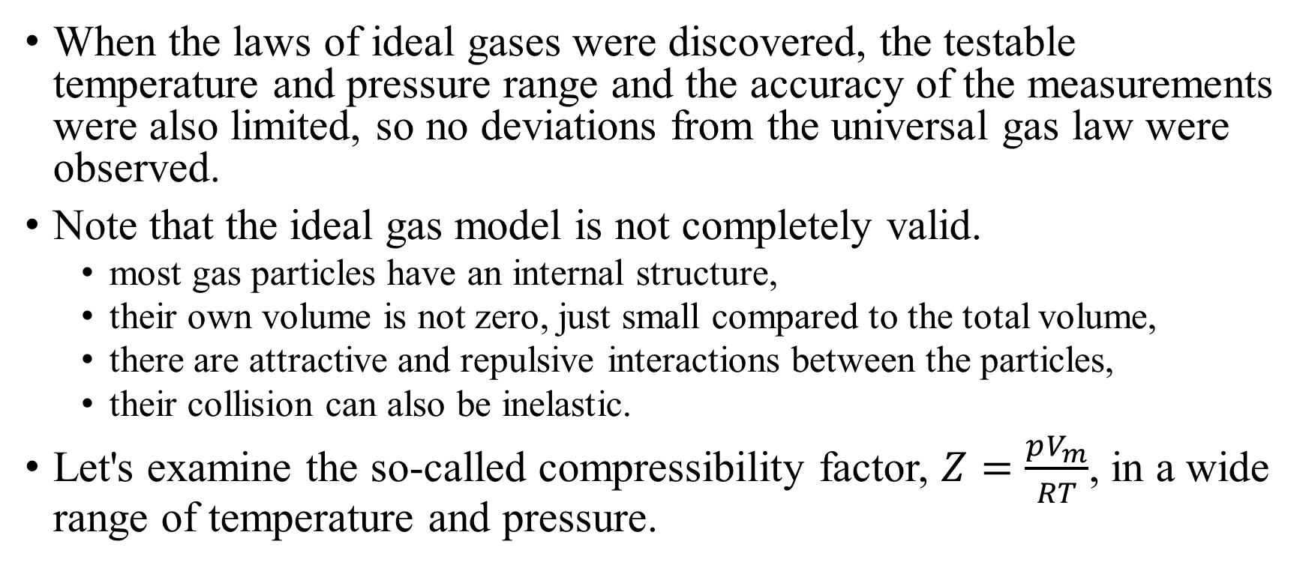
Real gases
When the laws of ideal gases were discovered, the testable temperature and pressure range and the accuracy of the measurements were also limited, so no deviations from the universal gas law were observed.
Note that the ideal gas model is not completely valid.
  most gas particles have an internal structure,
  their own volume is not zero, just small compared to the total volume,
  there are attractive and repulsive interactions between the particles,
  their collision can also be inelastic.
Let's examine the so-called compressibility factor, $Z=\frac{pV_{m}}{RT}$, in a wide range of temperature and pressure.

Slide 29


Real gases
$$\frac{pV_{m}}{RT}$$
2.0
Minima can be observed, e.g., for CO₂, CH₄, and N₂.
In certain pressure ranges Z<1, i.e., pV_{m,real} < pV_{m,ideal}, so the particles are attracted by each other resulting in gas compression.
At high pressure, where Z>1, repulsive forces dominate and thus, pV_{m,real} > pV_{m,ideal}
For instance, H₂ and He shows only Z>1, no minima on the plot.
N₂
1.5
H₂
1.0
CH₄
ideal gas
0.5
CO₂
0
200
400
600
800
1000
$$p/MPa$$

Slide 30


Real gases
$$\frac{pV_{m}}{RT}$$
2.0
Investigating the compressibility factor at different temperatures, however, the minima observed around room temperature disappears at higher temperature.
On the other hand, there is a low temperature range where the curve of a gas characterized by a curve without a minimum at high temperature shows a minimum.
200 K
500 K
1.5
1000 K
1.0
ideal gas
0.5
N₂
0
30
60
90
$$p/MPa$$

Slide 31
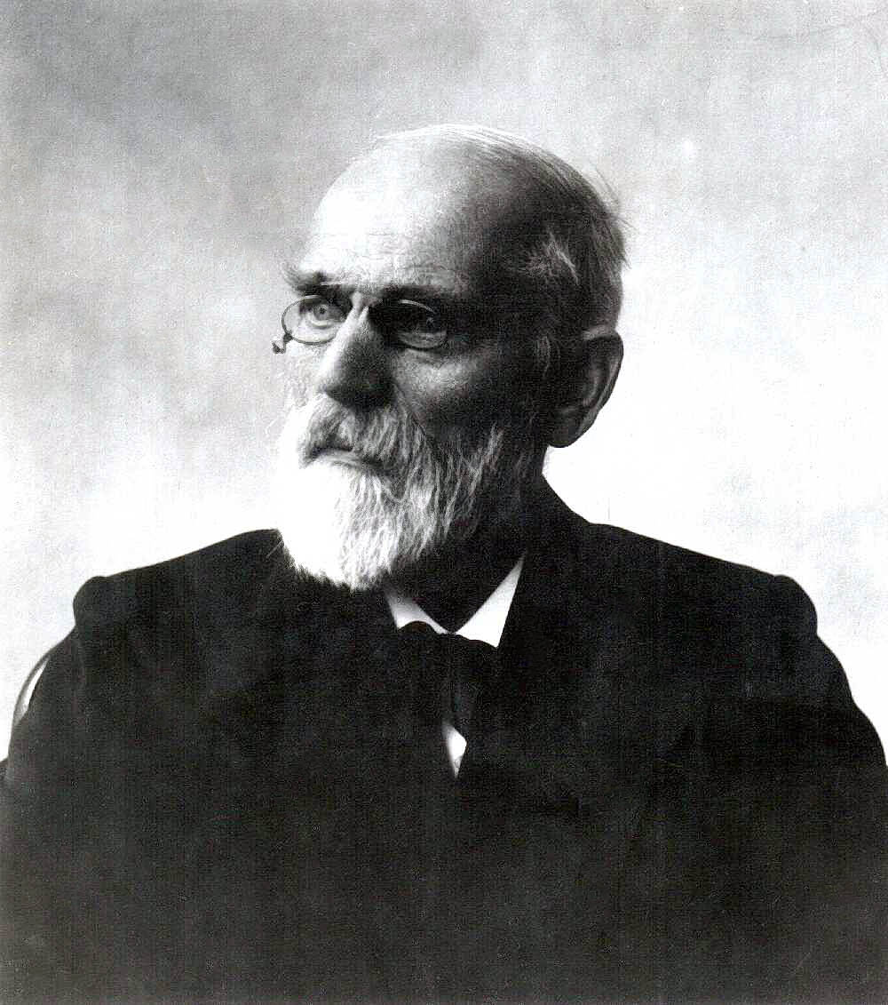
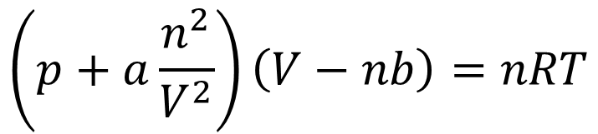
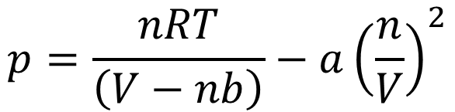
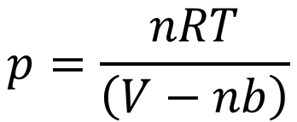
van der Waals equation
J. D. van der Waals tried to describe the deviations from the ideal gases by modifying the universal gas law:
  The own volume was subtracted from the total volume (V-nb), where „b” is a constant of the own volume.
  The attractive force between the particles reduces the frequency of collisions with the wall, as well as the energy of the collisions. Both are proportional to the spacial distribution of the particles (n/V)². The „a” is proportional to the constant describing the nature of interactions.
  Reorganized into a form similar to the universal gas law.
$$p=\frac{nRT}{\left(V−nb\right)}$$
$$p=\frac{nRT}{\left(V−nb\right)}−a{\left(\frac{n}{V}\right)}^{2}$$
$$\left(p+a\frac{n^{2}}{V^{2}}\right)\left(V−nb\right)=nRT$$

Slide 32













Critical state of gases
The van der Waals equation is not perfect because there is a section where three molar volumes belong to the same pressure (see e.g., T₁).
However, as the temperature increases, the length of such a section decreases, and at a given temperature it shrinks to an inflection point with a zero slope (T₄).
This temperature, pressure and molar volume correspond well to the so-called with critical state parameters.
Below their critical temperature, gases can be liquified/condensed by pressure, but not above it.
$$p/Pa$$
1.450E+07
$T_{1}<T_{2}<T_{3}<$ $T_{4}<$ $T_{5}<$ $T_{6}$
1.250E+07
$$T_{6}$$
$${T_{4}=T}_{crit.}=304.21K=31.06℃$$
$$p_{crit}=7380000 Pa=72.83 atm$$
1.050E+07
$$T_{5}$$
$$V_{m,crit.}=0.128 {dm}^{3}$$
8.500E+06
$$T_{4}$$
$$p_{crit.}$$
$$T_{3}$$
6.500E+06
$$T_{2}$$
4.500E+06
$$T_{1}$$
CO₂
2.500E+06
0,06
0.11
0.16
0.21
0.26
0.31
0.36
$$V_{m,crit.}$$
$$V_{m}/{dm}^{3}$$

Slide 33
State and properties of liquids
One can note that the ideal gas model works very well at pressures and temperatures close to normal conditions, but there are still attractive and repulsive interactions between the particles/gas molecules.
This is the reason why, in certain lower temperature and higher pressure ranges, materials do not exist as gases, but in a liquid state, as a liquid.
The description of the liquid state is even more difficult than that of the gas, there is no widely valid model, so searching for state equations is useless.
One needs specific properties to characterize the liquid state.

Slide 34
Intefacial/surface tension
The first property, which results from stronger interactions between molecules is the surface tension.
Consequences? See this video:
How it comes from the interaction between particles?
https://www.youtube.com/watch?v=EzahpSqGbVg
The molecules on the surface are pulled together by the assymetric force. This results in the spherical shape of a liquid drop, for instance.

Slide 35
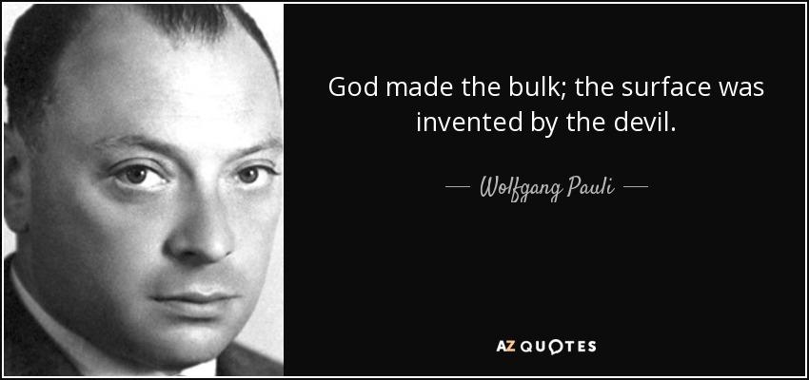
Interface
Nobel Prize in Physics 1945:
Pauli’s exclusion principle

Slide 36
Surface tensions
Surface tension could therefore be defined as a kind of force?
Yes, there is also a force-like definition, but first let's see what happens when we move a particle from inside the phase to the surface.
The surface molecules are in an energetically less favorable position, therefore, the system tries to minimize the number of surface molecules.
This results in a spherical shape of a liquid drop.

Slide 37
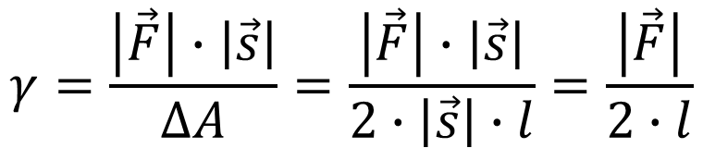





Surface tension
Then one may define the surface tension as an energy!
  Surface tension: (sign: γ; dimension: 1 J/m²) the energy required to create a unit of new surface area. (1 J/m²)
It is very difficult to measure surface tension experimentally.
The fact that 1 J/m² = 1 Nm/m² = 1 N/m, however, indicates that somehow the measurement of this energy can also be traced back to the measurement of force and length, which is feasible, as follows.
$$\vec{s}$$
$$ΔA=2∙\left|\vec{s}\right|∙l$$
$$\vec{F}$$
$$ΔE=γ∙ΔA= \left|\vec{F}\right|∙\left|\vec{s}\right|$$
$$γ=\frac{\left|\vec{F}\right|∙\left|\vec{s}\right|}{ΔA}=\frac{\left|\vec{F}\right|∙\left|\vec{s}\right|}{2∙\left|\vec{s}\right|∙l}=\frac{\left|\vec{F}\right|}{2∙l}$$
$$l$$

Slide 38
Surface tension
2024/9/25
The force that creates the new surface therefore acts at the surface, as the surface molecules must be "pulled apart" to create a new surface.
It should also be taken into account that the surface area increases on both sides of the liquid membrane, so twice as much force is needed in the experiment as would be required on a "one-sided" membrane. This justifies the factor of 2 in the denominator.
Force-type definition of surface tension is then:
surface tension: (sign: γ; dimentions: 1 N/m) the compressive force occurring within the surface in a unit length. (1 N/m).

Slide 39

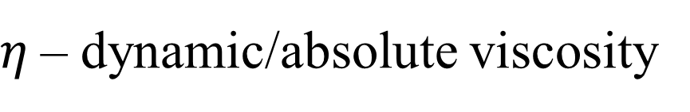



Viscosity
Resistance to flow was also experienced in the case of gases, but it became really significant in the case of liquids.
$$\vec{v}\sim −\vec{F}$$
$$A$$
$$\vec{F}=−η\frac{A\vec{v}}{d}$$
$$d$$
$η$– dynamic/absolute viscosity

Slide 40
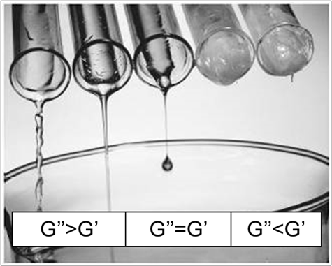
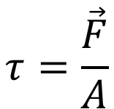

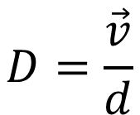
Viscosity
$$τ=\frac{\vec{F}}{A}$$
Newton's law of hydrodynamics is only valid for fluids that consist of spherical particles, and the forces acting between them are not controlled - Newtonian fluids.
Flow behaviour of more complex systems such as macromolecular solutions, suspensions, emulsions is much more complicated. The systems cannot be characterized by a single viscosity data - Colloid chemistry!
Let us see some flow curves!
Bingham-type
Newtonian
$$τ_{B}$$
dilatant/shear thickening
pseudoplastic/shear thinning
thixotropic
$$D=\frac{\vec{v}}{d}$$

Slide 41
Vapor pressure of liquids
vacuum
0,5
If a liquid is poured into an container equipped with a pressure gauge and the air is pumped out above the liquid, and the container is sealed, then, a finite pressure above the liquid phase can be measured shortly.
This pressure depends only on the chemical composition of the liquid and the temperature.
This pressure is the so-called equilibrium vapor pressure, also known as the tension of the liquid.
0
1

Slide 42
Vapor pressure of liquids
The pressure originates from the molecules leaving the surface of the liquid into the gas phase, which causes an increase in pressure.
Why does the increase in pressure stop after a while?
Because the number of molecules leaving the liquid and returning into the liquid becomes equal in a unit of time!
0,5
0
1

Slide 43


Vapor pressure of liquids
How and why the vapor pressure of liquids depends on temperature?
For this, get familiarized with the Maxwell-Boltzmann distribution!
$$\frac{dn}{N}/\%$$
1.40E+01
1.20E+01
T₁
T₁< T₂< T₃
1.00E+01
8.00E+00
T₂
6.00E+00
T₃
4.00E+00
2.00E+00
0.00E+00
v_{exit}
A₂
0
10
20
30
40
50
60
70
80
A₁
$$v/\left(\frac{m}{s}\right)$$
A₁< A₂< A₃ hence N₁< N₂< N₃
and thus p₁< p₂< p₃
A₃

Slide 44

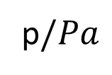
Boiling point
p$/Pa$
The vapor pressure of pure liquids increases exponentially with temperature.
The temperature dependence of vapor pressure can be used to explain another characteristic of liquids, the boiling point.
Boiling point: the temperature, at which the vapor pressure of the liquid reaches the external pressure.
It is characterized by the formation of air/gas bubbles inside the liquid.
700000
diethyl-ether
600000
methanol
500000
400000
300000
benzene
200000
water
100000
0
-20
0
20
40
60
80
100
120
T_{boiling} = 35°C 65°C 80°C 100 °C
$$t/℃$$
At a given presure, a liquid of a lower boiling point and higher vapor pressure is more volatile.

Slide 45
Capaillary activity
Both the surface tension and the vapor pressure of liquids are the result of attractive interactions between the molecules of the liquid, and are observed at the liquid-gas interface.
What happens when a liquid comes in contact with a solid?
Then one can observe the so-called capillary activity.
The interaction between the liquid molecules (cohesion) can be stronger or weaker than with the solid surface (adhesion).
How this leads to capillary activity?
https://www.youtube.com/watch?v=YoF7RuBZIpM

Slide 46
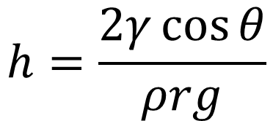



Capillary activity
h
If adhesion is stronger than cohesion, the surface of the liquid is concave.
If the liquid surface is concave, the liquid level rises in the capillary.
$${\vec{F}}_{up}=−{\vec{F}}_{down}$$
$$F_{up}=F_{st}\cos{θ}=γl\cos{θ}=γ\left(2rπ\right)\cos{θ}$$
$$F_{down}=mg=ρVg=ρ\left(r^{2}πh\right)g$$
$$h=\frac{2γ\cos{θ}}{ρrg}$$
X
X
X
$$γ\left(2rπ\right)\cos{θ}=ρ\left(r^{2}πh\right)g$$
X
r
θ
h
$$h>0$$
https://www.youtube.com/watch?v=3BBCAD8MSko

Slide 47



Capillary activity
If adhesion is weaker than cohesion, the surface of the liquid is convex.
h
If the surface of the liquid is convex, the liquid level drops in the capillary (the weight of displaced liquid resists the surface tension).
$${\vec{F}}_{down}=−{\vec{F}}_{up}$$
$$F_{down}=F_{st}\cos{θ}=γl\cos{θ}=γ\left(2rπ\right)\cos{θ}$$
$$F_{up}=mg=ρVg=ρ\left(r^{2}πh\right)g$$
$$h=\frac{2γ\cos{θ}}{ρrg}$$
θ
X
X
X
$$γ\left(2rπ\right)\cos{θ}=ρ\left(r^{2}πh\right)g$$
X
h
r
$$h<0$$
https://www.youtube.com/watch?v=zAe76hEv2yw

Slide 48



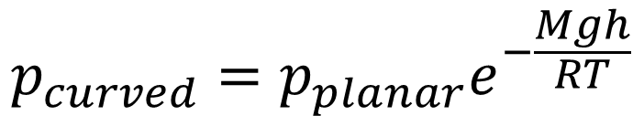
Capillary activity
The interactions of molecules on a planar surface ensure the equilibrium vapor pressure.
$$p_{concave}<p_{planar}<p_{convex}$$
The number of interactions on the concave surface is larger, so the vapor pressure is lower.
The number of interactions on the convex surface is smaller, so the vapor pressure is higher.
The equilibrium vapor pressure of curved surfaces can be calculated using the barometric method based on the measured rise and fall (h):
$$p_{curved}=p_{planar}e^{−\frac{Mgh}{RT}}$$
$$h>0$$
$$h<0$$

Slide 49
The phenomenon of overheating
Microwave ovens may cause a new type of accidents in the kitchen:
https://www.youtube.com/watch?v=LpDs7Xm1uLo&index=6&list=RD1_OXM4mr_i0
During heating very pure liquids, when the boiling point is reached, a strange phenomenon, the pushed boiling, can be observed!
The reason for this phenomenon is that liquids can be overheated, since the surface of the liquid does not increase during evaporation, but additional energy must be provided for the formation of the surface of the bubbles that form inside.
T/K
T_{b}
boiling starts
boiling starts
boiling starts
boiling stops
boiling stops
boiling stops
t/s

Slide 50
Solid state and properties
Materials with an ordered internal structure are considered solid.
The forces that create a crystalline solid state are even more complex than the forces that create a liquid state, so state equations are not important, but to discover the properties of solids is crucial.
The internal structure of crystals is characterized by symmetry and periodic repetition.
The forces acting between the atoms/molecules located in the crystal determine the properties of the solid material.
What are these?

Slide 51
Forces acting in crystals
Structural unit
Type of bond
Lattice type
Example
atom
covalent
atomic
diamond
neutral molecule
secondary
molecular
solid CO₂
oppositely charged ions
ionic
ionic
NaCl
metal nucleus
metallic
metallic
iron
Properties of solids:
  covalent – hard, high melting point, poor thermal and electrical conductivity
  molecular – soft, low melting point, poor thermal and electrical conductivity
  ionic – hard, high melting point, poor thermal and electrical conductivity
  metallic – hardness and melting point vary in a wide range, good thermal and electrical conductivity

Slide 52
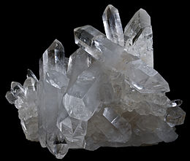
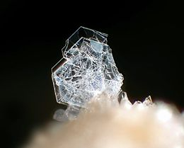
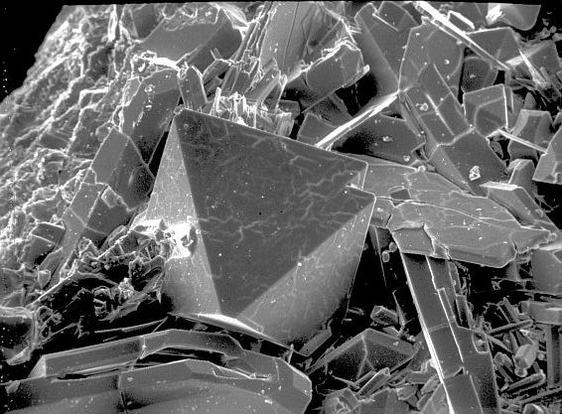
Modifications of crystals
Substances with the same composition but different crystal structures are called polymorphs. For instance, SiO₂ (silica) – quartz, tridymite and crystobalite.
Special case of polymorphism are the allotropes of the elements:
e.g., diamond-graphite or oxygen-ozone.
https://en.wikipedia.org/wiki/Quartz
https://en.wikipedia.org/wiki/Tridymite
http://minerals.gps.caltech.edu/Silica_Polymorphs/index.html

Slide 53
The melting point
Overheating, as discussed with liquids, is not possible in the solid state, because heating increases the amplitude of the vibration of the particles (atoms/ions/molecules/metals) in the lattices. If the attractive forces do not act anymore between them, then the crystal structure collapses and the material melts.
This is the reason why each crystal has a well-defined melting point:
melting/freezing point: the temperature at which the internal ordered structure of a solid collapses and passes into a liquid state, and these phases are in equilibrium. At this temperature, the vapor pressure of the liquid and the solid phase are the same.

Slide 54
The phenomenon of supercooling
Supercooling, when a crystalline material precipitates from a melt. Can one cool the liquid below the melting point without crystallization?
Yes! The more complicated the molecule or crystal, the easier is to overcool!
Why?
Crystallization takes place as a result of two sub-processes :
  crystal nucleation
  crystal growth
https://www.youtube.com/watch?v=_9N-Y2CyYhM

Slide 55
Steps of crystallization
Nucleation: some of the molecules in the liquid stick together as a result of a collision, arranged exactly as they are in the crystal - this is the so-called crystal nucleus.
  Rapid cooling reduces the number of collisions, thus the rate of nucleation.
  Defects on the wall of the vessel and impurities help the formation of nuclei.
Growth: particles that collide with the surface of crystals formed stick to it and hence, the crystal grows, while the characteristic crystal plates forms.
The relative rate of these two sub-processes determines the size and morphology of the formed crystals.
https://www.youtube.com/watch?v=kEHdyiBMgAg

Slide 56
Phase diagram of water
The state of matter is basically determined by the pressure and the temperature.
Therefore, one can present phase transformations on a pressure-temperature diagram, the so-called the phase diagram!
Melting curve
Freezing curve
Sublimation curve
critical state
p/Pa
triple point
220.6·10⁵
liquid
gas
solid
1.01·10⁵
vapor
611
273.15
273.16
373.17
647.15
T/K

Slide 57
Critical status - clarification
125
0
2501
If one starts heating the liquid in a vacuum chamber, the number of molecules that can escape into the vapor phase increases, the pressure in the vapor phase increases, and the density of the vapor increases.
Meanwhile, the density in the liquid phase decreases because the thermal energy pushes the mulecules apart.
At a temperature characteristic for a liquid, the increasing vapor density and the decreasing liquid density become equal and the phase boundary disappears, without the evaporation of the entire volume of the liquid.
This temperature is the critical temperature, and the pressure is the critical pressure.

