Slide 1
General Chemistry
Code: KBN804E-BE
Type: in-person lecture (in case at least 3 students are present)
Date: Monday between 11h00-13h00
Place: Béke building 4th floor "Tanuló" (BE-402-3) https://www.staff.u-szeged.hu/~szistvan/KemAlap2025EN.html
Teacher:
Dr. Habil. István Szilágyi, Associate Professor, D.Sc. szistvan@chem.u-szeged.hu & +36 62 343255
Department of Physical Chemistry and Materials Science, University of Szeged
PI of MTA-SZTE Lendület Biocolloids Research Group http://www2.sci.u-szeged.hu/physchem/bioc
Office: Bolyai building – room MF58/M28 on the ground floor
Consultation: Monday 15h00-17h00 (registration is mandatory)

Slide 2
Requirements https://www.staff.u-szeged.hu/~szistvan/KemAlap2025EN.html
Points during the term
2 exercise sections: 75 points
3 homeworks: 3×5=15 points
Presence on lectures: 2×5=10 points
Total: 100 points
Admission to exam: above 40 points
Offered marks: satisfactory (3), good (4) or excellent (5) – TABLE!
Exam: mark - TABLE!
% | Mark
0-39 | insufficient (1)
40-49 | sufficient (2)
50-59 | satisfactory (3)
60-69 | good (4)
70-100 | excellent (5)

Slide 3
General Chemistry
1. Scientific knowledge, measurement and calculation
Dr. István Szilágyi
Department of Physical Chemistry and Materials Science
2025.

Slide 4
The concept of science
Systematic order of human knowledge based on proven knowledge.
  A system of knowledge acquired during activities aimed at learning about the world around us.
  The activity, scientific knowledge/research, which is based on previous scientific knowledge and seeks to explore the unknown, which is aimed at discovering new knowledge and connections.
  Science disciplines: according to their subject areas - what they research - e.g., living nature, or the structure of society, and their methods - how they carry out discovery - e.g., we distinguish empirical, experimental or theoretical disciplines.

Slide 5
Scientific discovery
Gathering knowledge always begins with collection of facts which can happen
  by observations or
  by measurments.
In natural sciences, we always measure some quantites during any measurements – quantitative information.
Quantity = number x unit
Let us start with the units (also called dimensions)!

Slide 6
le Système International d'Unités - SI
In the course of the development of the natural sciences, the system of quantities that are suitable for describing any phenomena was established, this is the Système International d’Unités (FR), the so-called SI.
The SI consists of base units, auxiliary units, and derived units:
  Base units: mass – kg; length – m; time – s; temperature – K; electric current – A; light intensity – cd (candela); amount of substance – mole;
  Auxiliary units : angle – rad; solid angle – sr (steradian);
  Everything else (e.g., force – N: kgm/s² or electric charge – C: As) are derived units/quantities!

Slide 7
le Système International d'Unités - SI
The SI unit system records the comparative standards to which the measured quantity is compared during the measurement.
Originally, these standards, after being established, were preserved in some physical form, and authentic copies were made to achieve that a certain quantity could be measured in the same way worldwide!
However, the development of science and technology claimed that these benchmarks or standards should be determined in a way that is less dependent on the conditions (temperature, pressure, humidity, etc.) and can be reproduced anywhere (no need for authentic copies).
16-22 October 2011: at the 24th General Conference on Weights and Measures, the basic units were fixed to seven physical constants:
  Speed of light, Planck constant, elementary charge, Avogadro’s number, frequency of transition of Cs-133, and the luminous efficacy of a light of a certain frequency.

Slide 8
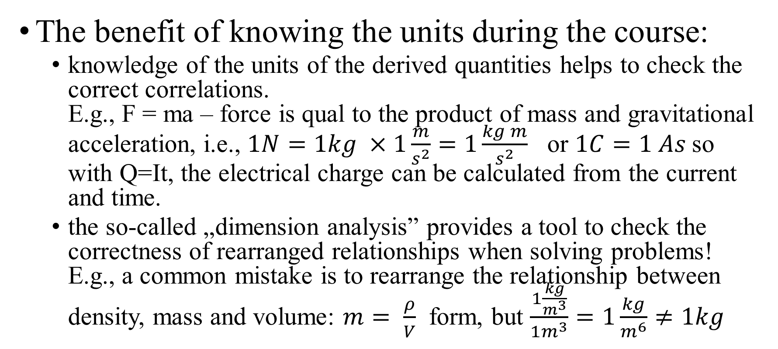
le Système International d'Unités - SI
The benefit of knowing the units during the course:
  knowledge of the units of the derived quantities helps to check the correct correlations.
  E.g., F = ma – force is qual to the product of mass and gravitational acceleration, i.e., $1N=1kg ×1\frac{m}{s^{2}}=1\frac{kg m}{s^{2}}$ or $1C=1 As$so with Q=It, the electrical charge can be calculated from the current and time.
  the so-called „dimension analysis” provides a tool to check the correctness of rearranged relationships when solving problems! E.g., a common mistake is to rearrange the relationship between density, mass and volume: $m= \frac{ρ}{V}$ form, but $\frac{1\frac{kg}{m^{3}}}{1m^{3}}=1\frac{kg}{m^{6}}≠1kg$

Slide 9
The measurement
Measurement is the process of determining an unknown quantity by comparing it to standards defined in the SI.
The result of the comparison is never exact!!!!!
The result contains the value determined and the error. The measurement is good if this error is random. Accordingly, the sign of the deviation from the real value can be positive or negative, and its magnitude can be smaller or larger within a certain limit.
Performing a large number of independent measurements, the results can be described by the so-called normal distribution!

Slide 10



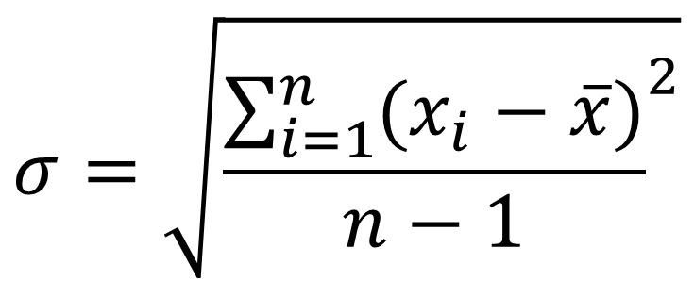



Accuracy of measurements
1/1
$$σ=\sqrt{{\frac{\sum_{i=1}^{n}{(x_{i}−\overline{x})}}{n−1}}^{2}}$$
dN/N
1/1
dN/N = frequency of measured data
1/2
$$±σ$$
1/2
standard deviation
$$±σ$$
1500
1525
1550
1575
1600
1625
1650
1675
1700
$$\overline{x}$$
x=measured data
1/1
dN/N
1/2
$$±σ$$
1550
1575
1600
1625
1650
x
Bad measurement!
$$\overline{x}$$
Better one!
1500
1525
1550
1575
1600
1625
1650
1675
1700
x
$$\overline{x}$$

Slide 11
Accuracy of measurements
It is important to understand that there is no perfect measurement. The measured value always contains an error.
  accuracy - the proximity of individual measurements results to the real value – it is also affected by the measuring device - e.g., length measurement: ruler (1 mm), caliper (0.1 mm), micrometre (0.01 mm).
  precision - the closeness of the average values, determined under the same conditions with the same measuring device, to the real value – it depends on the capabilities of the measuring person.
What is the origin of the error?
  from the quality of the tools used and from the accuracy of the method.
  skills of the person to properly reproduce the measurement conditions.

Slide 12
Accuracy of measurements
The average of several measurements is always closer to the real value than any individual measurement.
"One measurement is not a measurement, two measurements is half a measurement, three measurements... it's something!" Make an odd number of measurements if possible (differences can balance each other).
Giving the measured value accurately is important – significant figures or numbers.

Slide 13
Significant figures
Generic rules:
  Every number is significant, except for zeros at the beginning of the whole number. For example, the following numbers are given for three significant figures: 125 / 9.12 / 0.00256
  All zeros to the right of the decimal point, which closes the whole number, are significant. For example, all subsequent numbers are given for three significant figures: 25.0 / 5.00 / 9.10 / 0.00250
  The zeros to the left of the decimal point that end the number may also be significant numbers, but it is not certain (does the number end in zero(s) due to rounding, or is it considered an exact value?). For example, 400 maybe a number of 2 (rounded) or 3 (exact value) significant digits.
Entering the result of a calculation - changing the significant figures - rounding!

Slide 14
Accuracy of a calculation
From measured data, as a result of a calculation – using computers or scientific calculators – one can also obtain results with various significant figures.
Should we write all of them down?
For instance, 5.23 x 0.458 = 2.39534 with a pocket calculator.
The two multipliers are "accurate" to 3 digits each, which means that there is uncertainty in the fourth digit, i.e., 5.23±0.005 and 0.458±0.0005 is the accuracy.
The accuracy of the product, according to the rules of statistics: 0.0047596... i.e., it only slightly differs from 0.005, therefore, the correctly presented result is 2.40.

Slide 15
Rules of rounding
The previous result was rounded to two decimal places from 2.39534 - what are the rules for this?
Find the digit in the number that you want to round: 2.39|5|34
If this is 5, without zero(s) after, or larger than 5, then add one to the digit in front of it and leave the rest: 2.39 + 0.01 = 2.40
If this is 5, with zero(s) after, or smaller than 5, then we simply leave out the following digits: e.g., the result is rounded to four significant figures: 2.395|3|4=2,395

Slide 16
Consequences of rounding
Rounding, like many other "simplification tools", is only useful when you use it wisely/correctly.
The biggest problem can be caused by rounding partial results of multi-step calculations. This leads to an incorrect solution!
Incorrect rounding of the final result in calculations.
Note that correct rounding is part of the correct solution of the tasks!

Slide 17
Rounding of partial results
SF = Significant Figures

Slide 18
The effect of incorrect rounding - Result

Slide 19
The effect of typing without rounding

Slide 20
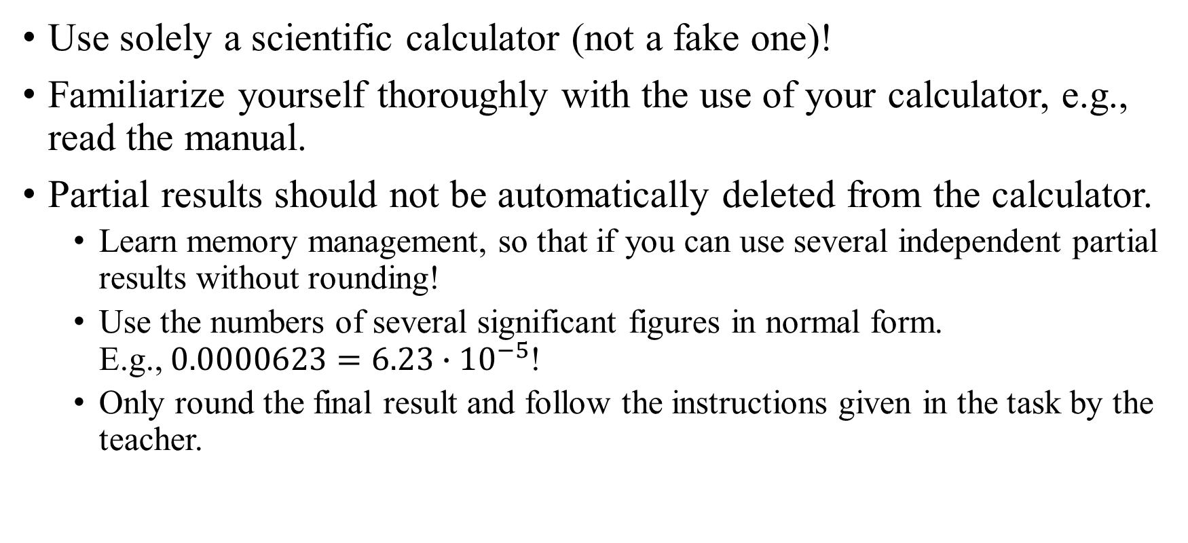
Procedure for solving tasks
Use solely a scientific calculator (not a fake one)!
Familiarize yourself thoroughly with the use of your calculator, e.g., read the manual.
Partial results should not be automatically deleted from the calculator.
  Learn memory management, so that if you can use several independent partial results without rounding!
  Use the numbers of several significant figures in normal form.
  E.g., $0.0000623=6.23∙{10}^{−5}$!
  Only round the final result and follow the instructions given in the task by the teacher.

Slide 21
Chemical science concept
Chemistry is the science of the structure and properties of matter existing in the conditions that humans are used to, and the transformation of the types of matter into one another.
  By normal conditions we mean the prevailing temperature and pressure conditions on Earth, and the usual level of light and radioactive radiation.
  Chemistry is a natural science dealing with the quality of materials, which is closely related to other natural sciences, such as physics, biology, geography, medicine, etc.
  Natural science is the collective name for disciplines dealing with the study of the living and non-living nature.

Slide 22
Chemistry as a modern scientific discipline
The first chemical observations were made by primitive humans during prehistoric times - e.g., alcoholic fermentation, the effect of fire on food, etc.
The extraction and processing of metals and the production of glass already included complicated operations.
In ancient times, chemistry was used extensively - e.g. cosmetics, medicines, and the first theories were developed - atoms (Democritos), basic elements (Aristotle - earth, water, air, fire), etc.
The spreading of alchemy can be traced back to the Middle Ages - it resulted in enormous technical progress, both in terms of tools and procedures.
Iatrochemistry (iatrosz=medical doctor) - medicinal chemistry - 16th century – Galenus, Paracelsus (origin of diseaes was explained by the salt-mercury-sulfur equilibrium).

Slide 23
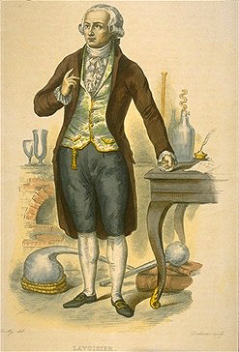
Chemistry as a modern scientific discipline
17th-18th century - rapid delopment in the field.
19th century - chemistry was the leading scientific discipline in that time.
Lavoisier (1743-1794) - he introduced and used the balance a tool in experiments - chemistry became quantitative science.
Law of conservation of mass or principle of mass conservation (1773).
Antoine-Laurent de Lavoisier
https://www.youtube.com/watch?v=0zY_73-DaFc

Slide 24
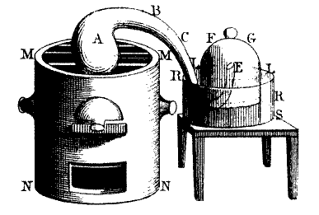
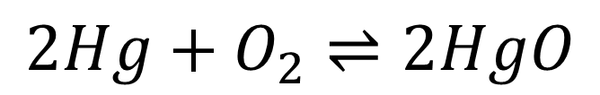
Antoine-Laurent de Lavoisier
$$2Hg+O_{2}⇌2HgO$$
J. Priestley: "air", which reacts easily with metals, was obtained by heating red mercury-oxide, while elemental mercury was heated in air to form red mercuric oxide
Hg into the retort (A), air under the hood (E). When heated, after 1/5 of the air is consumed, no more HgO is formed. Animals die in the rest of the air, it does not react with metals – azote.
HgO into the retort, water under the hood. When heated, HgO decomposes to Hg and 1/5 of the previously consumed gas is regenerated. Animals live and are active in it, it reacts with metals - oxygen.
The total mass does not change in the meantime!

Slide 25
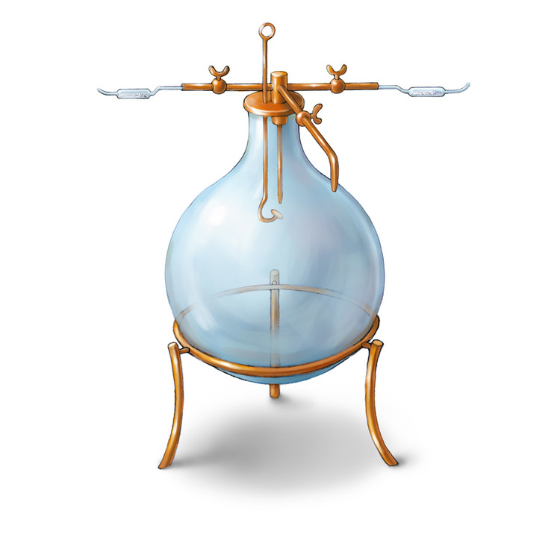
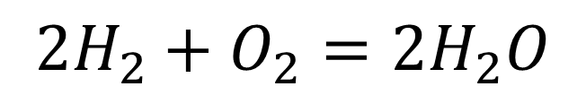
Antoine-Laurent de Lavoisier
$$2H_{2}+O_{2}=2H_{2}O$$
H. Cavendish: produced a very flammable gas, which he thought was pure "phlogiston"!
Phlogiston theory: all combustible materials contain phlogiston, which causes combustion. When materials are burned, phlogiston is removed from them.
Cavendish's "phlogiston" and the gas obtained from the decomposition of HgO were introduced into a closed container, and after its complete combustion, the product was water - hydrogen.
The mass of the water produced was equal to the sum mass of the two gases!

Slide 26
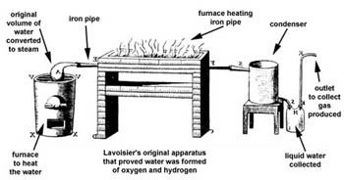
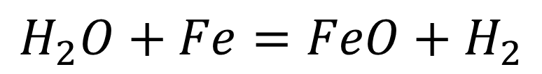
Antoine-Laurent de Lavoisier
$$H_{2}O+Fe=FeO+H_{2}$$
Confirmation of the result obtained during the formation of water.
Water splitting!
Water into the retort, which is evaporated and passed through a heated iron tube filled with iron powder.
The iron in the pipe turns into iron-oxide, while hydrogen gas leaves the system. The mass did not change.
https://www.youtube.com/watch?v=x9iZq3ZxbO8

